Slide 1
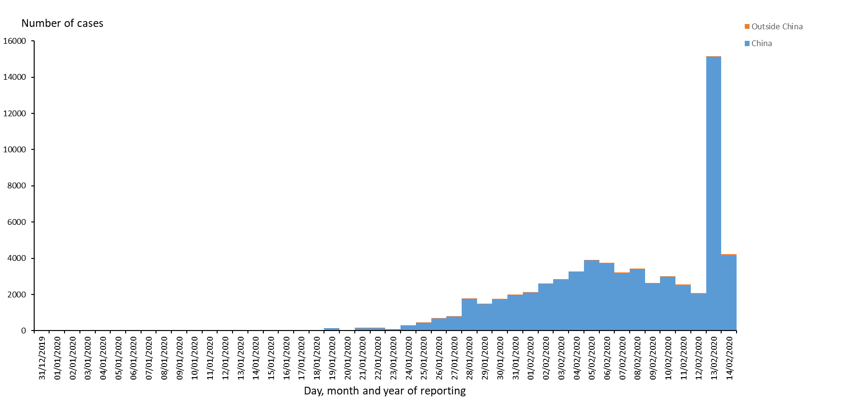
Update zum (Covid-19), 14.Februar 2020
Weltweit 64.544 Fälle (+4.214), davon 1.383 Todesfälle (2,1% CFR)
China* 64.021 Fälle (+4.156), davon 1.381 Todesfälle
Hubei (ink. Wuhan) 51.986 (+3.780, 81,2% Gesamt), davon 1.318 Todesfälle
*Taiwan nicht eingeschlossen
ECDC, 13.02.2020
Distribution of COVID-19 cases according to the applied case definition in the related countries, 14 February 2020

Slide 2
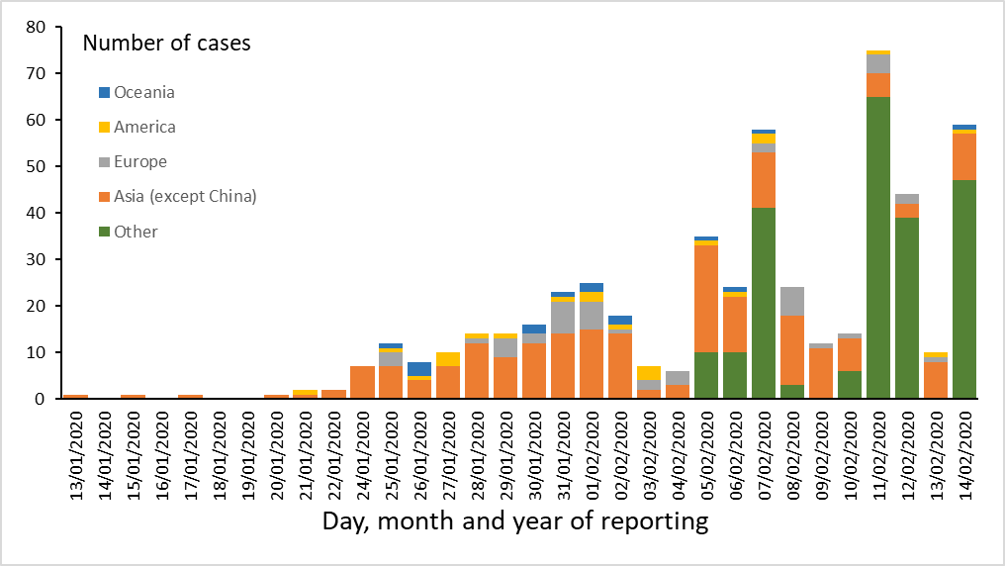
Distribution of COVID-19 cases according to the applied case definition by continent, outside China Mainland, 14 February 2020
Update zum (Covid-19), 14.Februar 2020
International: 24 Länder verzeichnen 523 Fälle, davon:
1 Todesfall Philippinen, 1 Todesfall Japan
17 schwere Krankheitsverläufe (ohne Honkong, Macau, Taiwan)
9 Länder in Europa (WHO Region) mit insgesamt 46 Fällen (FR, DE, IT, ES, SE, UK, FI, BE, RU)
221 bestätigte Fälle auf dem Kreuzfahrtschiff „ Diamond Princess“
Notes:
https://translate.google.de/translate?hl=&sl=auto&tl=de&u=https%3A%2F%2Fwww.mhlw.go.jp%2Fstf%2Fnewpage_09425.html

Slide 3
Stand: 14.02.2020
Hubei
Datum | Fälle | Todesfälle | CFR
10. Feb | 29631,00 | 871,00 | 2,94
11. Feb | 31728,00 | 974,00 | 3,07
12. Feb | 33366,00 | 1068,00 | 3,20
13. Feb | 48206,00 | 1368,00 | 2,84
14. Feb | 51986,00 | 1381,00 | 2,66
Quelle: BNONews
Note: Datenstand China und Hubei 14.02.2020 (Quelle: ECDC)
Notes:
https://translate.google.de/translate?hl=&sl=auto&tl=de&u=https%3A%2F%2Fwww.mhlw.go.jp%2Fstf%2Fnewpage_09425.html

Slide 4
Distribution of COVID-19 cases according to the applied case definition in the related countries by country and region,
13 February
14 February
Places reporting cases | Confirmed cases | Deaths | Comments
Asia | 60074 | 1369
China | 59865 | 1368 | Including 48206 cases from Hubei province
Singapore | 50 | 0
Thailand | 33 | 0
Japan | 29 | 0
Republic of Korea | 28 | 0
Taiwan | 18 | 0
Malaysia | 18 | 0
Vietnam | 16 | 0
United Arab Emirates | 8 | 0
India | 3 | 0
Philippines | 3 | 1
Sri Lanka | 1 | 0
Nepal | 1 | 0
Cambodia | 1 | 0
Europe | 46 | 0
Germany | 16 | 0
France | 11 | 0
United Kingdom | 9 | 0
Italy | 3 | 0
Russia | 2 | 0
Spain | 2 | 0
Belgium | 1 | 0
Finland | 1 | 0
Sweden | 1 | 0
America | 21 | 0
United States of America | 14 | 0
Canada | 7 | 0
Oceania | 15 | 0
Australia | 15 | 0
Other | 174 | 0
Cases on an international conveyance Japan | 174 | 0
Total | 60330 | 1369

Slide 5
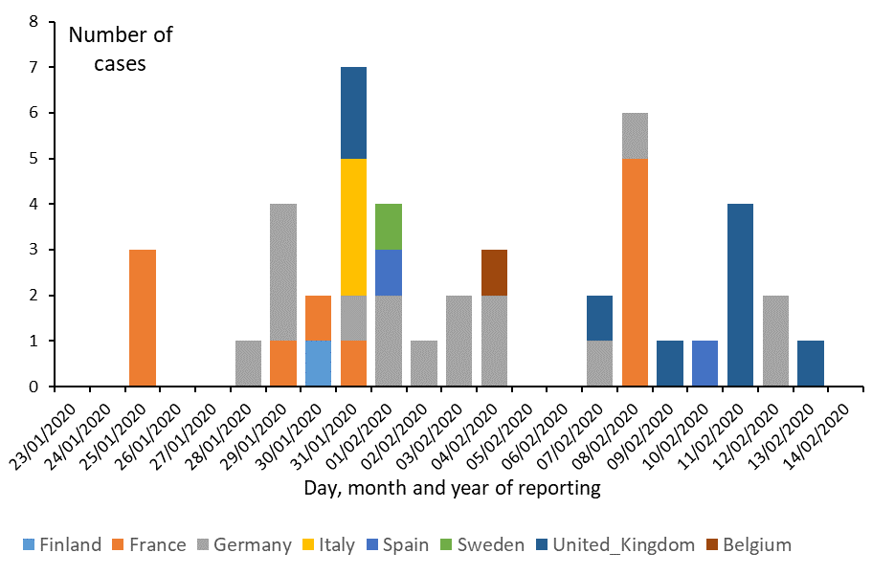
Distribution of laboratory-confirmed cases of COVID-19 in EU/EEA and the UK, 14 February 2020
Update zum (Covid-19), 14.Februar 2020
Notes:
https://translate.google.de/translate?hl=&sl=auto&tl=de&u=https%3A%2F%2Fwww.mhlw.go.jp%2Fstf%2Fnewpage_09425.html

