Slide 1
SARS-CoV-2 (COVID-19) – CHINA – 2020
Stockholm, 14 February 2020

Slide 2
Case definition change
According to the Health Commission of Hubei Province, the case definition in Hubei province has changed to align with the other provinces in China. All clinically diagnosed cases (suspected cases with imaging compatible with pneumonia) now also count as confirmed cases together with laboratory-confirmed cases.

Slide 3
Clinically diagnosed cases
Hubei province until yesterday had a definition of “clinically diagnosed cases” that WERE NOT counted as confirmed:
Definition of clinically diagnosed cases (ref: http://www.gov.cn/zhengce/2020-02/05/content_5474852.htm)
Hubei Province added a "clinical diagnosis" classification. And the "suspected case" standard is modified to: whether with or without epidemiological history, as long as it meets the two clinical manifestations of "fever and / or respiratory symptoms" and "normal or reduced white blood cells in the early stage of onset, or decreased lymphocyte count", then can be considered a suspected […] case. Suspected cases with pneumonia imaging features are clinically diagnosed cases.

Slide 4
Case definition change
Since today (13/02/2020) Hubei province is now counting these “clinically diagnosed cases” as confirmed cases.
The Health Commission of Hubei writes (ref: http://wjw.hubei.gov.cn/fbjd/dtyw/202002/t20200213_2025581.shtml)
According to the plan, Hubei Province has recently conducted investigations on suspected cases and revised the diagnosis results, and newly diagnosed patients were diagnosed according to the new diagnosis classification. In order to be consistent with the classification of case diagnosis issued by other provinces across the country, starting today, Hubei Province will include the number of clinically diagnosed cases into the number of confirmed cases for publication.

Slide 5
Case definition change
In summary, the definition of confirmed cases in Hubei was expanded by clinically diagnosed cases.
The Health Commission of Hubei also reported that the majority of cases were defined as confirmed due to this new, expanded definition (ref.: http://wjw.hubei.gov.cn/fbjd/dtyw/202002/t20200213_2025581.shtml)
“At 02:00 and 24:00 on February 12, 2020, Hubei Province newly added 14,840 new cases of pneumonia (including 13332 clinically diagnosed cases).”

Slide 6
Distribution of COVID-19 cases according to the applied case definition in the related countries by country and region, as of 13 and 14 February 2020
13 February
14 February
Places reporting cases | Confirmed cases | Deaths | Comments
Asia | 60074 | 1369
China | 59865 | 1368 | Including 48206 cases from Hubei province
Singapore | 50 | 0
Thailand | 33 | 0
Japan | 29 | 0
Republic of Korea | 28 | 0
Taiwan | 18 | 0
Malaysia | 18 | 0
Vietnam | 16 | 0
United Arab Emirates | 8 | 0
India | 3 | 0
Philippines | 3 | 1
Sri Lanka | 1 | 0
Nepal | 1 | 0
Cambodia | 1 | 0
Europe | 46 | 0
Germany | 16 | 0
France | 11 | 0
United Kingdom | 9 | 0
Italy | 3 | 0
Russia | 2 | 0
Spain | 2 | 0
Belgium | 1 | 0
Finland | 1 | 0
Sweden | 1 | 0
America | 21 | 0
United States of America | 14 | 0
Canada | 7 | 0
Oceania | 15 | 0
Australia | 15 | 0
Other | 174 | 0
Cases on an international conveyance Japan | 174 | 0
Total | 60330 | 1369

Slide 7
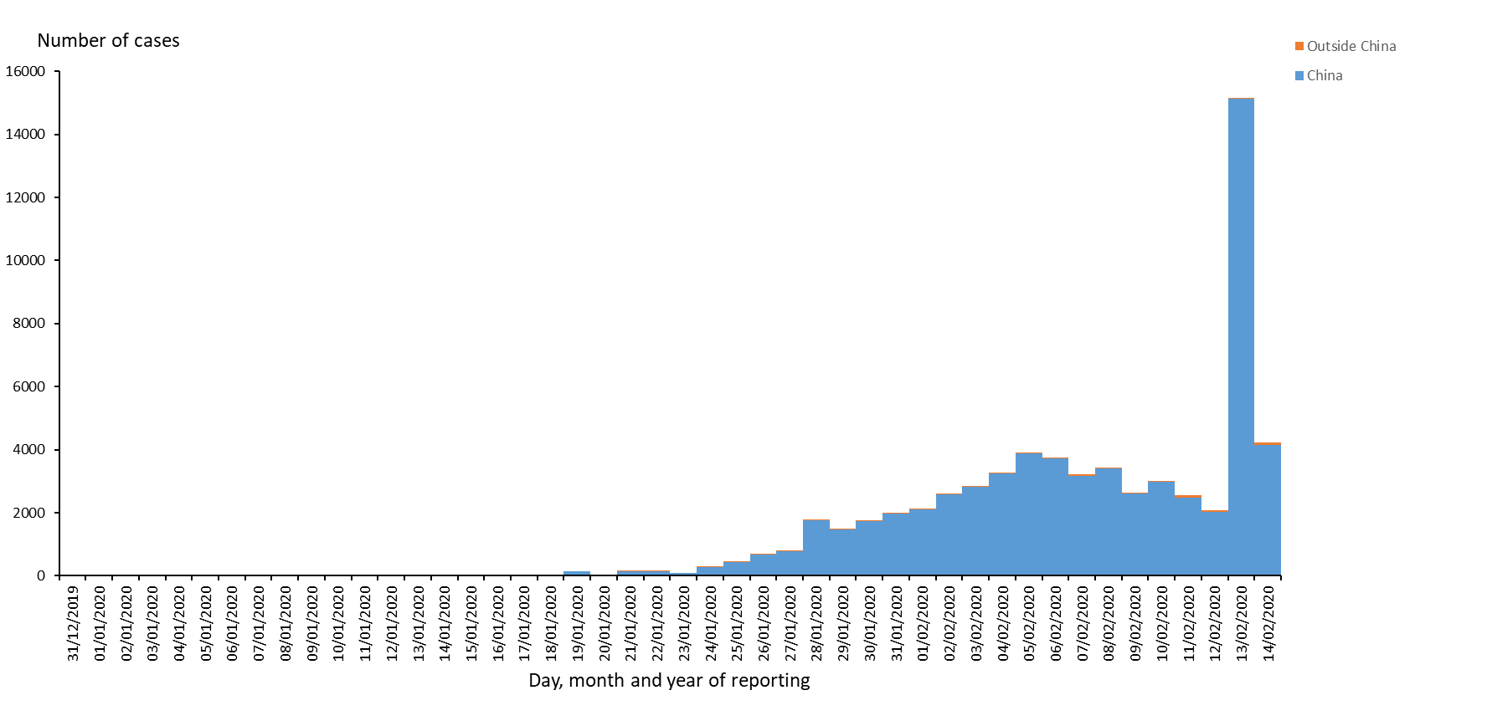
Distribution of COVID-19 cases according to the applied case definition in the related countries, as of 14 February 2020

Slide 8
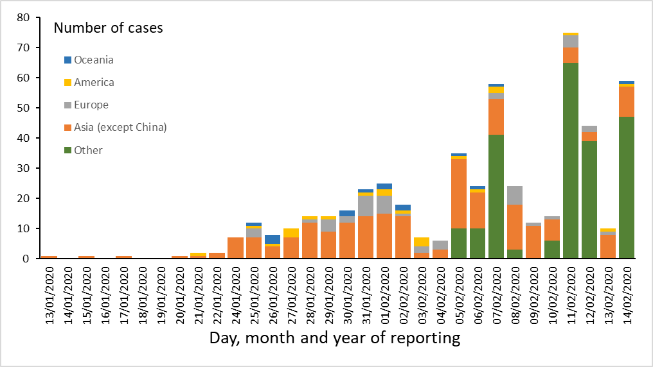
Distribution of COVID-19 cases according to the applied case definition in the related countries by continent, outside China Mainland, as of 14 February 2020

Slide 9
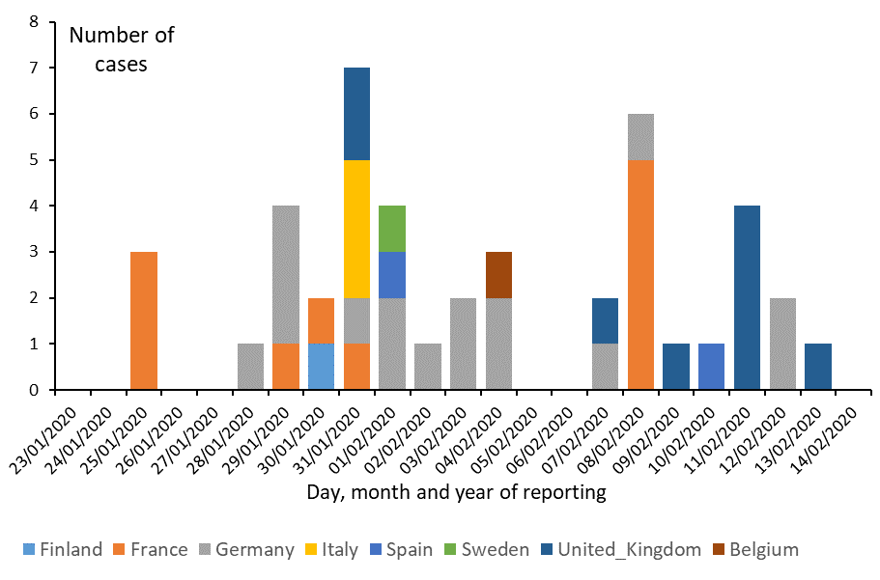
Distribution of laboratory-confirmed cases of COVID-19 in EU/EEA and the UK, as of 14 February 2020

Slide 10
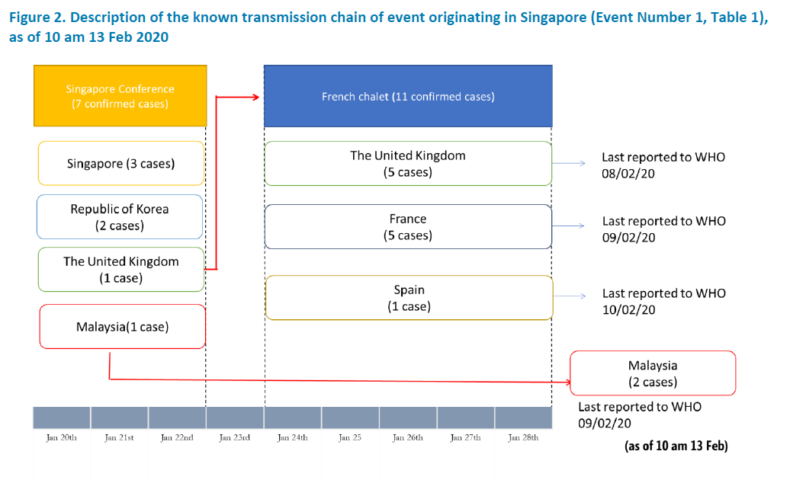
Source: WHO
(https://www.who.int/docs/default-source/coronaviruse/situation-reports/20200213-sitrep-24-covid-19.pdf?sfvrsn=9a7406a4_4)

Slide 11
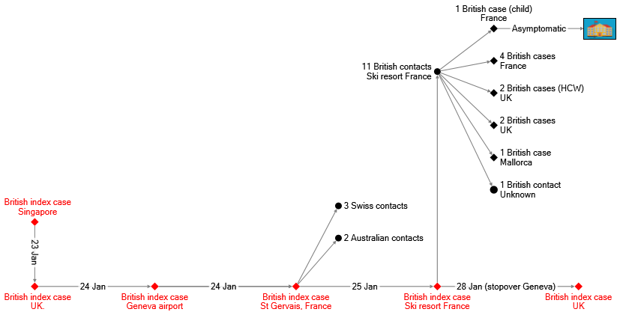
Transmission chain of cases related to the French ski resort cluster (n = 11)
→ Confirmed index case
→ Confirmed cases
 Close contacts

Slide 12
Distribution of laboratory-confirmed cases of COVID-19 by country in EU/EEA and in the UK, as of 14 February 2020

Slide 13
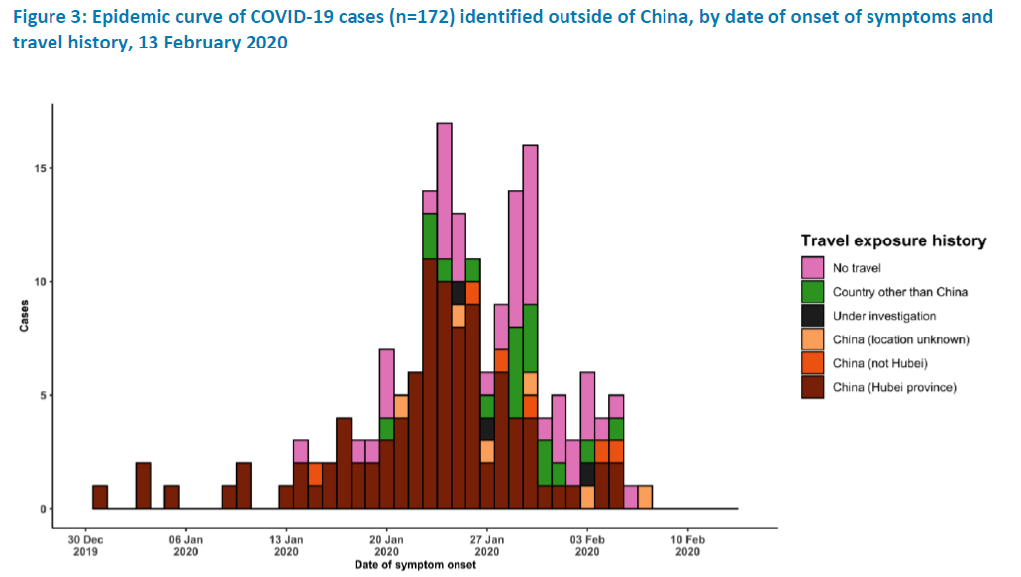
Source: WHO
(https://www.who.int/docs/default-source/coronaviruse/situation-reports/20200213-sitrep-24-covid-19.pdf?sfvrsn=9a7406a4_4)

Slide 14
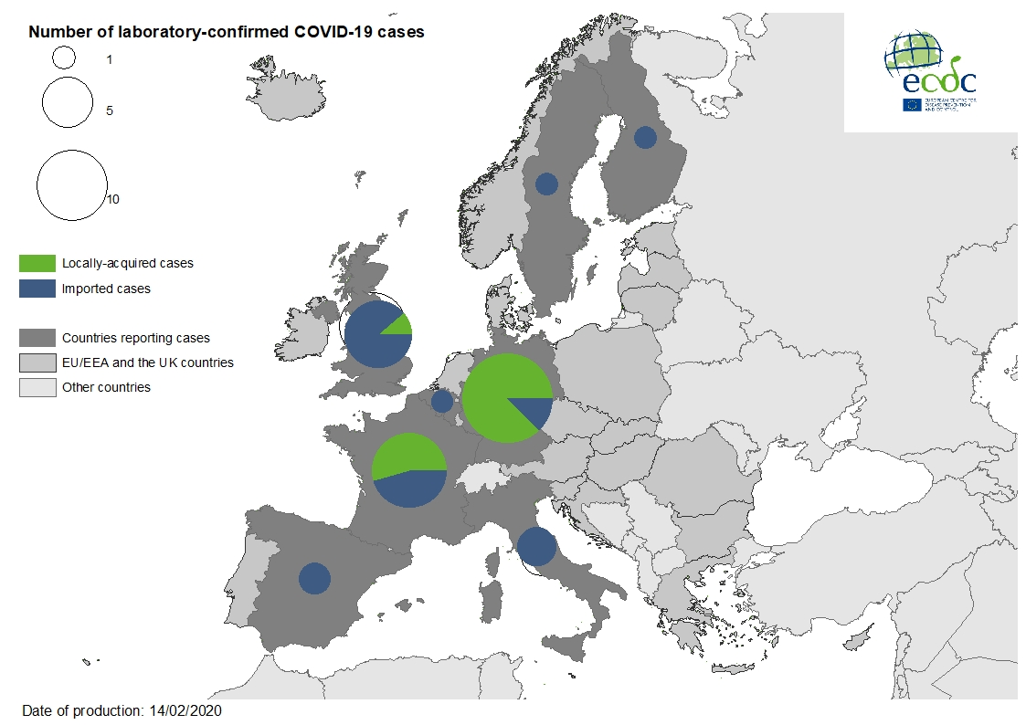
Geographical distribution of laboratory-confirmed cases of COVID-19 in the EU/EEA and the UK, as of 14 February 2020

Slide 15
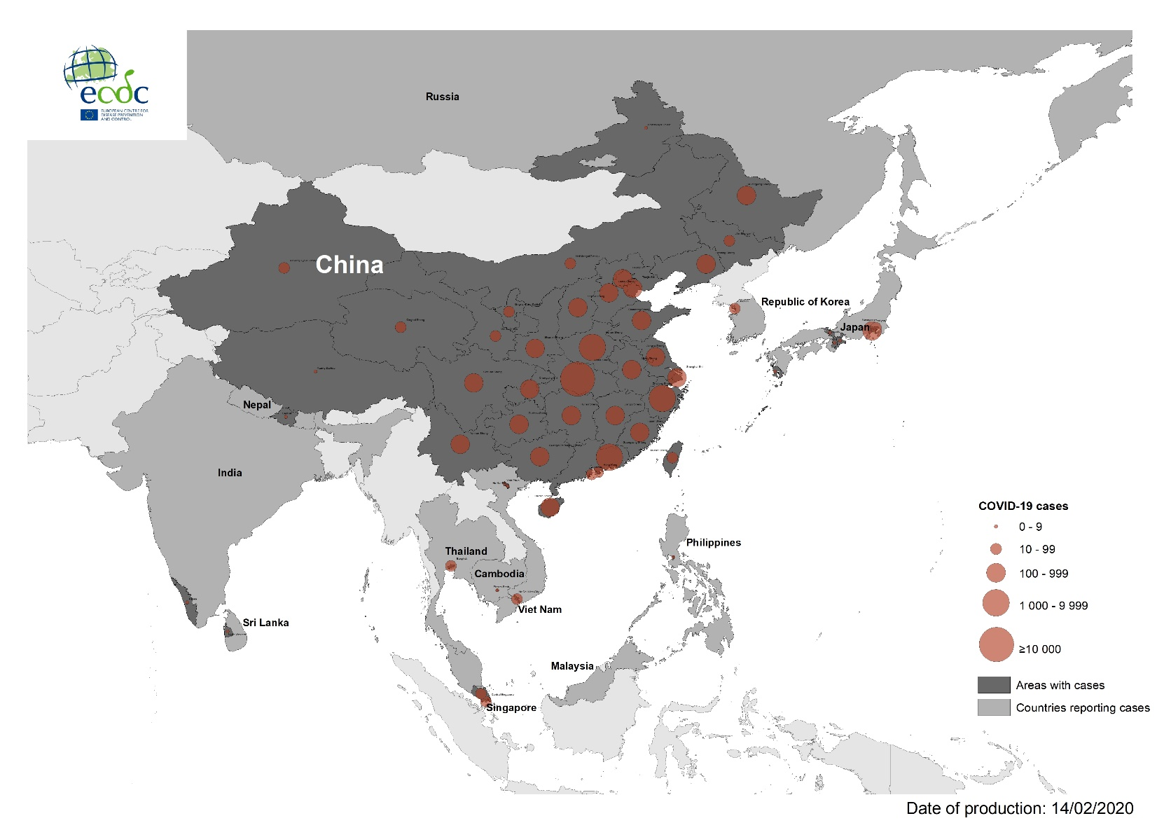
Geographical distribution of COVID-19 cases according to the applied case definition in the related countries in South-East Asia, as of 14 February 2020

Slide 16
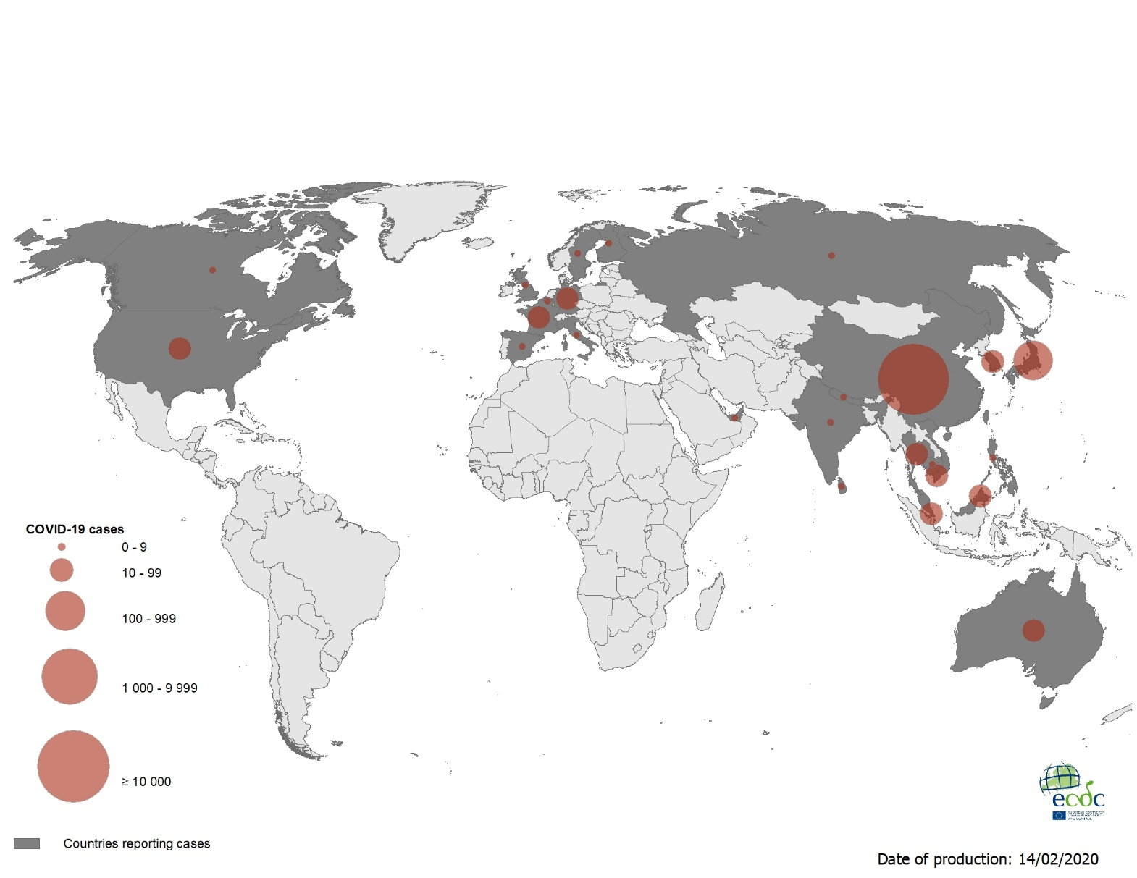
Geographical distribution of COVID-19 cases according to the applied case definition in the related countries worldwide, as of 14 February 2020

