Slide 1
SARS-CoV-2 (COVID-19) – CHINA – 2020
Stockholm, 18 February 2020

Slide 2
Distribution of COVID-19 cases according to the applied case definition in the related countries by country and region, as of 17 and 18 February 2020
17 February
18 February

Slide 3
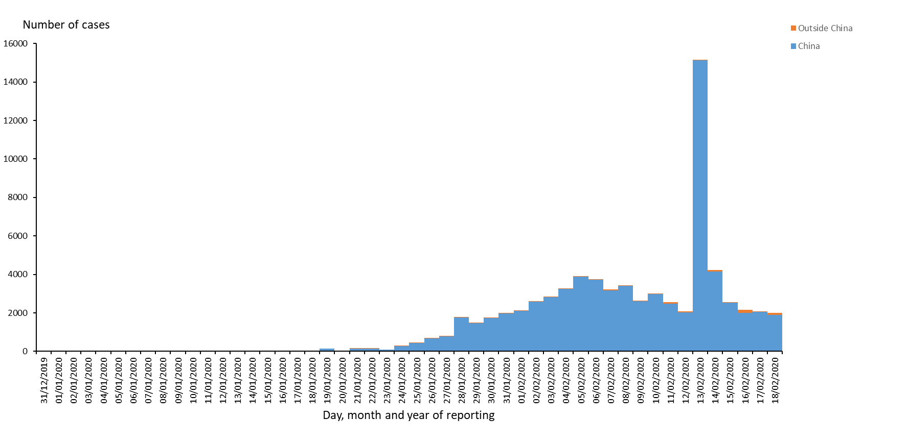
Distribution of COVID-19 cases according to the applied case definition in the related countries, as of 18 February 2020

Slide 4
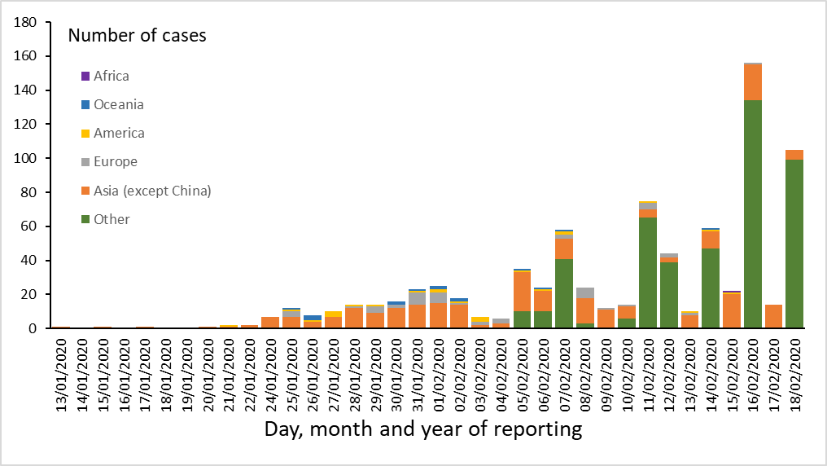
Distribution of COVID-19 cases according to the applied case definition in the related countries by continent, outside China Mainland, as of 18 February 2020

Slide 5
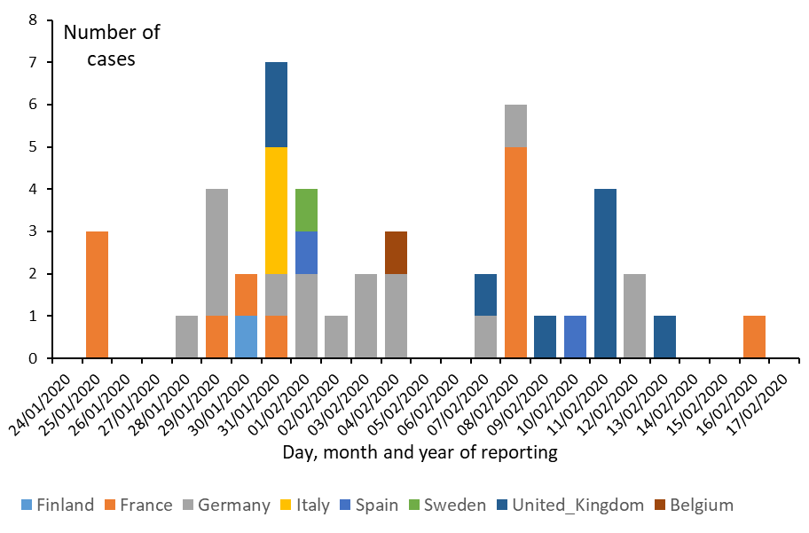
Distribution of laboratory-confirmed cases of COVID-19 in EU/EEA and the UK, as of 18 February 2020

Slide 6
Distribution of laboratory-confirmed cases of COVID-19 by country in EU/EEA and in the UK, as of 18 February 2020

Slide 7
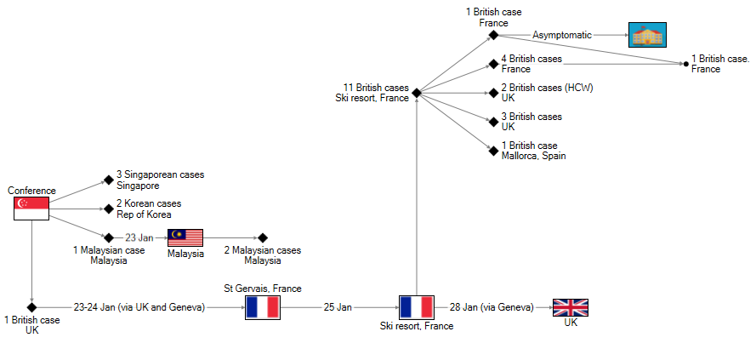
Transmission chain of cases related to the conference in Singapore (n = 21), as of 18 February 2020
→ Confirmed cases
 Close contacts

Slide 8
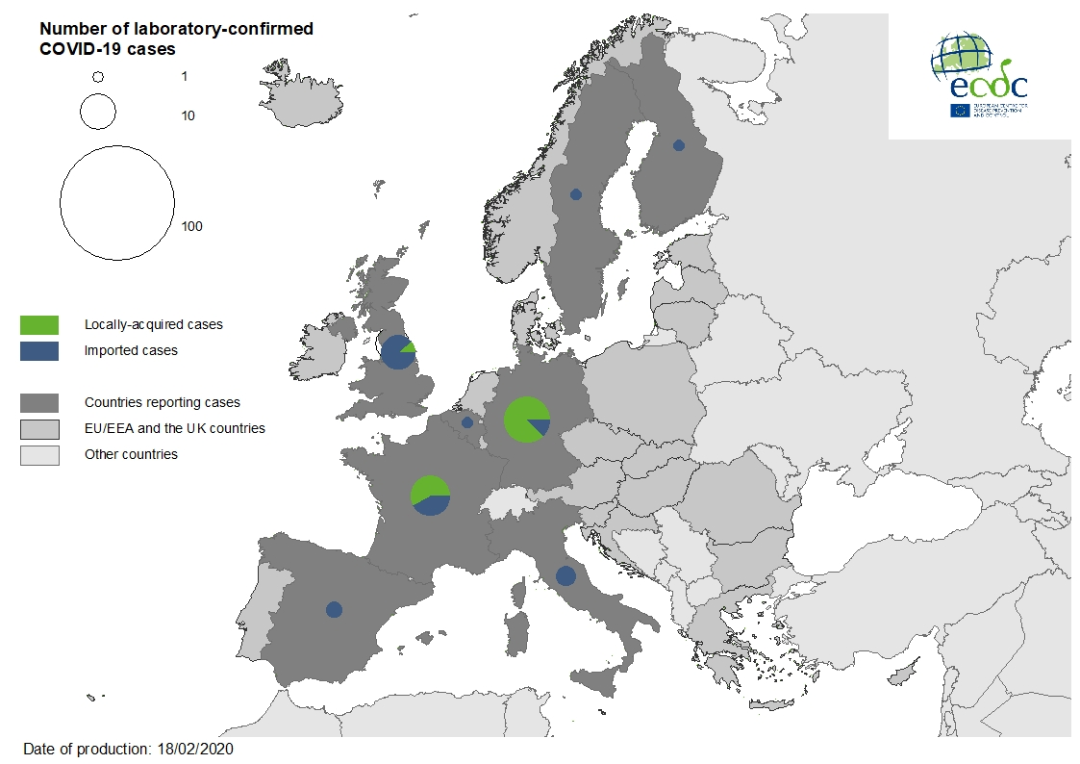
Geographical distribution of laboratory-confirmed cases of COVID-19 in the EU/EEA and the UK, as of 18 February 2020

Slide 9
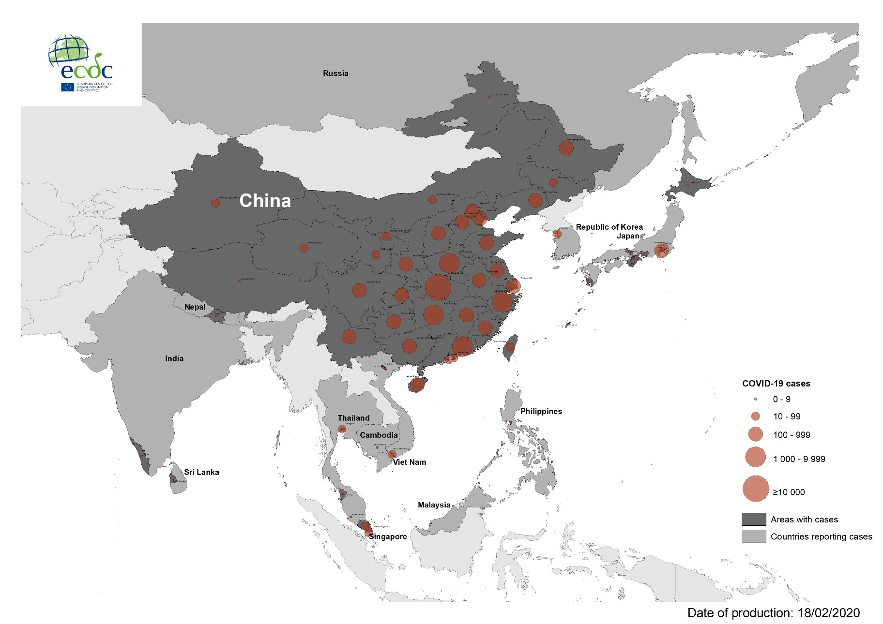
Geographical distribution of COVID-19 cases according to the applied case definition in the related countries in South-East Asia, as of 18 February 2020

Slide 10
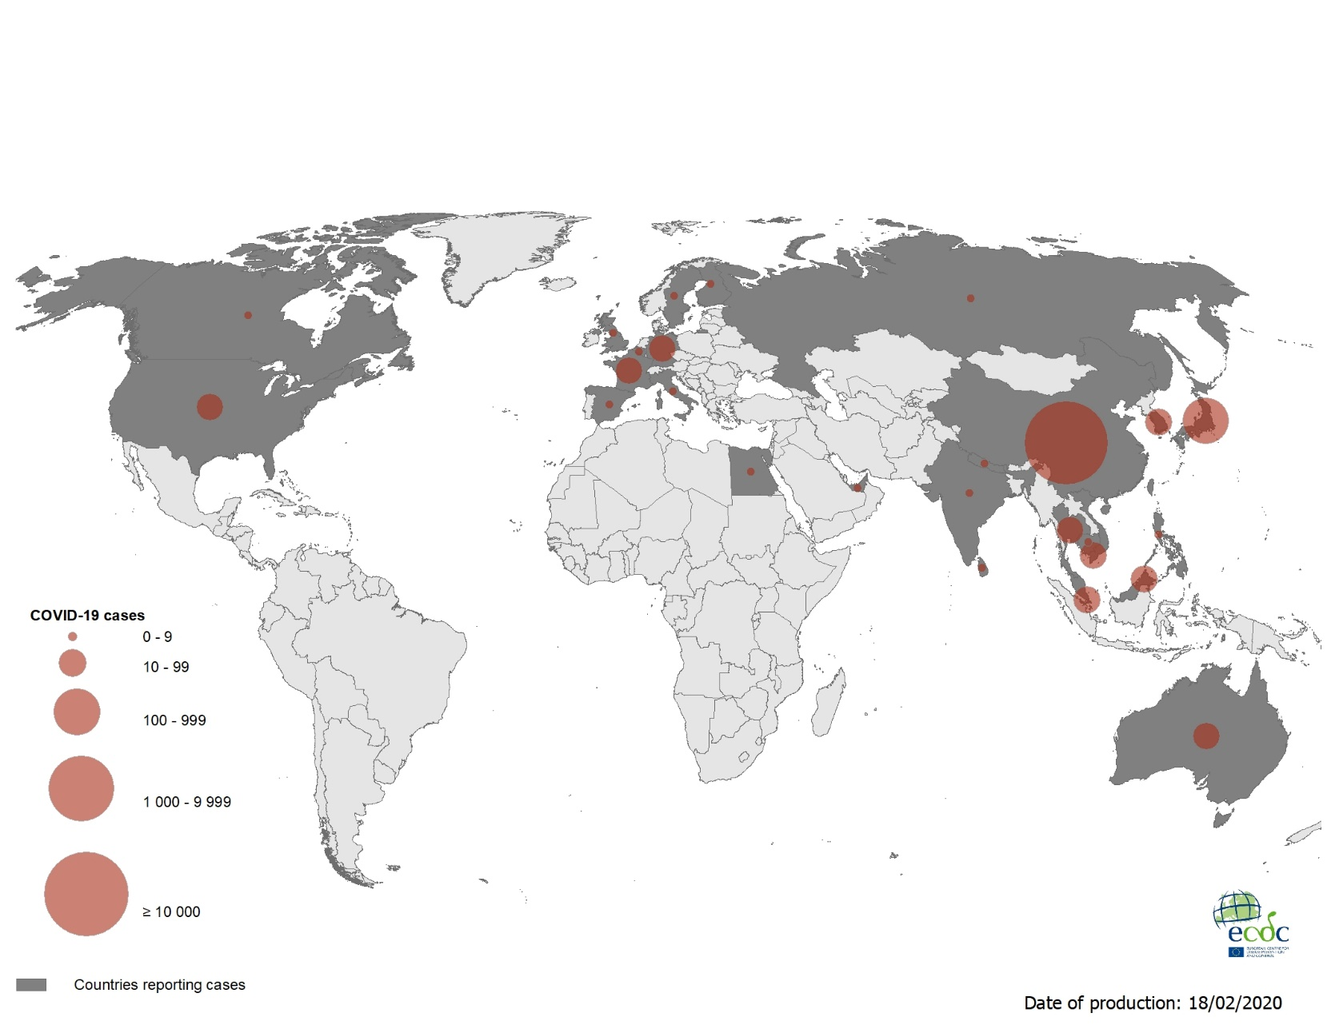
Geographical distribution of COVID-19 cases according to the applied case definition in the related countries worldwide, as of 18 February 2020

