Slide 1
SARS-CoV-2 (COVID-19) –2020
Stockholm, 12 June 2020
Disclaimer: These tables, histograms, maps and graphs are based on the available information at the time of publication, originating from several sources. Data completeness depends on the availability of information from the affected areas. All data should be interpreted with caution as the outbreak is evolving rapidly. In addition, due to the unavailability of date-of-onset data and different testing policies per country, these figures might not be reflective of the evolution of the epidemic.

Slide 2
Distribution of COVID-19 cases in accordance with the applied case definitions in the affected countries by country, Africa, as of 12 June 2020

Slide 3
Distribution of COVID-19 cases in accordance with the applied case definitions in the affected countries by country, Asia, as of 12 June 2020

Slide 4
Distribution of COVID-19 cases* in accordance with the applied case definitions in the affected countries by country, Europe, as of 12 June 2020
*Spain: Since 11 May, the frequency of reporting from regional level to national level has changed. This may lead to possible discrepancies in cases and death numbers due to data validation. This discrepancy could persist for several days.

Slide 5
Distribution of laboratory-confirmed cases* of COVID-19 by country in EU/EEA, and the UK as of 12 June 2020
*Spain: Since 11 May, the frequency of reporting from regional level to national level has changed. This may lead to possible discrepancies in cases and death numbers due to data validation. This discrepancy could persist for several days.
**Please note that as of 3 June France has changed from reporting the number of positive tests to the number of positive patients which has resulted in -766 cases reported today.

Slide 6
Distribution of COVID-19 cases in accordance with the applied case definitions in the affected countries by country, America and Oceania, as of 12 June 2020

Slide 7
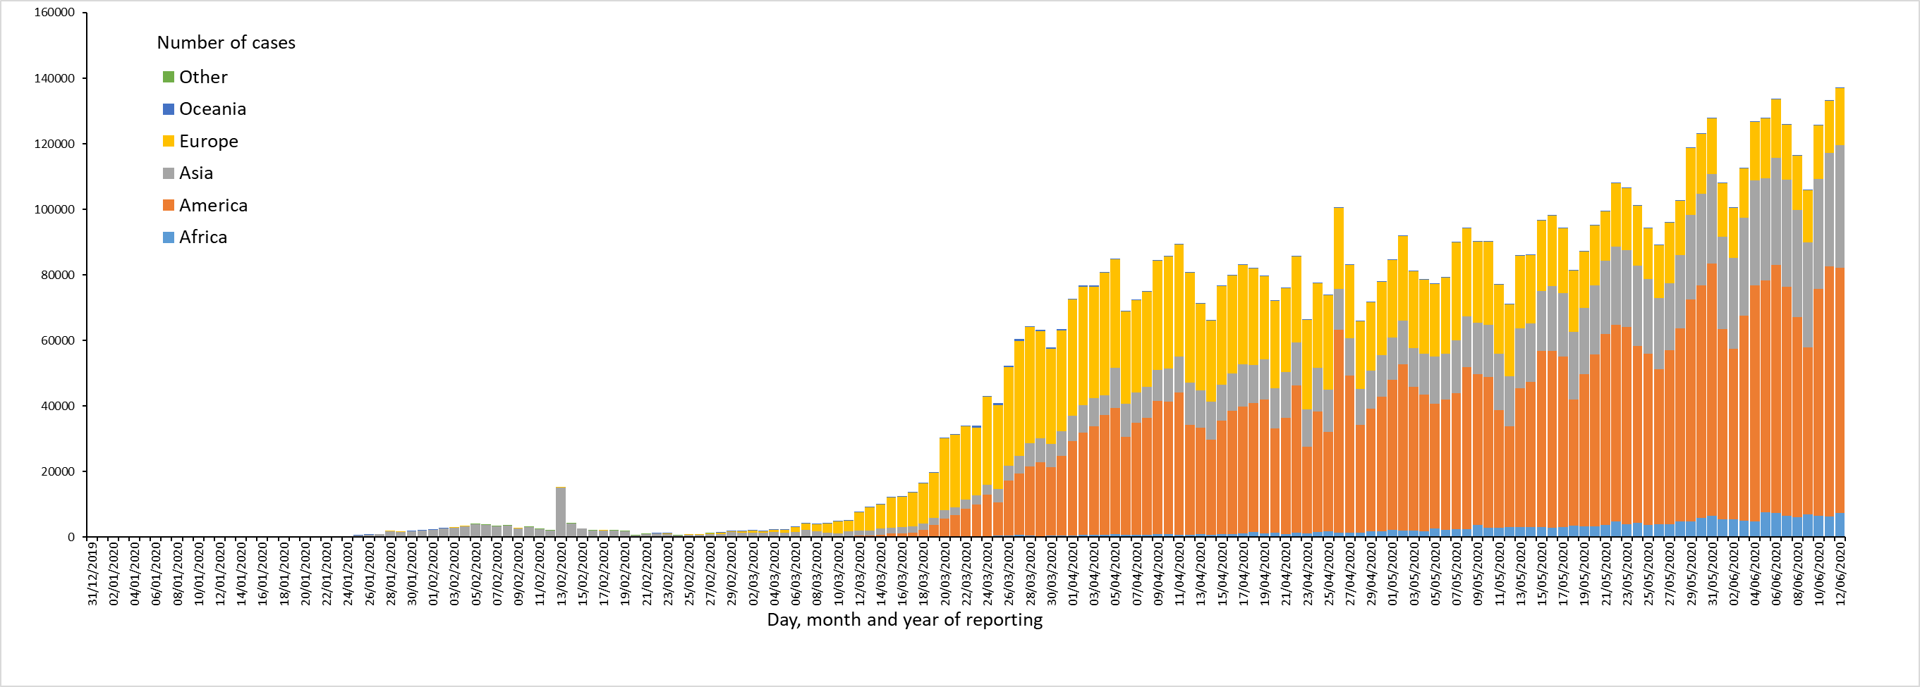
Distribution of COVID-19 cases* in accordance with the applied case definitions in the affected countries, as of 12 June 2020
*Spain: Since 11 May, the frequency of reporting from regional level to national level has changed. This may lead to possible discrepancies in cases and death numbers due to data validation. This discrepancy could persist for several days.

Slide 8
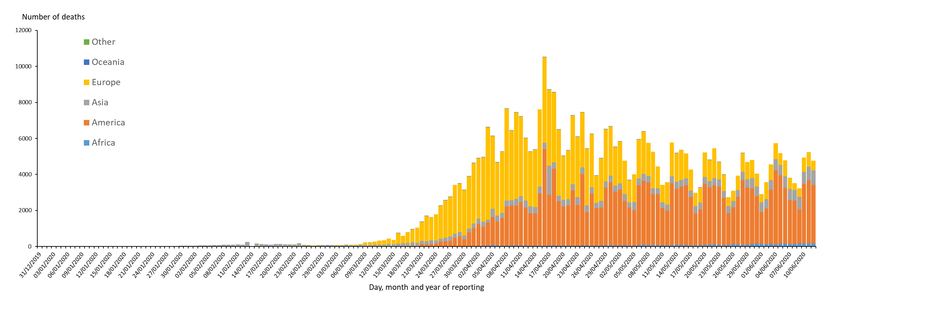
Distribution of COVID-19 deaths*,**, worldwide, as of 12 June 2020
* Increase of deaths in America is attributable to the US, which since 14 April 2020 includes confirmed and probable cases and deaths:
https://www.cdc.gov/coronavirus/2019-ncov/cases-updates/cases-in-us.html#2019coronavirus-summary
** Spain: Since 11 May, the frequency of reporting from regional level to national level has changed. This may lead to possible discrepancies in cases and death numbers due to data validation. This discrepancy could persist for several days.
In the displayed graph no new deaths are reported for Spain from the 25 of May as the change in reported deaths would result in a negative number of deaths for Europe overall.

Slide 9
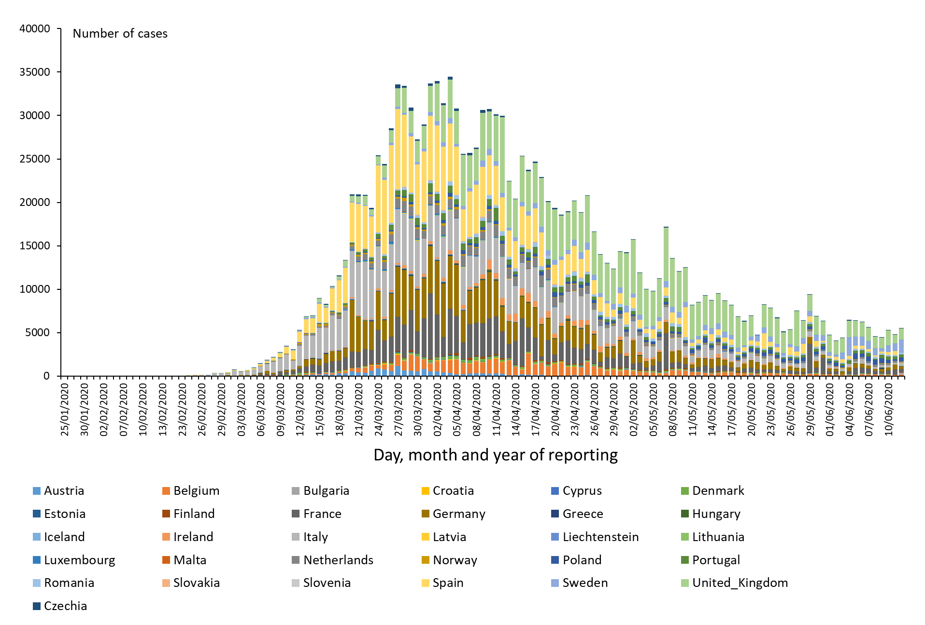
Distribution of laboratory-confirmed cases* of COVID-19 in EU/EEA and the UK, as of 12 June 2020
*Spain: Since 11 May, the frequency of reporting from regional level to national level has changed. This may lead to possible discrepancies in cases and death numbers due to data validation. This discrepancy could persist for several days.

Slide 10
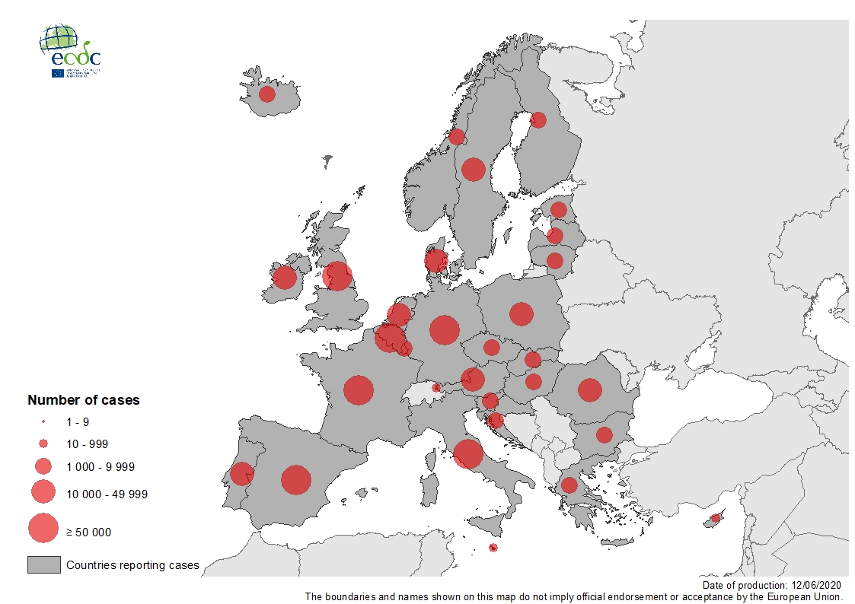
Geographical distribution of laboratory-confirmed cases of COVID-19 in the EU/EEA and the UK, as of 12 June 2020

Slide 11
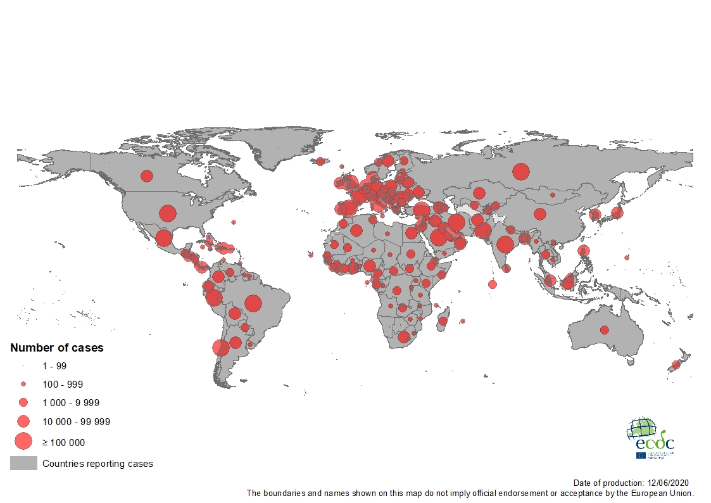
Geographical distribution of COVID-19 cases in accordance with the applied case definitions in the affected countries worldwide, as of 12 June 2020

Slide 12
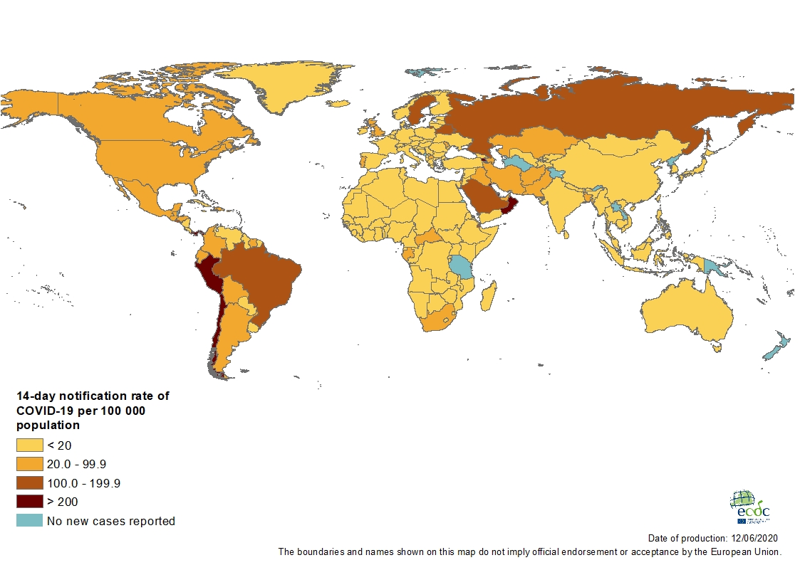
Geographic distribution of 14-day cumulative number of reported COVID-19 cases per 100 000 population, worldwide, as of 12 June 2020

Slide 13
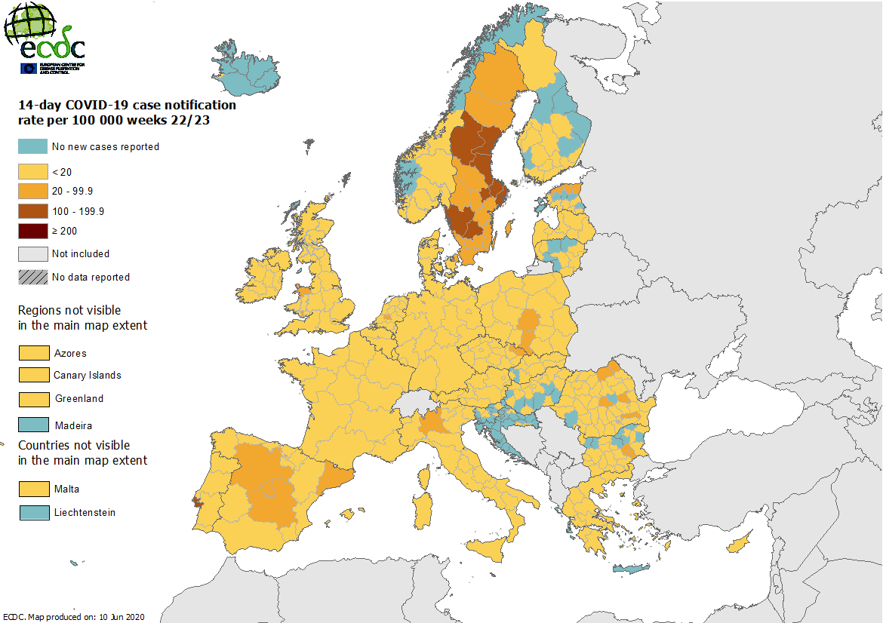

Slide 14
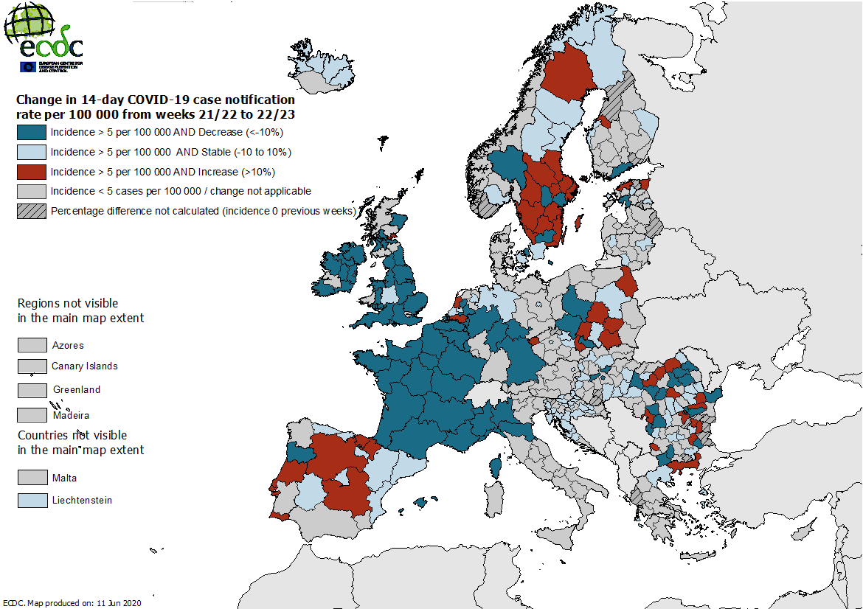

Slide 15
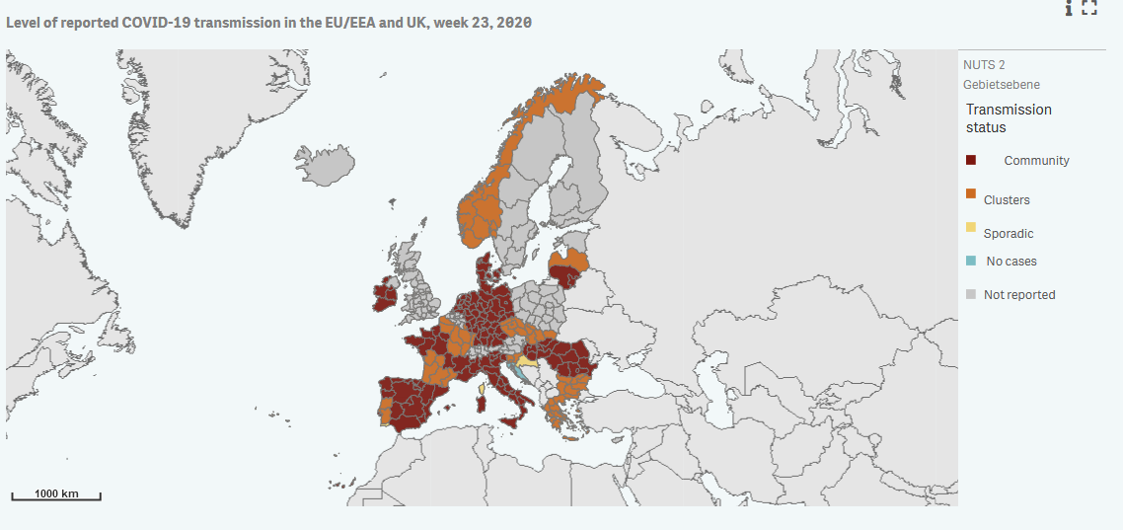

Slide 16
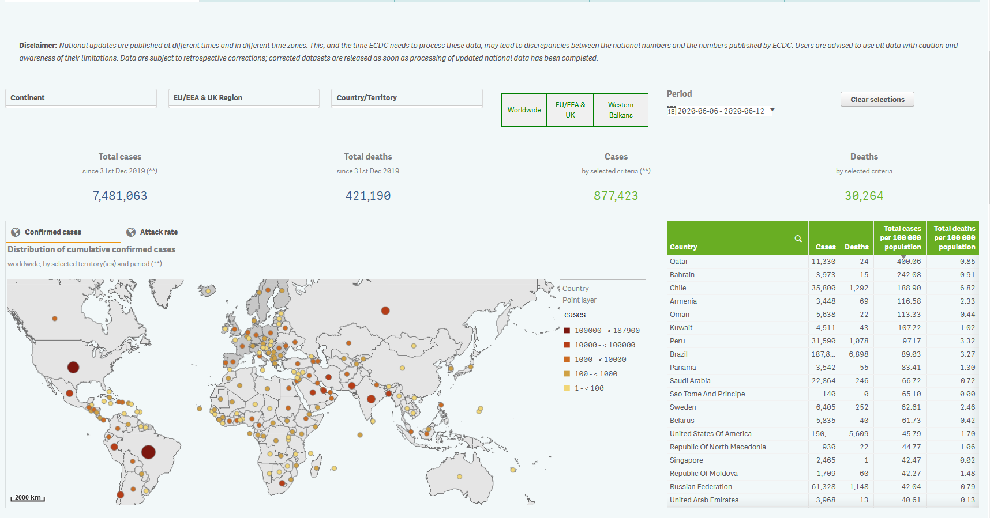
> 50/100.000 in 7-Tagesinzidenz

Slide 17
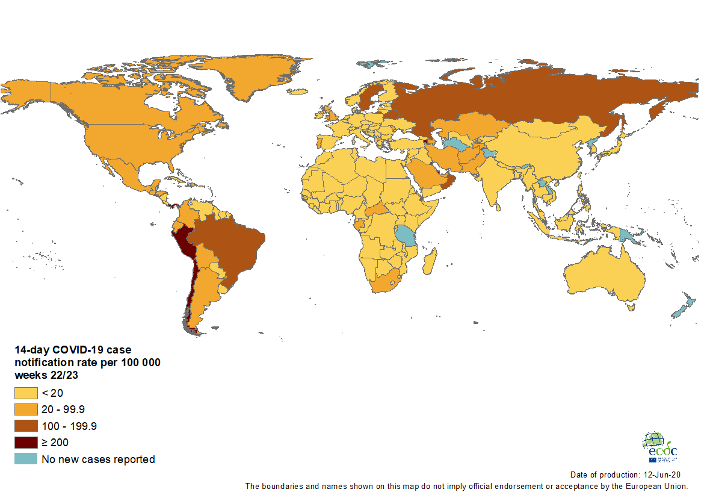

Slide 18
