Slide 1
The impact of social and physical distancing measures on COVID-19 activity in England

Slide 2
AIM
To describe how the impact SPDM was detected through each surveillance system and how these systems may be applied to detect increases in COVID-19 activity as SPDM are eased.

Slide 3
Methods
from the start of the epidemic to Week 20 2020 Data were used from
national population surveys,
web-based indicators,
syndromic surveillance,
sentinel swabbing,
respiratory outbreaks,
secondary care admissions, and
mortality indicators
to identify timing of peaks in the indicator relative to the introduction of SPDM.
This was compared to median time from symptom onset to different stages of illness or interactions with healthcare services.

Slide 5
England - Measures
end January: First cases
March 12
Symptomatic persons self-isolate 7 days
School trips cancelled
At risk persons: No cruises
March 16
Advice against non-essential travel
No non-essential contact
Work from home
March 23
School closure
Require to stay at home
Closing certain buisiness and venues
No more than 2 people in public

Slide 6
Results - Survey

Slide 7
Syndromic Surveillance

Slide 8
Primary care swabbing

Slide 9
Outbreaks

Slide 10
Secondary Care

Slide 11
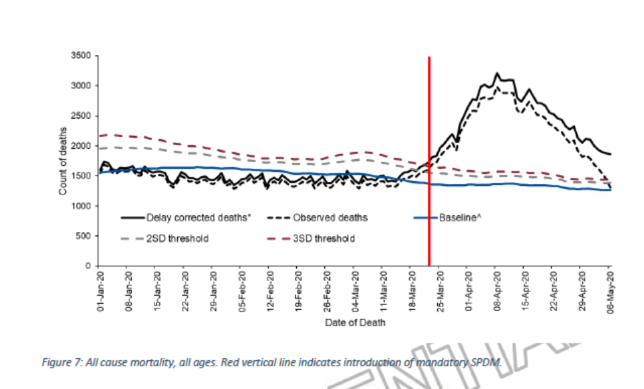
All cause mortality

Slide 12
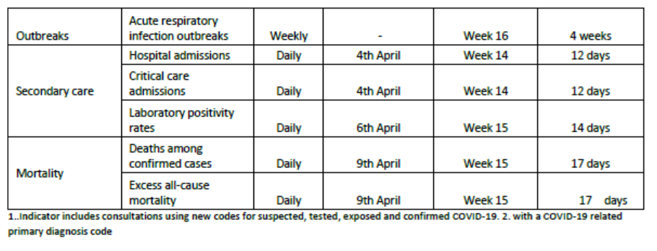

Slide 13
Discussion
Clear impact of measures in surveillance systems
Delay in line with expected intervals between measure and outcome
Voluntary measures ahead of mandatory
Influence surveillance systems adapted – but also difficult to interpret
Community surveillance important early indicator for changes
Next to case-based surveillance, syndromic surveillance population surveys and community testing necessary (consistent, uninterrupted)

Slide 14
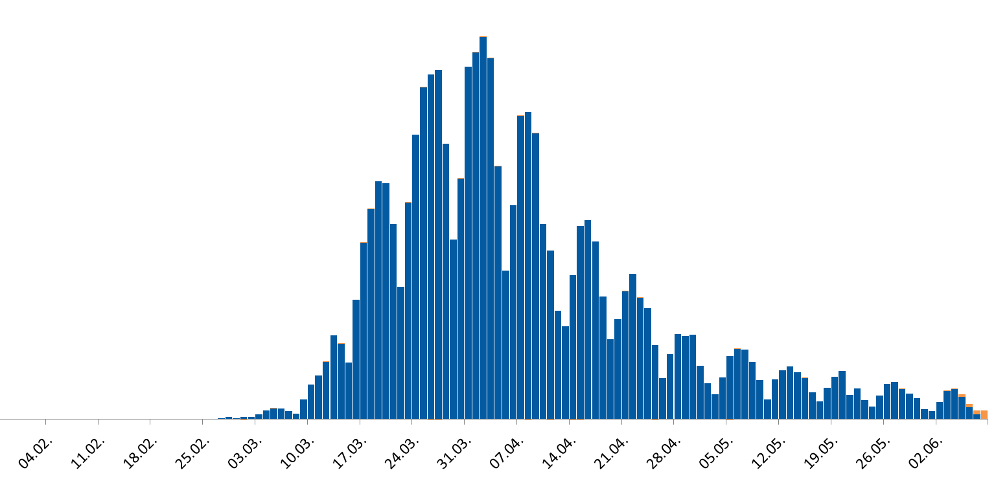
Timeline of events in Germany
23.03.
General contact ban
09.03.
First COVID-19 death
in Germany
20.04.
First relaxation of measures
Curve by onset
Curve by possible date of exposure
27.02.
Start of wave in Germany
30.01.
WHO declars PHEIC
31.12.
Cluster of pneumonia reported from Wuhan, China
27.01.
First case in Germany, 14 secondary cases
13.03.
Cancelling of mass gatherings Closing of schools and kindergardens

Slide 15
