Slide 1
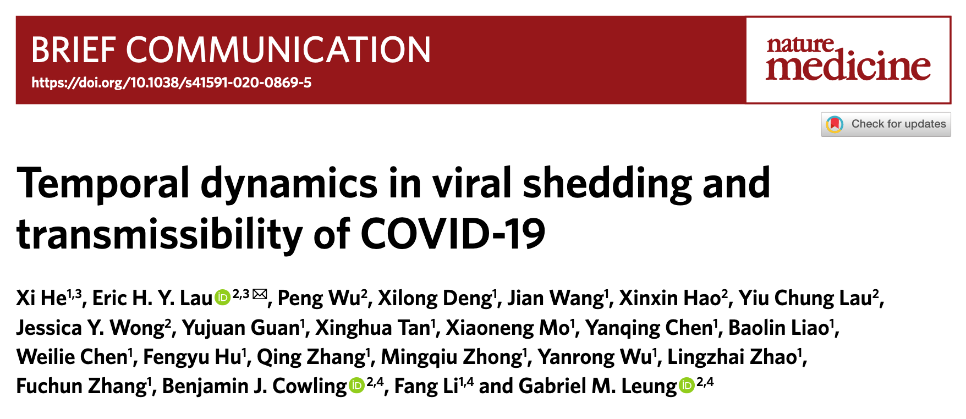
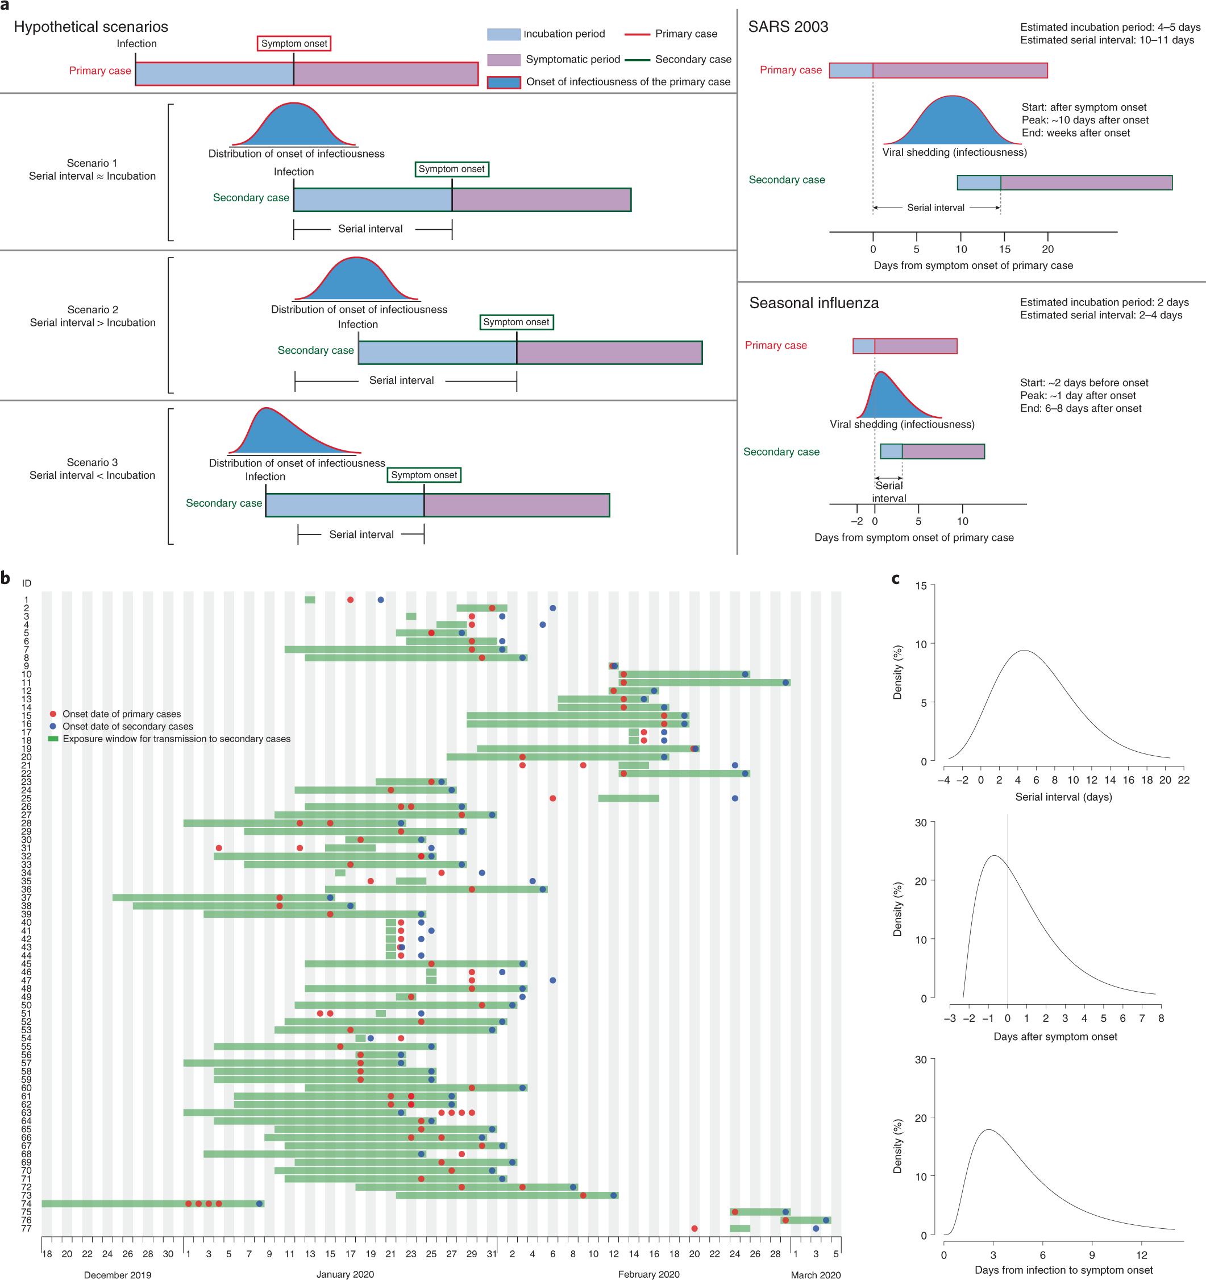
Analysis of time of transmission based on fully characterized transmission pairs
He, Nat Med 2020

Slide 2
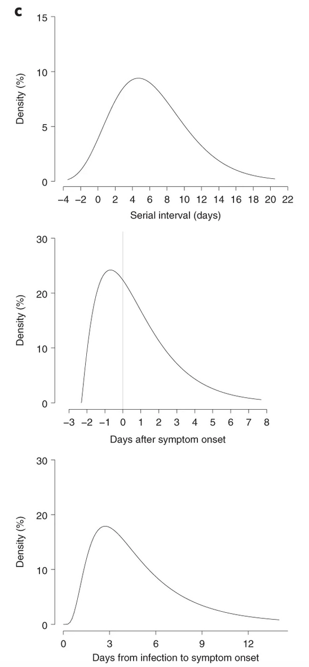
Serial interval
Time of transmission (=infectivity)
This is when patients are usually diagnosed
Symptoms-based incubation time
He, Nat Med 2020

Slide 3
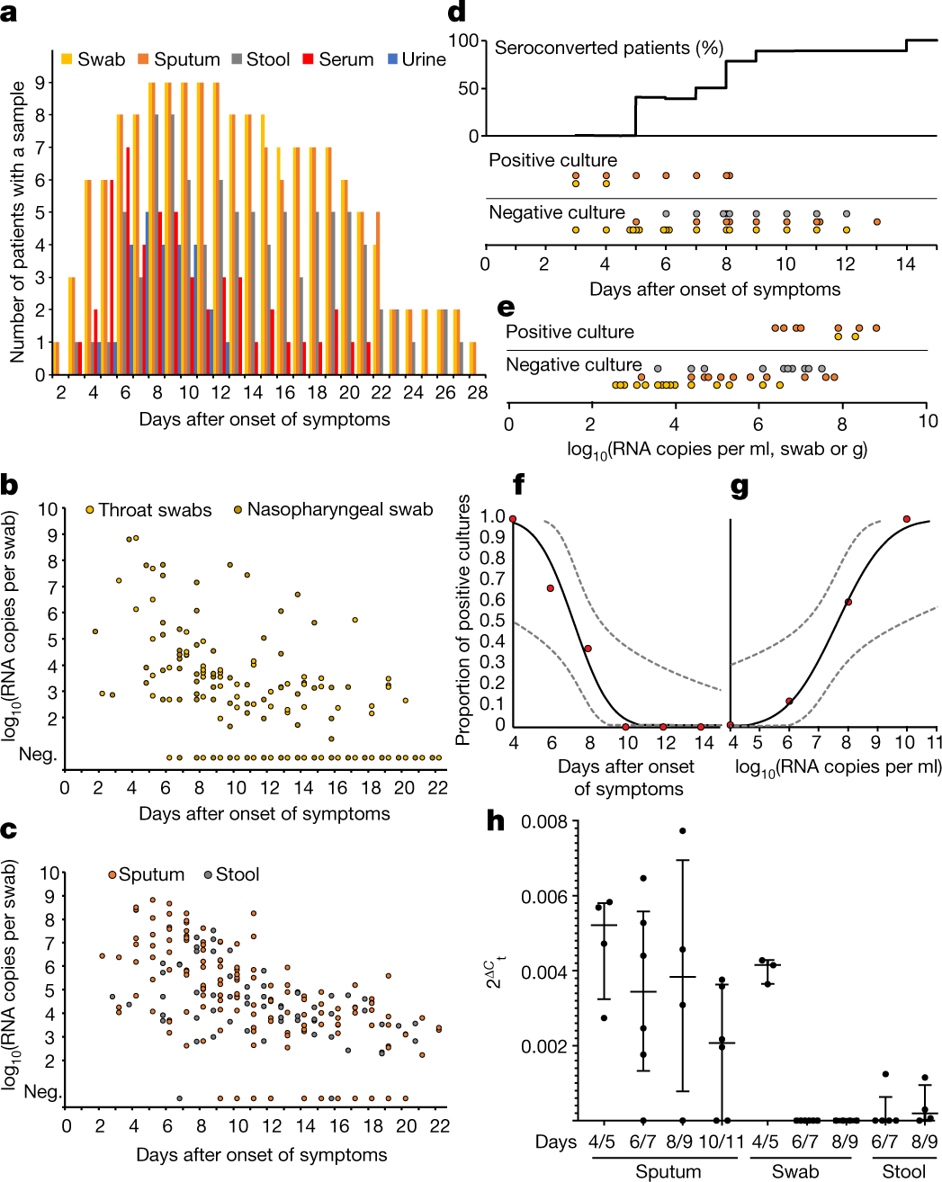
Same notion based on virus detection
Virus isolation unlikely after day 10, 50% isolation success rate by end of first week
Active virus replication in upper respiratory tract up to day 5
Wölfel / Corman, Nature 2020

Slide 4
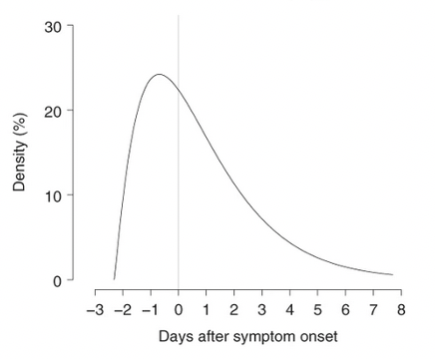
Forward contact tracing will often come late
Focus on individual contacts may not be efficient

Slide 5
There is a source cluster cooking!
Forward contact tracing will often come late
Focus on individual contacts may not be efficient
Backward cluster-specific tracing
Forward cluster-specific tracing

Slide 6
https://www.mhlw.go.jp/content/10900000/000635891.pdf
Japanese Ministry of Health

Slide 7
Cluster tracing
Once a case is detected by RT-PCR, the chance to stop onward transmission by isolation is almost gone
Forward and backward cluster tracing focuses on past exposures: acquisition (backward) as well as classical contact investigation
Clusters need to be isolated immediately, before diagnostic workup
RT-PCR for clear-testing of cluster members (after 5 days?)
Criterion: infectivity, rather than RNA detection (Ct 23? Antigen?)

