Slide 1
Impact of type and timeliness of control measures on COVID-19 epidemic growth: Organization for Economic Co-operation and Development countries, March – July 2020. Francisco Pozo Martin (ZIG2), Heide Weishaar (ZIG2), Florin Cristea (ZIG2), Johanna Hanefeld (ZIG), Lars Schaade (Inst.Leit.), Charbel El Bcheraoui (ZIG2)

Slide 2
COVID-19 challenge
World: 30.3 million cases / ~1 million deaths
OECD: 11.5 million cases / ~0.5 million deaths
Ongoing pandemic with no vaccine available
Possible 2nd, 3rd… waves
No vaccine yet available and uncertain end dates
Stringent non-pharmaceutical interventions
Lockdowns
How long can the public adhere to restrictions?

Slide 3
If we had to choose, what measures work best?
Aim
Provide policymakers with the much needed evidence about which measures to relax or suspend and which measures to tighten and rely on in case of a second wave or resurging numbers of cases
Objectives
Measure the effect of the various policy interventions that were implemented in response to COVID-19 on the epidemiological trend of the pandemic in OECD member states*.
*Australia, Austria, Belgium, Canada, Chile, Colombia, Czech Republic, Denmark, Estonia, Finland, France, Germany, Greece, Hungary, Iceland, Ireland, Israel, Italy, Japan, Latvia, Lithuania, Luxembourg, Mexico, The Netherlands, New Zealand, Norway, Poland, Portugal, Slovak Republic, Slovenia, South Korea, Spain, Sweden, Switzerland, Turkey, United Kingdom, United States of America.

Slide 4
Longitudinal panel study using data from publicly available databases. Study period is the period spanning 13 weeks after the first policy is implemented in each country
Policy regressors = intensity of…
1. School closing requirements
2. Workplace closing requirements
3. Cancelling of public events
4. Restrictions on gatherings
5. Public transport restrictions
6. Stay at home requirements
7. Internal travel restrictions
8. Public information campaigns
9. Mask wearing requirements
10. Testing policy
11. Contact tracing policy
+
Delay in policy implementation
Control variables:
1. Sociodemographic Index
2. GDP per capita (PPP)
3. % of population living in urban areas
4. % of total GDP spent in health
5. Average size of household
6. Palma ratio (measure of inequality)
Maximum likelihood estimation
(Nelder-Mead Optimiser)
Multilevel growth model
Bayesian estimation
(Integrated Nested Laplace Estimation)
Average daily growth rate of weekly confirmed cases
4
Notes:
So, the way we did this is through a Longitudinal panel study where we used publically available data. The spectrum of the analysis covered 13 weeks from the time the first policy is implemented in each country.
We took restriction policies mostly from the Oxford COVID tracker, control variables from different but well-known sources and fitted the data into a multilevel growth model. We applied first an MLE model and then a no-prior Bayesian estimation to check whether we are on the right track. We used the average daily growth rate of weekly confirmed cases as our outcome variable. Obviously, I did not go through all the details, but for instance, the outcome variable was probit-transformed for normalization, etc…

Slide 5
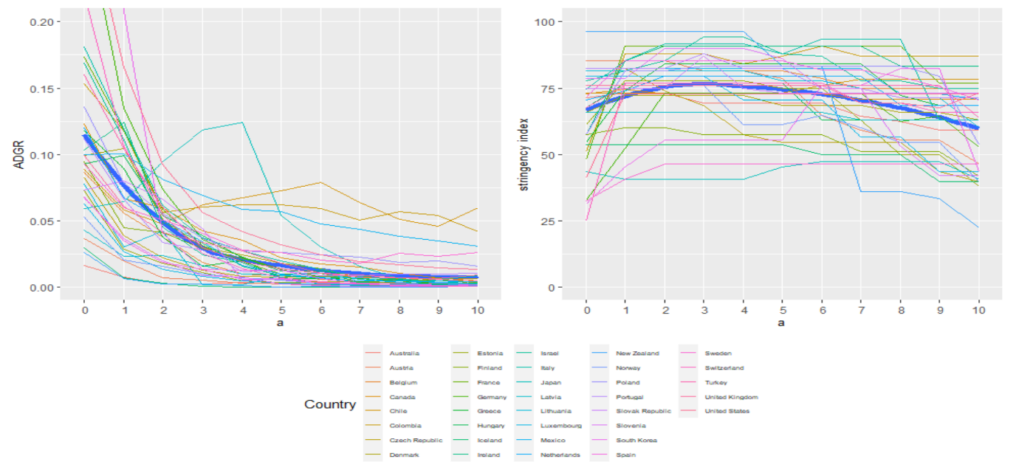
Epidemic growth / intensity of policies over time
Notes:
I’ll start now with the results, but happy to answer further questions about the methodology. We see that within 2 weeks most countries controlled their epidemic. The three not-so-successful outliers were Colombia, Chile and Japan

Slide 6
Epidemic growth / intensity of policies over time
Notes:
Now, in parallel, we see how all countries, or at least those that were not yet there, really ramped up their policies within a week or so. But later on we also see mostly a relaxation of most policies, in most countries

Slide 7
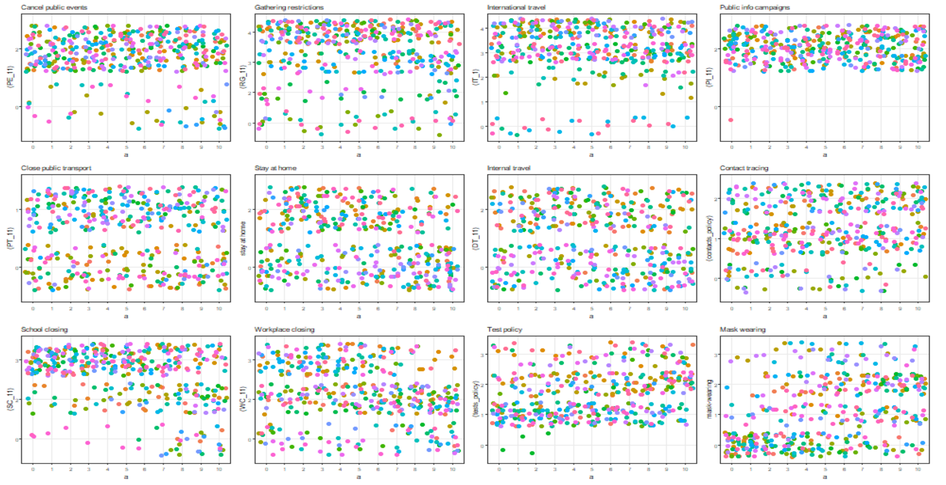
Stringency of policy implementation over time
Notes:
What I’d like to point out here is the spectrum of policy implementation stringency over time. We see four clusters mainly. The first one here, we mostly observe that cancelation of public events, restrictions on gatherings, international travel control, and public info campaigns were held quite high through the study period almost everywhere.
In the second cluster, we see that closure of public transport, stay-at-home policies, domestic travels, and contact tracing had very variable levels across the study period and countries with no discernable direction over time.
In the third cluster, we see school and work place closure were quite strict for schools and moderate to quite strict for work but progressively relaxed towards the end of the study period, and for the final cluster we see that testing and mask wearing policies have been progressively tightened over time, especially mask wearing.

Slide 8
Final model results
Maximum likelihood estimation |  | Bayesian estimation
Regressors | Coefficients (SE)^{SIG} | Mean parameter
Intercept | -0.595 (0.134) *** | -0.550
Time | -0.133 (0.009) *** | -0.134
Restrictions on gatherings: gatherings of more than 100 people not permitted | -0.370 (0.088) *** | -0.407
Restrictions on gatherings: gatherings of between 11 and 100 people not permitted | -0.531 (0.086) *** | -0.558
Restrictions on gatherings: gatherings of fewer than 10 people not permitted | -0.494 (0.083) *** | -0.536
Mask-wearing: recommended | -0.050 (0.052) | -0.043
Mask-wearing: required in some public places or in some geographical areas | -0.090 (0.044) * | -0.103
Mask-wearing: required in all public places in all geographical areas | -0.285 (0.060) *** | -0.314
School closing: require closing of only some levels or categories, e.g. just high school, or just public schools | -0.167 (0.064) *** | -0.189
School closing: require closing of all levels | -0.270 (0.073) *** | -0.293
Workplace closing: require closing (or work from home) for some sectors or categories of workers | -0.146 (0.044) *** | -0.141
Workplace closing: require closing (or work from home) of all-but-essential workplaces (e.g. grocery stores, doctors) | -0.201 (0.049) *** | -0.209
Total number of tests performed per thousand population | -0.004 (0.002) ** | -0.004
Notes:
For the final model, we see that the results were almost identical between the MLE and the Bayesian estimation, which is a big indicator of the validity of our results. I won’t spend much time on the coefficients, but what we take from this is the following

Slide 9
Our study indicates that
Restrictions on gatherings
Mask wearing requirements
School closing requirements
Work closing requirements
The total number of tests performed
Average daily growth rate of
weekly confirmed SARS-CoV-2 cases
Notes:
Our study indicates, even further, the data tell us, and in the following order, that Restrictions on gatherings, Mask wearing requirements , School closing requirements, Work closing requirements, The total number of tests performed are significant predictors of the Average daily growth rate of weekly confirmed SARS-CoV-2 cases

Slide 10
Policies analyzed
School closing requirements | 0 - No measures or recommend closing 2 - Require closing (only some levels or categories, e.g. just high school, or just public schools) 3 - Require closing all levels
Stay at home requirements | 0 – No measures or recommend not leaving house 1 - require not leaving house with exceptions for daily exercise, grocery shopping, and ‘essential’ trips or require not leaving house with minimal exceptions (e.g. allowed to leave only once a week, or only one person can leave at a time, etc.)
Workplace closing requirements | 0 - No measures or recommend closing (or work from home) 2 - require closing (or work from home) for some sectors or categories of workers 3 - require closing (or work from home) all-but-essential workplaces (e.g. grocery stores, doctors)
Restrictions on internal movement | 0 – No measures or recommend not to travel between regions/ cities 2 – internal movement restrictions in place
International travel controls | 0 - No measures 1 - Screening 2 - Quarantine arrivals from high-risk regions 3 - Ban on arrivals from some regions 4 - Ban on all regions or total border closure
Public events cancelling requirements | 0 – No measures or recommend cancelling 2 – Require cancelling
Restrictions on gatherings | 0 - No restrictions 1 - Restrictions on gatherings of more than 100 people 2 - Restrictions on gatherings of between 11 and 100 people 3 – Restrictions on gatherings of 10 people or less
Public health information campaigns | 0 -No COVID-19 public information Campaign 1 - public officials urging caution about COVID-19 2 - coordinated public information campaign (e.g. across traditional and social media)
Public transport restrictions | 0 – No measures 1 – Recommend closing (or significantly reduce volume/ route/ means of transport available) or require closing (or prohibit most citizens from using it)
Mask policies | 0 - No mask-wearing requirements 1 – Mask wearing in public recommended 2 – Mask wearing in public required in some public places/ geographical areas 3 – Mask wearing in public required in all public places/ geographical areas

