Slide 1
RKI_COVIDTestCalculator
Max von Kleist (RKI-MF1)
Wiep van der Toorn (RKI-MF1)
Djin-Ye Oh (FG17)

Slide 2
Problem statement
SARS-CoV2 continues to spread globally
Vaccine or prophylaxis not broadly available yet
Non-pharmaceutical interventions
Quarantine
Isolation
Sources:
ECDC; www.ecdc.europa.eu/en/covid-19/
30,000
20,000
10,000
America
Asia
Europe
Reported cases/day
03/20 06/20 09/20

Slide 3
Disambiguation
possible
exposition
no symptoms
14 days
quarantine
symptoms/virus detection
symptom onset
or SARS-CoV2
positive
isolation
10 days
Quarantine
Contact individuals
Travellers from risk areas (incidence > 50/100k/w)
Isolation
People with symptoms
Confirmed cases
Testing
to shorten
duration
Kleist M, et al. (2020)
Epid Bull 2020;39:3-11

Slide 4
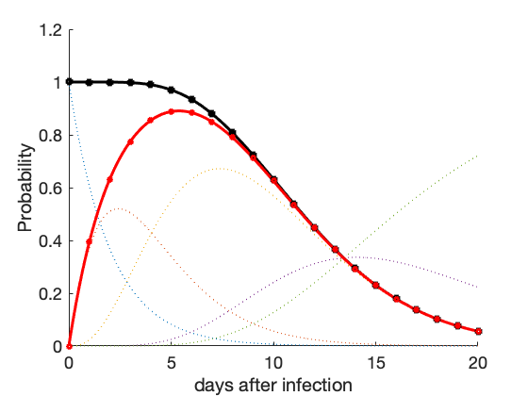
Methods – brief math
Output:
residual risk(t) = infectious($t_{∞}$) * false omission rate(t)
fold risk reduction(t) = pre-procedure risk/residual risk(t)
1. Residual risk
Testing (+ quarantine)
Quarantine
2. Fold risk reduction
Infectious & detectable
Is- or will become infectious
$$RR\left(t\right)= P\left({PCR}^{−}| Inf(t)\right)∙P(Inf(t))$$
Incubation
symptomatic presymptomatic
side products
Prevalence estimator
Efficiency estimator
: : :
$$RR\left(t\right)= P(Inf(t))$$
Post-
symptomatic
$$FRR(t)= \frac{P\left(Inf\left(t_{0}\right)\right)}{RR\left(t\right)}$$

Slide 5
Methods – brief math
II. Test sensitivity
residual risk
I. Infection time course
$$RR\left(t\right)= P\left({PCR}^{−}| Inf(t)\right)∙P(Inf(t))$$
fold risk reduction
$$FRR= \frac{RR\left(t\right)}{P\left(Inf\left(t_{0}\right)\right)}$$
III. pre-procedure risk

Slide 6
Methods: Infection time course
Transit model
absorbing state
x₁
x₂
x₃
…
x_{i}
…
x_{i+k}
…
x_{n}
pre-detection
pre-symptomatic
(symptomatic) infectious
non-infectious
„Incubation“
Mean residence time <-> rates
$$τ_{sympt}= days= \sum_{i∈inc}{\frac{1}{k_{i}}. ⇒k_{i}=\frac{n_{inc}}{τ_{inc}}}$$

Slide 7
Methods: Infection time course
Transit model
absorbing state
x₁
x₂
x₃
x₇
x₈
Transit model
…
absorbing state
x₁
x₂
x₃
x₄
Incubation
presymptomatic
Symptomatic
presymptomatic
Symptomatic consists of 5 states
Incubation
Symptomatic
Symptomatic consists of 1 state

Slide 8
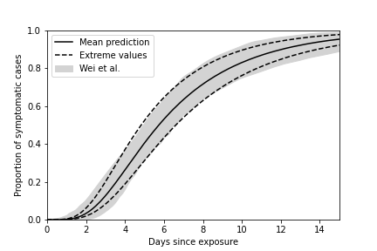
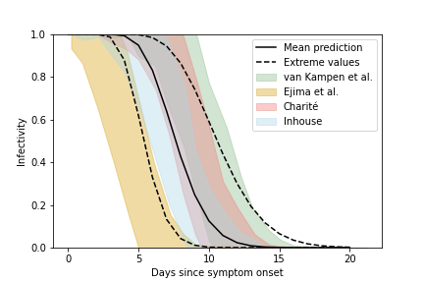
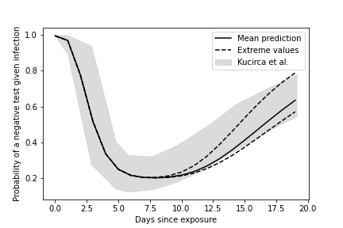
Parameters
II. Test sensitivity
$$RR\left(t\right)= P\left({PCR}^{−}| Inf(t)\right)∙P(Inf(t))$$
incubation
I. Infection time course
symptomatic infectious
Test sensitivity
Wei et al. (2020) MedRXiv
Singanayagam et al (2020) Euro Surveill
Van Kampen et al (2020) MedRXiv
Ejima et al. (2020) MedRXiv
Kucirca et al (2020) Ann Int Med
Charite: Unpublished data Drosten Lab
In house: Unpublished data RKI
Notes:
8

Slide 9
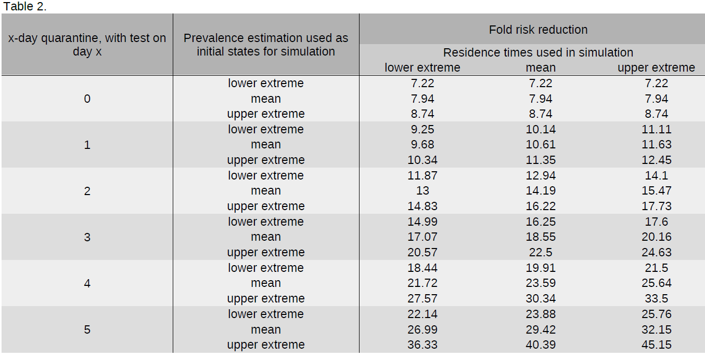
Example: Incoming Travellers

Slide 10
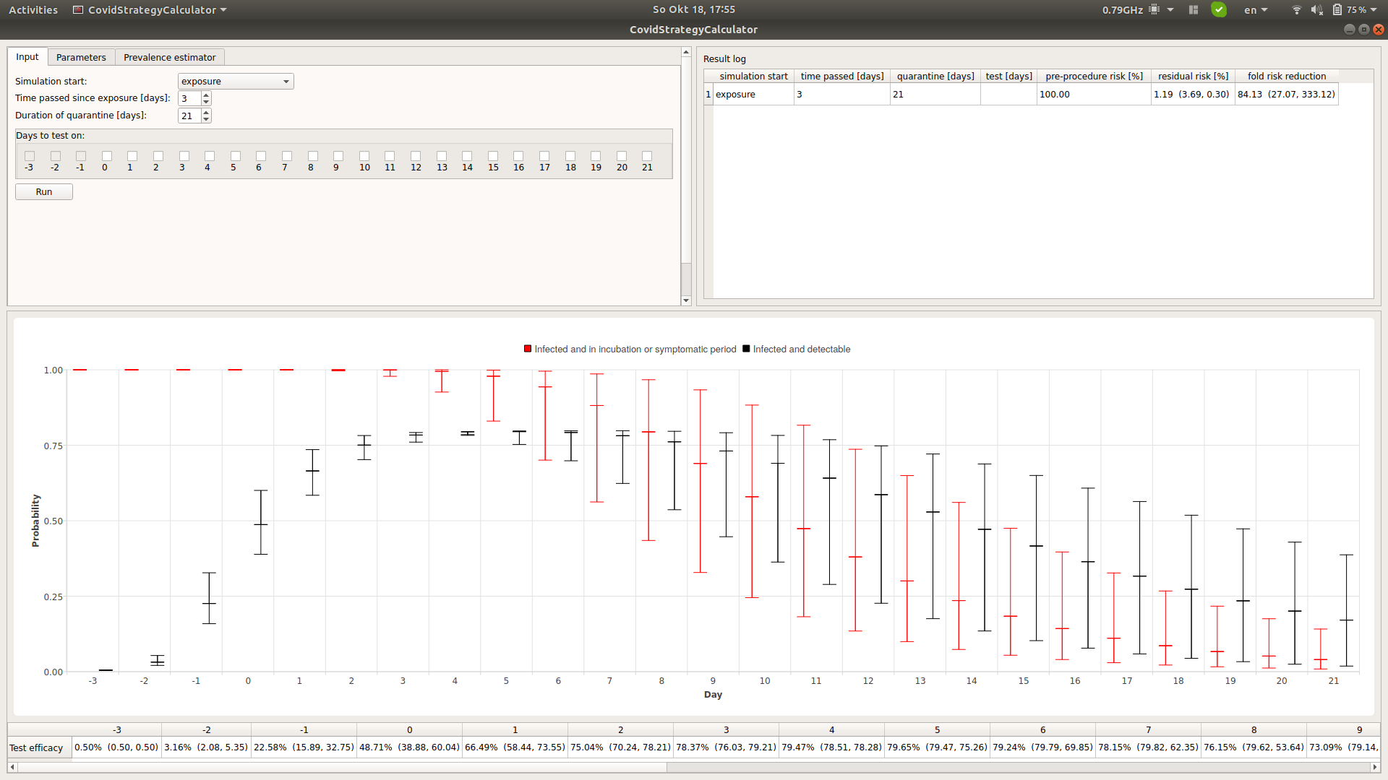
<Show case tool (live demo)>
residual risk
fold risk reduction
optimal time to place the test

Slide 11
Summary
Easy-to-use-GUI to assess quarantine/isolation and testing strategies from an infection prevention perspective
Parameters can be adjusted
Default values depict uncertainty (dynamic scientific setting)
Tool extendible
Input welcome!
Code availability: https://github.com/Wvandertoorn/CovidStrategyCalculator
OS: Linux, Mac, PC
Publication: manuscript in preparation

Slide 12
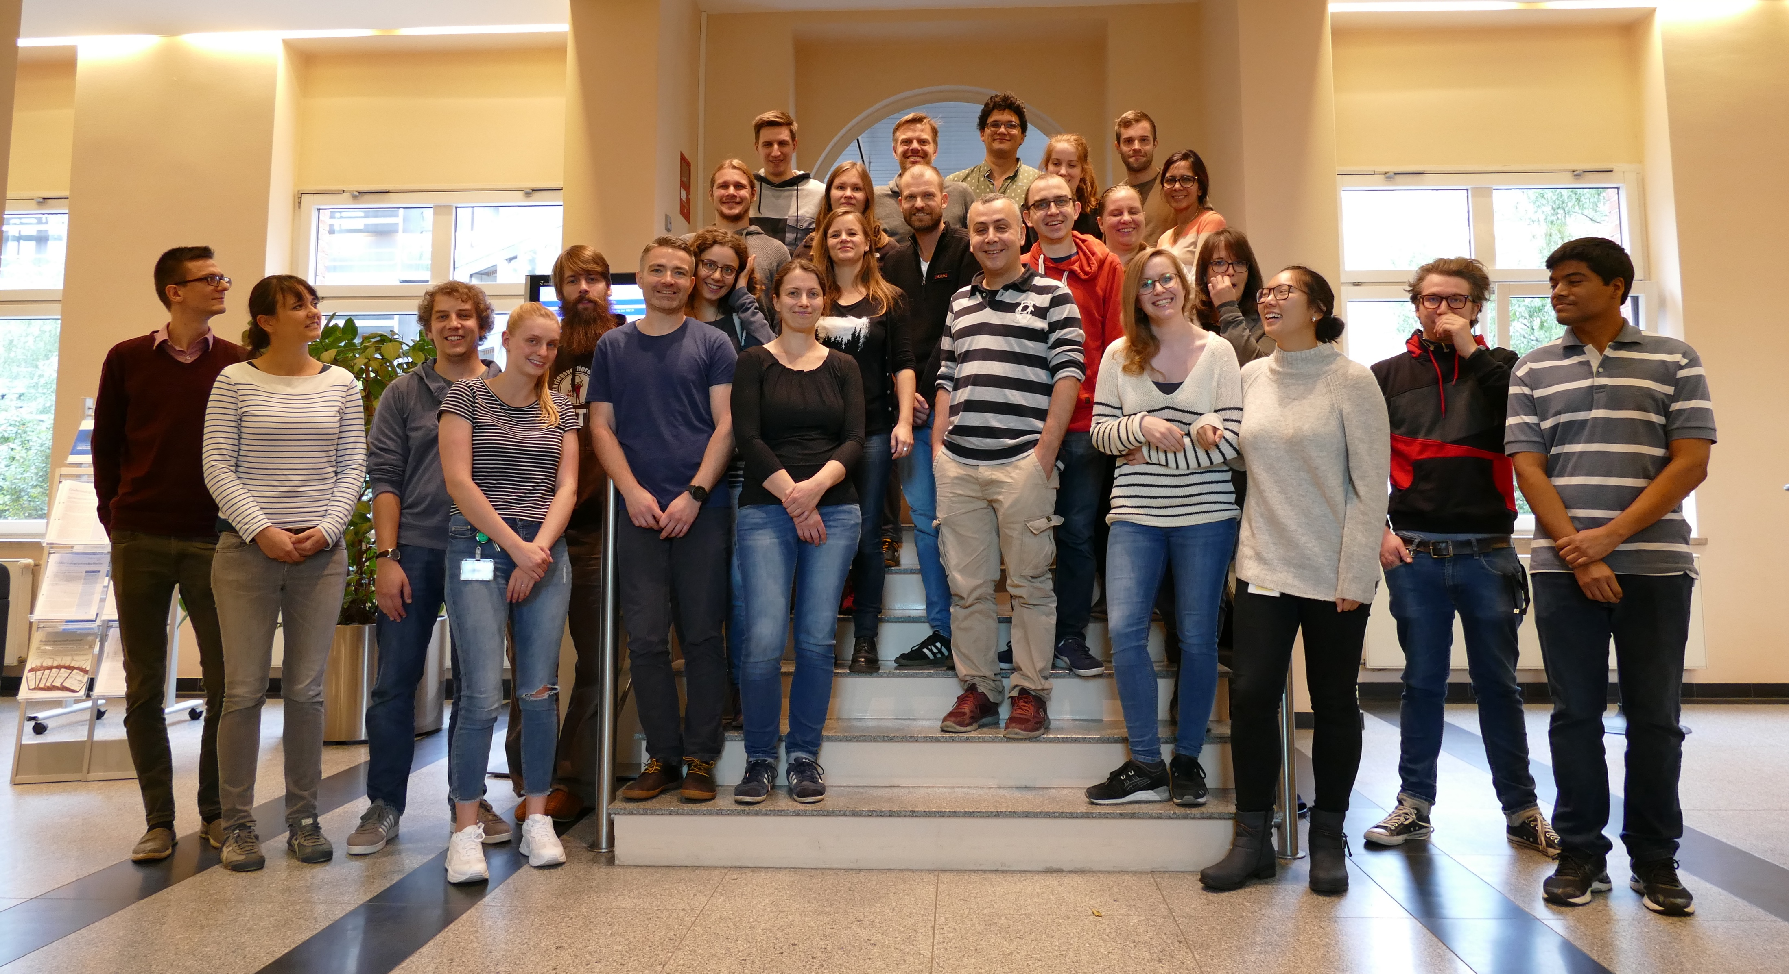
Acknowledgements
Wiep van der Toorn
Djin-Ye Oh (FG18)
Andreas Nitsche (ZBS1)
SARS-CoV2 Diagnostics work group
SARS-CoV2 Lagezentrum
Terry Jones et al.
(Drosten Lab)
SARS-CoV2 Krisenstab
MF1 Team

