Slide 1
Rapid genome-based estimation of SARS-CoV2 incidence
Max von Kleist (RKI-MF1/P5)
Denise Kühnert (MPI-SHH)

Slide 2
Problem statement
Case numbers unreliable
depend on testing behaviour, time delays, etc..
Differences over time and between countries
Importance:
Identify ‘risk areas’ (travel restrictions)
Did measures work?
test bias over time and between countries
Tests /100,000/week
Sources:
ECDC
www.ecdc.europa.eu/en/covid-19/
Nepal Ministr. Of Health
https://covid19.mohp.gov.np

Slide 3
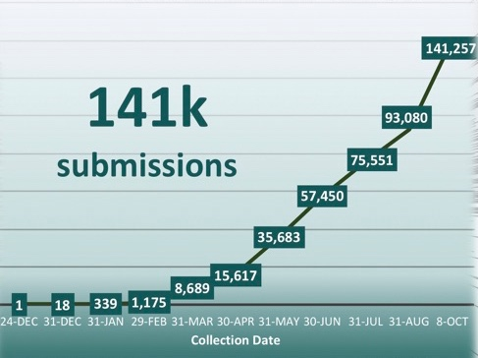
Aim & Reasoning
Aim:
Use genetic data to infer incidence
Reasoning:
SARS-CoV2 evolves slowly and is new to human.
-> one mutation per 2 transmissions <-

Slide 4
Method* – Part 1
Number of mutants
Number of new mutants
$θ$ is proportional to the population size
Determine $\tilde{η}\left(t\right)$ and $n_{m}$ from a multiple sequence alignment
Solve for $θ$
*Idea inspired by:
Mol. Bio. Evol. (2019) 36(9): 2040-52

Slide 5
Method – Part 2
$∆$t

Slide 6
Method verification: Part I
$θ$ is proportional to the population size
sub-sampling
sequencing errors
introductions
MSA
distorted MSA
ATGCG….TGCA
ATGCG….TGCA
: : :
ATGCC….TCCA
CTTCG….AGCA
ATGCG….AGCA
Simulated epidemic
GTGCG….TGCA
: : :
ATGGC….TCAA
CTTCG….ACCA
inference
generation
i+1
?match?
resampling
smoothing
$$θ_{i}$$
population size $N_{i}$

Slide 7
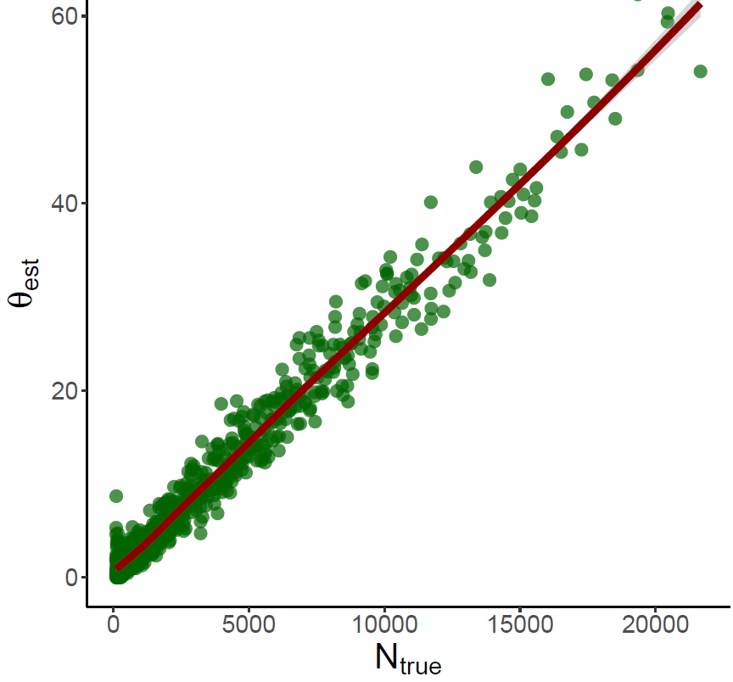
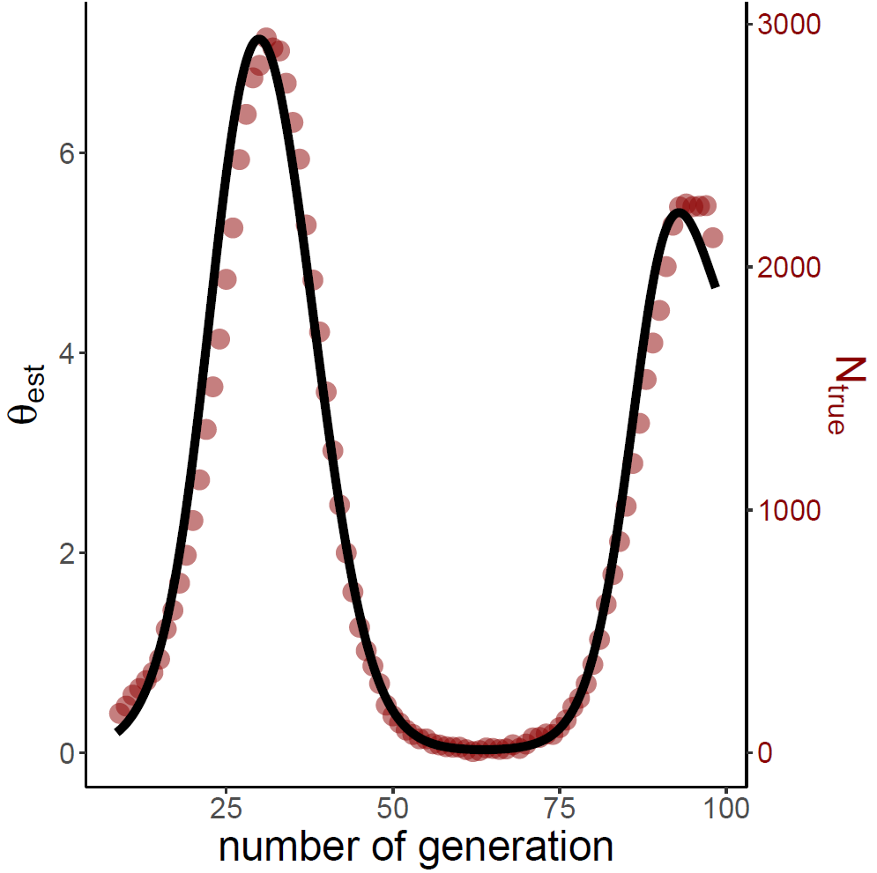
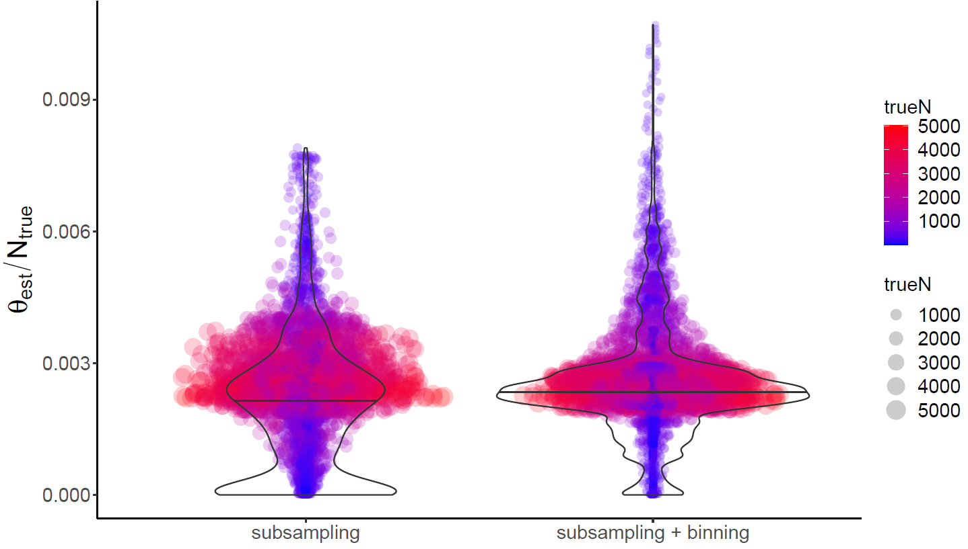
Method verification: Part II

Slide 8
Applications

Slide 9
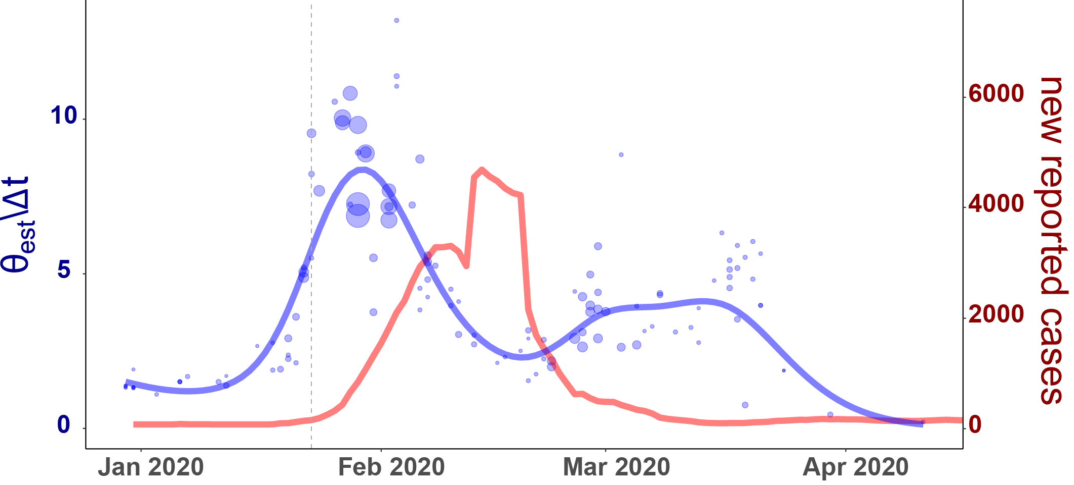
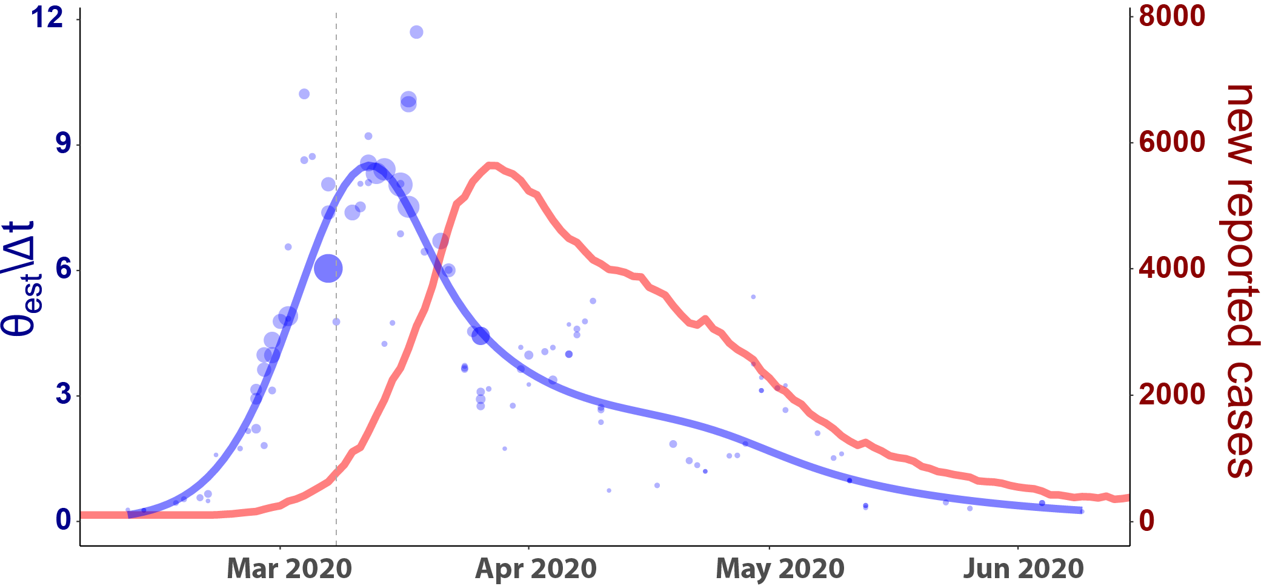
China vs. Italy
$≈$14-18d
Lock down
-Hubei
-other provinces
China
???
Lock down
$≈$14d
Lock down tightened
Italy

Slide 10
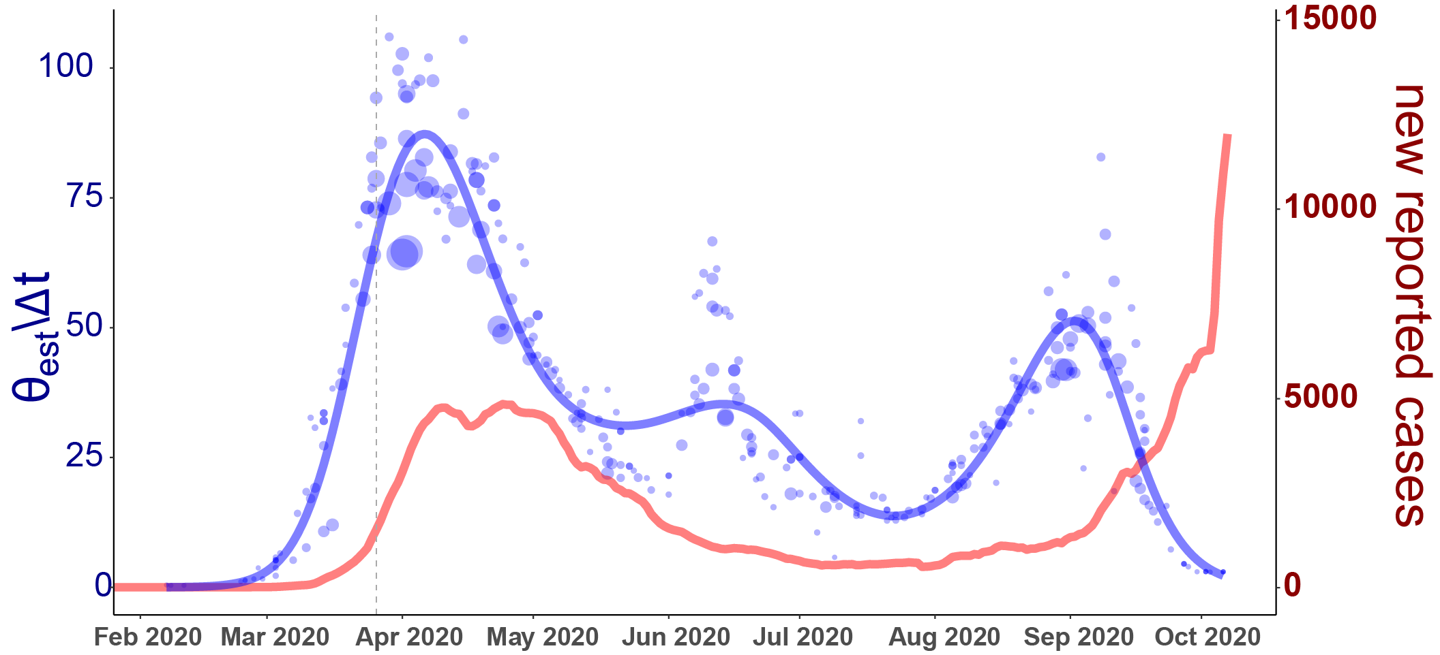
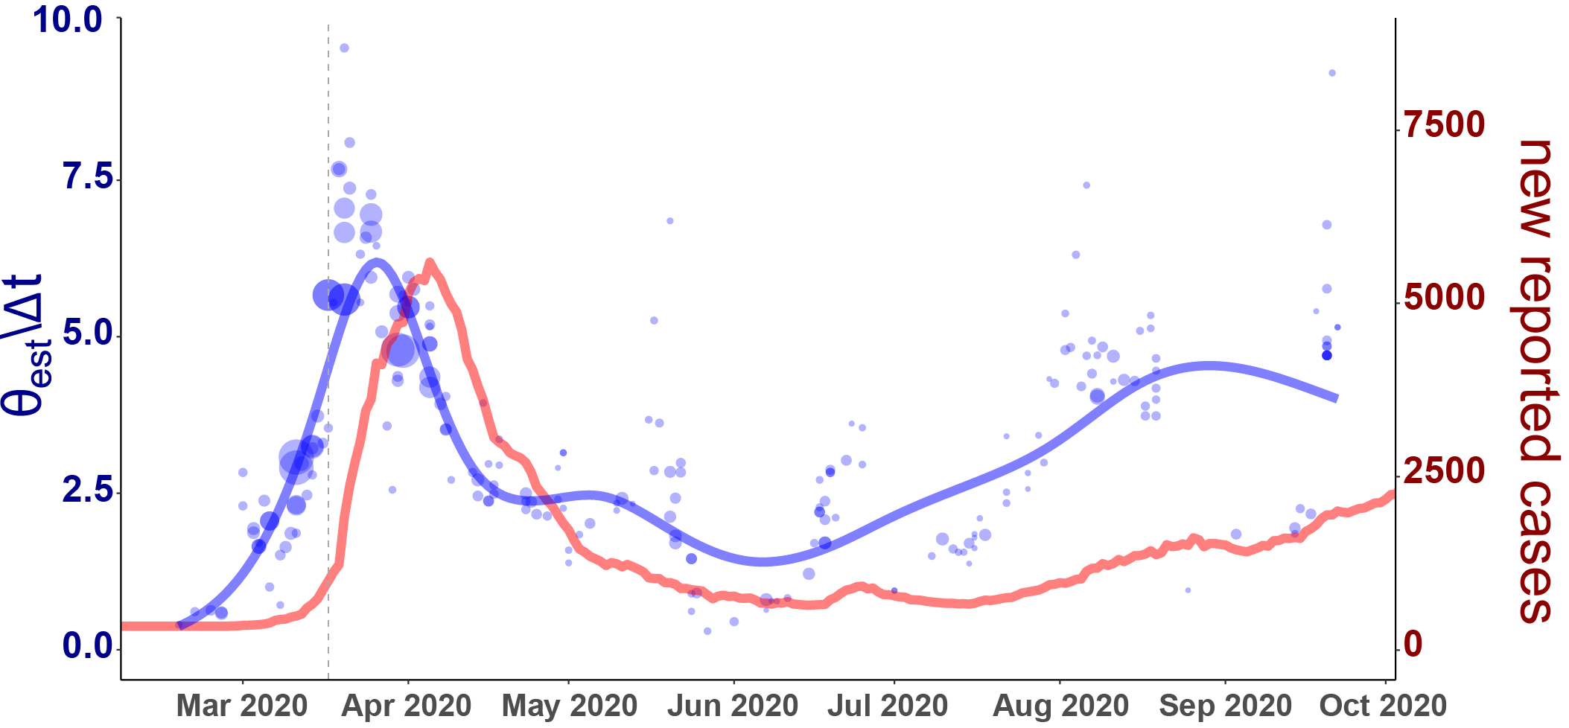
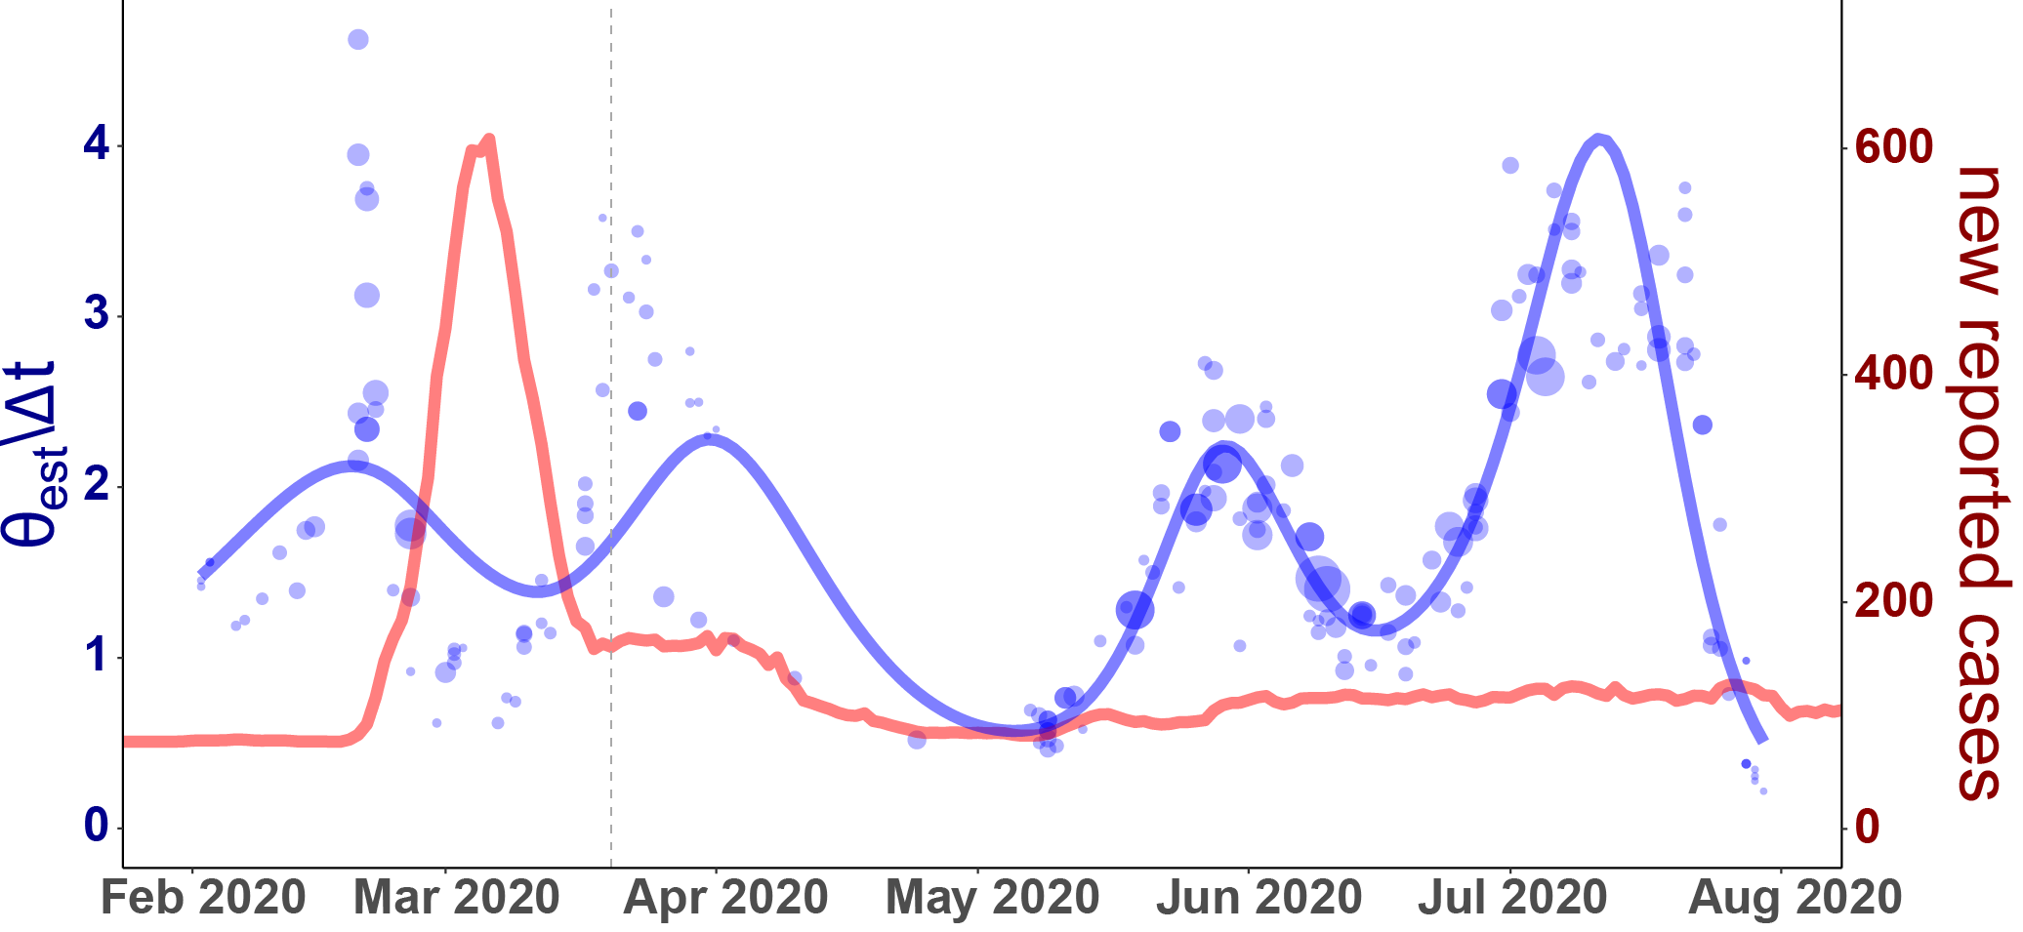
Applications: Other countries
Testing capacities are increased
(W14-W20)
Facemasks in-doors and publ. places
UK
Testing capacities are further increased
(W26-W37)
Testing capacities are increased
Germany
South Korea
(no lock down)

Slide 11
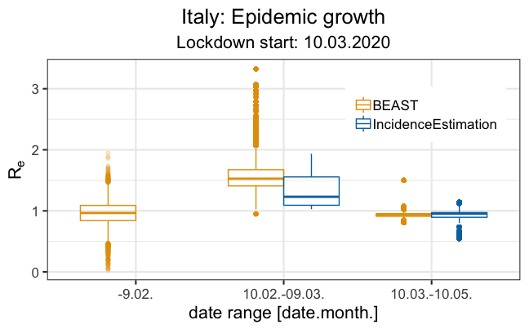
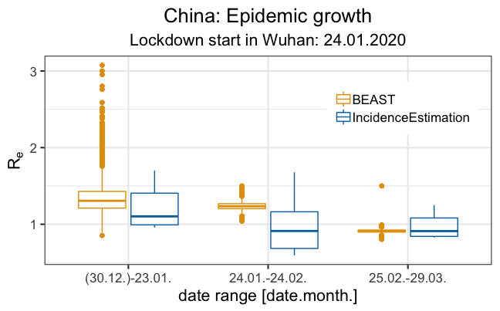
Method verification: Part III
-->- Comparison with BEAST: R₀ -<--

Slide 12
Summary
Fast method for incidence reconstruction (~min)
Works:
for simulated data,
makes sense for actual data
Compares with established tools (BEAST)
Works on large data sets (UK; 40,000~Sequences)
Valuable as an additional parameter for outbreak surveillance
Publication: manuscript in preparation
Disclaimer
Sequencing currently too slow for real time epidemiological tracking.
Towards massive- and timely sequencing: UK/PHE shows us how this could be done in the future.

Slide 13
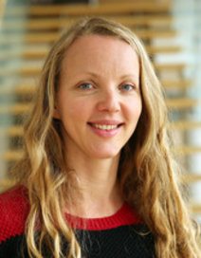
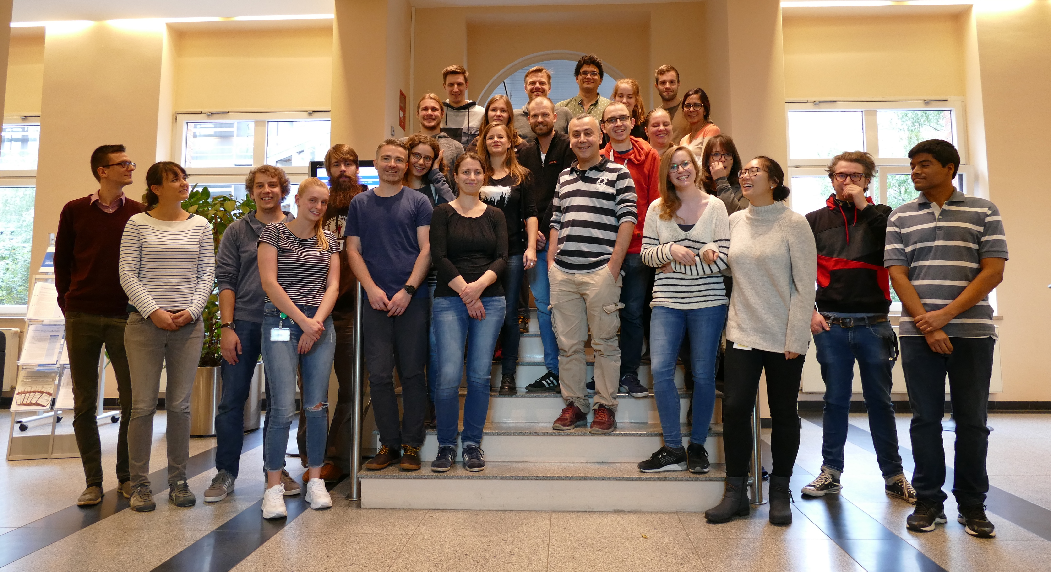
Acknowledgements
deCOI (www.decoi.eu)
(German COVID-Omics Initiative)
GISAID
www.gisaid.org
Robert-Koch Institute
Maria Trofimova
Dr. Maureen Smith
Max-Planck Institute SHH
Ariane Weber
Dr. Denise Kühnert
MF1 Team
Fuchs
Drechsel
Kmicienski
SARS-CoV2 MolSurv
Wolff (RKI-FG18), Haas, Kröger (RKI-FG36)
Nitsche (RKI-ZBS1), Thürmer, Radonic (RKI-MF2)
Drosten Lab (Charité)

Slide 14
We are looking for excellent data scientists!
New center for data science and artificial intelligence in public health research
!About 44 permanent positions for data scientists at all levels!

Slide 15
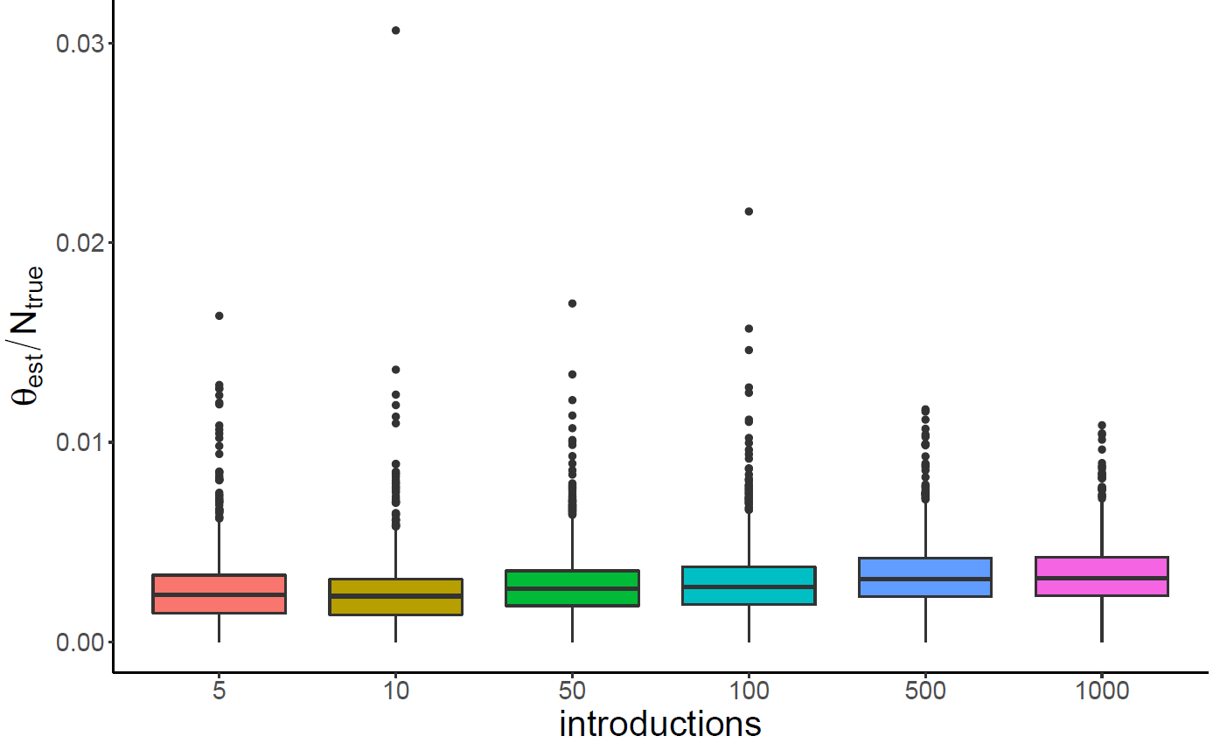
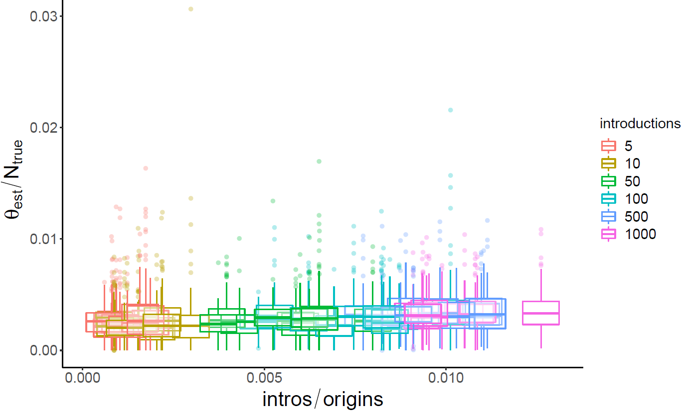
Extra Slides: Introductions

Slide 16
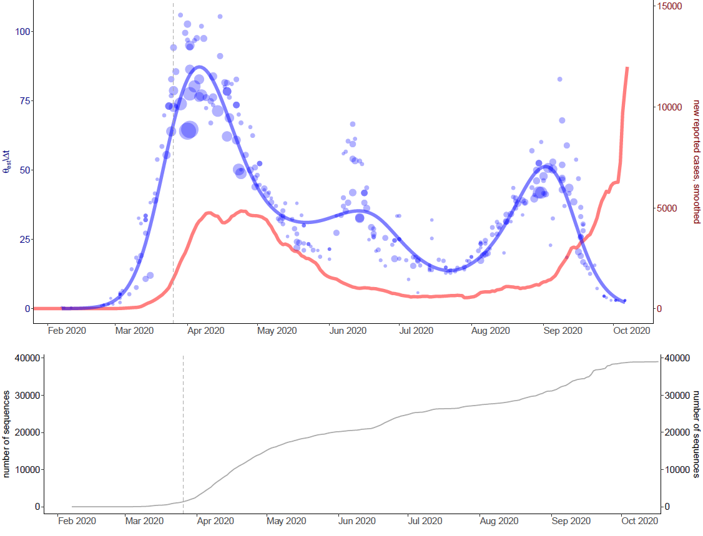
UK

Slide 17
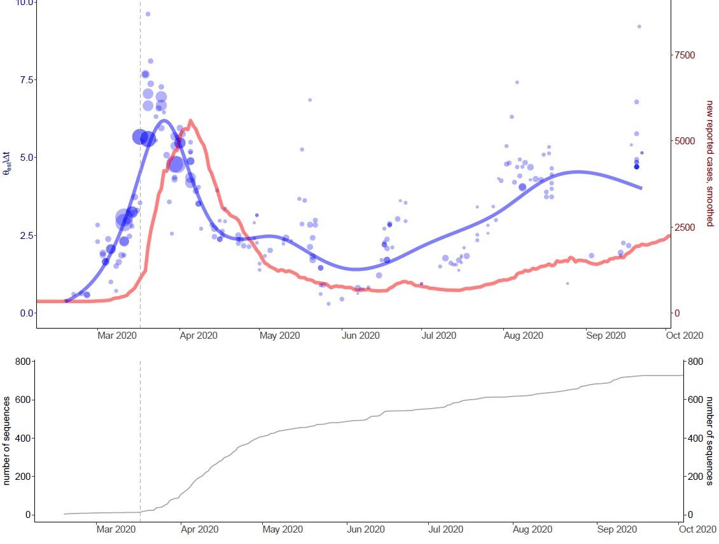
Germany

Slide 18
MCC trees

