Slide 1
Top 10 Länder nach Anzahl neuer Fälle in den letzten 7 Tagen
47.093.220 Fälle
1.297.2790 Verstorbene (2,6%)
Land | Fälle kumulativ | Neue Fälle in den letzten 7T | Veränderung % (7T) | 7d-Inzidenz/ 100.000 Ew | R (7T) | CFR % | Trend
Vereinigte Staaten | 9.291.245 | 586.721 | 19,8 | 178,3 | 1,13 | 2,49 | ▲
Indien | 8.267.623 | 321.194 | -8,06 | 23,51 | 0,95 | 1,49 | ▼
Frankreich | 1.466.433 | 301.155 | 18,1 | 449,4 | 1,13 | 2,55 | ▲
Italien | 731.588 | 188.799 | 58,37 | 312,79 | 1,33 | 5,34 | ▲
Großbritannien | 1.053.864 | 159.174 | 3,71 | 238,83 | 1,04 | 4,45 | ▲
Brasilien | 5.554.206 | 144.352 | -9,29 | 68,4 | 0,89 | 2,89 | ▼
Spanien | 1.240.697 | 142.377 | 14,94 | 303,34 | 1,1 | 2,92 | ▲
Polen | 395.480 | 131.551 | 63,05 | 346,43 | 1,33 | 1,49 | ▲
Russische Föderation | 1.655.038 | 123.814 | 6,82 | 84,88 | 1,06 | 1,72 | ▲
Deutschland | 560.379 | 111.104 | 45,98 | 133,83 | 1,25 | 1,9 | ▲
Quelle: ECDC, Stand: 03.11.2020

Slide 2
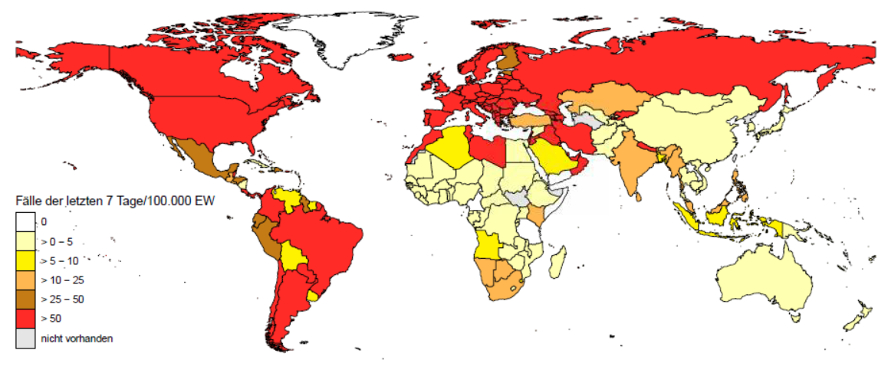
7-Tages-Inzidenz pro 100.000 Einwohner
Europa (nicht EU/EWR/UK/CH)
Land | Inzidenz 7T
Andorra | 739,07
Armenien | 485,71
Montenegro | 369,83
Bosnien und Herzegowina | 322,72
Nordmazedonien | 279,13
Georgien | 261,51
San Marino | 220,59
Monaco | 196,46
Kosovo | 139,39
Serbien | 134,67
Republik Moldau | 122,82
Ukraine | 121,09
Gibraltar | 109,77
Russische Föderation | 84,88
Albanien | 72,6
Weißrussland | 70,81
Aserbaidschan | 65,23
81 Länder/Territorien mit einer 7-Tages-Inzidenz > 50 Fälle / 100.000 Ew.
Afrika
Amerika
Asien
Land | Inzidenz 7T
Libyen | 83,87
Cabo Verde | 83,46
Tunesien | 81,29
Marokko | 69,44
Land | Inzidenz 7T
Argentinien | 180,5
Vereinigte Staaten | 178,3
Puerto Rico | 172,15
Kolumbien | 135,49
Costa Rica | 134,66
Sint Maarten (NL) | 129,75
Panama | 121,61
Belize | 108,62
Aruba | 97,83
Curaçao | 74,65
Bahamas | 69,07
Brasilien | 68,4
Paraguay | 64,76
Kanada | 53,59
Chile | 50,6
Land | Inzidenz 7T
Jordanien | 264,19
Libanon | 167,9
Kuwait | 118,28
Bahrain | 97,49
VAE | 91,16
Palästina | 90,44
Iran | 65,04
Israel | 60,24
Irak | 59,28
Nepal | 58,27
Oman | 56,24
Kirgisistan | 55,19
Katar | 52,44
Ozeanien
Land | Inzidenz 7T
Französisch Polynesien | 502,35
Guam | 213,4
Quelle: ECDC, Stand: 03.11.2020

Slide 3
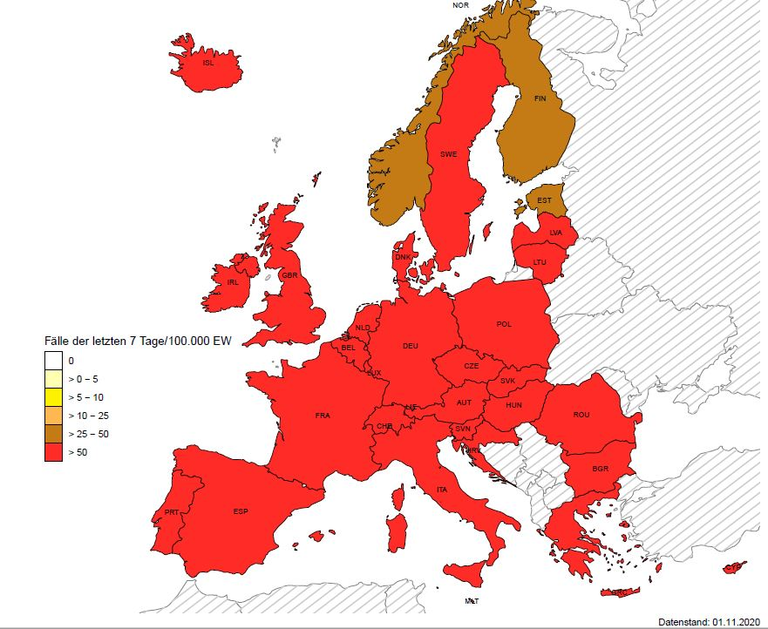
7-Tages-Inzidenz pro 100.000 Einwohner – EU/EWR/UK/CH
Europa (EU/EWR/UK/CH)
Land | Inzidenz 7T
Tschechische Republik | 791,61
Luxemburg | 720,49
Belgien | 626,17
Slowenien | 589,1
Liechtenstein | 557,26
Frankreich | 502,89
Niederlande | 415,04
Kroatien | 405,23
Polen | 376,74
Österreich | 318,08
Italien | 309,39
Slowakei | 302,68
Spanien | 297,3
Portugal | 289,8
Großbritannien | 244,92
Ungarn | 236,54
Bulgarien | 218,31
Litauen | 204,16
Rumänien | 187,75
Malta | 183,09
Deutschland | 135,14
Zypern | 131,94
Island | 124,97
Dänemark | 119,53
Griechenland | 109,05
Irland | 105,26
Schweden | 97,9
Lettland | 86,33
Norwegen | 74,32
Land | Inzidenz 7T
Estland | 46,65
Finnland | 25,92
Quelle: ECDC, Stand: 03.11.2020
Notes:
Norwegen dazu gekommen

Slide 4
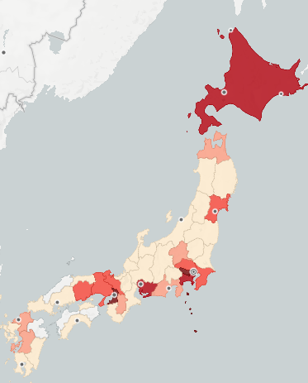
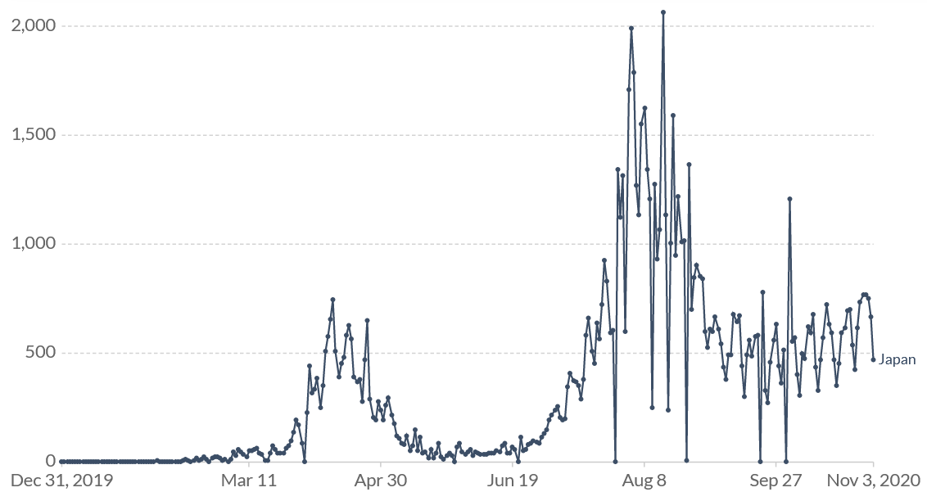
COVID-19/ Japan
102.281 Fälle (ECDC, 03.11.2020)
1.780 Todesfälle (Fallsterblichkeit : 1,74%)
7T-Inzidenz /100.000 Ew.: 3,77
Fälle 7T: 4.783
R eff 7T: 1,11
Testrate / 100.000 Ew / Tag: 17
Testpositivität: 3,1% (Our World in Data; 29.10., 7-day rolling average)
„Clusters of cases“
(WHO SitRep, 27.10.)
Stand 03.11.
16.01.: erster Fall aus Wuhan importiert
bestätigte Fälle / Tag; Stand 03.11.
Notes:
Fallzahlen: ECDC
https://ourworldindata.org/coronavirus/country/japan?country=~JPN
https://covid19japan.com/

Slide 5
COVID-19/ Japan
Überblick der Maßnahmen
relativ „locker“ (Government Response Stringency Index, 38.89 / 100; Stand 03.11.)
Auf Präfektur-Ebene eingeführt
Frühe Reisebeschränkungen, Massenveranstaltungsverbot und Schulschließungen
Relativ strenge Reisebeschränkungen: Einreiseverbot („foreign nationals“) für viele Länder; 14-Tage Quarantäne und Test für Einreisende Bürger aus vielen Ländern
Kein social distancing, aber „three Cs“ sollten vermieden werden:
Closed spaces with poor ventilation
Crowded spaces
Close-contact settings (ex. close-range conversations)
Relativ wenig Testung im Vergleich zu vielen Ländern (17 / 100.000 Ew vs. DE 207 / 100.000 Ew)
„Cluster-based“ approach; Cluster Response Teams
Gute Kommunikation bzw. Bereitstellung von Informationen für die Öffentlichkeit (über z.B. Fallzahlen, Ausbrüche, Prognosen, Maßnahmen usw.)
Notes:
https://www.who.int/publications/m/item/weekly-epidemiological-update---27-october-2020
https://thediplomat.com/2020/04/covid-19-strategy-the-japan-model/
https://www.japan.travel/en/coronavirus/#measures_government
https://www.japantimes.co.jp/news/2020/11/04/world/contact-tracers-eye-cluster-busting-tackle-covid-19s-new-surge/

Slide 6
COVID-19/ Japan: Zusammenfassung
SARS Erfahrung (2002-2004)
Schnelle / früh Einführung von Maßnahmen (z.B. Reisebeschränkungen)
Hohe Compliance der Bevölkerung bei Empfehlungen /Maßnahmen
Breite Akzeptanz /Nutzung von Masken
Wenig Testung im Vergleich zu vielen Ländern ( „cluster approach“)
Insel / Reisebeschränkungen

Slide 7
Hintergrund

Slide 8
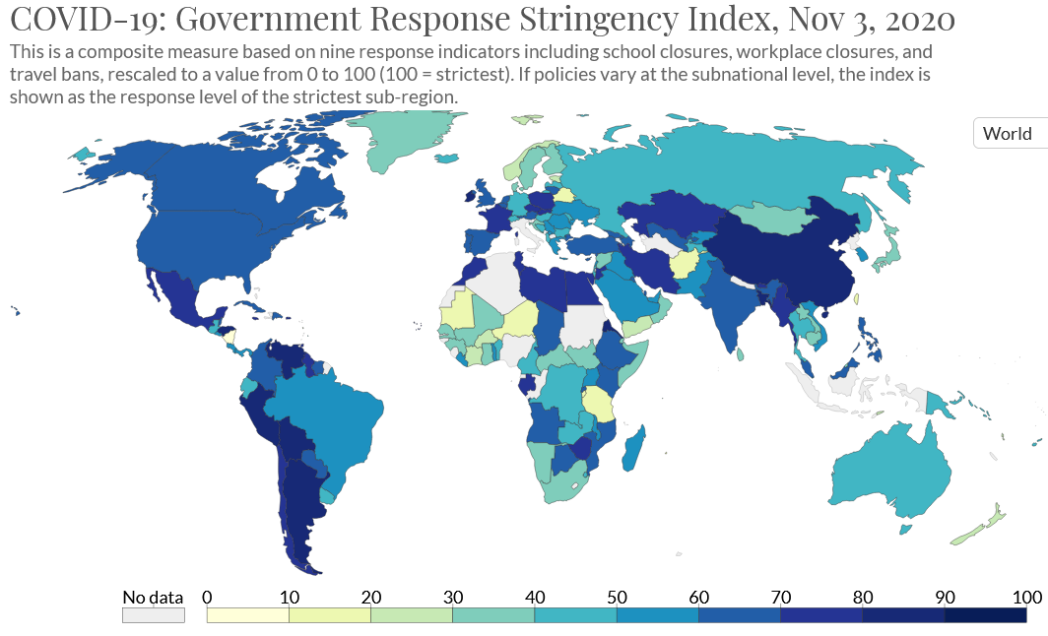
Stringency Index
Notes:
https://ourworldindata.org/grapher/covid-stringency-index?time=2020-11-02

Slide 9
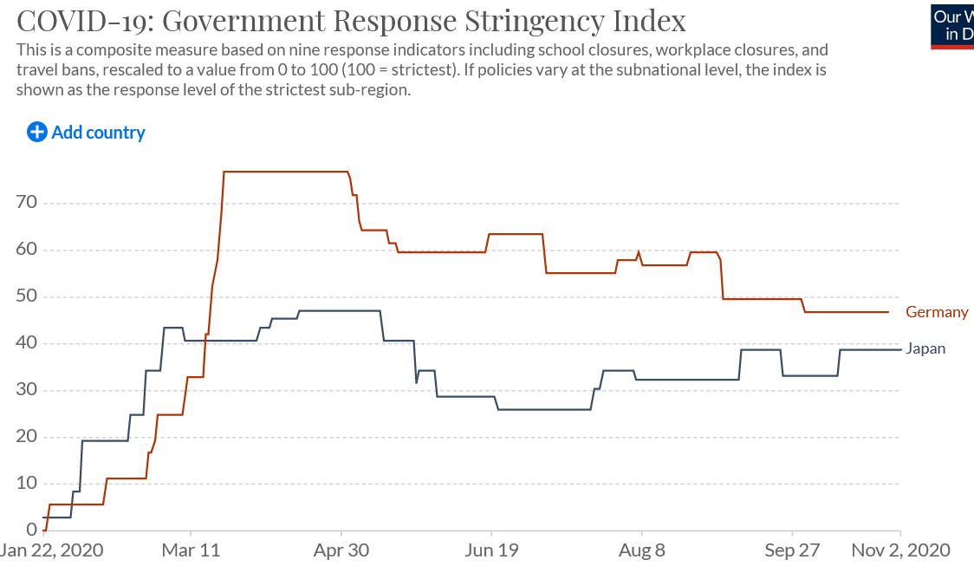
Stringency Index
Notes:
https://ourworldindata.org/grapher/covid-stringency-index?time=2020-11-02

Slide 10
Stringency Index
Stringency Index (OxBSG)
Variable time span Jan 1, 2020 – Nov 2, 2020
Link https://www.bsg.ox.ac.uk/research/research-projects/oxford-covid-19-government-response-tracker
The specific policy and response categories are coded as follows:
School closures:
0 - No measures
1 - recommend closing
2 - Require closing (only some levels or categories,
eg just high school, or just public schools)
3 - Require closing all levels
No data - blank
Workplace closures:
0 - No measures
1 - recommend closing (or work from home)
2 - require closing (or work from home) for some
sectors or categories of workers
3 - require closing (or work from home) all but essential workplaces (eg grocery stores, doctors)
No data - blank
Cancel public events:
0- No measures
1 - Recommend cancelling
2 - Require cancelling
No data - blank
Restrictions on gatherings:
0 - No restrictions
1 - Restrictions on very large gatherings (the limit is above 1000 people)
2 - Restrictions on gatherings between 100-1000 people
3 - Restrictions on gatherings between 10-100 people
4 - Restrictions on gatherings of less than 10 people
No data - blank
Close public transport:
0 - No measures
1 - Recommend closing (or significantly reduce volume/route/means of transport available)
2 - Require closing (or prohibit most citizens from using it)
Public information campaigns:
0 -No COVID-19 public information campaign
1 - public officials urging caution about COVID-19
2 - coordinated public information campaign (e.g. across traditional and social media)
No data - blank
Stay at home:
0 - No measures
1 - recommend not leaving house
2 - require not leaving house with exceptions for daily exercise, grocery shopping, and ‘essential’ trips
3 - Require not leaving house with minimal exceptions (e.g. allowed to leave only once every few days, or only one person can leave at a time, etc.)
No data - blank
Restrictions on internal movement:
0 - No measures
1 - Recommend movement restriction
2 - Restrict movement
International travel controls:
0 - No measures
1 - Screening
2 - Quarantine arrivals from high-risk regions
3 - Ban on high-risk regions
4 - Total border closure
No data - blank
Testing policy
0 – No testing policy
1 – Only those who both (a) have symptoms AND (b) meet specific criteria (eg key workers, admitted to hospital, came into contact with a known case, returned from overseas)
2 – testing of anyone showing COVID-19 symptoms
3 – open public testing (eg “drive through” testing available to asymptomatic people)
No data
Contract tracing
0 - No contact tracing
1 - Limited contact tracing - not done for all cases
2 - Comprehensive contact tracing - done for all cases
No data
Face coverings
0- No policy
1- Recommended
2- Required in some specified shared/public spaces outside the home with other people present, or some situations when social distancing not possible
3- Required in all shared/public spaces outside the home with other people present or all situations when social distancing not possible
4- Required outside the home at all times regardless of location or presence of other people
Notes:
https://ourworldindata.org/grapher/covid-stringency-index?time=2020-11-02

Slide 11
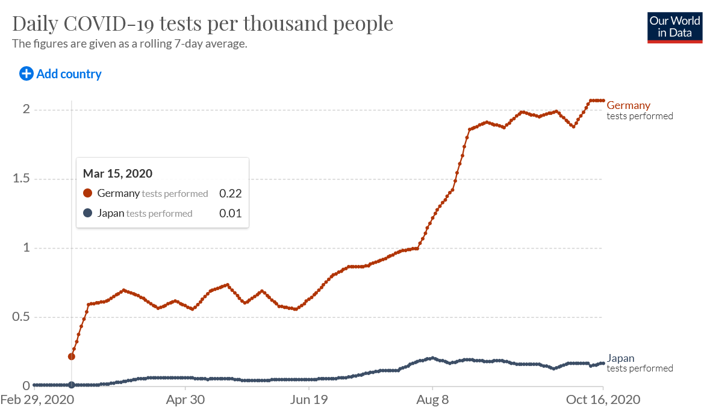
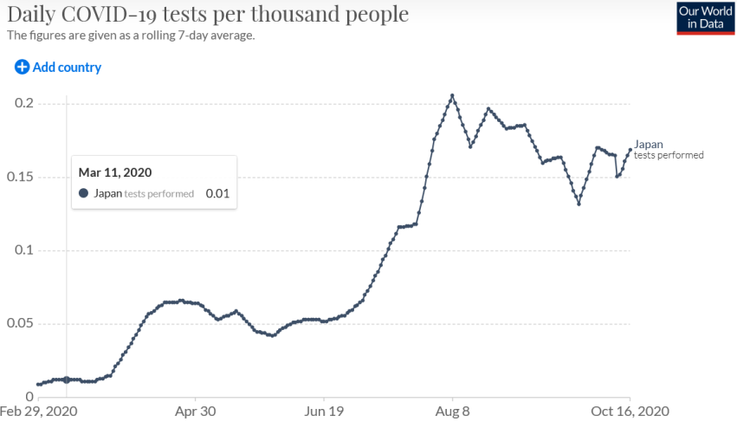
COVID-19/ Japan, Testung
Notes:
https://ourworldindata.org/coronavirus/country/japan?country=~JPN
In Japan, countermeasures have been taken based on an analysis of COVID-19, which is characterized by a large proportion of asymptomatic cases among the infected. Most of these asymptomatic cases do not spread the infection, but a small proportion of them — so called super-spreaders — infect multiple people, resulting in a pattern of clusters of new infections.
Based on this scientific finding, Japan decided to prioritize preventing clusters from spawning new clusters by retroactively tracing the chain of transmission. Under this strategy, the Japanese government conducts rigorous contact tracing; therefore, given its finite testing capacity, Japan’s testing operations are focused on potential and identified clusters as opposed to mass testing.
Japan’s unique testing policy has been criticized both within and outside of the country, despite the low number of deaths in this country. There is a concern that the actual status of the epidemic in Japan may be inadequately captured, primarily because of the small number of PCR tests. However, compared to other countries, the positivity rate in Japan (the number of positive PRC test results as a percentage of total PCR tests performed) is relatively low at 5.5 percent (compared to 6.0 percent in Germany, 17.4 percent in the United States, and 26.9 percent in the United Kingdom), indicating that Japan has been adequately detecting COVID-19 cases.
https://www.japantimes.co.jp/opinion/2020/06/28/commentary/japan-commentary/japans-pragmatic-approach-covid-19-testing/
Covid app

