Slide 1
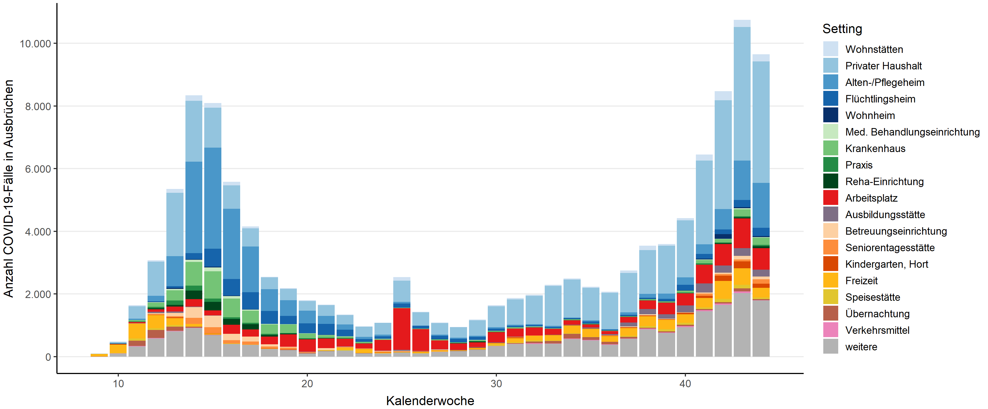
Cases assigned to an outbreak, by infection environment (setting) and calendar week (time of notification of each case)
(As of 03.11.2020, 0:00)
Residences
Private Household
Nursing homes
Refugee home
Dormitory
Health Care Facility
Hospital
Practice
Rehab facility
Work place
Vocational training institute
Care facility
Day care center for the elderly
Day care for children
Freetime
Gastronomy
Lodging
Transport
Other
Number of COVID-19 cases in outbreaks
Calendar week

