Slide 1
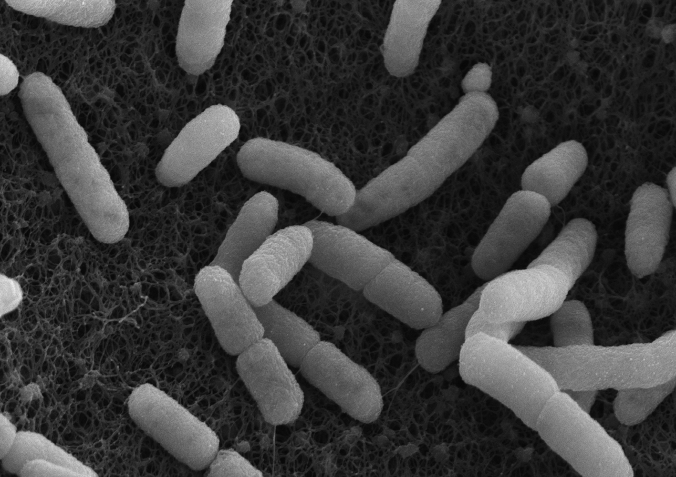
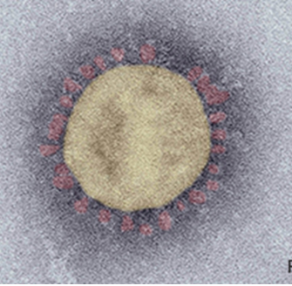
Umbrella Review:
Risk groups for severe COVID-19 disease (hospitalisation and death)
Thomas Harder (für FG33)

Slide 2
Umbrella review: Methods
Principle:
  Meta-synthesis of existing systematic reviews in situations when multiple reviews on a particular topic are available
  Effective use of existing resources; time-sparing approach
Search and inclusion of reviews:
  COVID-19 data base of RKI library
  Systematic reviews with/without meta-analysis
  Investigated association between comorbidity and severe COVID-19
Extraction and mapping of primary studies:
  Primary studies were extracted when conducted in Europe or USA
  Only studies which report adjustment for age were included
Pooling of estimates:
  Estimates reported in the primary studies were pooled using meta-analytic techniques (random-effect models)
Assessment of confidence in the pooled estimates:
  GRADE Methodology for risk factor studies

Slide 3
Umbrella review: Overview of Results
Search and selection of systematic reviews:
  Last search: 25 September 2020
  96 systematic reviews selected based on title and abstract
    44 reviews excluded because contained exclusively studies from Asia
    52 reviews were used to extract primary studies
Selection of primary studies:
  196 studies extracted based on the region: USA, Europe
  70 primary studies report age-adjusted estimates
  32 report hospitalisation, in-hospital mortality, ICU admission, intubation
  all: cohort studies

Slide 4
Umbrella review: Risk of hospitalization (I)
Disease | Estimate (95%CI) | I² (%) | Studies | # patients | GRADE Quality
Heart/Circulation
Arrhythmia or Atrial fibrillation | 1.38 (1.20-1.71) | 0.00 | 2 | 9841 | +++
Congestive heart failure | 2.60 (1.56-4.34) | 62.86 | 4 | 16292 | +++
Coronary artery disease | 1.08 (0.81-1.44) | NA | 1 | 5279 | +++
Hypertension | 1.74 (1.57-1.93) | 0.00 | 5 | 16614 | ++++
Cardiovascular (composite) | 1.89 (1.34-2.65) | 87.07 | 5 | 12024 | +++
Metabolism
Diabetes | 2.09 (1.83-2.38) | 12.32 | 6 | 17303 | ++++
Hyper- or Dyslipidemia | 0.63 (0.53-0.74) | 0.00 | 2 | 5601 | ++++
Obesity | 1.94 (1.73-2.18) | 0.00 | 5 | 16251 | ++++
Chronic kidney disease | 2.24 (1.28-3.90) | 83.7 | 4 | 15809 | +++
Chronic liver disease | 1.30 (1.10-1.60) | NA | 1 | 500 | +++

Slide 5
Umbrella review: Risk of hospitalization (I)
Disease | Estimate (95%CI) | I² (%) | Studies | # patients | GRADE Quality
Heart/Circulation
Arrhythmia or Atrial fibrillation | 1.38 (1.20-1.71) | 0.00 | 2 | 9841 | +++
Congestive heart failure | 2.60 (1.56-4.34) | 62.86 | 4 | 16292 | +++
Coronary artery disease | 1.08 (0.81-1.44) | NA | 1 | 5279 | +++
Hypertension | 1.74 (1.57-1.93) | 0.00 | 5 | 16614 | ++++
Cardiovascular (composite) | 1.89 (1.34-2.65) | 87.07 | 5 | 12024 | +++
Metabolism
Diabetes | 2.09 (1.83-2.38) | 12.32 | 6 | 17303 | ++++
Hyper- or Dyslipidemia | 0.63 (0.53-0.74) | 0.00 | 2 | 5601 | ++++
Obesity | 1.94 (1.73-2.18) | 0.00 | 5 | 16251 | ++++
Chronic kidney disease | 2.24 (1.28-3.90) | 83.7 | 4 | 15809 | +++
Chronic liver disease | 1.30 (1.10-1.60) | NA | 1 | 500 | +++

Slide 6
Umbrella review: Risk of hospitalization (II)
Disease | Estimate (95%CI) | I² (%) | Studies | # patients | GRADE Quality
Cancer
Cancer | 1.15 (0.83-1.59) | 27.5 | 3 | 10893 | +++
Cancer + Neoplasm composite | 1.27 (1.07-1.49) | 0.00 | 4 | 11582 | ++++
Lung
Asthma | 1.64 (1.14-2.36) | 0.00 | 3 | 2063 | +++
COPD | 1.78 (1.11-2.86) | 0.00 | 3 | 2063 | +++
Respiratory disease composite | 1.45 (1.16-1.80) | 49.33 | 6 | 17303 | +++
CNS
Cerebrovascular disease or Stroke | 1.30 (1.03-1.64) | 0.00 | 2 | 9841 | ++++
Dementia | 0.82 (0.41-1.65) | 93.35 | 2 | 111510 | ++
Immunodeficiency
Autoimmune condition | 1.08 (1.01-1.17) | NA | 1 | 109367 | +++
Immunodeficiency | 1.14 (0.75-1.75) | NA | 1 | 1542 | +++
Rheumatological disease | 1.40 (1.10-1.80) | NA | 1 | 9519 | +++
Organ transplant history | 2.70 (1.30-5.40) | NA | 1 | 9519 | +++

Slide 7
Umbrella review: Risk of hospitalization (II)
Disease | Estimate (95%CI) | I² (%) | Studies | # patients | GRADE Quality
Cancer
Cancer | 1.15 (0.83-1.59) | 27.5 | 3 | 10893 | +++
Cancer + Neoplasm composite | 1.27 (1.07-1.49) | 0.00 | 4 | 11582 | ++++
Lung
Asthma | 1.64 (1.14-2.36) | 0.00 | 3 | 2063 | +++
COPD | 1.78 (1.11-2.86) | 0.00 | 3 | 2063 | +++
Respiratory disease composite | 1.45 (1.16-1.80) | 49.33 | 6 | 17303 | +++
CNS
Cerebrovascular disease or Stroke | 1.30 (1.03-1.64) | 0.00 | 2 | 9841 | ++++
Dementia | 0.82 (0.41-1.65) | 93.35 | 2 | 111510 | ++
Immunodeficiency
Autoimmune condition | 1.08 (1.01-1.17) | NA | 1 | 109367 | +++
Immunodeficiency | 1.14 (0.75-1.75) | NA | 1 | 1542 | +++
Rheumatological disease | 1.40 (1.10-1.80) | NA | 1 | 9519 | +++
Organ transplant history | 2.70 (1.30-5.40) | NA | 1 | 9519 | +++

Slide 8
Umbrella review: Risk of death (I)
Disease | Estimate (95%CI) | I² (%) | Studies | # patients | GRADE Quality
Heart/Circulation
Atrial fibrillation | 1.37 (1.07-1.74) | 0.00 | 2 | 2704 | ++++
Congestive heart failure | 1.41 (1.09-1.82) | 45.57 | 6 | 8082 | +++
Coronary artery disease | 1.29 (1.09-1.53) | 0.00 | 4 | 5378 | +++
Hypertension | 1.11 (0.98-1.26) | 0.00 | 8 | 8774 | +++
Cardiovascular disease composite | 1.27 (1.13-1.42) | 17.51 | 7 | 8320 | ++++
Metabolism
Hyperlipidemia | 1.01 (0.82-1.22) | 0.00 | 2 | 4216 | +++
Diabetes | 1.37 (1.22-1.56) | 0.00 | 9 | 8388 | ++++
Obesity | 1.82 (1.40-2.37) | 65.76 | 8 | 9379 | +++
Chronic kidney disease | 1.70 (1.46-1.97) | 0.00 | 8 | 8296 | ++++
Chronic liver disease | 1.51 (1.21-1.88) | NA | 1 | 15194 | +++
Chronic liver disease composite | 1.52 (1.23,1.89) | 0.00 | 2 | 16035 | +++

Slide 9
Umbrella review: Risk of death (I)
Disease | Estimate (95%CI) | I² (%) | Studies | # patients | GRADE Quality
Heart/Circulation
Atrial fibrillation | 1.37 (1.07-1.74) | 0.00 | 2 | 2704 | ++++
Congestive heart failure | 1.41 (1.09-1.82) | 45.57 | 6 | 8082 | +++
Coronary artery disease | 1.29 (1.09-1.53) | 0.00 | 4 | 5378 | +++
Hypertension | 1.11 (0.98-1.26) | 0.00 | 8 | 8774 | +++
Cardiovascular disease composite | 1.27 (1.13-1.42) | 17.51 | 7 | 8320 | ++++
Metabolism
Hyperlipidemia | 1.01 (0.82-1.22) | 0.00 | 2 | 4216 | +++
Diabetes | 1.37 (1.22-1.56) | 0.00 | 9 | 8388 | ++++
Obesity | 1.82 (1.40-2.37) | 65.76 | 8 | 9379 | +++
Chronic kidney disease | 1.70 (1.46-1.97) | 0.00 | 8 | 8296 | ++++
Chronic liver disease | 1.51 (1.21-1.88) | NA | 1 | 15194 | +++
Chronic liver disease composite | 1.52 (1.23,1.89) | 0.00 | 2 | 16035 | +++

Slide 10
Umbrella review: Risk of death (II)
Disease | Estimate (95%CI) | I² (%) | Studies | # patients | GRADE Quality
Cancer
Cancer | 1.15 (1.05-1.24) | 0.00 | 4 | 22480 | ++++
Cancer composite | 1.19 (1.10-1.28) | 19.93 | 5 | 22480 | ++++
Lung
Asthma | 0.55 (0.32-0.97) | 0.00 | 2 | 1136 | +++
COPD | 1.15 (1.03-1.29) | NA | 1 | 8582 | +++
Respiratory disease composite | 1.23 (0.76-2.02) | 62.96 | 8 | 4606 | ++
CNS
Stroke | 1.21 (0.82-1.78) | 23.9 | 3 | 2942 | +++
Dementia | 2.24 (1.06-4.72) | 68.06 | 3 | 2796 | +++
Immunodeficiency
Autoimmune condition | 1.19 (1.06-1.33) | NA | 1 | 8582 | +++
Immunosuppressed State | 1.39 (1.13-1.70) | NA | 1 | 2490 | +++
Rheumatological Disease | 0.87 (0.66-1.16) | NA | 1 | 2490 | +++
HIV | 1.32 (0.24-7.36) | NA | 1 | 614 | +++
Organ transplant history | 4.20 (1.60-11.40) | NA | 1 | 2090 | +++

Slide 11
Umbrella review: Risk of death (II)
Disease | Estimate (95%CI) | I² (%) | Studies | # patients | GRADE Quality
Cancer
Cancer | 1.15 (1.05-1.24) | 0.00 | 4 | 22480 | ++++
Cancer composite | 1.19 (1.10-1.28) | 19.93 | 5 | 22480 | ++++
Lung
Asthma | 0.55 (0.32-0.97) | 0.00 | 2 | 1136 | +++
COPD | 1.15 (1.03-1.29) | NA | 1 | 8582 | +++
Respiratory disease composite | 1.23 (0.76-2.02) | 62.96 | 8 | 4606 | ++
CNS
Stroke | 1.21 (0.82-1.78) | 23.9 | 3 | 2942 | +++
Dementia | 2.24 (1.06-4.72) | 68.06 | 3 | 2796 | +++
Immunodeficiency
Autoimmune condition | 1.19 (1.06-1.33) | NA | 1 | 8582 | +++
Immunosuppressed State | 1.39 (1.13-1.70) | NA | 1 | 2490 | +++
Rheumatological Disease | 0.87 (0.66-1.16) | NA | 1 | 2490 | +++
HIV | 1.32 (0.24-7.36) | NA | 1 | 614 | +++
Organ transplant history | 4.20 (1.60-11.40) | NA | 1 | 2090 | +++

Slide 12
Cluster analysis: Aim and Methods
Aim:
  Identification of two groups of comorbidities (high risk vs. moderate risk) which show similarities with regard to severe course of COVID-19
Methods:
  Each comorbidity has two attributes: risk of hospitalization due to COVID-19; risk of death due to COVID-19
  Algorithm (EM algorithm in R) tries to cluster comorbidities into two groups based on these attributes

Slide 13
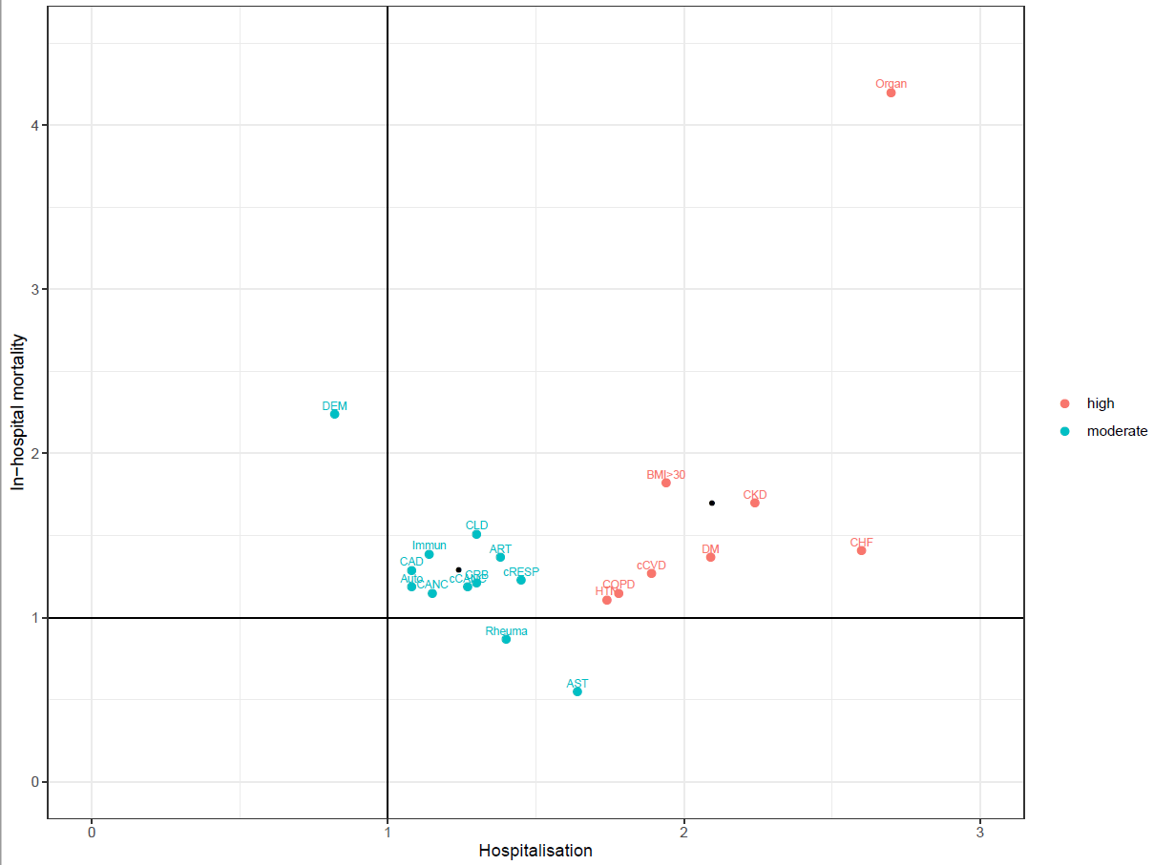
Cluster analysis: Result for comorbidities

Slide 14
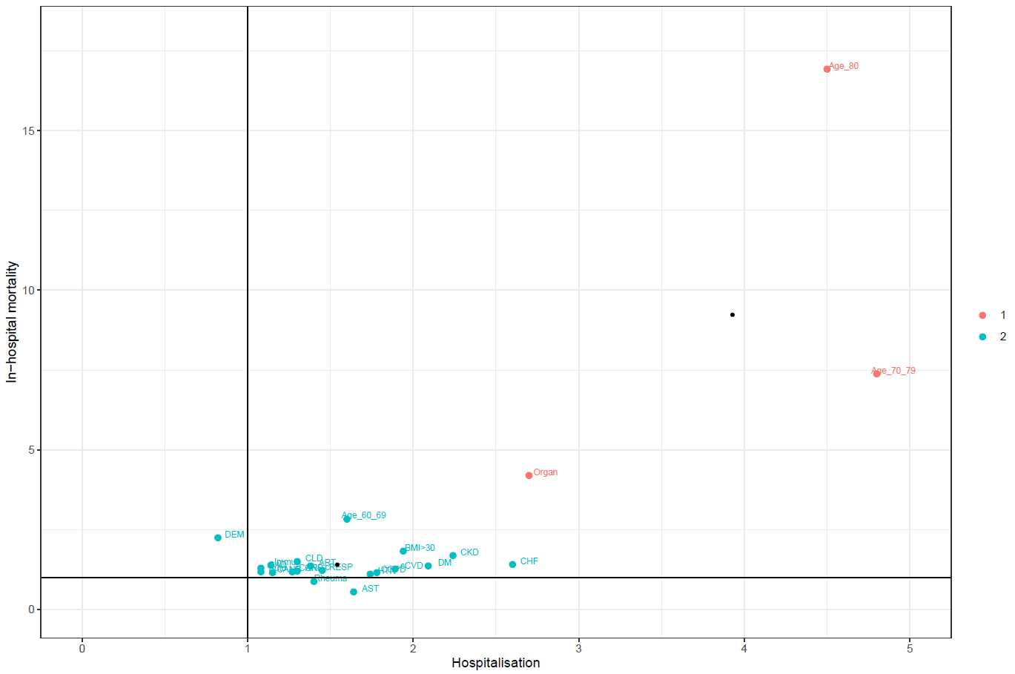
Cluster analysis: Result for comorbidities and age

Slide 15
Summary & Conclusion
Umbrella review identified risk of hospitalization and death for a total of 23 comorbidities/disease groups
Cluster analysis was used to identify two clusters of comorbidities (high risk vs moderate risk)
High age (>=80 years) is associated with an even more pronounced risk of severe COVID-19
Data are used to inform STIKO decision on priority groups for vaccination

Slide 16
Vielen Dank!
Fragen?

