Slide 1
Towards a long-term control of COVID-19 at low case numbers - Anwendung auf Deutschland 30.11.2020

Slide 2
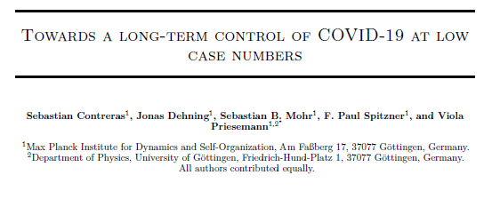
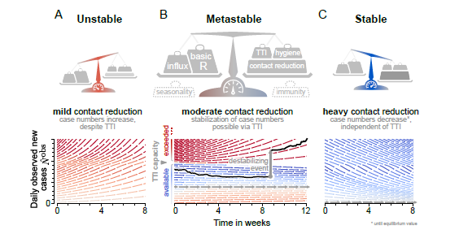

Slide 3
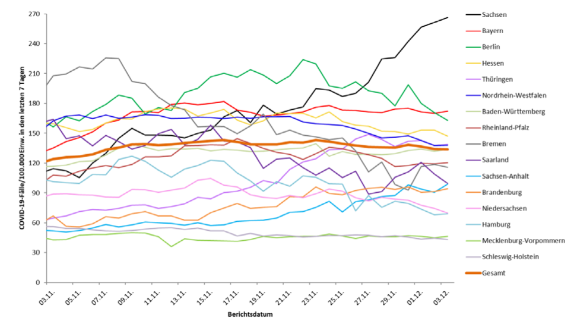
 | Viel zu hoch | Zu hoch | ok
Unstable | ST, BB, TH, SN
Metastable | NI, SL, RP, BW, NW, HE, BY, BE | SH, MV
Stable | HH, HB
Notes:
When the aim is to stay in the metastable regime of low case numbers
below TTI capacity, then only a moderate contact reduction is required to stabilize the system; reoccurring lockdowns are not necessary. Hence, this regime is very promising for a mid- and long-term management of the pandemic, until a vaccination or better treatment of COVID is developed, as it poses the least burden on economy and society.
The alternative option is to stabilize case numbers at higher levels (below the hospital capacity), which requires a stronger contact reduction (about 60%). This is because testing and tracing become less efficient.
However, if case numbers are stabilized at the high level and then need to be lowered, an even stronger contact reduction of 75% over the duration of a lockdown (a few weeks) is necessary to achieve a suppression of the spread.

Slide 4
Last für Gesellschaft
Durchseuchung - Containment - Eradikation
Frankreich
Spanien
Italien
Ökonomische Last
Finnland
Südkorea
Taiwan
Vietnam
USA
Schweden Frühjahr
Schweiz jetzt
China
Neuseel.
Deutschland
BE
BY
SH
MV

Slide 5
Wie jetzt weiter?
Neue Fälle müssen gedrückt werden
Ende des „Stable“ Regime erst wenn < 50 / 100.000 / 7 Tage →
Dann weiterhin Maßnahmen, damit „Metastable“ Regime bleibt
Cave bei Aussage: Schutz der Risikogruppen als Rechtfertigung der Lockerung der Ziele

