Slide 1
NRZ Influenzaviren
Krisenstab 09.12.2020

Slide 2
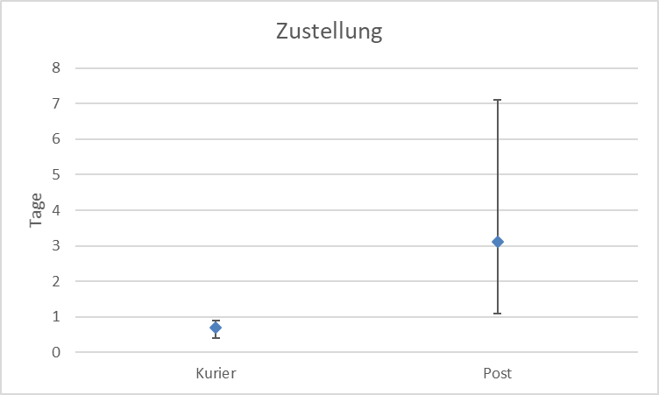
Week | SARS-CoV-2+ | Samples | % positive for SARS-CoV-2
46 | 6 | 86 | 6%
47 | 2 | 97 | 2%
48 | 6 | 96 | 6%
49 | 20 | 166 | 12%
50 | 4 | 39 | 10%

Slide 3
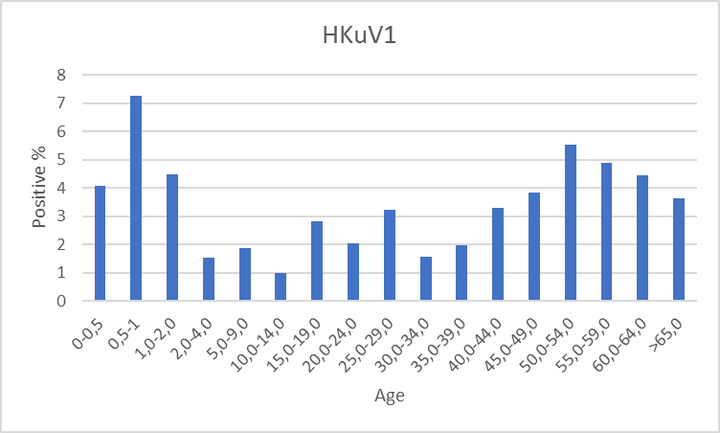
n=3208

Slide 4
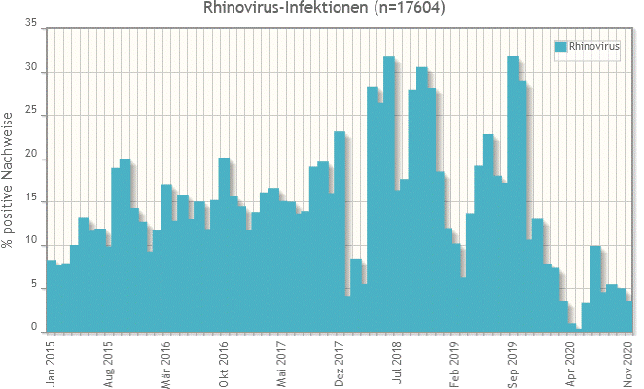

Slide 5
