Slide 1
NRZ Influenzaviren
Krisenstab 15.12.2020

Slide 2
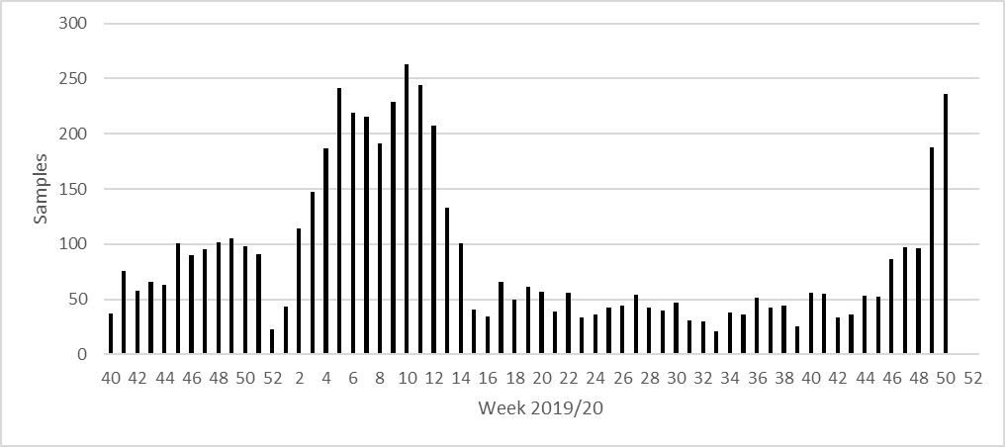
Week | SARS-CoV-2+ | Samples | % positive for SARS-CoV-2
46 | 6 | 86 | 6%
47 | 2 | 90 | 2%
48 | 6 | 94 | 6%
49 | 20 | 188 | 11%
50 | 26 | 236 | 12%
51 | 7 | 30 | 23%
SARS-CoV-2 Diagnostik
Kurier

Slide 3
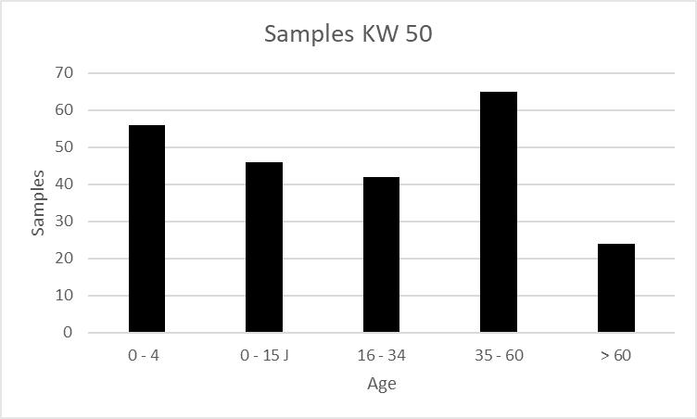
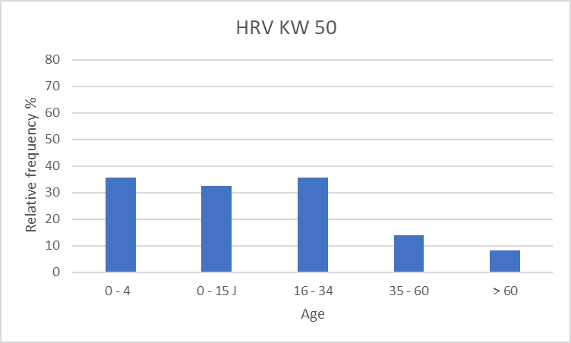
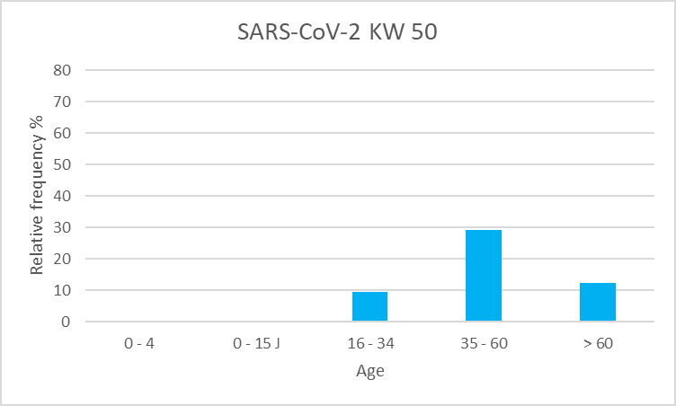
Lockdown
Partieller Lockdown

