Slide 1
NRZ Influenzaviren
Krisenstab 23.12.2020

Slide 2
Week | SARS-CoV-2+ | Samples | % positive for SARS-CoV-2
46 | 6 | 86 | 6%
47 | 2 | 90 | 2%
48 | 6 | 94 | 6%
49 | 20 | 188 | 11%
50 | 28 | 247 | 11%
51 | 15 | 151 | 10%
52 | 5 | 30 | 17%
SARS-CoV-2 Diagnostik
Kurier

Slide 3
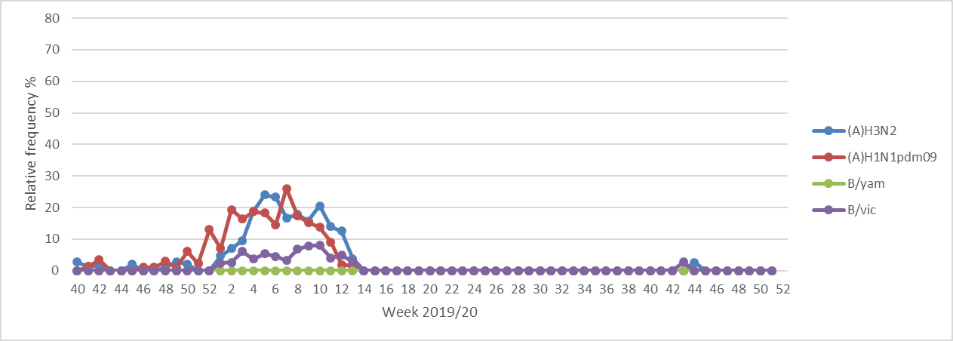
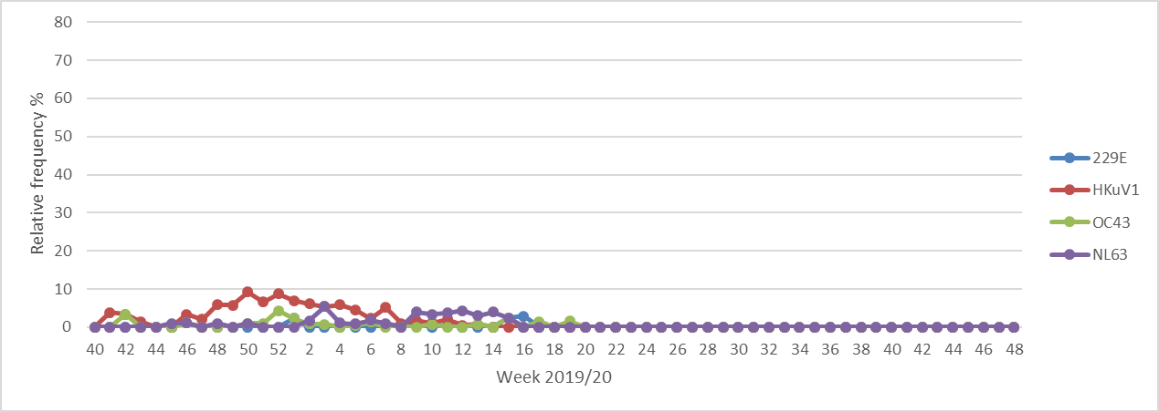
Lockdown
Partieller Lockdown

