Slide 1
NRZ Influenzaviren
Krisenstab 30.12.2020

Slide 2
Week5 | SARS-CoV-2+ | Samples | % positive for SARS-CoV-2
46 | 6 | 86 | 6%
47 | 2 | 90 | 2%
48 | 6 | 94 | 6%
49 | 20 | 188 | 11%
50 | 28 | 247 | 11%
51 | 16 | 186 | 8,6%
52 | 11 | 71 | 15,5%
53 | 1 | 19 | 5,3
SARS-CoV-2 Diagnostik
Kurier

Slide 3
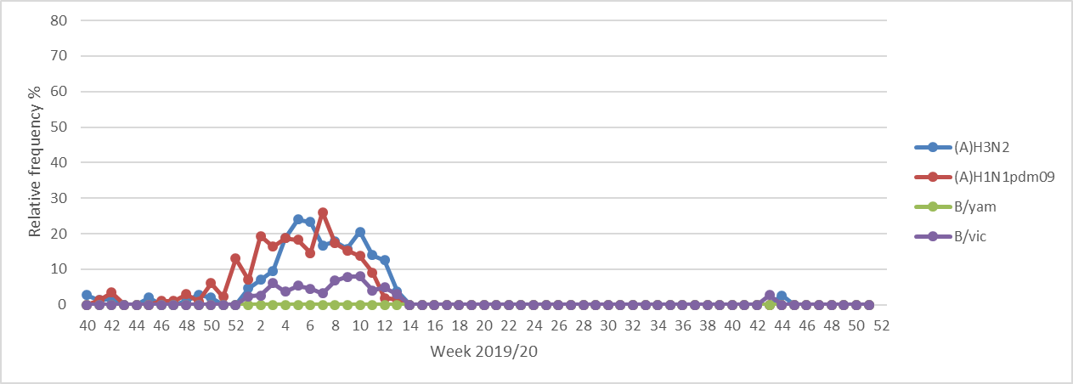
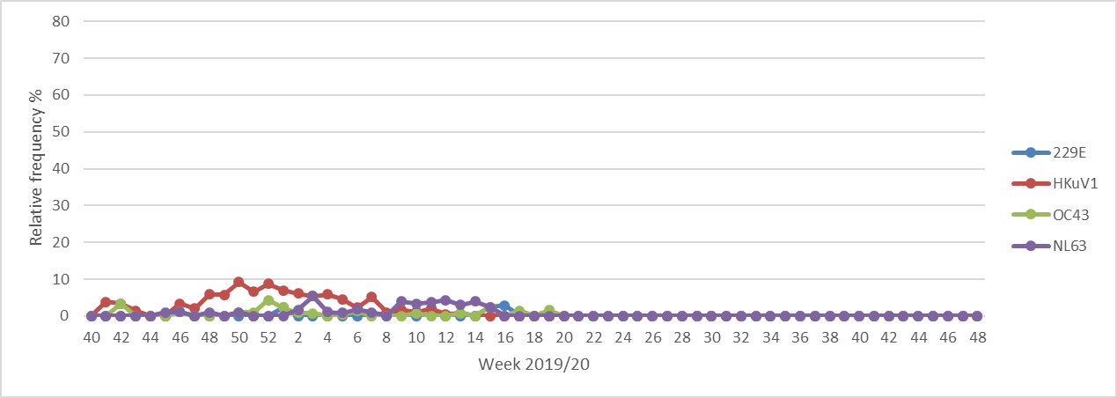
Lockdown
Partieller Lockdown

