Slide 1
Data and information background for the COVID-19 pandemic management
Management of data background
for the monitoring of COVID-19 epidemiology

Slide 2
Components of the ISIN-COVID-19 system: TESTING & EPIDEMIOLOGY
Daily and running reporting
No. of examinations and persons
No. of positive tests/persons
Demography of positive persons
  Age, sex, region
Employment
Place of infection origin – country
Contact, perm./current residence
Place of stay of positive persons
  Home, quarantine, hospital
No. of persons in quarantine
Tracking of positive persons
Tracking of discharged/cured persons
Follow-up sledování
…….
Hospitalised COVID-19 patients
Hospitals
COVID-19: hospital-based care
Patient
Hospitalisation
Progress
ISID
Daily reporting
Public Health Authorities
COVID-19: Public Health Authority (PHA)
Patient / sample
Med. history
Epidemic
COVID-19: laboratory
Labs
Sample
Source
Result
ISID

Slide 3
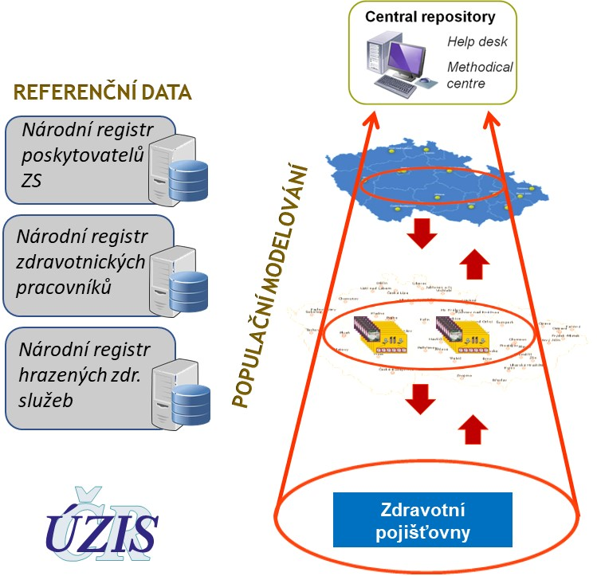
Components of the National Health Information System (NHIS)
Providers
Availability
Bed resources
Equipment
Capacity
REFERENCE DATA
National Registry of Healthcare Providers
National Registry of Health Professionals
National Registry of Reimbursed Health Services
Personnel
Capacity
Competency
Substitution capability
Availability
POPULATION-BASED MODELLING
Health services
Patient pathway
Case progress
Outcomes
Risks
Health insurance companies

Slide 4

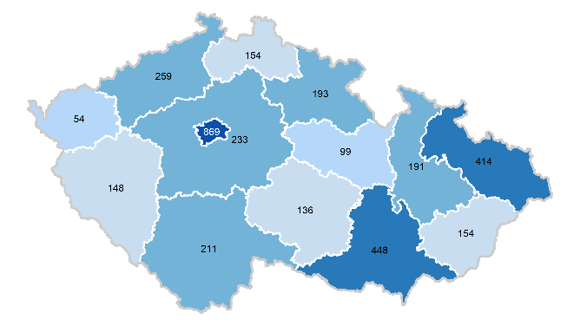
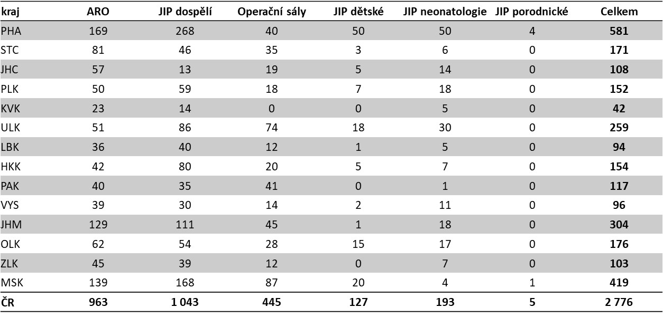
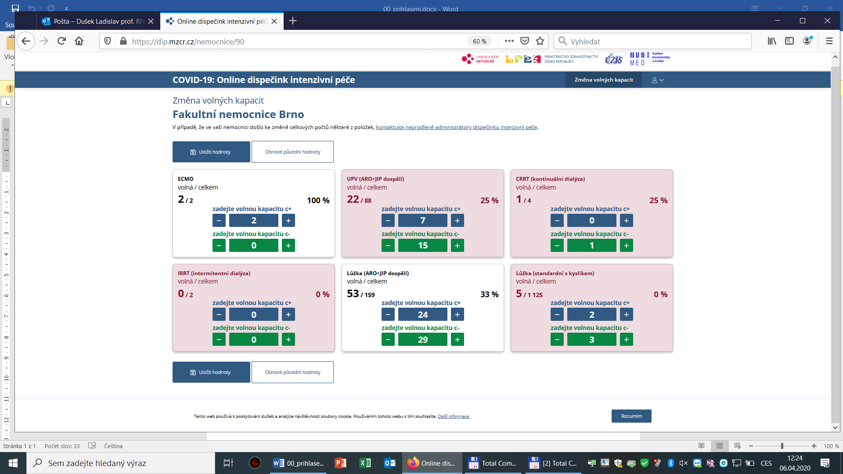



Online controlling of intensive care (CIC)
Reliable communication among regional IC coordinators and coordinators in healthcare facilities
Current capacity of equipment,
beds, and personnel
Overview of capacities according to
region and healthcare facilities
IC coordinators in
healthcare facilities
Regional IC
coordinators
National IC coordinator

Slide 5
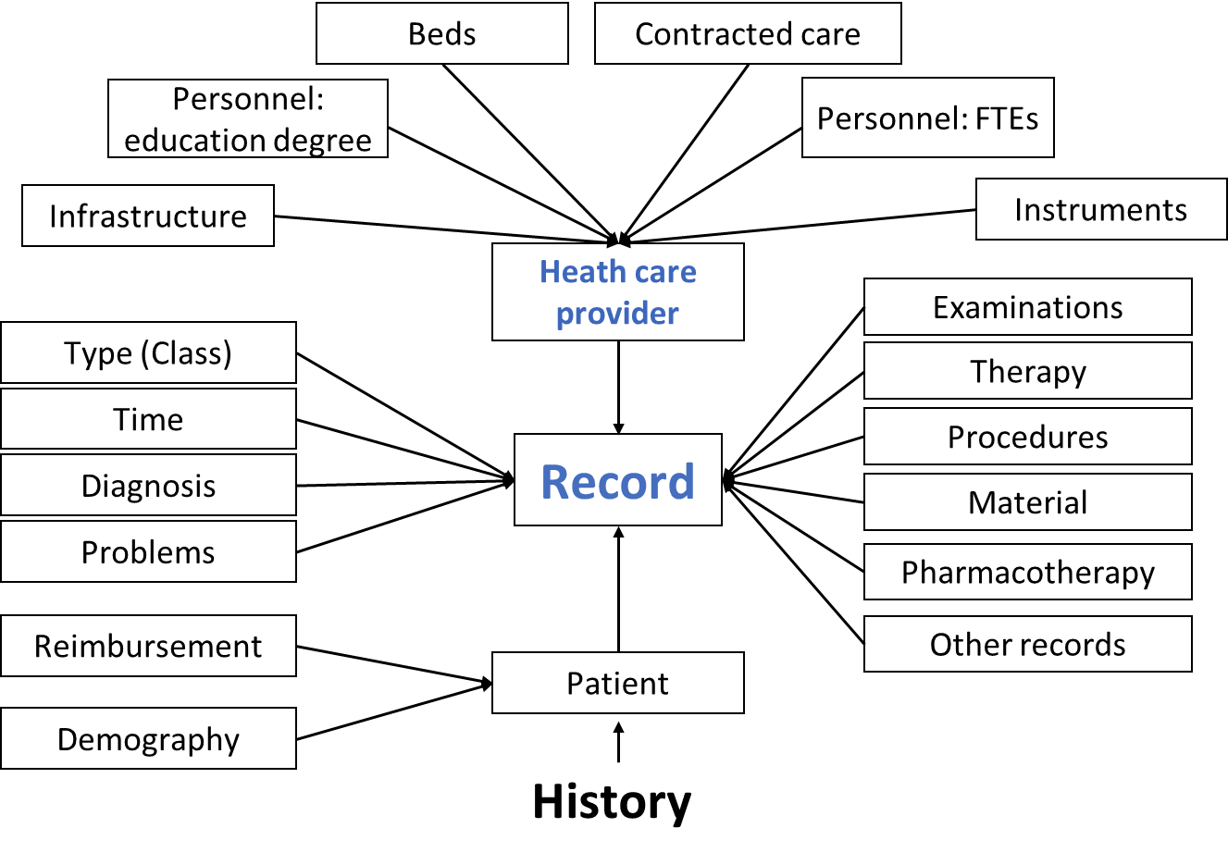
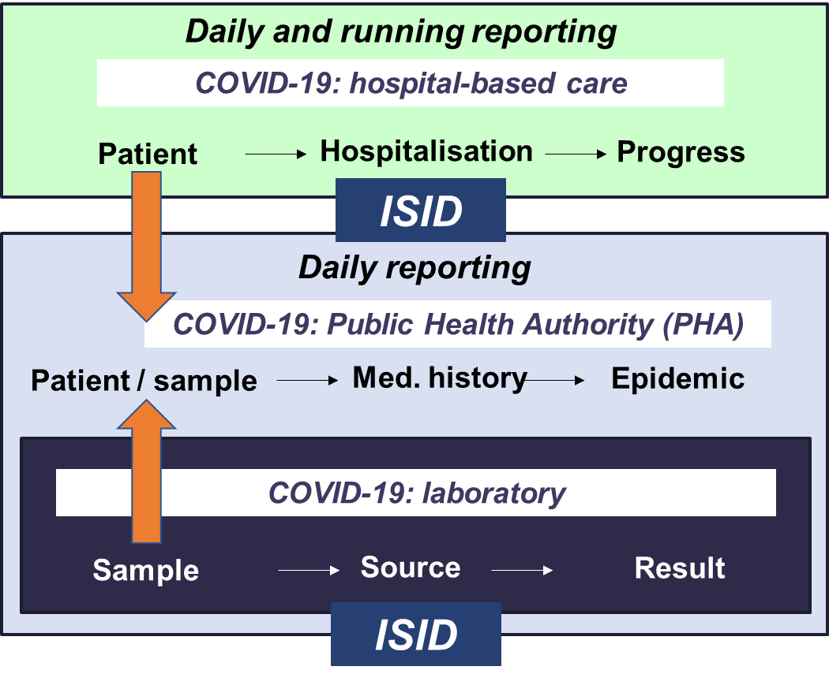
NR H PROF
NR HC PROV
NR HOSP
COVID-19: Online controlling of intensive care
Reporting system for hospitals and regional authorities

Slide 6

System for the early detection of risk trends
Identification of infection clusters and risk trends
Monitoring of risk professions, facilities, activities
?
Risk of disease spread on (inter)regional level
Monitoring of vulnerable cohorts, risk of severe form of the disease
Monitoring of intensive care requirements and capacities

Slide 7
Data and information background for the COVID-19 pandemic management
Current situation in data-based summary

Slide 8
Dynamics od COVID-19 spreading in the Czech Republic started to slow down, all key population measures are decreasing in values: reproduction number, no. of newly diagnosed cases, positive detection rate based on performed tests, …
Principal anti-epidemic strategies are based on two elementary points: vaccination and effective testing.
Testing strategy of COVID-19 has been recently changed significantly. Besides PCR testing (diagnosis confirmation), we have adopted repeated antigen testings for diagnostics in „closed communities“ (i.e.employees in companies, clients in senior homes) and in „wide community“, (i.e. population-based screening testing of inhabitants).

Slide 9
High volume of tests, including screening antigen tests, contributes to high daily quantified incidence rate
Current estimate of reproduction number
0,74 (95% IS 0,74–0,75)*
Incidence
Počet osob s COVID-19
* SW R (balíček EpiEstim), (Nishiura et al., 2020)

Slide 10
COVID-19 detection rate: clinically indicated (PCR) tests
Day | Detection rate
09.01.2021 | 40,1%
10.01.2021 | 32,8%
11.01.2021 | 24,8%
12.01.2021 | 28,5%
13.01.2021 | 31,2%
14.01.2021 | 27,4%
15.01.2021 | 29,5%
7day average | 30,6%
COVID-19 detection rate is decreasing
Detection rate

Slide 11
COVID-19 detection rate: prevention, screening (AG) tests
Day | Detection rate
09.01.2021 | 4,7%
10.01.2021 | 4,3%
11.01.2021 | 2,0%
12.01.2021 | 3,0%
13.01.2021 | 3,5%
14.01.2021 | 2,8%
15.01.2021 | 2,8%
7day average | 3,3%
COVID-19 detection rate is decreasing
Detection rate

Slide 12
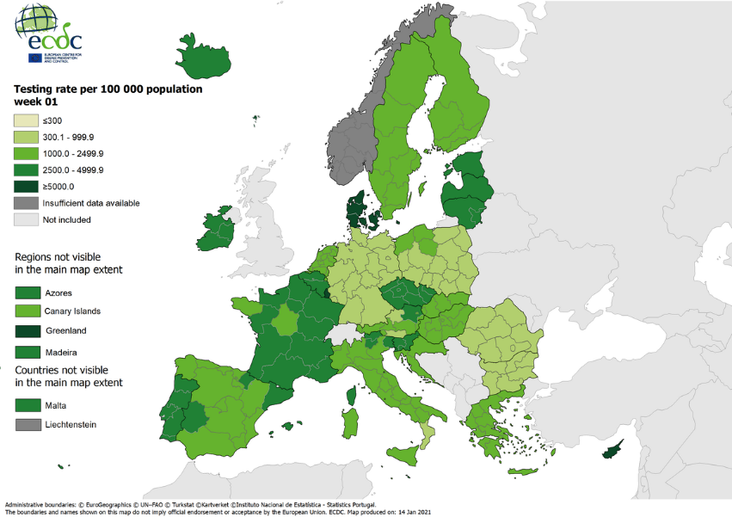
No. of realized tests in international comparison
Czech Republic:
current volume of tests (week sum):
14 986 / 100 000 inhab.

Slide 13
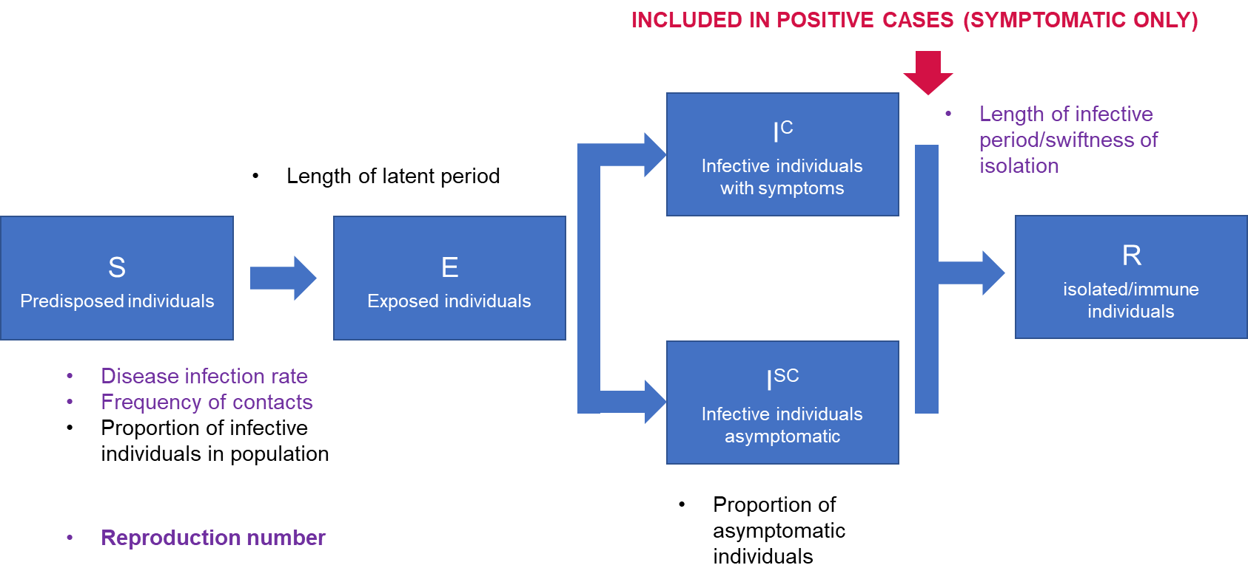
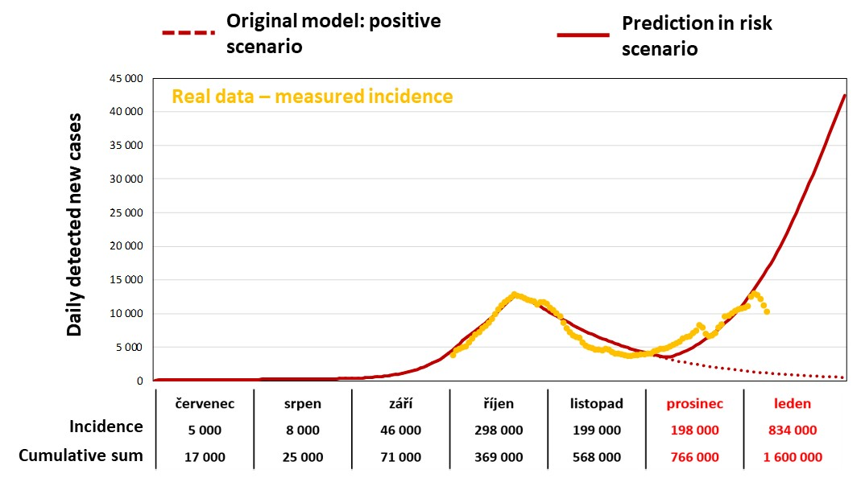
Management of epidemic situaion is supported by several predictive models: population SIR, SEIR stochastic modelling and probability models of future health impact
SEIR model
PREM, Kiesha, et al. The effect of control strategies to reduce social mixing on outcomes of the COVID-19 epidemic in Wuhan, China: a modelling study. The Lancet Public Health, 2020.
Long-term risk prediction was confirmed in the 1st half of January – current the trend is reversed

Slide 14
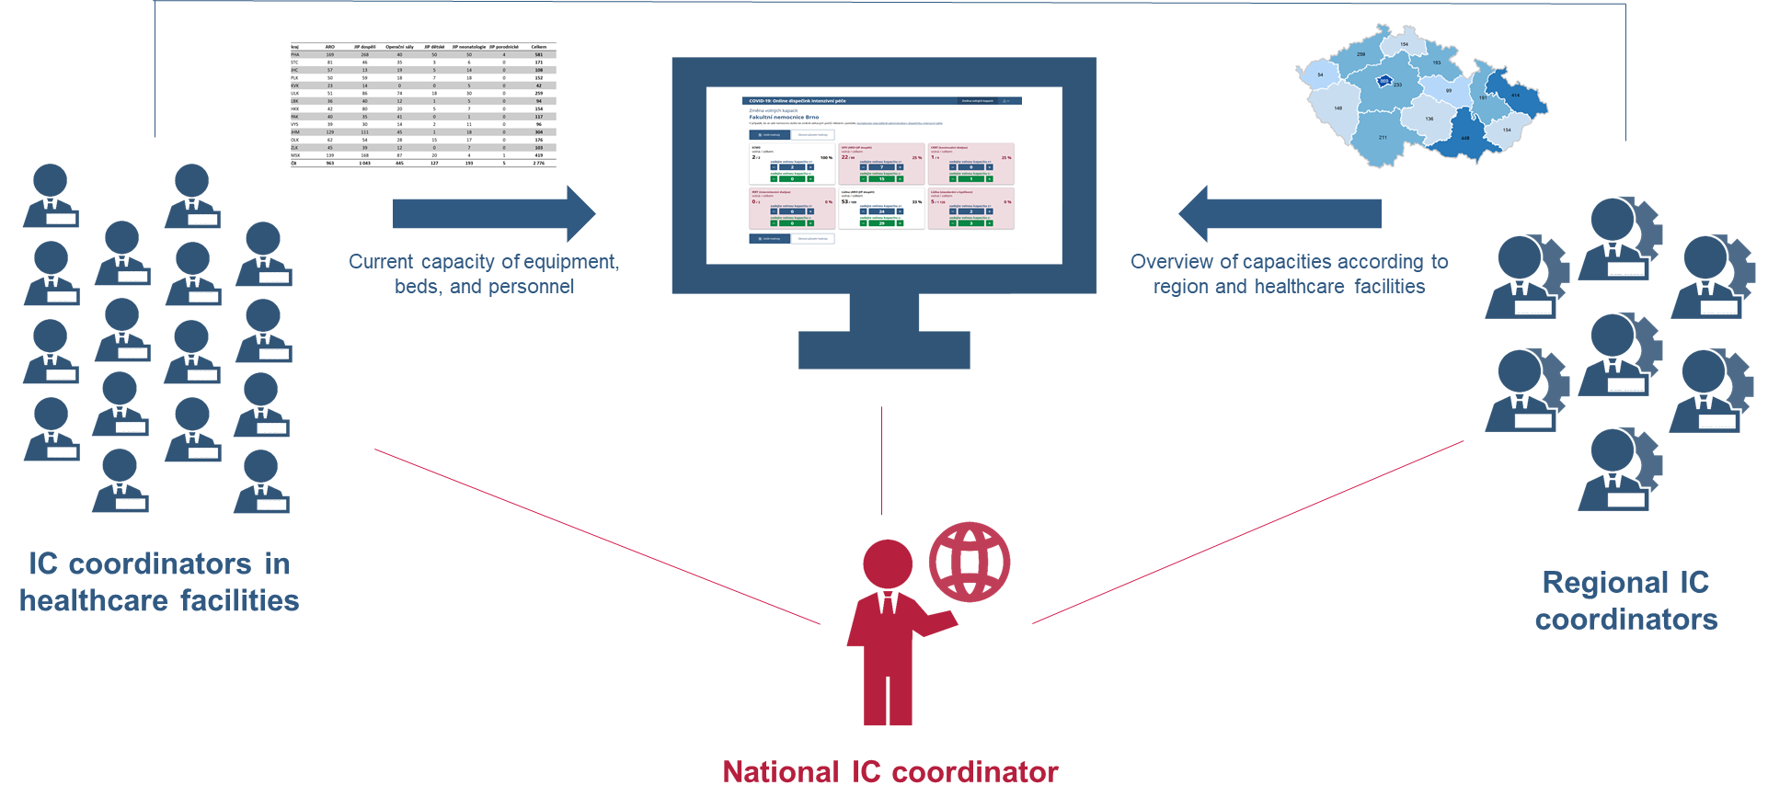
Monitoring of intensive care requirements and capacities
System capacities available in real time
Prediction of requirements
Parameters of hospitalisation of patients with COVID-19
Online controlling of intensive care
Reporting system for hospitals and regional authorities
Total duration of hospitalisation
Duration of intensive care
Hospitalisation course – treatment
Probability of severe form
Transfers and follow-up care
Inpatient mortality

Slide 15
Real national data: probability of progress to severe form of the disease
Patients with positive test – time from the first positive test to the progress to severe form
Days from the first positive test | Probability of severe form (95% confidence interval)
Day 1 | 1,22 % (0,99 %; 1,46 %)
Day 5 | 3,18 % (2,80 %; 3,56 %)
Day 10 | 4,62 % (4,16 %; 5,07 %)
Day 15 | 5,32 % (4,83 %; 5,80 %)
Day 20 | 5,60 % (5,10 %; 6,10 %)
Day 30 | 5,75 % (5,24 %; 6,26 %)
Severe form of the disease
Probability of severe form
(95% confidence interval)
The Kaplan–Meier estimate method was used. Apart from occurrence of the monitored event, the method also reflects duration of follow-up and may therefore provide slightly different results from cumulative proportion of patients with the event.
Days from the first positive test

Slide 16
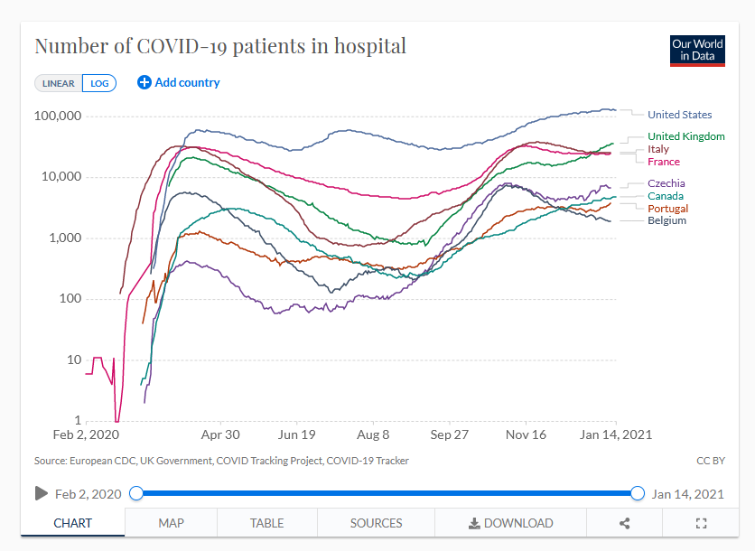
Patients in hospitals
No. of cases in hospitals has increased significantly since Xmas time, currently it is decreasing
The country still keeps reserves (approx. 20%) in ICU beds and other infrastructure components

