Slide 1
SARS-COV-2 reinfections: rapid review of the literature Charbel El Bcheraoui and Kofi Abrokwa Evidence-Based Public Health (ZIG2)

Slide 2
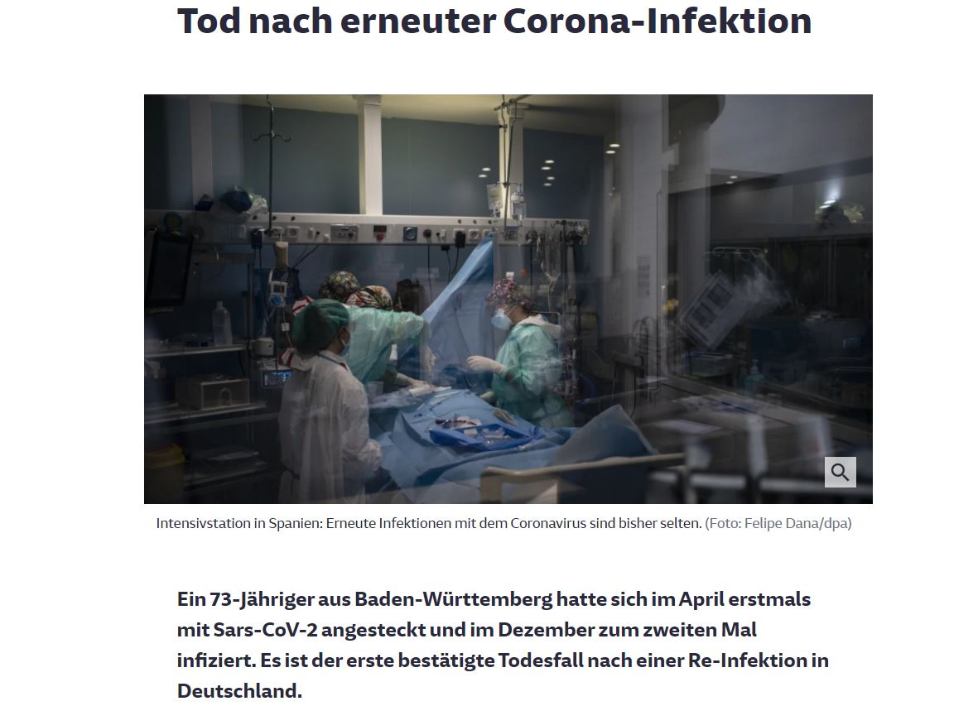
SARS-COV-2 reinfections
Literature search
Data extraction
Case reports/series
Observational studies
Reviews
Main observations

Slide 3
Google Scholar
Not exhaustive
Since 2020
SARS COV2 reinfection: 17000 results, first five pages: 9
Coronavirus reinfection: 2570 results, first 20 pages: 73
Coronavirus recurrence: 4640 results, first eight pages: 33
Coronavirus SARS COV2 recurrence reinfection quarantine: 3230 results, first three pages: 2

Slide 4
Summary of study types
Animal models: 4
Lab/serology studies: 5
Commentaries/letters to the editor: 23
Mathematical model simulations: 5
Case reports/series: 42
Observational studies: 6
Reviews: 5

Slide 5
Case reports/series: 42
82 previously recovered COVID-19 cases testing positive (PCR) with SARS-COV-2
4 – 90 years
At least 20 with co-morbidities
11 and 16 asymptomatic at 1st and 2nd “episode”
7 are the same
Duration between the two “episodes”: 1 – 28 weeks

Slide 6
Case reports/series
Transmission onward reported in 3 case reports
Case 1*: 7 family members falling ill and later testing positive
Case 2: Treating physician falling ill and later testing positive
Case 3: Family members were traced and tested negative
Only 7 cases confirmed as reinfections through whole genome sequencing
China (1), Ecuador (1), India (2), Netherlands (1), South Korea (1), USA (2)
Germany (1) ?

Slide 7
Observational studies: 6 (3 preprints)
All from healthcare settings, all testing is PCR-based
Two cohorts of healthcare workers
Three general population
One pediatric population
In total, 136.122 previously tested positive cases from five studies
87 re-positive + 44 from study with no denominator
No genome sequencing performed in any of the studies

Slide 8
Observational studies
Age of re-positive: <1 – 65+
Duration between two “episodes”: 1 week – 2 waves
Symptoms at re-positive: at least 40% when reported
Onward transmission: not reported in any

Slide 9
Reviews: 5 (1 preprint)
Include a multiplicity of study types
Three descriptive and two with metanalysis
Focus on re-positive respiratory samples after recovery
Largest include 82 publications
32 case reports, 50 case series, and 5 reviews
Identifies 1350 re-positive cases
2.6% required ICU

Slide 10
Reviews: Metanalysis
Camilla Mattiuzzi et al: 17 clinical studies with sample size > 50
Recurrence monitoring period 1 – 60 days
Pooled rate of recurrence of positive SARS-CoV-2 viral RNA: 12% (95%CI: 12-13%)
Tung Hoang: 14 case reports, 5 case series, 18 observational studies
Pooled recurrence rate from observational studies: 16% (95% CI: 12-20%)
Points to a report from Korea CDC
Monitoring of 790 contacts of 285 re-positive cases, no case was found that was newly infected solely from contact with re-positive cases during re-positive period

Slide 11
Reviews
A recurrent positive test of SARS-CoV-2 virus in patients who have recovered from COVID-19 is common (>10%)
The cause of this re-positive is still unclear
No demographics associated with recurrence
In most cases the presumptive recurrence is indeed a prolonged, not contagious, viral RNA persistence in the respiratory tract
Observed COVID‐19 relapse within a 90‐day frame might be a protracted initial infection and not a reinfection

Slide 12
Main observations
Confirmed re-infections are rare (seven known cases)
Difficult to ascertain first infection
Testing error
Genome sequencing to distinguish genetic material between the two “episodes” is rarely performed
Mostly due to lack of samples from first “episode”
Re-positive SARS-COV-2 test among previously recovered cases is a commonly-reported phenomenon
Many of these cases follow exposure
Severe illness at “re-positive” reported (includes deaths)
Limited evidence on
Transmission onward from re-positive cases
Tracing contacts of re-positive cases

Slide 13
Animal models: 4
Wei Deng et al: primary SARS-CoV-2 exposure protects against subsequent reinfection in rhesus macaques
Linlin Bao et al: primary SARS-CoV-2 infection could protect from subsequent exposures
Young-Il Kim et al: there is close correlation between a low NAb titre and SARS-CoV-2 reinfection in a recovered ferret reinfection model

