Slide 1

Independent Panel for Pandemic Preparedness and Response – Interim Report
Dr Iris Hunger
29 January 2021

Slide 2
Three review bodies active at the moment
Independent Oversight and Advisory Committee for the WHO Health Emergencies Programme (IOAC)
Review Committee on the Functioning of the International Health Regulations (2005) during the COVID-19 Response (IHRRC)
Independent Panel for Pandemic Preparedness and Response (IPPPR)

Slide 3
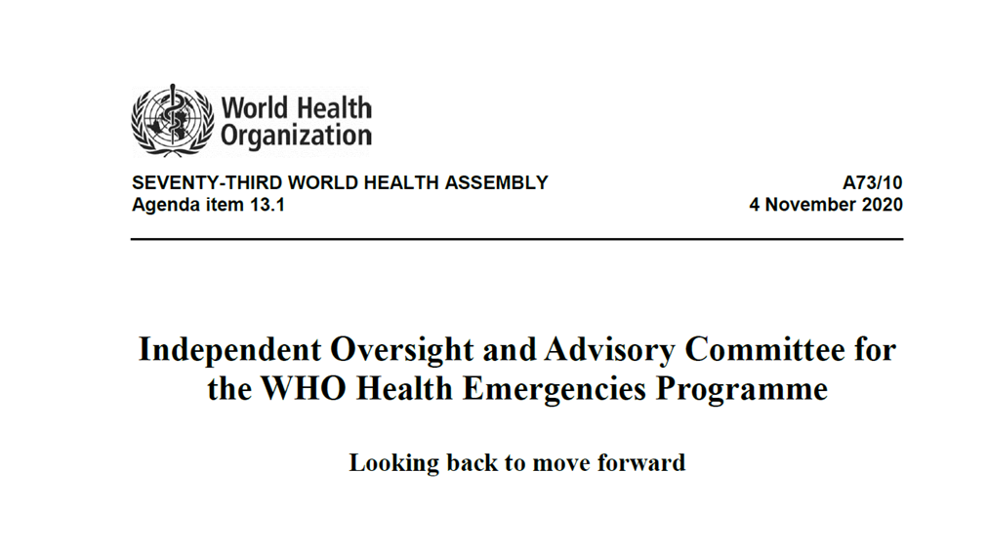
Independent Oversight and Advisory Committee for the WHO Health Emergencies Programme (IOAC)
Established 2016; 7 members; Chair: Dr Felicity Harvey (UK)
Mandate: “to provide independent scrutiny of the implementation
of WHO’s reform of its work on outbreaks and emergencies,
and its ongoing health emergency management”
Reports to WHO DG on a regular basis
COVID-specific report in Apr 2020
Last regular report in Nov 2020

Slide 4
Review Committee on the Functioning of the International Health Regulations (2005) during the COVID-19 Response (IHRRC)
Established September 2020; 21 members; Chair: Prof Lothar Wieler (DE)
Mandate: “to review the functioning of the IHR during the COVID-19 response; and the status of implementation of the relevant recommendations of previous IHR Review Committees”
Reports to WHO DG by May 2021
Interim Report in Jan 2021

Slide 5
Independent Panel for Pandemic Preparedness and Response (IPPPR)
Established July 2020; 13 members; Chairs: Ellen Johnson Sirleaf (LR), Helen Clark (NZ)
Mandate: “review experience gained and lessons learned from the WHO-coordinated international health response to COVID-19 including:
  the effectiveness of the mechanisms at WHO’s disposal;
  the functioning of the International Health Regulations (2005) and the status of implementation of the relevant recommendations of previous IHR Review Committees;
  WHO’s contribution to United Nations-wide efforts; and
  the actions of WHO and their timelines pertaining to the COVID-19 pandemic.”
Reports directly to Member States of WHO

Slide 6
Latest IPPPR Report (Jan 2021) – Key messages
The public health measures which would curb the pandemic
need to be applied comprehensively.
The pandemic response has deepened inequalities.
The global pandemic alert system is not fit for purpose.
There has been a failure to take seriously the already known
existential risks posed by pandemic threat.
The World Health Organization has been underpowered
to do the job expected of it.
The Panel believes that the COVID-19 pandemic must be a catalyst for fundamental and systemic change in preparedness for future such events, from the local community right through to the highest international levels.

Slide 7
Thank you

