Slide 1
NRZ Influenzaviren
Krisenstab 03.02.2021

Slide 2
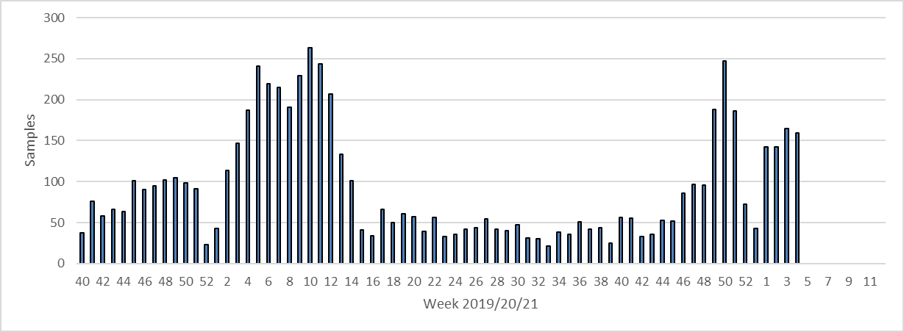
Week 20/21 | SARS-CoV-2+ | Samples | % positive for SARS-CoV-2
46 | 6 | 86 | 6%
47 | 2 | 90 | 2%
48 | 6 | 94 | 6%
49 | 20 | 188 | 11%
50 | 28 | 247 | 11%
51 | 16 | 186 | 8,6%
52 | 11 | 72 | 15,3%
53 | 5 | 43 | 11,6%
1 | 20 | 142 | 14,1%
2 | 15 | 142 | 10,56%
3 | 17 | 165 | 10,3%
4 | 10 | 159 | 6,3%
SARS-CoV-2 Diagnostik
Kurier
1

Slide 3
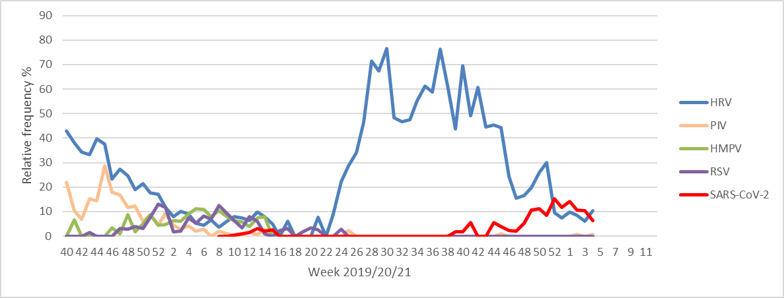
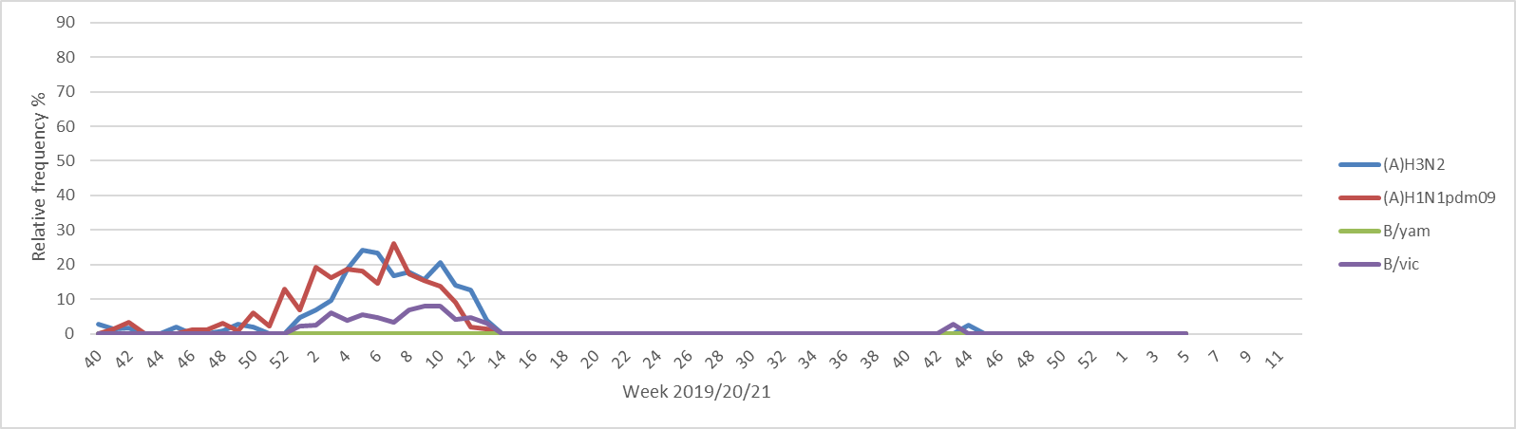
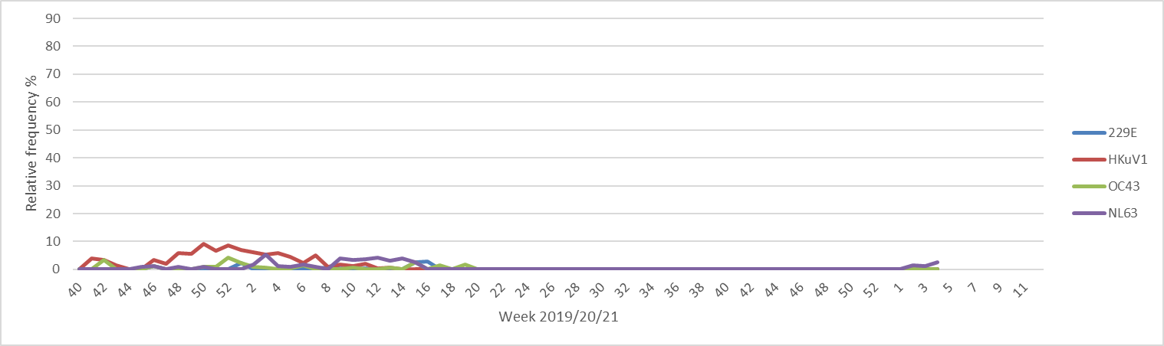
Partieller Lockdown
Lockdown
2

Slide 4
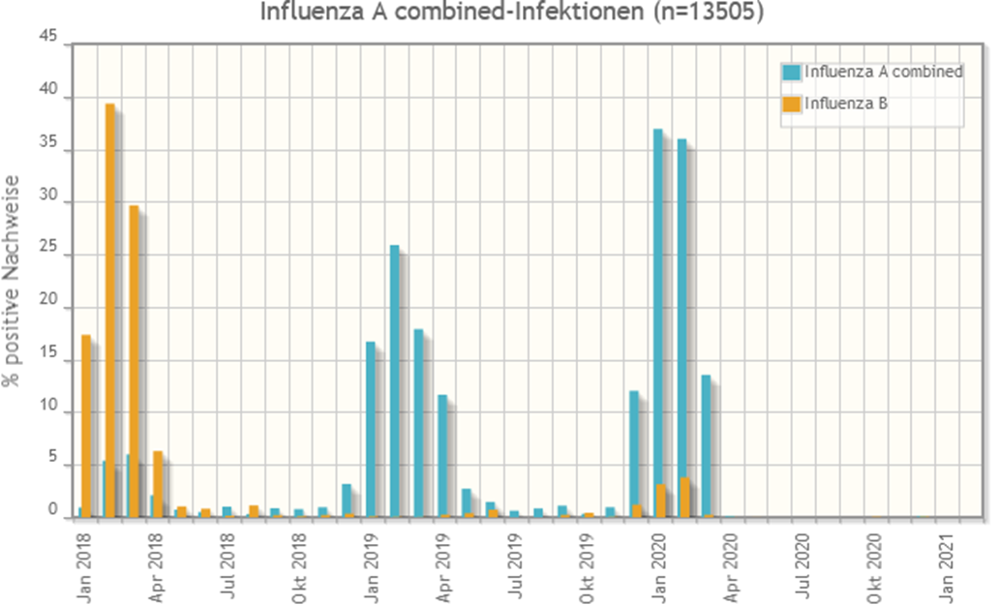
Influenzameldungen

Slide 5
