Slide 1
Health effects of travel policies on the COVID-19 pandemic: rapid mixed-methods systematic review and policy mapping Charbel El Bcheraoui Evidence-Based Public Health (ZIG2)

Slide 2
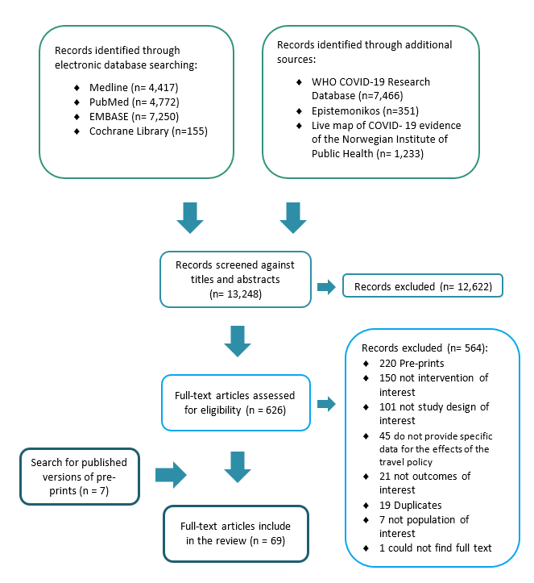
Search results

Slide 3
Border closure
May reduce COVID-19, spread across countries:
If implemented early
When close to the “tipping point”.*
When imported cases compared to local incidence is high (e.g.>1%)
When coupled with community measures.
But:
It may adversely affect epidemic size
Less effective than community measures.
Inclusive evidence on the effect of lifting border closure.

Slide 4
Quarantine
May reduce # COVID-19 cases:
If mandatory
If travellers comply
Followed by testing
But:
Less effective than lockdown in controlling the epidemic
Less effective if not followed by testing

Slide 5
Travelers screening
Unlikely to detect large # COVID-19 cases or to delay an outbreak.
Its effectiveness can be ↑ with:
↑test sensitivity
Screening many asymptomatic travellers
Exit screening at country source
Travellers’ awareness
However, it is less effective than border closure in decreasing spread across countries.

Slide 6
Travel policies adopted by 31 countries in 2020
EU: UK, France, Germany, Sweden, Finland, Greece, Spain, Italy, The Netherland
Asia: China, Taiwan, Hong Kong, Japan, Singapore.
MENA: KSA, UAE, Qatar, Lebanon.
Americas: USA, Canada, Brazil, Chile, Mexico.
Africa: Nigeria, Liberia, Sierra Leon, Guinea, South Africa, Kenya.

