Slide 1
SARS-COV-2 reinfections: rapid review of the literature Kofi Abrokwa, Sophie Müller, Alba Méndez, Charbel El Bcheraoui Centre for International Health Protection (ZIG)

Slide 2
Summary of 138 study types
Case reports/series: 60/33
Observational studies: 33
Reviews: 8

Slide 3
Case reports/series: 60/33
199 previously recovered COVID-19 cases testing positive (PCR) with SARS-COV-2
3 – 91 years
At least 75 with co-morbidities
16 and 60 asymptomatic at 1st and 2nd “episode”
7 are the same
Duration between the two “episodes”: 1 – 32 weeks

Slide 4
Case reports/series
Follow-up testing reported in 7 studies
Transmission onward reported in 3 case reports
4 identified positive contacts
Family members in 2 studies (duration 3 and 20 weeks)
Treating physician in 1 study (duration 7 weeks)
Patients in 1 study from a confirmed re-infection (> 20 weeks)
Only 17 cases confirmed as reinfections through whole genome sequencing (Possibly 1 more based on genetic mutations)
Belgium (2), China (1), Ecuador (1), France (1), India (2), Netherlands (1), Qatar (2), South Korea (6), UK (1), USA (2)
Germany (1) ?

Slide 5
Using RKI in-working definition
Remaining 51 non confirmed cases from case reports
1 probable
39 possible

Slide 6
Observational studies: 33 (4 preprints)
Predominantly from China
In total, 168.874 previously tested positive cases from 33 studies
1041 re-positive (0.6%) + 44 from study with no denominator
Genome sequencing performed in only 1 study
Full-length viral genomes could not be obtained

Slide 7
Observational studies
Age of re-positive: 2 months – 90 years
Duration between two “episodes”: 1 – 33 weeks
Symptoms at re-positive: at least 56% when reported
2 studies included follow-up testing
No onward transmission identified

Slide 8
Quality Assessment Tool for Observational Cohort and Cross-Sectional Studies
Top rates studies: 11/14 criteria
Zhou J et al: 23/368 (6.25%), 5 weeks between both episodes
Wong J et al: 21/106 (19.81), 3 – 5 weeks between both episodes
Chen LZ et al: 44/NA, 2 weeks post-discharge
Studies ≥ 12 weeks FU
Pilz et al (rating 9/14): 40/10840 (0.27), 30 ± 4 weeks
Hanrath AT et al (rating 10/14): 0/1038, 24 weeks
Lumley SF et al (rating 10/14): 4/1246 (0.32), 22.8 – 33 weeks
Studies with RP >20%: 21.4 – 50.0
Denominator 13 – 59
FU <1 – 5 weeks
Three studies rated 8, two studies rated 10

Slide 9
Reviews: 8 (1 preprint)
Three descriptive and five with metanalysis
Largest include 82 publications
32 case reports, 50 case series, and 5 reviews
Identifies 1350 re-positive cases
2.6% required ICU

Slide 10
Quality Assessment of Systematic Reviews and Meta-Analyses
Pooled recurrence rate from top two rated studies ( 11 and 9/11 criteria)
Between 14.6% (95%CI: 11.-18.1%) and 17.7% (95% CI: 12.4%-25.2%)
Median interval duration from disease onset to recurrence ranged from 21 to 50 days (Azam)
Time from discharge to recurrence of SARS-CoV-2 was 13.38 days (12.1- 14.7)

Slide 11
Main observations
Confirmed re-infections are rare (17 known cases, maybe 19)
Difficult to ascertain first infection
Testing error/lack of samples)
Genome sequencing to distinguish genetic material between the two “episodes” is rarely performed
Re-positive SARS-COV-2 test among previously recovered cases is a commonly-reported phenomenon during first few weeks
Some of these cases follow exposure
Severe illness at “re-positive” reported (includes deaths)
Limited evidence on
Tracing contacts of re-positive cases
Transmission onward from re-positive cases

Slide 12
Extra slides

Slide 13
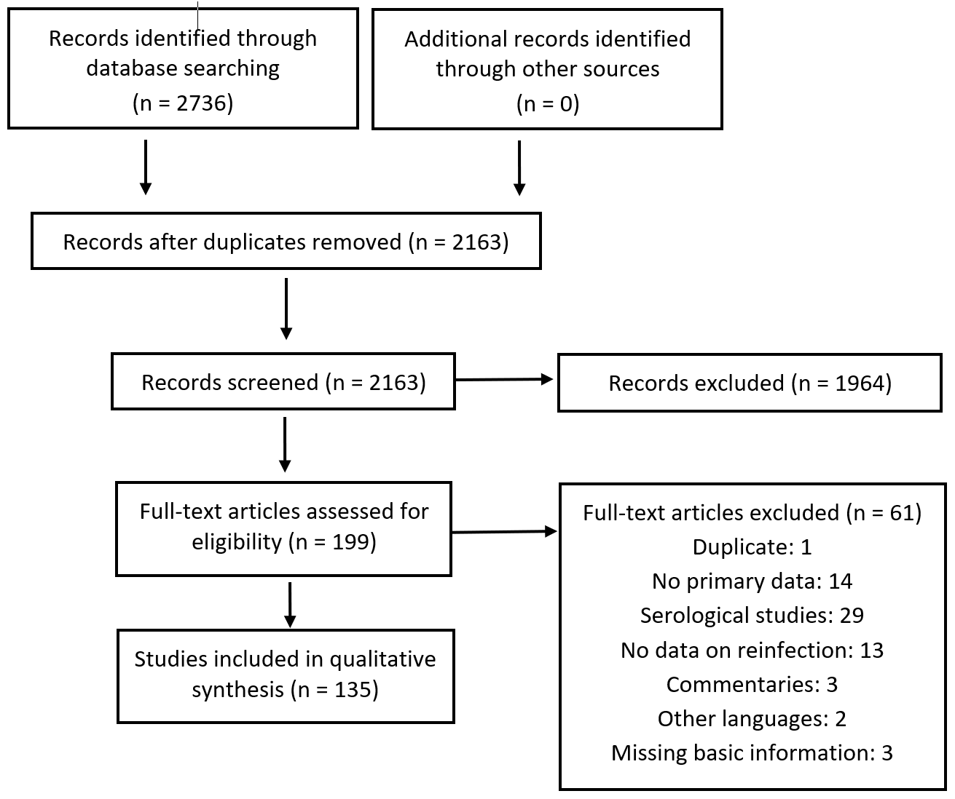
Search results

Slide 14
Data extracted
Type of study | Variables
All | Authors, year, country, age, study population, number of cases, testing methods, symptomatology, duration between episodes and onward transmission of infection
Case reports/series | Comorbidities, testing methods, infection differentiation method, relaxation of protective behavior, symptomatology of onward infection
Observational studies | Publication status, country and setting, serology, case definition for suspected reinfection, evidence for reinfection, total sample size, rate of re-positive, accidental identification
Reviews | Publication status, type of studies reviewed, confirmed reinfection, associated demographics, case severity, comorbidity, key sconclusion from authors

Slide 15
Reviews
A recurrent positive test of SARS-CoV-2 virus in patients who have recovered from COVID-19 is common (>10%)
The cause of this re-positive is still unclear
Increased with prolonged initial illness moderate disease severity, decreased leucocytes, low platelets and low CD4 count
Age association with recurrence is controversial

Slide 16
Confirmed re-infection
Genome sequence of virus from previous SARS-CoV-2 infection is known
AND
Genome sequence of the virus of the current SARS-CoV-2 infection is known
AND
Genome sequences of viruses from previous and current SARS-CoV-2 infection do not match.

Slide 17
Probable re-infection
Prerequisite: no genome sequencing result is available or known for at least one of the two confirmed SARS-CoV-2 infections
Person has overcome acute respiratory illness after confirmed SARS-CoV-2 infection ² or had asymptomatic SARS-CoV-2 infection
AND
Tested negative by PCR at least once after prior SARS-CoV-2 infection.
or
the last positive PCR detection of the preceding infection was more than 3 months ago
AND
SARS-CoV-2 genome copy number in the context of current PCR detection ≥105/ml.
or
Virus can be grown

Slide 18
Possible re-infection
Precondition: neither A nor B applies
Person has overcome acute respiratory illness after confirmed SARS-CoV-2 infection or had asymptomatic SARS-CoV-2 infection
AND
Tested negative by PCR at least once after prior SARS-CoV-2 infection.
or
the last positive PCR detection of the preceding infection was more than 3 months ago
AND
Individual tested positive for SARS-CoV-2 by PCR, but:
SARS-CoV-2 genome copy number in current PCR detection <105/ml or not known.
and virus cultivation is not possible (because sample is not available or cultivation is negative).

