Slide 1
NRZ Influenzaviren
Krisenstab 10.03.2021

Slide 2
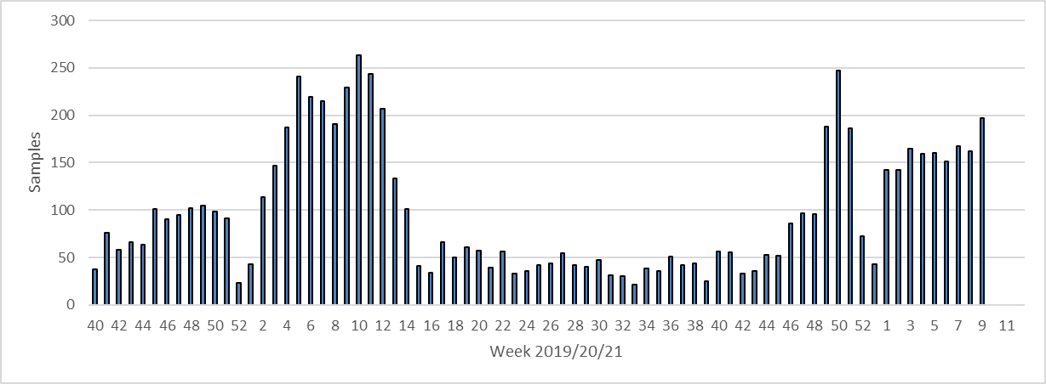
Week 20/21 | SARS-CoV-2+ | Samples | % positive for SARS-CoV-2
46 | 6 | 86 | 6%
47 | 2 | 90 | 2%
48 | 6 | 94 | 6%
49 | 20 | 188 | 11%
50 | 28 | 247 | 11%
51 | 16 | 186 | 8.6%
52 | 11 | 72 | 15.3%
53 | 5 | 43 | 11.6%
1 | 20 | 142 | 14.1%
2 | 15 | 142 | 10.56%
3 | 17 | 165 | 10.3%
4 | 10 | 159 | 6.3%
5 | 10 | 160 | 6.25%
6 | 11 | 151 | 7.28%
7 | 12 | 167 | 7.19%
8 | 12 | 159 | 7.55%
9 | 6 | 196 | 3.06%
Sentinel 2020/21 KW9: 2766
2019/20 Sentinel KW9: 2576
2019/20 Sentinel
gesamt: 4637
Rekrutierung neuer Sentinelpraxen
Aktive Betreuung
Kurier
SARS-CoV-2 Diagnostik

Slide 3
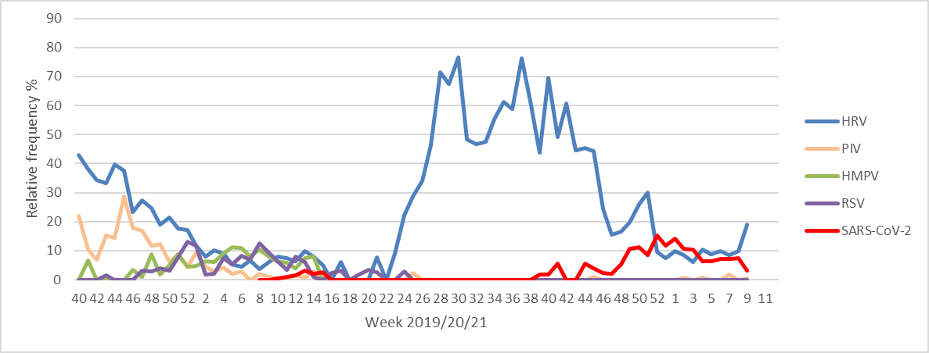
Partieller Lockdown
Lockdown

Slide 4
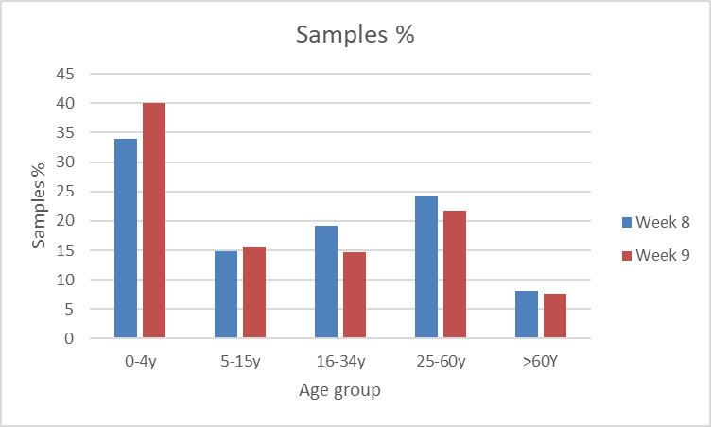
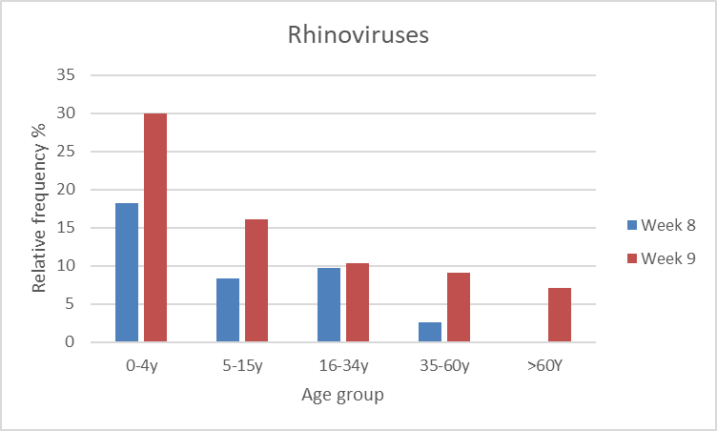

Slide 5
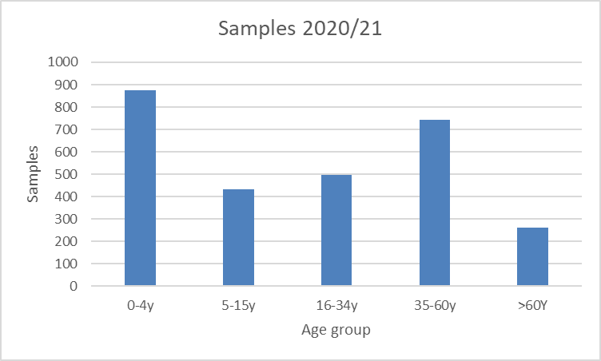
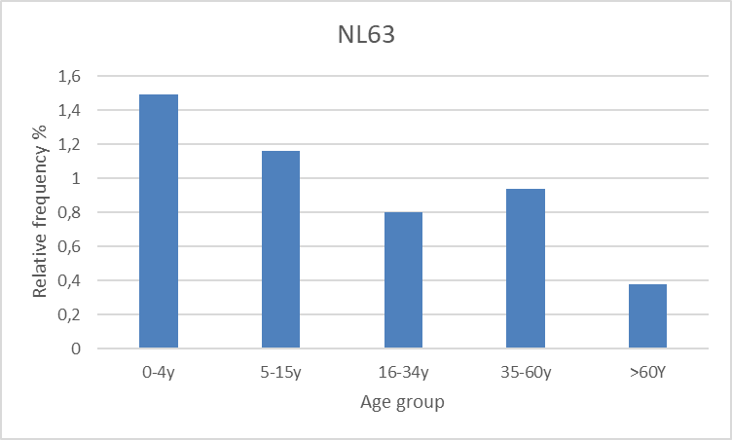

Slide 6
