Slide 1
Top 10 Länder nach Anzahl neuer COVID-19-Fälle
143.445.675 Fälle (+14,5% im Vergleich zu Vorwoche)
3.051.736 Todesfälle (2,1%)
Land | Fälle kumulativ | Neue Fälle (7T) | Veränderung % (7T) | 7T-Inzidenz/ 100.000 Ew | R (7T) | CFR % | Trend | Mind. eine Dosis* | Vollst. Geimpft*
Indien | 15.930.965 | 1.856.401 | +61.99 | 134,52 | 1,39 | 1,16 | ▲ | 8,1% | 1,3%
Brasilien | 14.043.076 | 443.082 | -11.28 | 208,45 | 0,96 | 2,69 | ▼ | 11,7% | 4,3%
USA | 31.466.876 | 437.176 | -10.54 | 132,08 | 0,99 | 1,79 | ▼ | 40,2% | 26,2%
Türkei | 4.446.591 | 421.034 | +7.51 | 499,22 | 1,09 | 0,83 | ▲ | 14,9% | 9,3%
Frankreich | 5.291.461 | 221.462 | -4.4 | 340,5 | 0,98 | 1,91 | ▼ | 19,1% | 7,1%
Iran | 2.311.813 | 168.019 | +5.38 | 200,04 | 1,13 | 2,94 | ▲ | 0,6% | 0,2%
Argentinien | 2.743.620 | 164.620 | +9.04 | 364,24 | 1,14 | 2,18 | ▲ | 12,7% | 1,8%
Deutschland | 3.217.710 | 144.268 | +1.18 | 173,47 | 1,09 | 2,51 | ▲ | 21,4% | 6,8%
Kolumbien | 2.684.101 | 114.787 | +13.56 | 225,59 | 1,19 | 2,58 | ▲ | 5,4% | 2,4%
Italien | 3.904.899 | 95.706 | -12.03 | 160,47 | 0,95 | 3,02 | ▼ | 19,0% | 7,9%
Quelle: WHO, Stand: 22.04.2021; *https://ourworldindata.org/covid-vaccinations, 23.04.2021

Slide 2
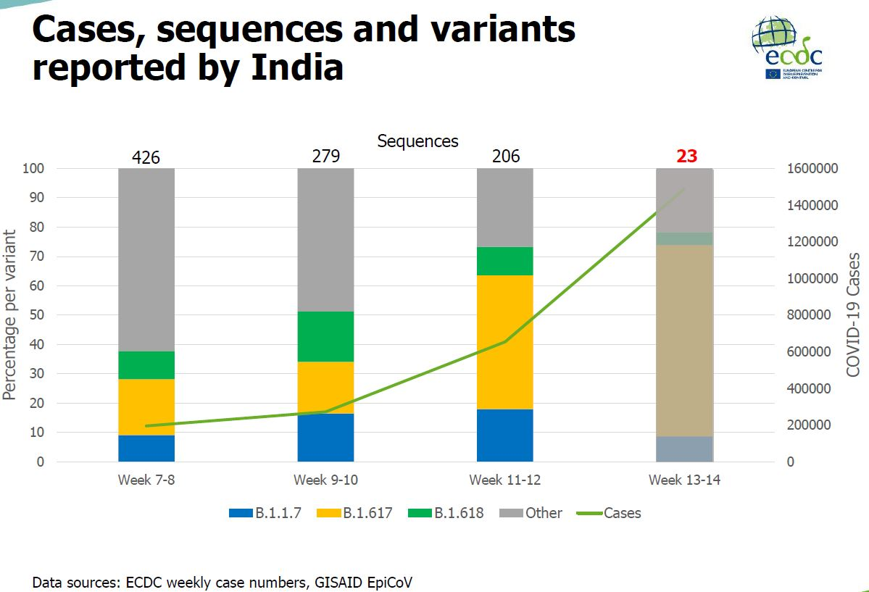
B.1.617 und B.1.618 in Indien
B.1.617: L452R und E484Q
B.1.618: E484K und Deletion in N-terminaler Domäne (Mutationsprofil nicht besorgniserregender im Vergleich zu anderen E484K-Mutanten
Quelle: ECDC, HSC meeting, 21.04.2021

Slide 3
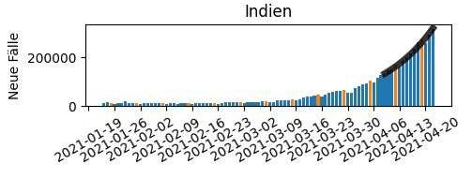
B.1.617 in Indien und weltweit
Weitere Treiber der Neuinfektionen in Indien:
Nichteinhaltung nicht-pharmazeutischer Maßnahmen, falsches Sicherheitsgefühl, Massenbewegungen von Stadt aufs Land, frühzeitig gelockerte Maßnahmen
B1.617 in weiteren Ländern:
England, DEU, Israel, Bahrain, USA, Australien, Neuseeland
Schlussfolgerung ECDC:
If the so-far scarce sequence data are representative for the country, they indicate that B.1.617 is driving the rapid increase in COVID-19 cases in India
The mutation profile for B.1.617 suggests that the variant will be less susceptible to neutralisation by antibodies, which may lead to higher rates of reinfections and breakthrough infections
It is unlikely but not impossible the variant will pose an increased public health threat for the EU/EEA compared to variants B.1.351 and P.1
More data is required to provide a full assessment
WHO, 22.02.2021
Quelle: ECDC, HSC meeting, 21.04.2021

Slide 4
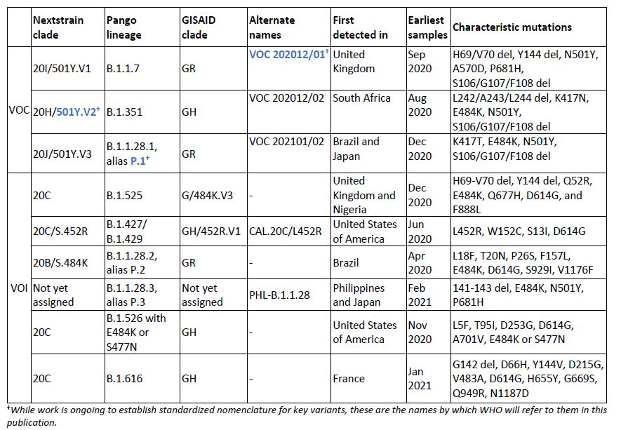
WHO Epidemiological Update 20.04.2021
3 Variants of concern (VOC),
6 Variants of interest (VOI),
19 variants under investigation (VUI)

Slide 5
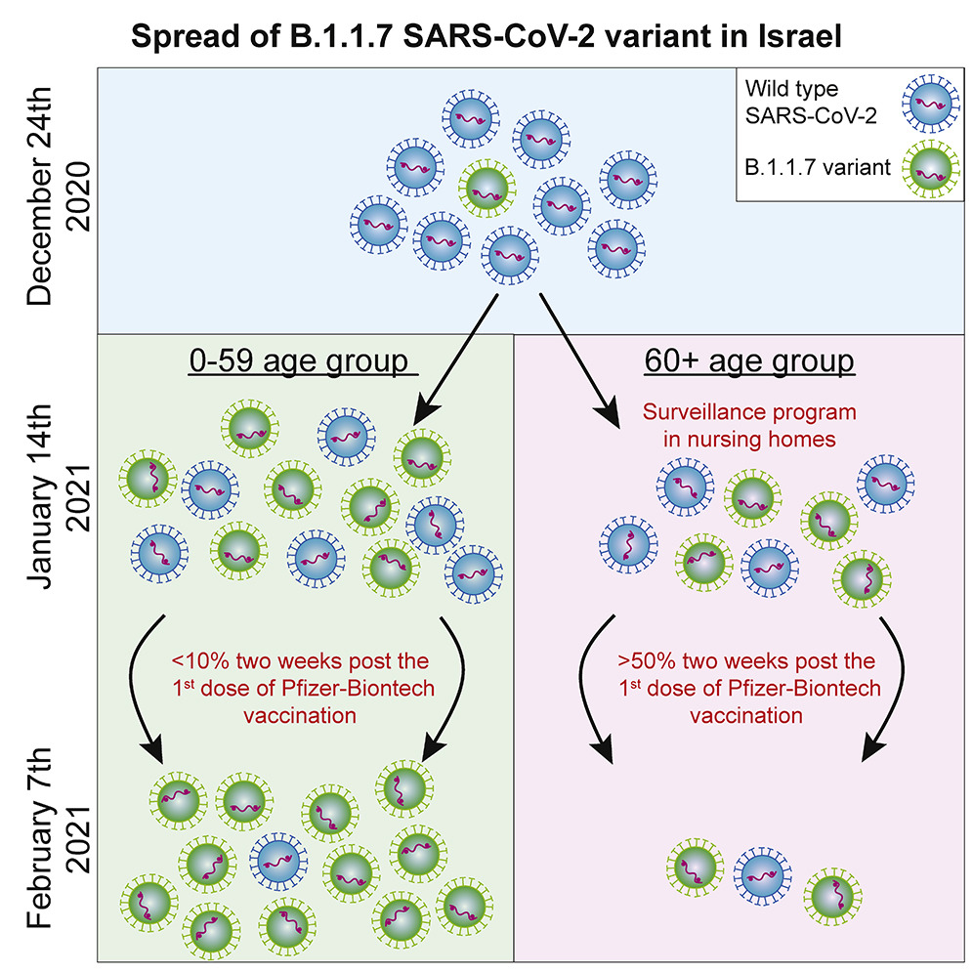
Munitz et al. 2021 in Cell Report Medicine: BNT162b2 Vaccination Effectively Prevents the Rapid Rise of SARS-CoV-2 Variant B.1.1.7 in high risk populations in Israel
292,000 RT-PCR samples collected from December 6th 2020 until February 10th 2021: SGTF analyses, comparison of R-number
B.1.1.7 became dominant within 3,5 weeks:
24/12/2020: 5 % B.1.1.7
Jan 2021: 90% B.1.1.7
Currently: 99,5%
B.1.1.7 is 45% (95% CI:20-60%) more transmissible
Massive RT-PCR testing, focused surveillance in nursing homes and prioritized vaccination programs → preventing the spread of the B.1.1.7 variant in the elderly
https://www.sciencedirect.com/science/article/pii/S266637912100080X?via%3Dihub
Notes:
On December 24, 2020 only 5% of the positive results were attributed to the British variant. Just six weeks later, in January 2021, this variant was responsible for 90% of Covid-19 cases in Israel. The current figure is about 99.5%.
Until January we saw a linear dependence of almost 100% between the different age groups in new cases per 1,000 people," says Dr. Dan Yamin. "Two weeks after 50% of the 60+ population received the first dose of the vaccine this graph broke sharply and significantly. During January a dramatic drop was observed in the number of new cases in the 60+ group, alongside a continued rise in the rest of the population. Simply put, since more than 90% of those who died from Covid-19 were over 60, we can say that the vaccine saved hundreds of lives - even in the short run.

Slide 6
Interim guidance on the benefits of full vaccination against COVID-19 for transmission and implications for non-pharmaceutical interventions, ECDC, 21.04.2021 https://www.ecdc.europa.eu/en/publications-data/interim-guidance-benefits-full-vaccination-against-covid-19-transmission Technical briefing documents on novel SARS-CoV-2 variants,9th Update, PHE, 22.04.2021 https://www.gov.uk/government/publications/investigation-of-novel-sars-cov-2-variant-variant-of-concern-20201201

Slide 7
BACK-UP

Slide 8
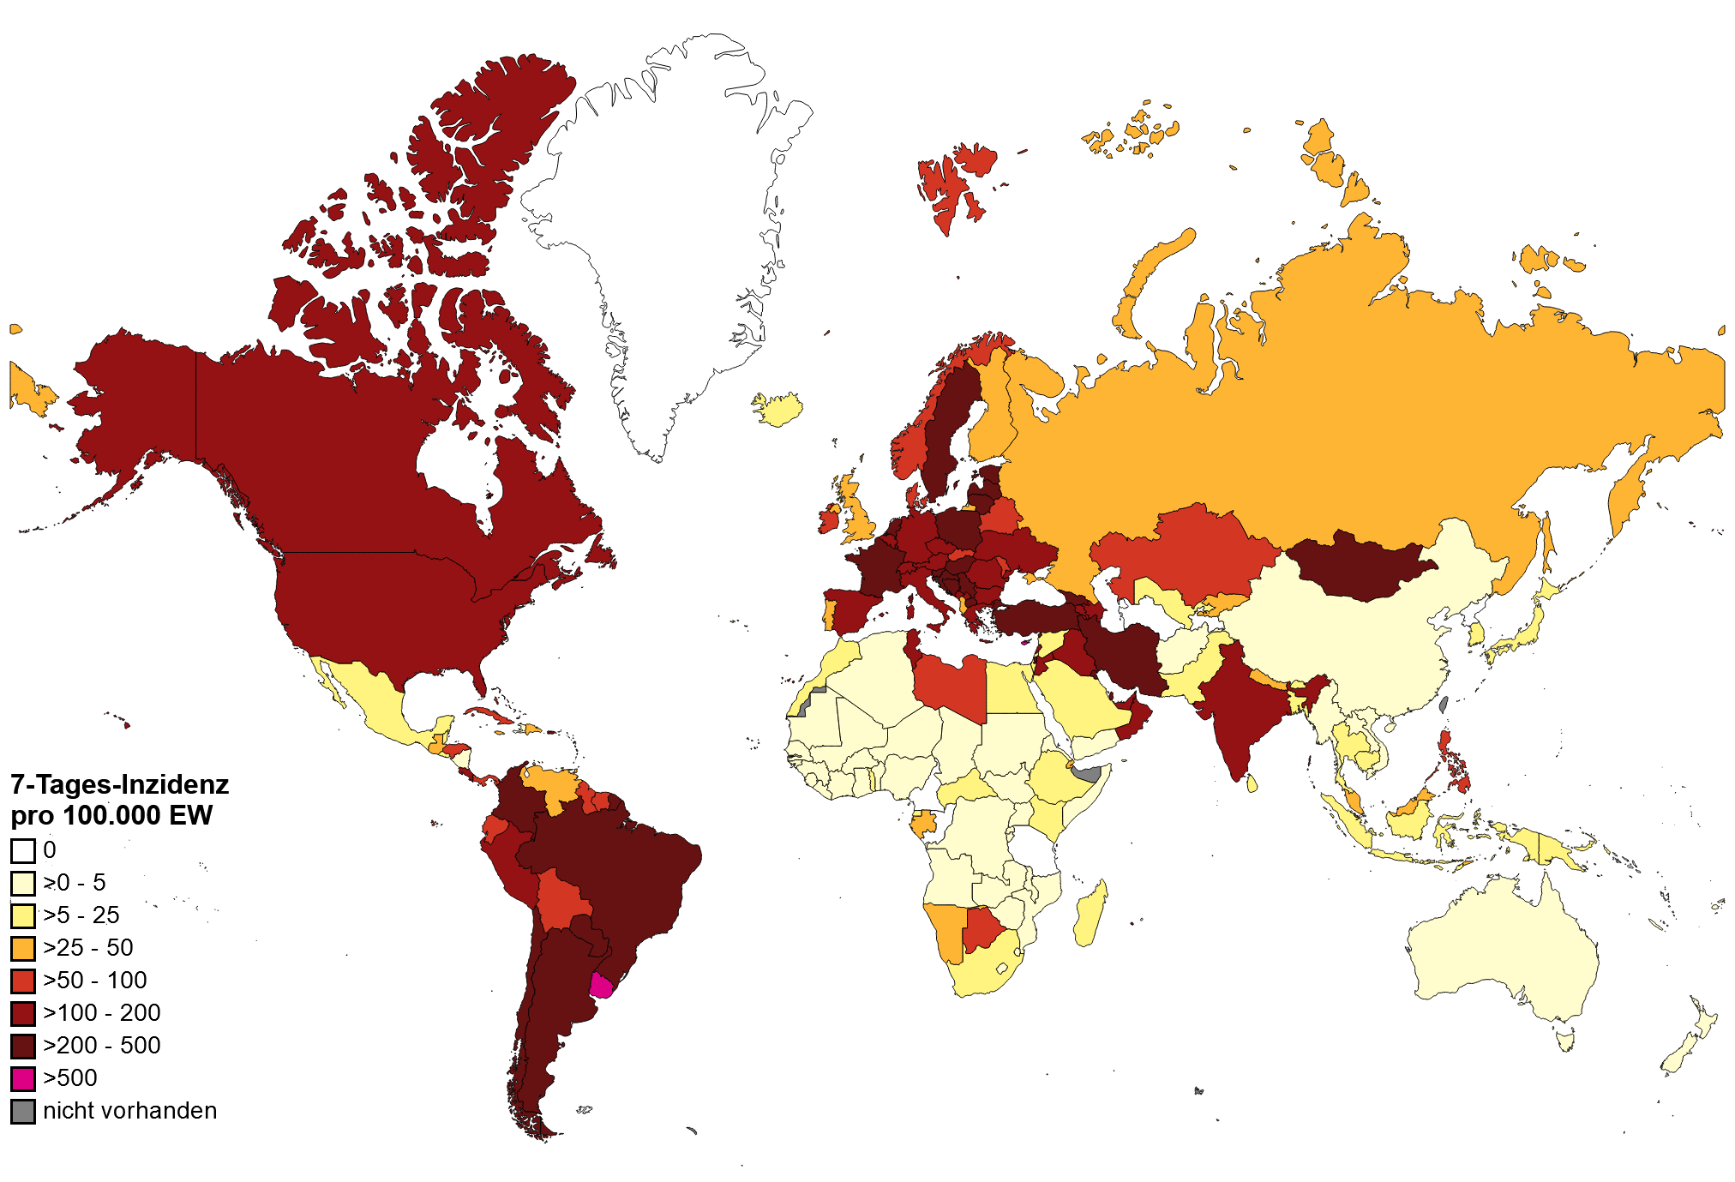
7-Tages-Inzidenz weltweit pro 100.000 Einwohner
Quelle: WHO, Stand: 22.04.2021

Slide 9
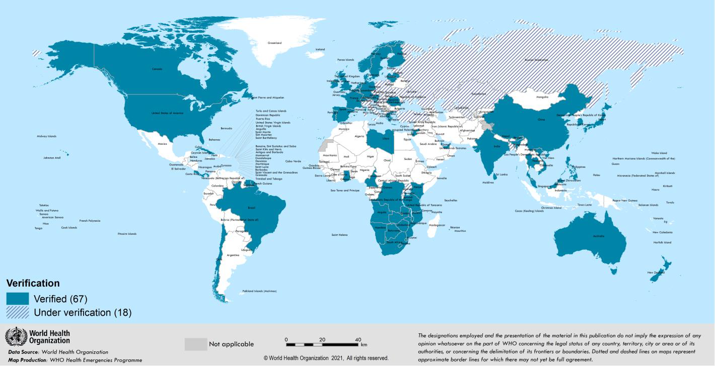
SARS-CoV-2 Varianten: 501Y.V2 (Linie B1.351)
Virusvarianten-Risikogebiete: Botsuana, Eswatini, Lesotho, Malawi, Mosambik, Sambia, Simbabwe, Südafrika, Moselle in Grand Est (Frankreich)
Unter Beobachtung: Afrika (u.a. Angola, Burundi, Ghana, Kenia, Namibia, Nigeria, Ruanda, Tansania)
Quelle: WHO Sitrep vom 20.04.2021
Notes:
56 Länder (+5 seit der Vorwoche)
https://www.who.int/publications/m/item/weekly-epidemiological-update---2-march-2021

Slide 10
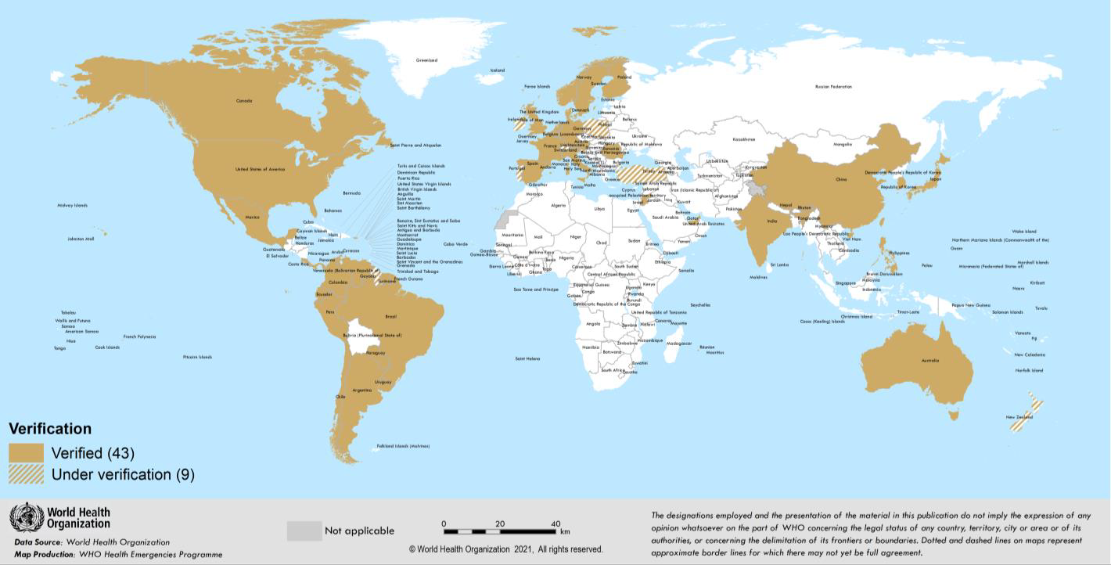
SARS-CoV-2 Varianten: P1. Variante (Linie B1.128.1)
Virusvarianten-Risikogebiete: Brasilien
Unter Beobachtung: Südamerika, Italien, Niederlande
Quelle: WHO Sitrep vom 20.04.2021
Notes:
29 Länder (+1 seit der Vorwoche)
https://www.who.int/publications/m/item/weekly-epidemiological-update---2-march-2021

Slide 11
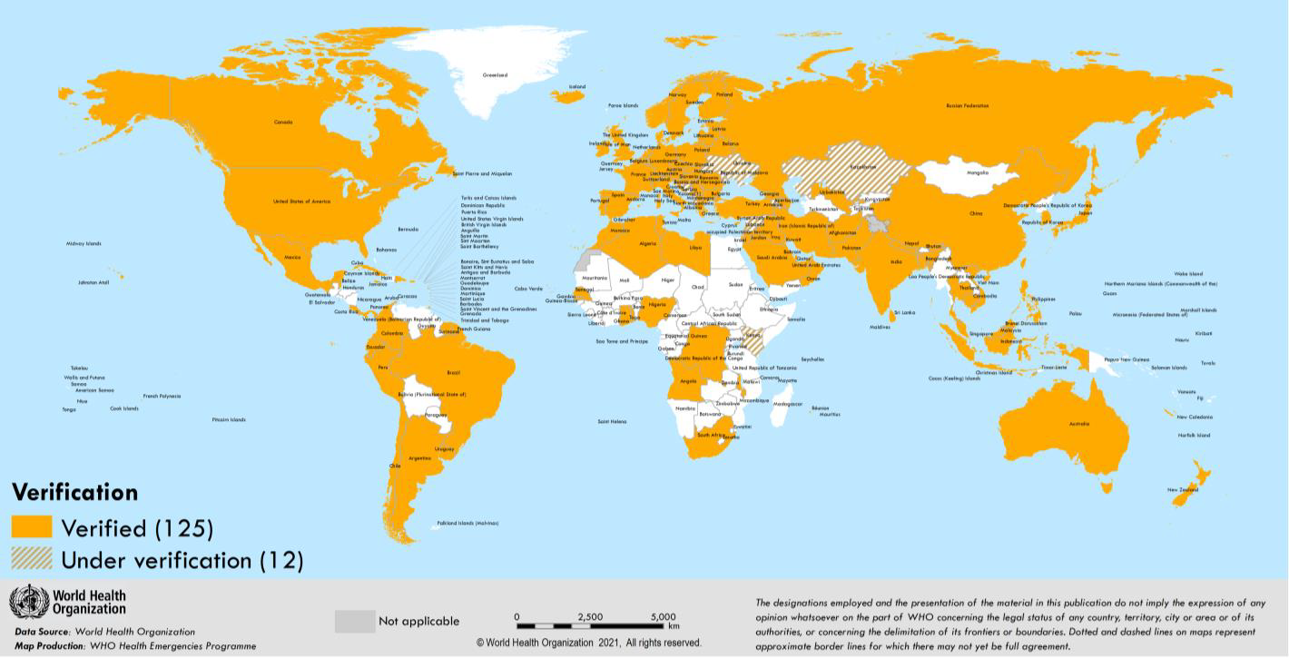
SARS-CoV-2 Varianten: VOC 202012/01 (Linie B.1.1.7)
Virusvarianten-Risikogebiete: Keine
Quelle: WHO Sitrep vom 20.04.2021
Notes:
106 Länder (+5 seit der Vorwoche)
https://www.who.int/publications/m/item/weekly-epidemiological-update---2-march-2021

