Slide 1
VOC basierend auf Übermittlungen im Meldesystem
Problem: Anteil der VOC wird konstant massiv unterschätzt
Ursache:
a) Nur positive Testergebnisse werden gemeldet, aber Nenner bilden alle Meldefälle b) Nicht alle Proben w(u/e)rden getestet bzw. Ergebnisse nicht übermittelt
Ansatz: Nenner bilden aus allen Fällen zu denen Informationen zu VOC übermittelt wurden (keine VOC, Hinweise, Verdacht, Nachweis von VOC) Probleme:
Abhängigkeit von Testintensität auf VOC der Labore: a) Überschätzung wenn spezifisch auf VOC getestet wird, aber Inzidenz niedrig ist b) Unterschätzung wenn nicht mehr getestet wird, da Verbreitung sehr hoch → B.1.1.7
Bisher keine Meldepflicht für neg. Testung auf VOC → aber Möglichkeit vorhanden

Slide 2
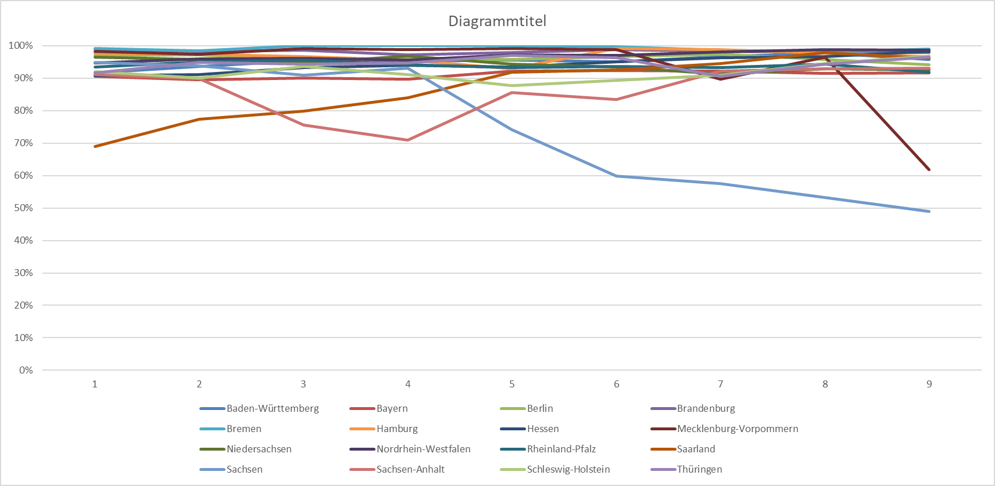
IfSG-Daten zu B.1.1.7
B.1.1.7
 | 8 | 9 | 10 | 11 | 12 | 13 | 14 | 15 | 16
Baden-Württemberg | 92% | 94% | 95% | 95% | 95% | 95% | 97% | 98% | 96%
Bayern | 91% | 89% | 90% | 90% | 92% | 92% | 92% | 91% | 92%
Berlin | 97% | 97% | 95% | 96% | 96% | 97% | 97% | 96% | 94%
Brandenburg | 99% | 98% | 99% | 97% | 98% | 99% | 98% | 98% | 98%
Bremen | 99% | 98% | 100% | 100% | 100% | 100% | 99% | 98% | 99%
Hamburg | 98% | 97% | 97% | 95% | 93% | 99% | 99% | 98% | 97%
Hessen | 91% | 91% | 93% | 94% | 93% | 95% | 96% | 97% | 98%
Mecklenburg-Vorpommern | 98% | 97% | 99% | 99% | 99% | 99% | 90% | 96% | 62%
Niedersachsen | 96% | 96% | 95% | 97% | 94% | 93% | 91% | 93% | 93%
Nordrhein-Westfalen | 95% | 96% | 96% | 96% | 97% | 97% | 98% | 99% | 99%
Rheinland-Pfalz | 93% | 95% | 95% | 94% | 93% | 94% | 93% | 94% | 92%
Saarland | 69% | 77% | 80% | 84% | 92% | 93% | 94% | 98% | 96%
Sachsen | 95% | 94% | 91% | 93% | 74% | 60% | 57% | 53% | 49%
Sachsen-Anhalt | 91% | 90% | 76% | 71% | 86% | 83% | 92% | 93% | 93%
Schleswig-Holstein | 92% | 90% | 94% | 91% | 88% | 89% | 91% | 95% | 97%
Thüringen | 92% | 95% | 94% | 95% | 97% | 96% | 91% | 94% | 96%
Gesamtergebnis | 93% | 93% | 94% | 94% | 93% | 93% | 93% | 93% | 92%
Bisherige Berechnung | 23% | 19% | 45% | 46% | 49% | 51% | 51% | 53% | 38%
Genomseq. | 44% | 52% | 64% | 74% | 80% | 88% | 88% | 88% | NA
RKI-Testzahlerfassung B.1.1.7 | 40% | 54% | 64% | 71% | 79% | 82% | 85% | 90% | 90%

Slide 3
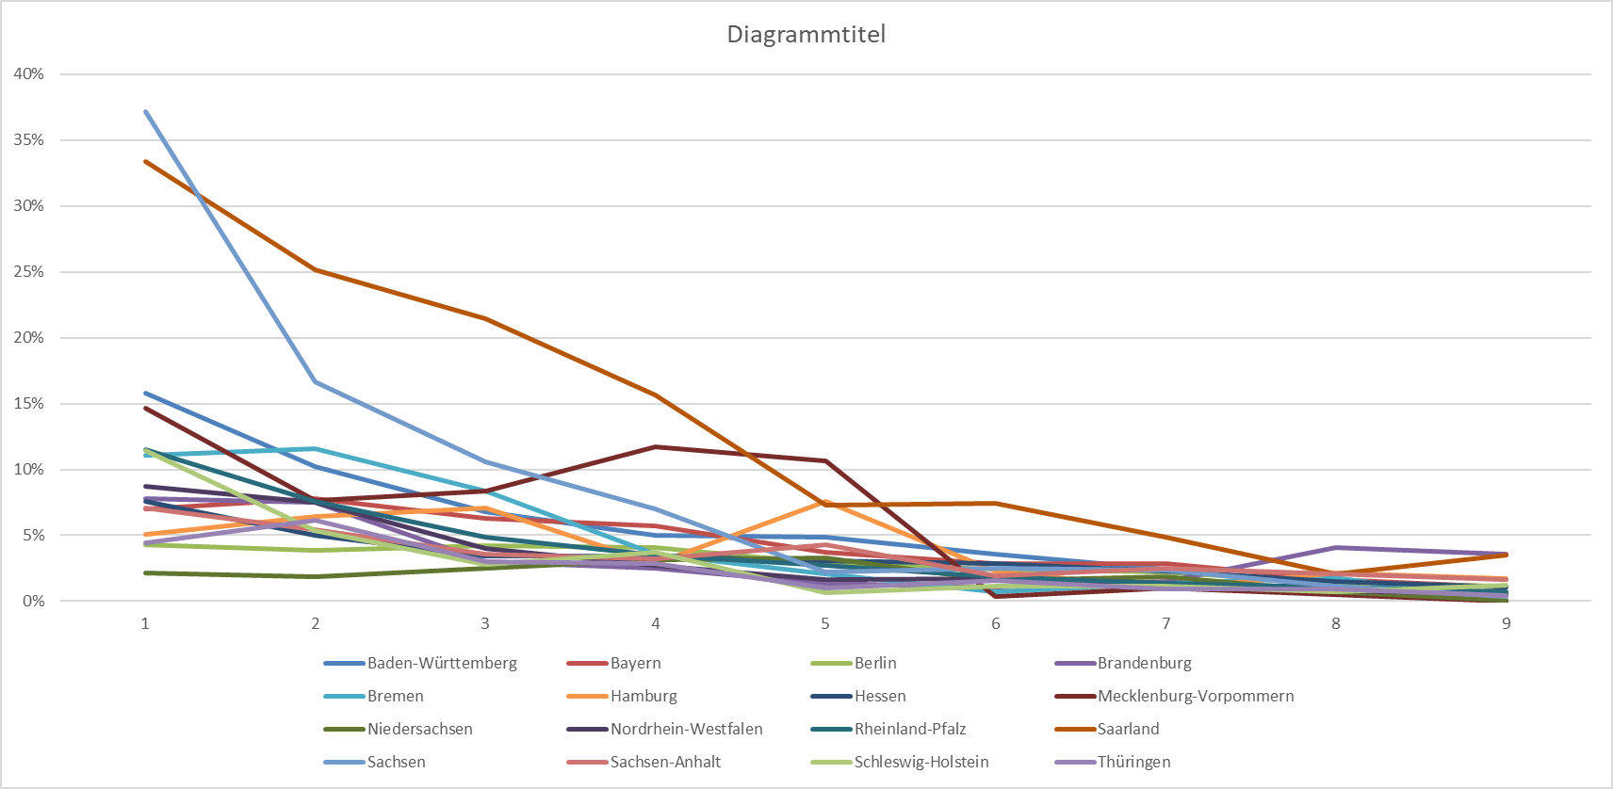
IfSG-Daten zu B.1.351
 | 8 | 9 | 10 | 11 | 12 | 13 | 14 | 15 | 16
Baden-Württemberg | 16% | 10% | 7% | 5% | 5% | 4% | 2% | 1% | 1%
Bayern | 7% | 8% | 6% | 6% | 4% | 3% | 3% | 2% | 1%
Berlin | 4% | 4% | 4% | 4% | 3% | 2% | 2% | 1% | 1%
Brandenburg | 8% | 7% | 3% | 3% | 1% | 1% | 1% | 4% | 4%
Bremen | 11% | 12% | 8% | 4% | 2% | 1% | 1% | 2% | 0%
Hamburg | 5% | 6% | 7% | 3% | 8% | 2% | 1% | 2% | 2%
Hessen | 8% | 5% | 3% | 3% | 3% | 3% | 2% | 1% | 1%
Mecklenburg-Vorpommern | 15% | 8% | 8% | 12% | 11% | 0% | 1% | 0% | 0%
Niedersachsen | 2% | 2% | 2% | 3% | 3% | 2% | 2% | 1% | 0%
Nordrhein-Westfalen | 9% | 8% | 4% | 3% | 2% | 2% | 1% | 1% | 1%
Rheinland-Pfalz | 12% | 8% | 5% | 3% | 3% | 2% | 1% | 1% | 1%
Saarland | 33% | 25% | 21% | 16% | 7% | 7% | 5% | 2% | 4%
Sachsen | 37% | 17% | 11% | 7% | 2% | 3% | 2% | 1% | 0%
Sachsen-Anhalt | 7% | 5% | 4% | 3% | 4% | 2% | 3% | 2% | 2%
Schleswig-Holstein | 11% | 5% | 3% | 4% | 1% | 1% | 1% | 1% | 1%
Thüringen | 4% | 6% | 3% | 3% | 1% | 2% | 1% | 1% | 0%
Gesamtergebnis | 10% | 8% | 5% | 4% | 3% | 2% | 2% | 1% | 1%
Bisherige Berechnung | 1 % | 0% | 1% | 1% | 0% | 0,5% | 0,4% | 0,3% | 0,1%
Genomseq. | 0,7 % | 1,8% | 1,8% | 1,2% | 1,6% | 1,1% | 1,9% | 1,6% | NA
RKI-Testzahlerfassung B.1.351 | 1,1% | 1,0% | 0,9% | 1,0% | 0,9% | 0,8% | 0,9% | 0,8% | 0,7%
B.1.351

