Slide 1
COVID-19 Vaccination Rollout and COVID-19 Containment Measures, January – April 2021 Thurid Bahr, Charbel El-Bcheraoui ZIG 2

Slide 2
Analysis of International Epidemiological Data and Response Measures
2021
2021
Bi-weekly analysis of COVID-19 containment measures vs epidemiological indicators in select countries
Neighbouring countries
Policy/Epidemiological relevance
Decision-making processes leading to the adoption of COVID-19 containment measures
COVID-19 Vaccination Rollout and Containment Measures, Jan – Apr 2021
How do vaccination campaigns differ between countries with high and low vaccination coverage?
How have containment measures been modified across differentlevels of vaccination coverage?
Apr
Today

Slide 3
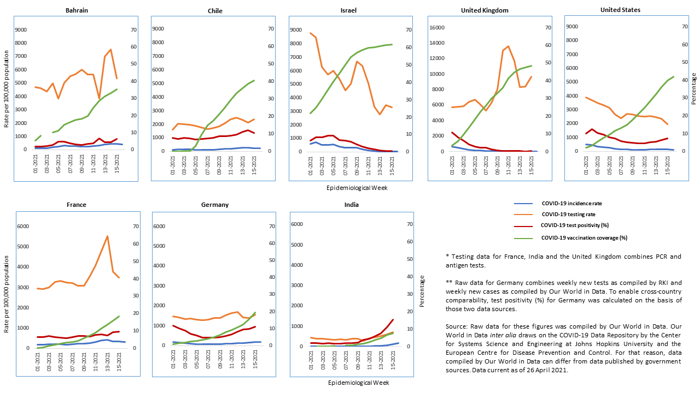
COVID-19 Incidence, Testing rate, Test Positivity and Vaccination Coverage, January – April 2021

Slide 4
Vaccination Campaigns
Shared characteristics
Decentralized (except Bahrain)
Free (in public system)
Countries with higher vaccination coverage
Universal access, or lower limit for age at which vaccination is approved
Countries with lower vaccination coverage
Priority groups and higher limit for age at which vaccination is approved

Slide 5
Heatmap COVID-19 Containment Measures
Notes:
Progressive lifting of measures in ISR (Feb), UK (Mar), USA (Apr)
BHR: Opening of schools, tightening of restrictions on public events and gatherings, international travel (Apr)
FRA: Tightening internal movement and workplace closures (Mar), tightening school closures, international travel (Apr)
IND: Restrictions in place unchanged across most measures categories (Feb), some tightening of school closures and internal movement (Apr)

Slide 6
Policy Recommendations
Countries with high and low vaccination coverage should uphold effective COVID-19 containment measures
Contain virus circulation within country and limit across-country transmission
Low vaccination coverage + heavy virus circulation
Increased risk of emergence of new virus variants (IND)
Countries with lower vaccination coverage should avail vaccines and make access more universal

Slide 7
Extra Slides

Slide 8
Country Selection Criteria
Countries with high and low COVID-19 vaccination coverage and incidence
Important European neighbors

Slide 9
Report Data
BHR, CHL, FRA, DEU, IND, ISR, GBR, USA; January – April 2021
Data | Sources
Weekly COVID-19 incidence per 100,000 population; Weekly test positivity, %; Vaccination coverage (one shot), % | Our World in Data (combines various sources, incl. ECDC, Johns Hopkins CCSE)
Weekly new tests per 100,000 population | Our World in Data, RKI Testzahlerfassung
Vaccine acceptance | Imperial College/YouGov
COVID-19 containment measures | Oxford COVID-19 Government Response Tracker
Rollout national vaccination campaigns (priority groups, infrastructure, vaccination certificates …) | Government sources, supplemented by grey literature and media reports

Slide 10
Evidence Rating
Epidemiological data from Our World in Data to ensure comparability across countries
Data | Availability
Epidemiological indicators | 8/8 countries
Vaccine acceptance | 5/8 countries
Indicators rollout national vaccination campaigns | 6/8 countries
COVID-19 containment measures | 8/8 countries

Slide 11
Risks
Low vaccination coverage + heavy virus circulation
Increased risk of emergence of new virus variants (IND)
Trends in vaccination coverage can be affected by
Vaccine access and acceptance (ISR, FRA)

