Slide 1
Oh et al., 2021, Ärzteblatt 118(9), 460-466

Slide 2
Definitions: Viruses of Concern (VOC), Viruses of Interest (VOI), WHO -25.02.2021
(https://www.who.int/publications/m/item/covid-19-weekly-epidemiological-update)
Working Definition of “SARS-CoV-2 Variant of Concern”
A VOI (as defined above) is a variant of concern (VOC) if, through a comparative assessment, it has been demonstrated to be associated with
• Increase in transmissibility or detrimental change in COVID-19 epidemiology;
• Increase in virulence or change in clinical disease presentation; or
• Decrease in effectiveness of public health and social measures or available diagnostics, vaccines, therapeutics.
OR
assessed to be a VOC by WHO in consultation with the WHO SARS-CoV-2 Virus Evolution Working Group
Working Definition of “SARS-CoV-2 Variant of Interest”
A SARS-CoV-2 isolate is a variant of interest (VOI) if it is phenotypically changed compared to a reference isolate or has a genome with mutations that lead to amino acid changes associated with established or suspected phenotypic implications;
AND
has been identified to cause community transmission2/multiple COVID-19 cases/clusters, or has been detected in multiple countries;
OR
is otherwise assessed to be a VOI by WHO in consultation with the WHO SARS-CoV-2 Virus Evolution Working Group.

Slide 3
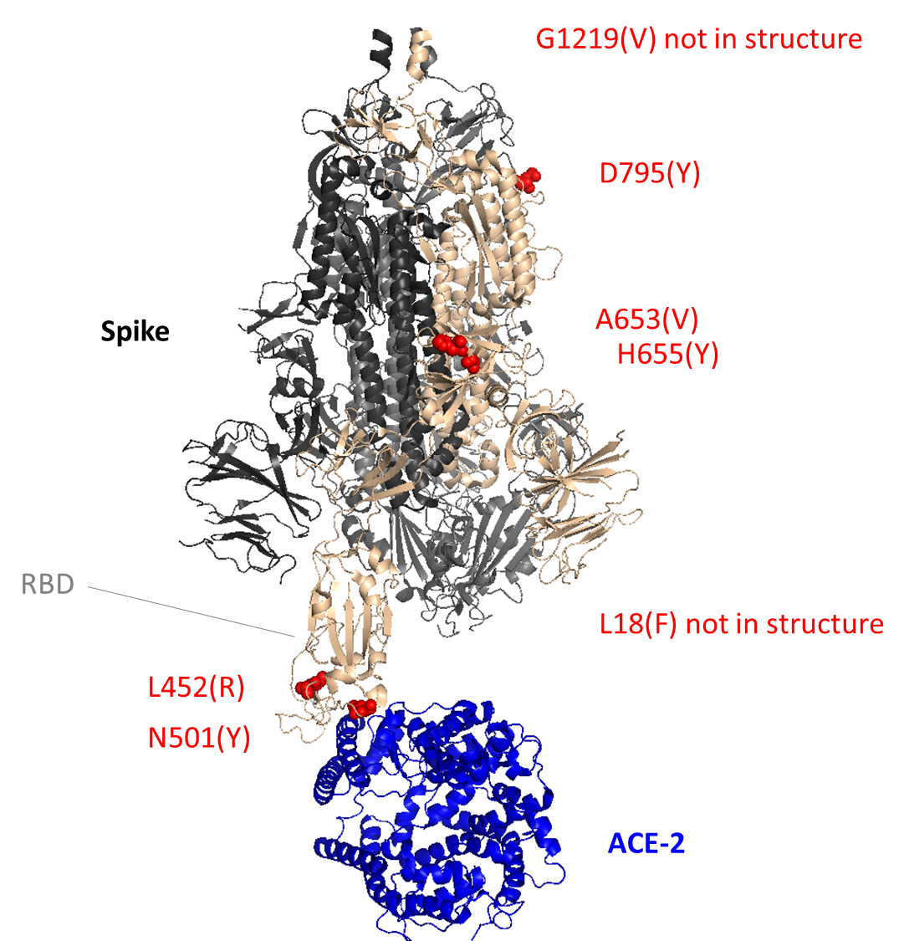
Percentages of VOCs in random sequence pool 2021
B.1.1.7
B.1.351
P.1
B.1.1.7/501.V1; Spike: ΔH69/ΔV70, ΔY144, N501Y, A570D, P681H, T716I, S982A, D1118H
B.1.351 /501.V2; Spike: L18F, D80A, D215G, R246I, K417N, E484K, N501Y, A701V
P.1 /501.V3; Spike: L18F, T20N, P26S, D138Y, R190S, K417T, E484K, N501Y, H655Y, T1027I, V1176F

Slide 4
WHO Definitionen: Variants of Concern (VOC) / Variants of Interest (VOI) (27.04.21)

Slide 5
Beobachtung von VOC/VOI für Deutschland am RKI
AG Integrierte Molekulare Surveillance (IMS)
Stefan Kröger, Stefan Fuchs, Torsten Semmler, Thorsten Wolff
Jour Fixe (wöchentlich)
MS-Labornetzwerk: Steering, Reporting
RKI-Sequenzierbericht, BMG (wöchentlich)
Variantenbericht, RKI-Webseite (wöchentlich) inkl.
Virologische Bewertung von Surveillancedaten
Screening auf VOCs, VOIs
AG Virusevolution
Max von Kleist, Sebastien Calvignac-Spencer
Conference Call, 14-tägig
Evolutionsbiologische Bewertung von Surveillancedaten
- In silico Tools zur Erfassung von Mutationen
DESH
Screening auf VOCs, VOIs
Meldedatengruppe, Abt. 3
Silke Buda, Claudia Sievers
Analyse der Meldedaten u.a. hinsichtlich Schwere, Altersgruppen
Modellierung und Trends

Slide 6
Festlegung SARS-CoV-2 VOC/VOI für Deutschland
(AG Diagnostik, 20.04.2021 - Entwurf)
AG Integrierte Molekulare Surveillance (RKI)
AG Virusevolution (RKI)
Int. VOC-Gruppe: Abt. 3 / Abt.1 / MF
Vorschlag für eine VOC/VOI mit zusammenfassenden Bericht zur Datenlage (Muster A.27)
Leitung/Krisenstab
ext. „VOC-Beirat“ (?)
WHO / ECDC
- Meldung: Notiz über EWRS
- Kontakt: WHO SARS-CoV-2 Virus Evolution Working Group; ECDC
(Dorit Nitzan (nitzankaluskid@who.int; Chantal Reusken chantal.reusken@rivm.nl; Erik.Alm@ecdc.europa.eu)

Slide 7
Mögliche Mitglieder, ext. VOC- Beirat
VIROLOGIE: C. Drosten (Charité), S. Smola (Homburg/Saar), J. Ziebuhr (Giessen),
STIKO: T. Mertens (Ulm),
ÖGD: R. Gottschalk (Frankfurt a.M.),
KLINIK: M. Pletz (Jena),
IMPFSTOFFe: E. Hildt (PEI, Langen),
EXP. ANALYSE: M. Beer (FLI)

