Slide 1
Einstufung B.1.617 als VOC/VOI
12. Mai 2021

Slide 2
Einschätzung von ECDC, WHO, PHE
ECDC (11.05.21):
"At this time, ECDC maintains its assessment of B.1.617.1,B.1.617.2 and B.1.617.3 as variants of interest and will continue to actively monitor the situation.“ tbc.
WHO (11.05.21, SITREP):
B.1.617 sublineages appear to have higher rates of transmission, including observed rapid increases in prevalence in multiple countries (moderate evidence available for B.1.617.1 and B.1.617.2), and
Preliminary evidence suggests potential reduced effectiveness of Bamlanivimab, a monoclonal antibody used for COVID-19 treatment, and potentially slightly reduced susceptibility to neutralisation antibodies (limited evidence available for B.1.617.1).
PHE (07.05.21, tech. Brief.):
„VUI-21APR-02 (B.1.617.2) was escalated to a variant of concern on 6 May 2021 (VOC-21APR-02). It is assessed as having at least equivalent transmissibility to B.1.1.7 based on available data (moderate confidence). There are insufficient data currently to assess the potential for immune escape.”

Slide 3
Epi Curve B.1.617.1 (108) , B.1.617.2 (118), B.1.617.3 (1) (Stand 11.05.)
 | STICHPROBE | UNBEKANNT | VERDACHT
2021-KW09 | 5
2021-KW10 | 1 |  | 2
2021-KW11 | 2
2021-KW12 | 3
2021-KW13 |  | 2 | 3
2021-KW14 | 4 | 6 | 3
2021-KW15 | 10 | 13 | 7
2021-KW16 | 33 | 17 | 20
2021-KW17 | 31 | 16 | 23
2021-KW18 | 19 | 7
 | 108 | 61 | 58

Slide 4
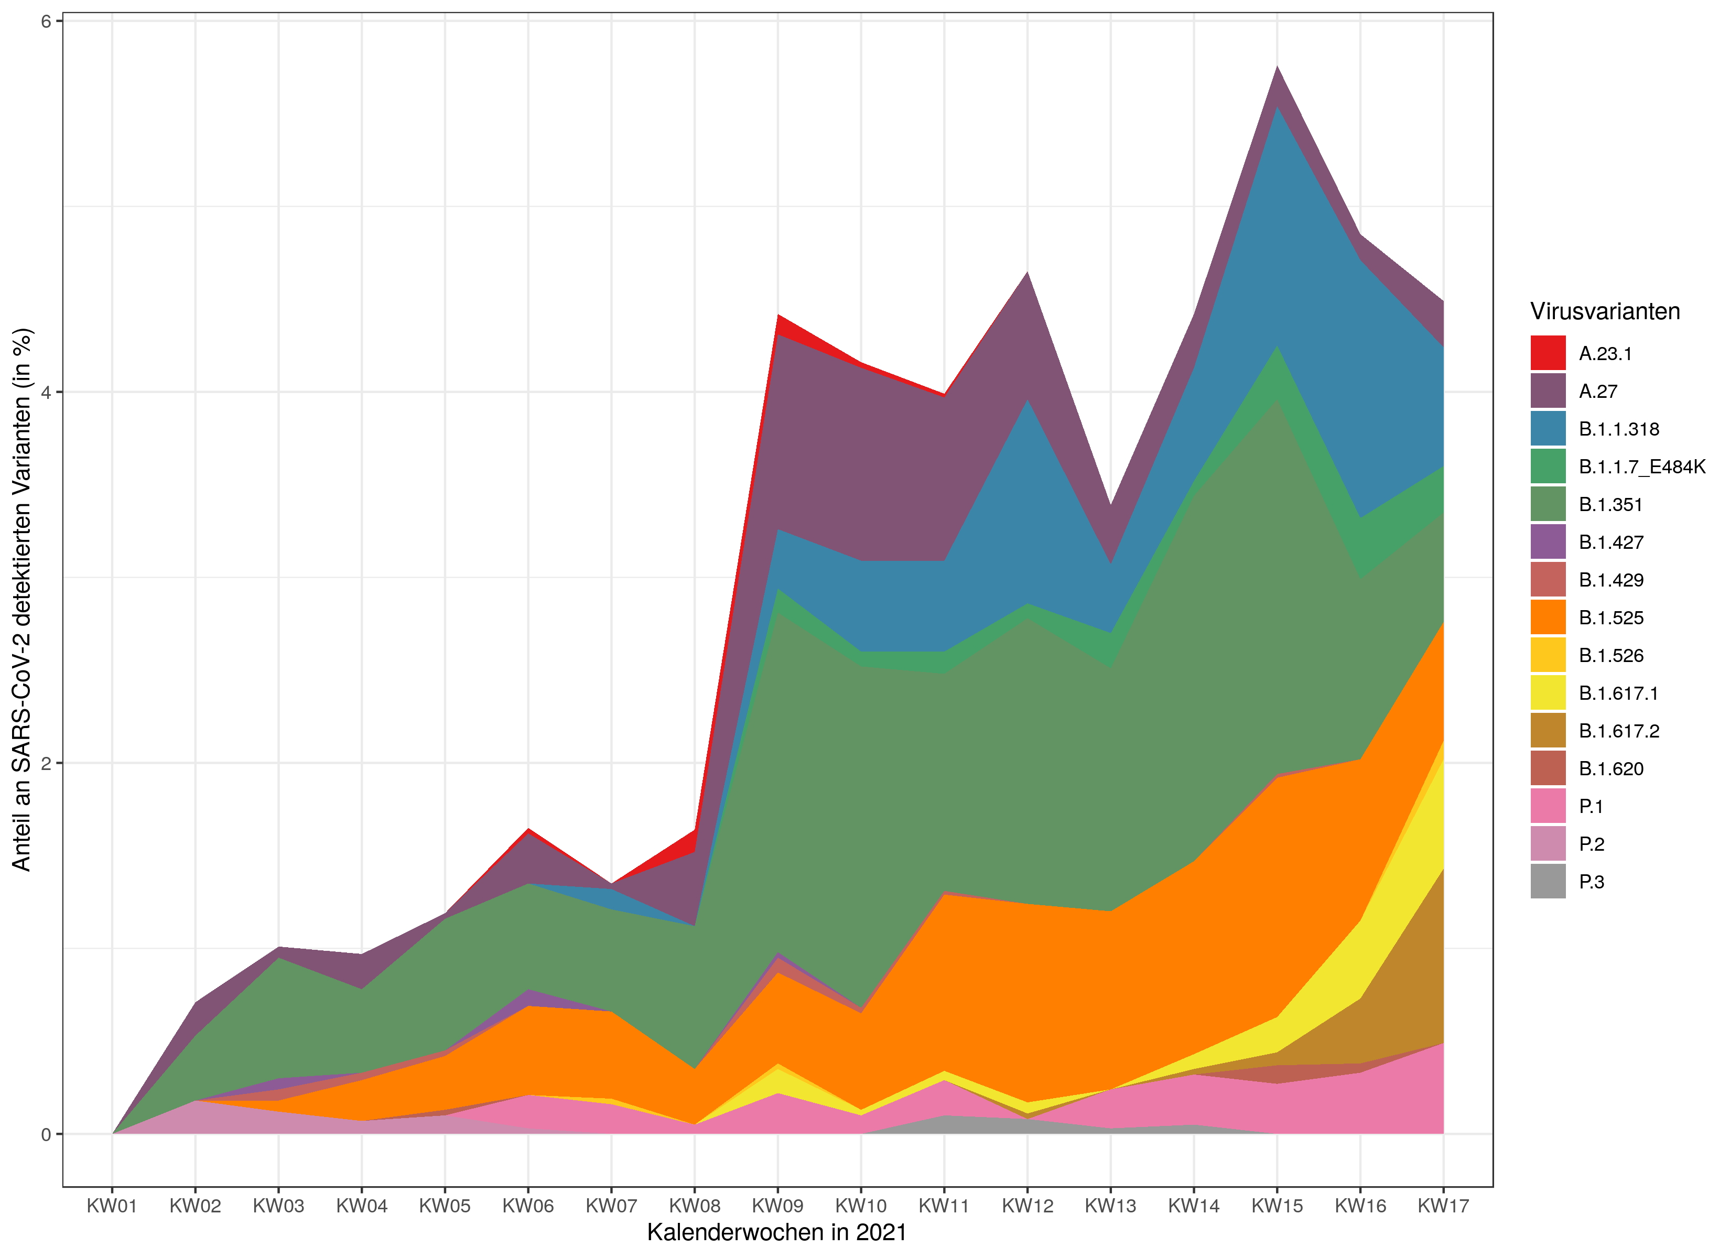
Anteil von B.1.617.x unter VOC/VOI ohne B.1.1.7

Slide 5
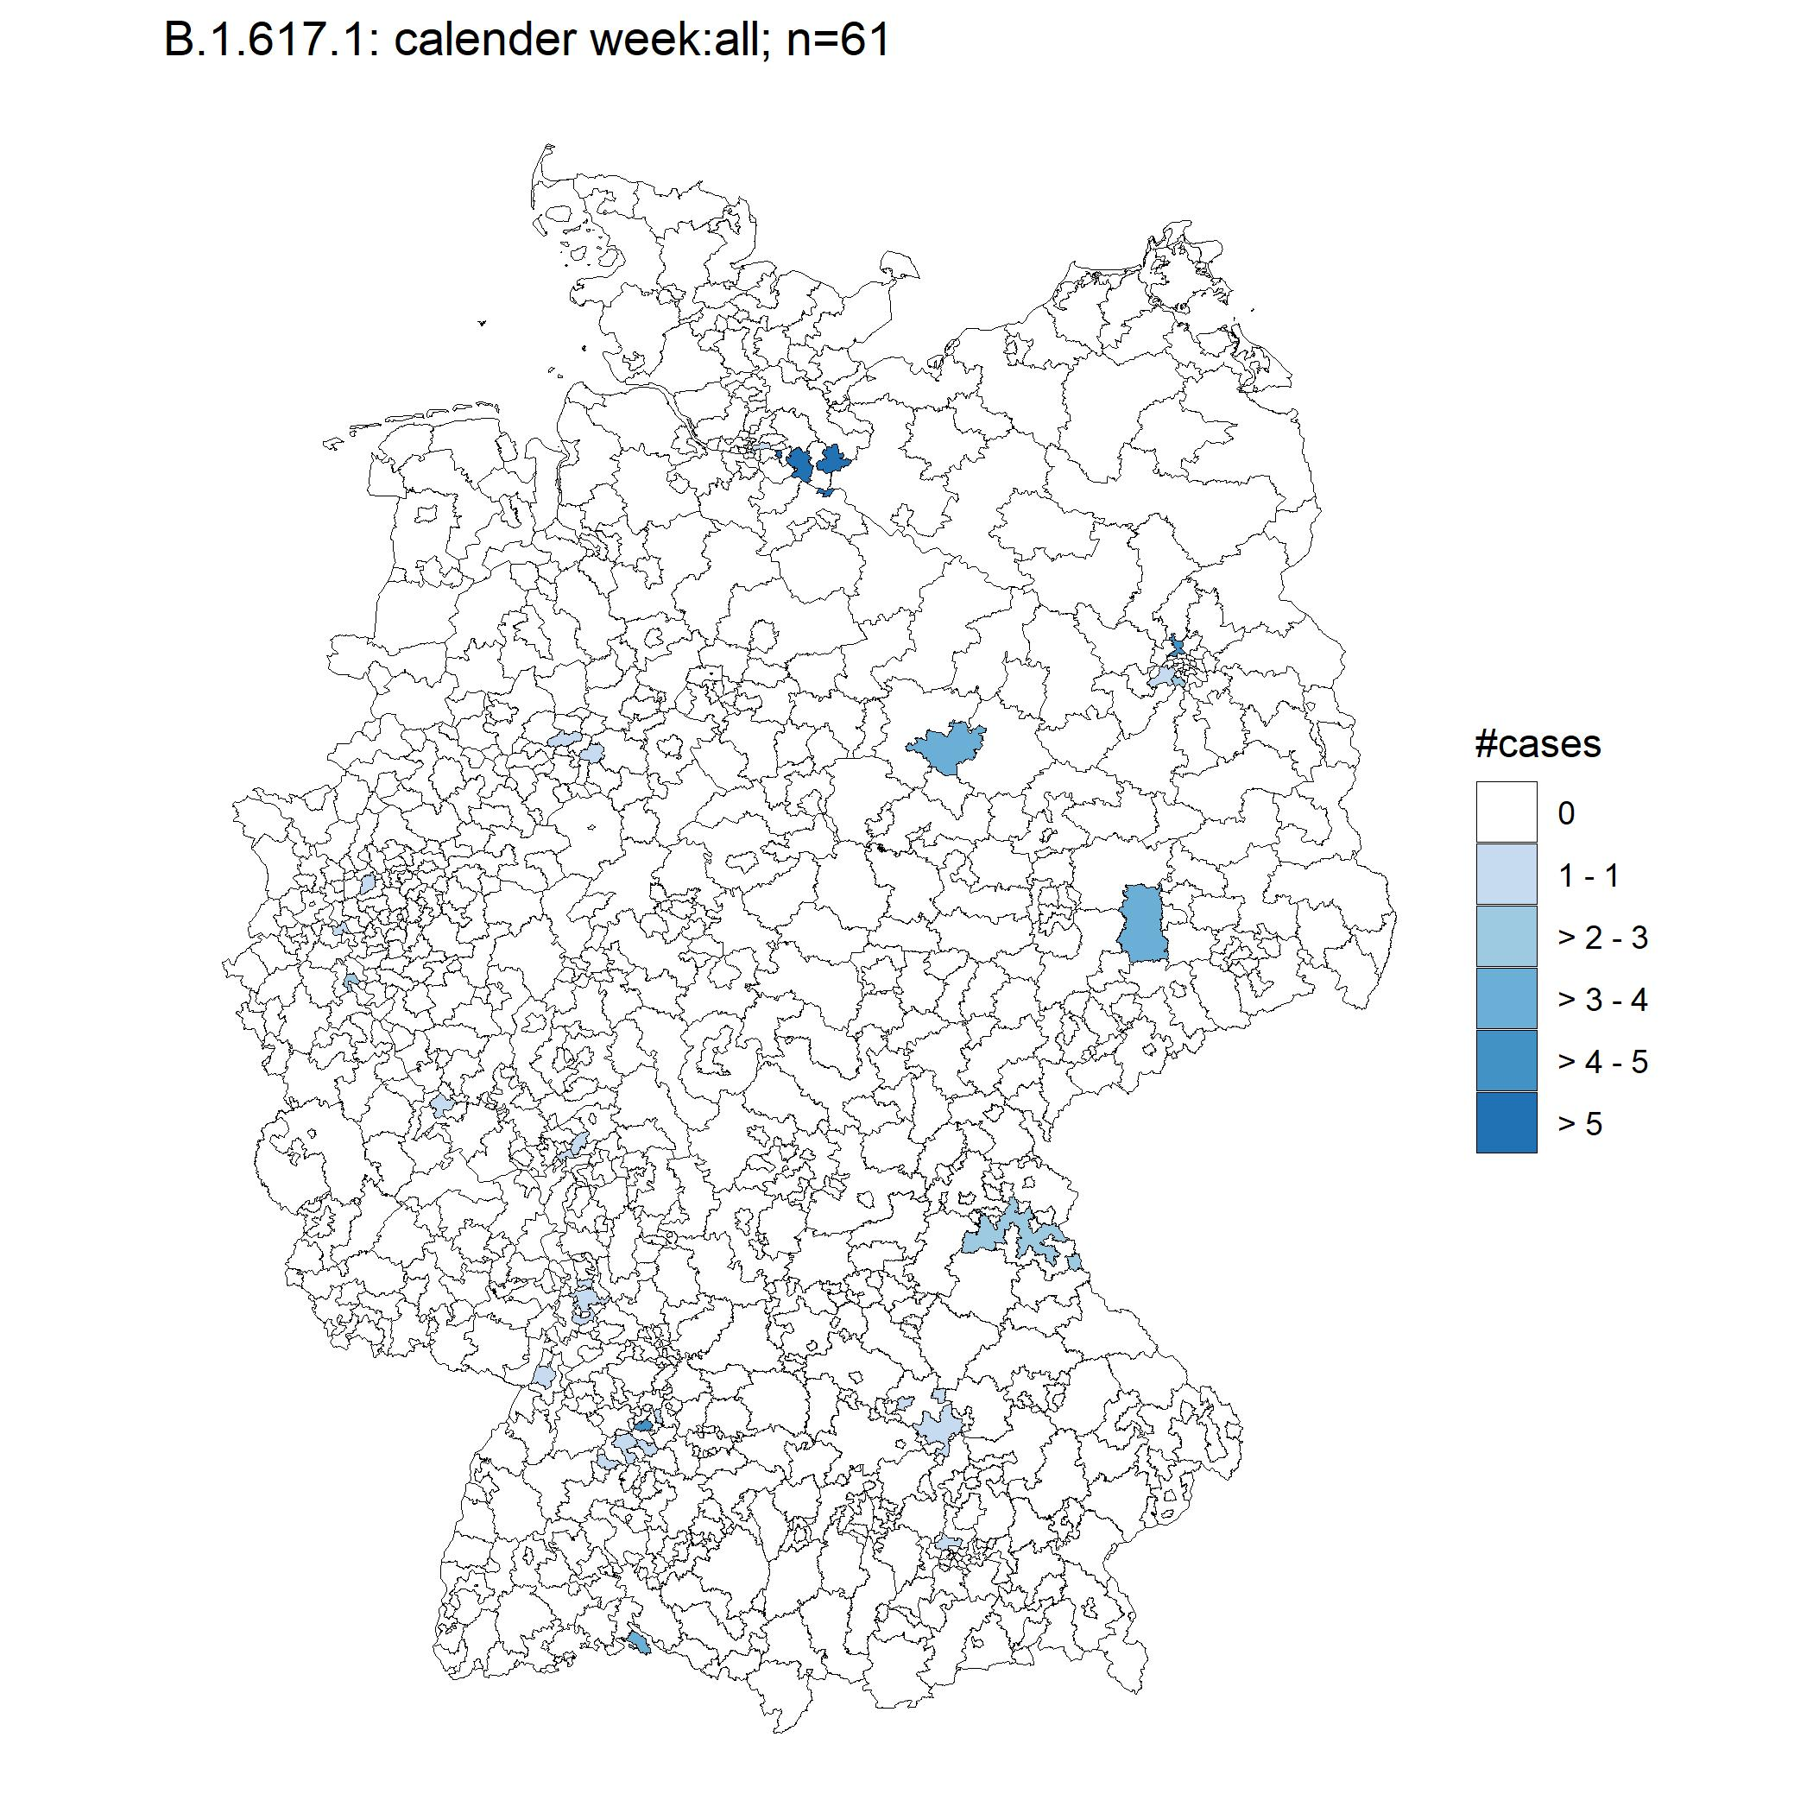
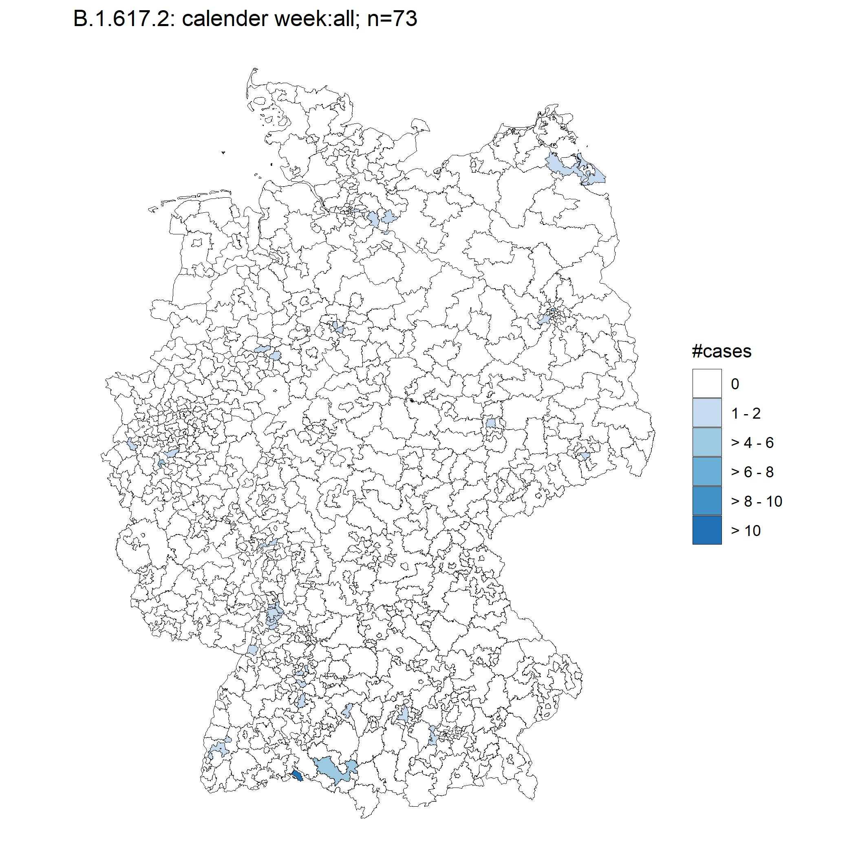
Geographic distribution (Stand 07.05.)

Slide 6
Geographic distribution / travel history (Stand 07.05.)

Slide 7
Age groups / hospitalization – mortality (Stand 07.05.)
Hosp | Died | B.1.617.1 | B.1.617.2 | B.1.617.3
yes | no | 1 | 3 | 0
no | no | 12 | 8 | 0
NA | NA | 49 | 57 | 1
unkown | no | 4 | 7 | 1

Slide 8
Zusammenfassung
Stark Steigenden Fallzahlen seit KW15 bei sinkender Inzidenz (gesamt)
Es wird eine erhöhte Übertragbarkeit/Fitness vergleichbar mit B.1.1.7 vermutet (UK, WHO, KL)
Nur für wenige Fälle liegen Information zur Exposition im Ausland vor → Geschehen in D unklar
Starker Anstieg der Fallzahlen von B.1.617.2 in UK, suspected community Transmission in einigen Region
Einstufung als VOC ermöglich
Gezieltes Testen (target PCR) mit Kostenerstattung im Rahmen der VO
Gezieltes Sequenzierung bei Verdacht auf Vorliegen (auch ohne Reiseanamnese o.ä.)
Keine Unterscheidung von B.1.617.1 und B.1.617.2 da Differenzierung nur per NGS praktikabel

Slide 9
Definitions: Viruses of Concern (VOC), Viruses of Interest (VOI), WHO -25.02.2021
(https://www.who.int/publications/m/item/covid-19-weekly-epidemiological-update)
Working Definition of “SARS-CoV-2 Variant of Concern”
A VOI (as defined above) is a variant of concern (VOC) if, through a comparative assessment, it has been demonstrated to be associated with
• Increase in transmissibility or detrimental change in COVID-19 epidemiology;
• Increase in virulence or change in clinical disease presentation; or
• Decrease in effectiveness of public health and social measures or available diagnostics, vaccines, therapeutics.
OR
assessed to be a VOC by WHO in consultation with the WHO SARS-CoV-2 Virus Evolution Working Group
Working Definition of “SARS-CoV-2 Variant of Interest”
A SARS-CoV-2 isolate is a variant of interest (VOI) if it is phenotypically changed compared to a reference isolate or has a genome with mutations that lead to amino acid changes associated with established or suspected phenotypic implications;
AND
has been identified to cause community transmission2/multiple COVID-19 cases/clusters, or has been detected in multiple countries;
OR
is otherwise assessed to be a VOI by WHO in consultation with the WHO SARS-CoV-2 Virus Evolution Working Group.

Slide 10
Andere VOI

