Slide 1
COVID-19 Containment Measures Analysis
2021
2021
Exemptions from COVID-19 containment measures for fully vaccinated, recently recovered and negatively tested individuals, February - May 2021
One shot/Full vaccination coverage
  Germany (32.59/9.33 %), France (26.39/11.5 %), United Kingdom (52.25/26.30 %), Bahrain (46.85/34.01 %), United States (45.48/34.16 %), Chile (44.78/37.37 %), Israel (62.64/58.68 %), as of 9 May, 2021
Today

Slide 2
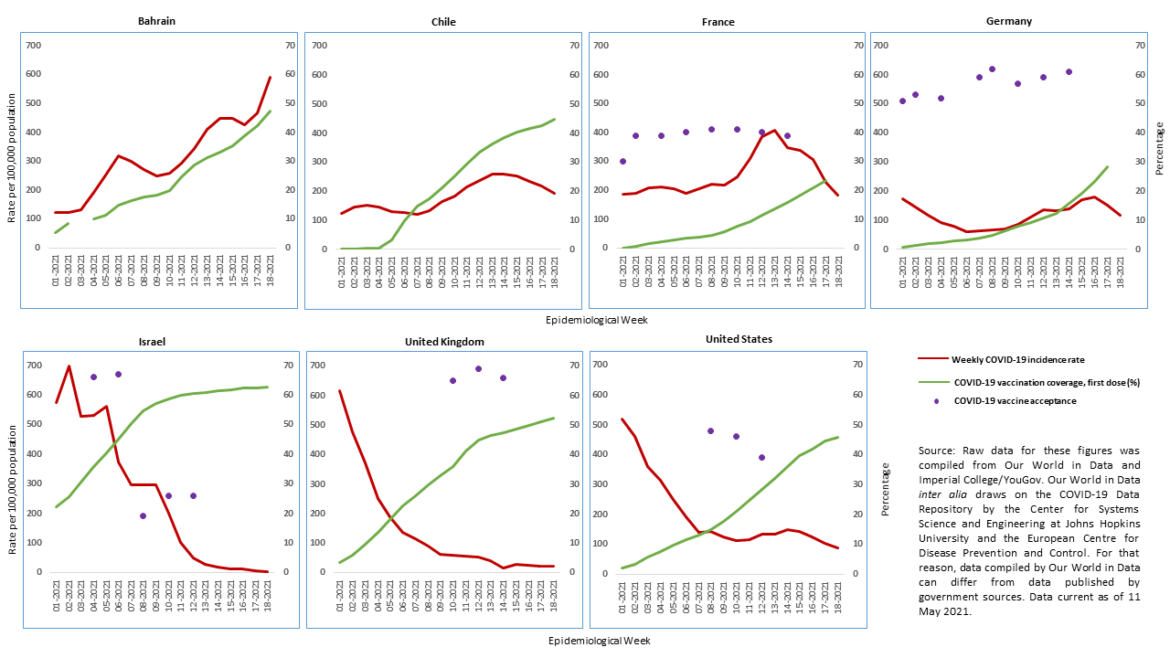
COVID-19 Incidence, Vaccination Coverage (One Dose), and Vaccine Acceptance, February – May 2021

Slide 3
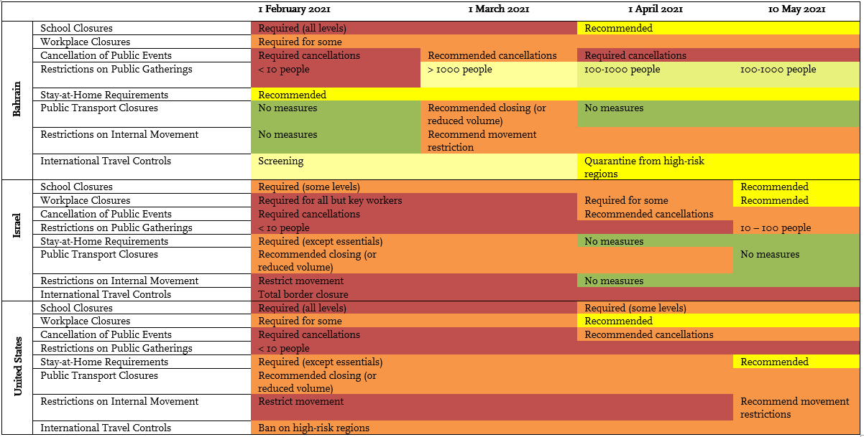
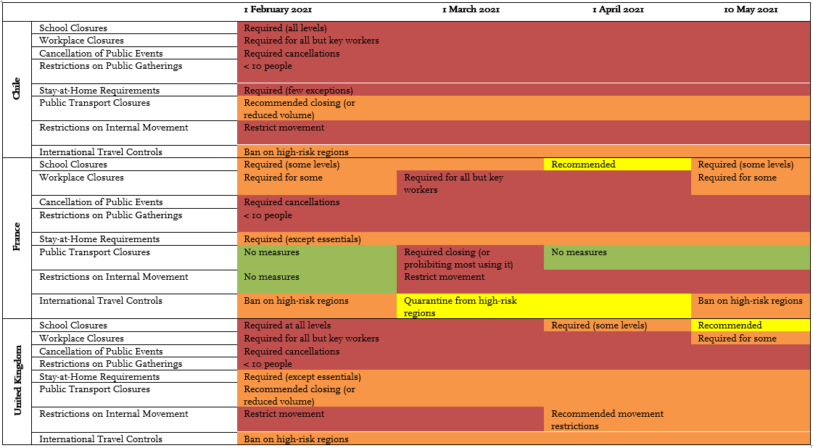
Heatmap COVID-19 Containment Measures
Source: Oxford COVID-19 Government Response Tracker/Our World in Data.

Slide 4
Trends in Exemptions from Containment Measures
4/7 countries provide exemptions for fully vaccinated as well as recently recovered individuals
  Both categories treated nearly the same
Most exemptions for leisure, international travel
 | Universal vaccination
Exemptions |  | Yes | No
 | Yes | BHR, ISR, USA | DEU
 | No |  | CHL, FRA*, GBR*
 | Vaccine acceptance
Exemptions |  | Higher | Lower
 | Yes | DEU | USA, ISR
 | No | GBR*, CHL | FRA*
* Exemptions for fully vaccinated and/or recently recovered individuals are currently under discussion in France and the United Kingdom.

Slide 5
Risks and Policy Recommendations
Risks
  Viral circulation high, vaccination coverage < 40% in 6/7 countries (BHR, CHL, DEU, FRA, GBR, USA)
  High incidence in 2 countries with implemented or planned exemptions (BHR, FRA)
Recommendations
  If countries grant exemptions while vaccination coverage remains low and no universal vaccination:
    Continue to communicate importance of mask wearing, physical distancing, hand washing, ventilation
    Communicate concrete perspective to rest of population when vaccination will be offered

