Slide 1
COVID-19 Containment Measures Analysis
2021
2021
Recognition of “fully vaccinated”-status, vaccination schemes and vaccination certificates and exemptions from testing and quarantine during international travel, February - May 2021
Full vaccination coverage
Germany (11.21%), France (13.15%), United Kingdom (29.88%), Bahrain (37.27%), United States (39.28%), Israel (58.89%), Seychelles (62.67%) as of week 19, 2021 (Our World in Data)
Today

Slide 2
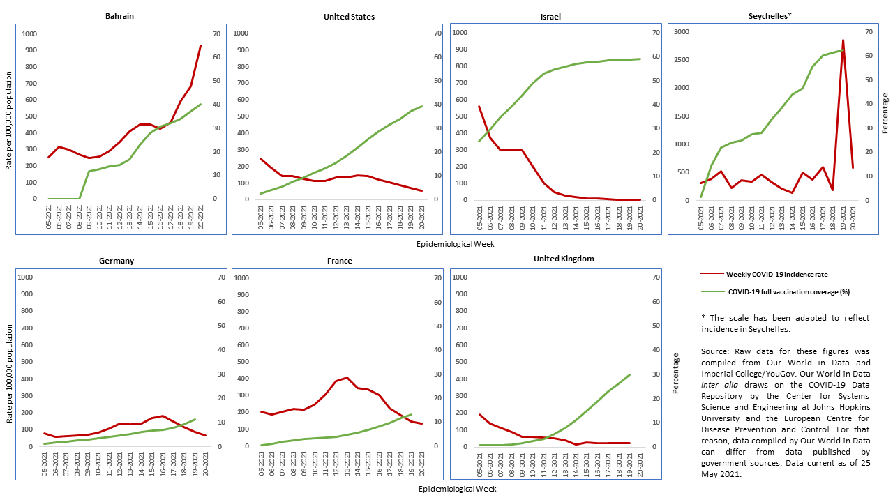
COVID-19 Incidence and Full Vaccination Coverage, February – May 2021

Slide 3
Heatmap COVID-19 Containment Measures
Source: Oxford COVID-19 Government Response Tracker/Our World in Data.

Slide 4
Mutual Recognition of „Fully Vaccinated“-Status and Travel Exemptions
Variation in accepted vaccines
DEU, FRA (EU), ISR only accept vaccinations with vaccines admitted in their countries, SYC accepts any vaccine
Patchwork of vaccination certificates
BHR, DEU grant exemptions from testing requirements for international travelers under certain conditions
BHR, DEU, ISR, USA countries grant exemptions from quarantine for international travelers under certain conditions

Slide 5
Risks and Policy Recommendations
More countries grant exemptions from quarantine after international travel than exemptions from testing before travel
Risk of cross-country transmission?
Obstacles to international travel
Uneven recognition of vaccines, no internationally agreed vaccination certificate (yet)
Governments should recognize international travelers’ vaccination status on the basis of scientific evidence

