Slide 1
IPPPR Report
28 May 2021
Krisenstab RKI

Slide 2
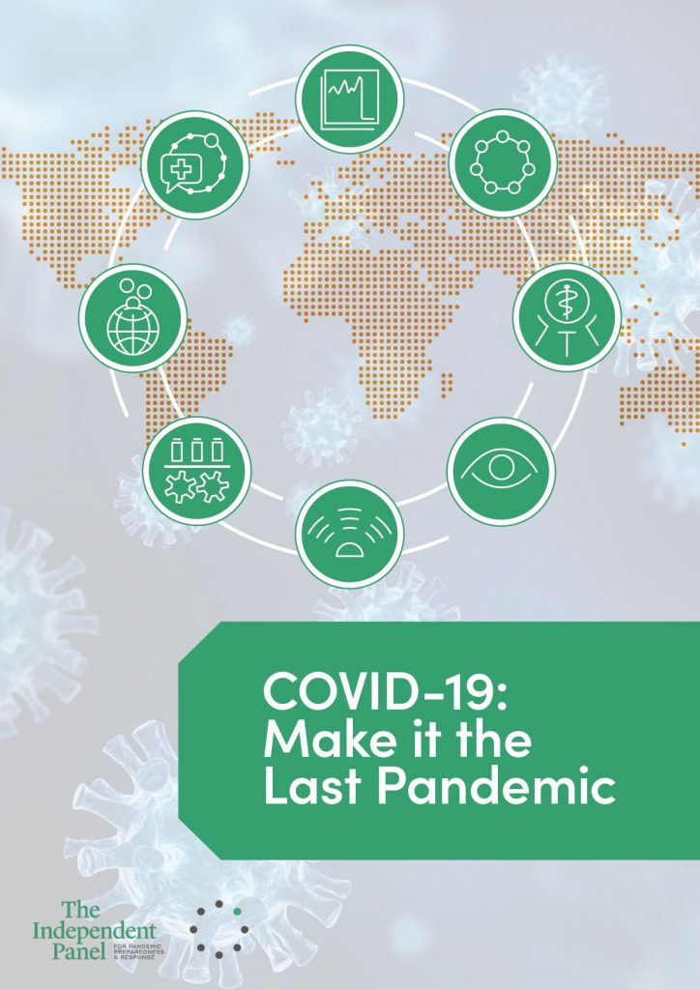
Independent Panel for Pandemic Preparedness and Response
Established in July 2020 by WHO DG to carry out an impartial, independent and comprehensive evaluation of the WHO-coordinated international health response to COVID-19
Active: September 2020 to May 2021
“The mission of the Independent Panel is to provide an evidence-based path for the future, grounded in lessons of the present and the past to ensure countries and global institutions, including specifically WHO, effectively address health threats.”
Report published in May 2021 (https://theindependentpanel.org/mainreport/)

Slide 3
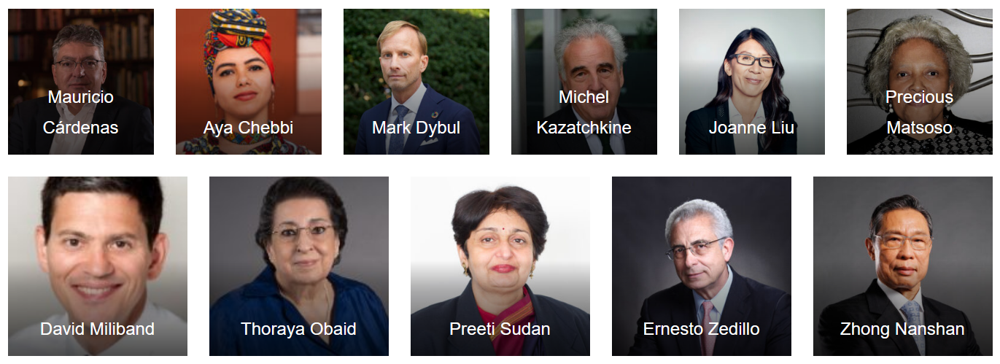
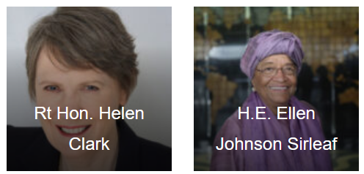
IPPPR Members
13 members
Co-chairs: H.E. Ellen Johnson Sirleaf (Liberia), Rt Hon Helen Clark (New Zealand)
Independent Secretariat headed by Anders Nordström

Slide 4
IPPPR Tasks
Assess the overall relevance and effectiveness of the international health response to the COVID-19 pandemic;
Assess the functioning of the International Health Regulations (2005) and the status of implementation of the relevant recommendations of previous IHR Review Committees;
Assess the effectiveness of the mechanisms at WHO’s disposal and the actions of WHO and their timelines pertaining to the COVID-19 pandemic;
Assess WHO’s contribution to United Nations-wide efforts;
Examine global health security threats and provide an analysis of past and future challenges and lessons learned
Analyse the broader impacts of pandemics, including economic and social ones, and make recommendations to the extent that they have a direct bearing on future threats to global health security
Make recommendations to improve capacity for global pandemic prevention, preparedness, and response, including through strengthening, as appropriate, the WHO Health Emergencies Programme

Slide 5
IPPPR Main Findings - 1
Lessons of the past have not been learned:
Preparedness was underfunded and not stress-tested.
International alert was too slow.
Even after PHEIC declaration, still “wait and see” approach in many countries delaying adequate response.
WHO is and should remain leading organization on health, but has insufficient authority and funding.
Not enough political commitment to health at country level (Health Threats Council is suggested at level of heads of state).
Lack of planning and gaps in social protection resulted in the pandemic widening inequalities.

Slide 6
IPPPR Main Findings - 2
Health workers have been tireless in their efforts. They need much more support and protection.
Successful national responses built on lessons from previous outbreaks (SARS, EVD) and/or had response plans which they could adapt.
Country wealth was not a predictor of success.
Vaccines were developed at unprecedented speed.
Open data and open science collaboration were central to alert and response.

Slide 7
IPPPR Main Recommendations
Apply non-pharmaceutical measures systematically and rigourously
Equitable vaccination
Distribute vaccines equally
Share licences
Accelerate production (including financing by G7 states)
In the long run: change from market model to global public goods model
Adopt a Pandemic Framework Convention (within six months)
Strengthen independence, authority and funding of WHO
New international alert system that does not require member states’ approval
“Prethink” platforms for medical tools development and supply
New financing facility to provide long-term and predictable funding as well as surge funding for crisis response
„COVID-19 should become the last pandemic.“

Slide 8
THANK YOU!

