Slide 2
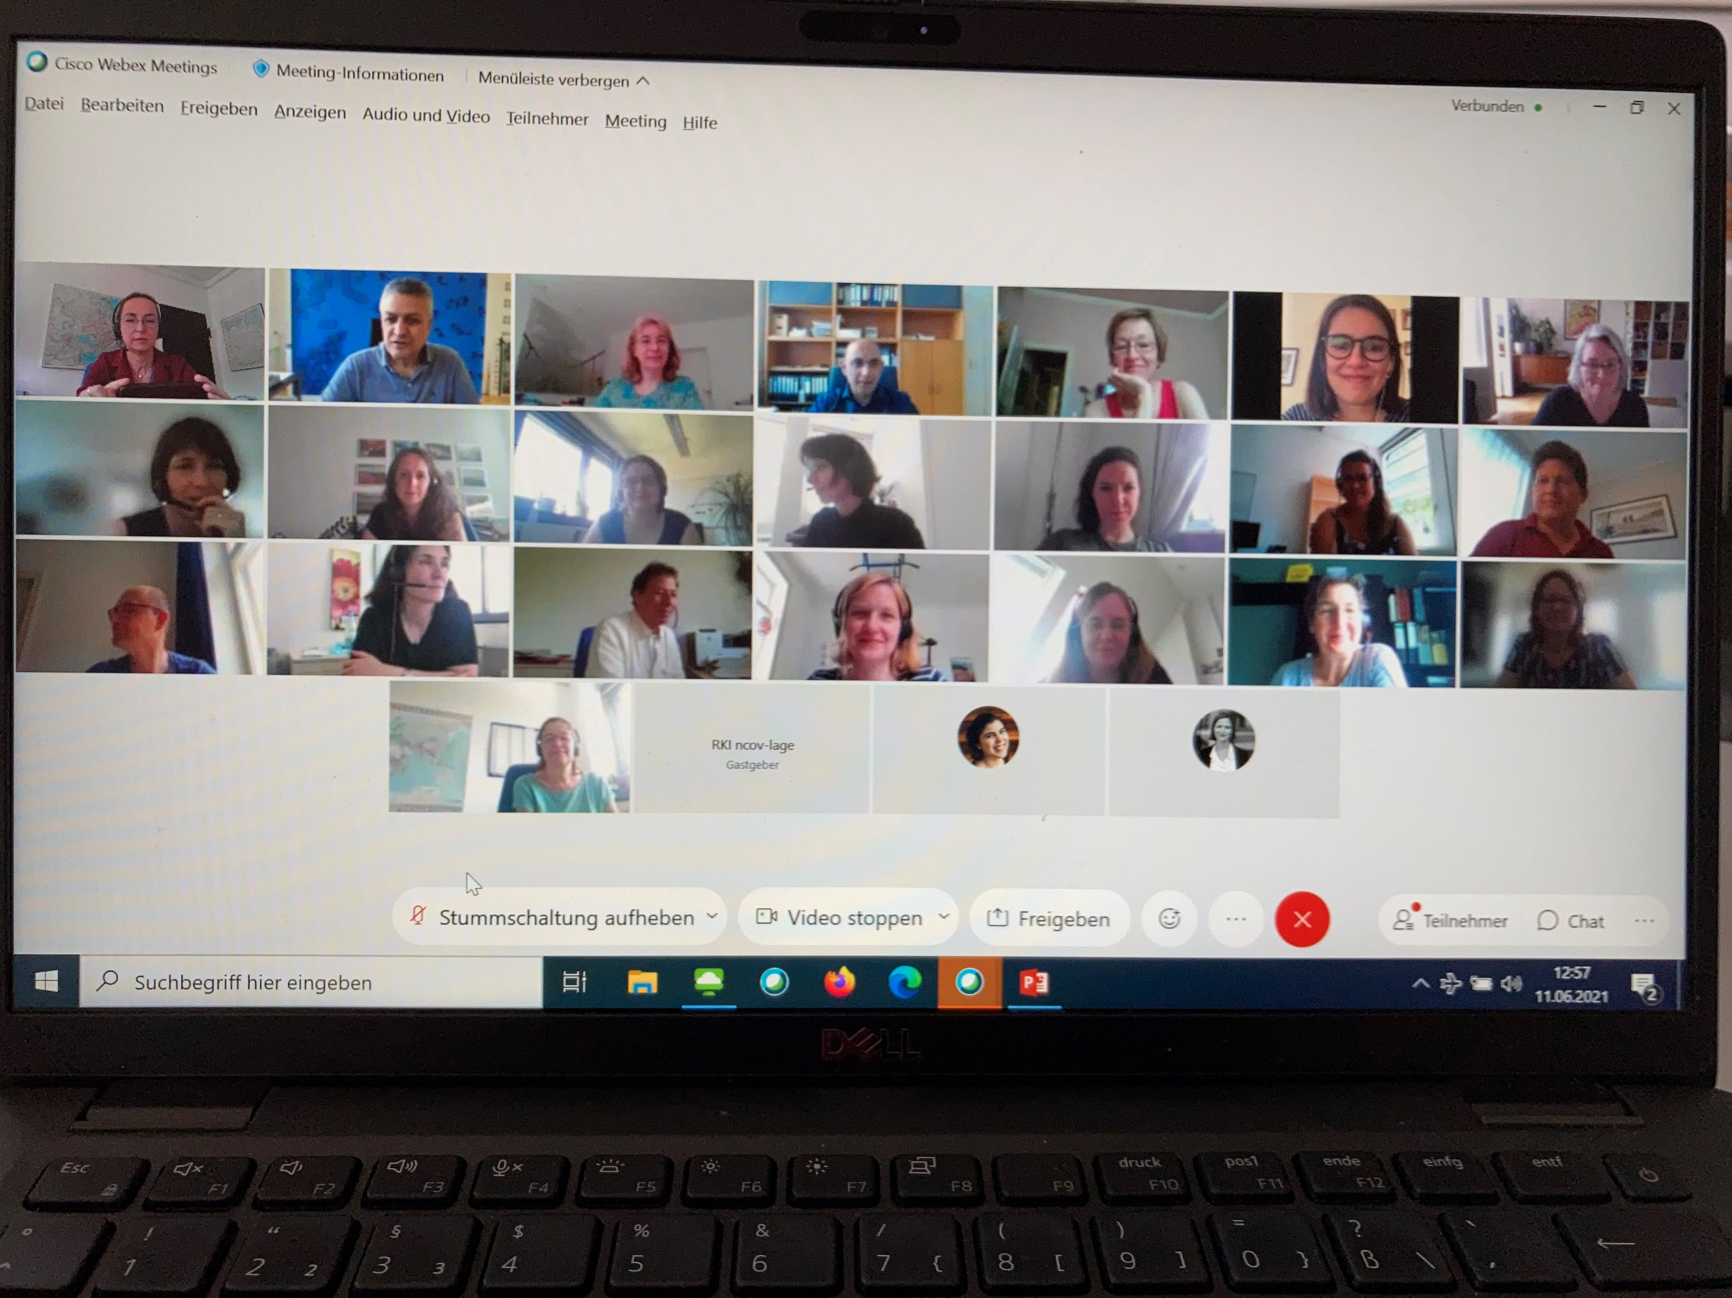
RKI-Krisenstab zu COVID-19

