Slide 1
COVID-19 Containment Measures Analysis
2021
2021
Countries with high vaccination coverage that recently experienced surges in COVID-19 incidence
Countries: Bahrain, Chile, Seychelles, the United Kingdom, Uruguay (and Germany)
1 March to 29 June 2021
Today

Slide 2
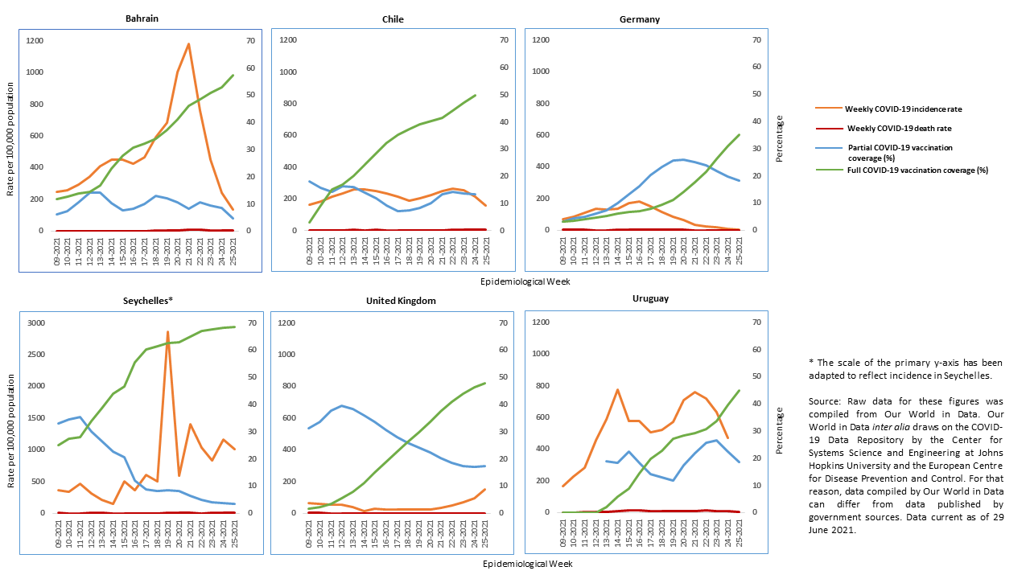
COVID-19 Incidence, Death Rates and Vaccination Coverage, March – June 2021

Slide 3
COVID-19 Containment Measures
Source: Oxford COVID-19 Government Response Tracker/Our World in Data.

Slide 4
Possible Reasons for Surges in Incidence
Premature loosening of COVID-19 containment measures.
Reduced compliance with physical distancing requirements, including by individuals with incomplete vaccination coverage.
Effectiveness Sinovac early after first dose especially low.
Spread of Variants of Concern (Gamma, Delta).

Slide 5
Recommendations
While vaccination campaigns are ongoing, risk communication should continue to emphasize the importance of protective measures for all individuals, including physical distancing and mask wearing.
National vaccination campaigns should strive to reach unvaccinated individuals. Continued high incidence worldwide entails a continued risk that further Variants of Concern may emerge and spread. Therefore, vaccination campaigns should also be considered a global effort.
Genomic surveillance remains crucial, even with higher vaccination coverage, since new Variants of Concern can spread quickly.

Slide 6
Extra Slides

Slide 7
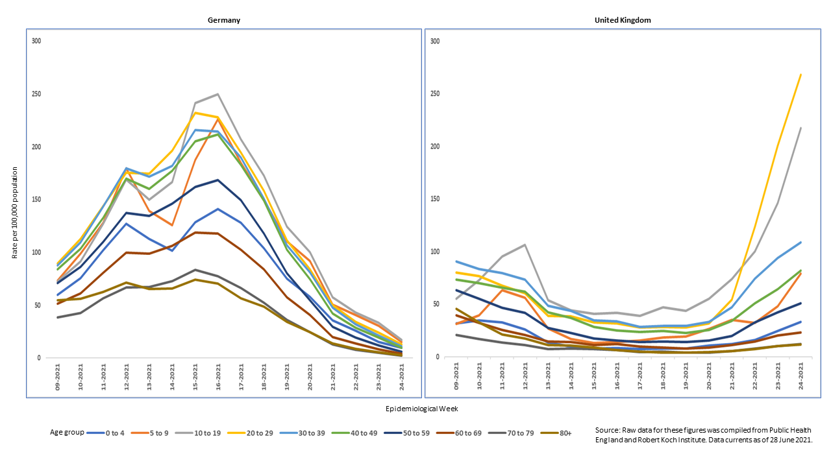
COVID-19 Incidence by Age Group, March – June 2021

