Slide 1
COVID-19 Containment Measures Analysis, Issue 7
2021
2021
Health outcomes by age group
Chile, Germany, Spain, United Kingdom, United States
12 April – 5 September 2021
Today

Slide 2
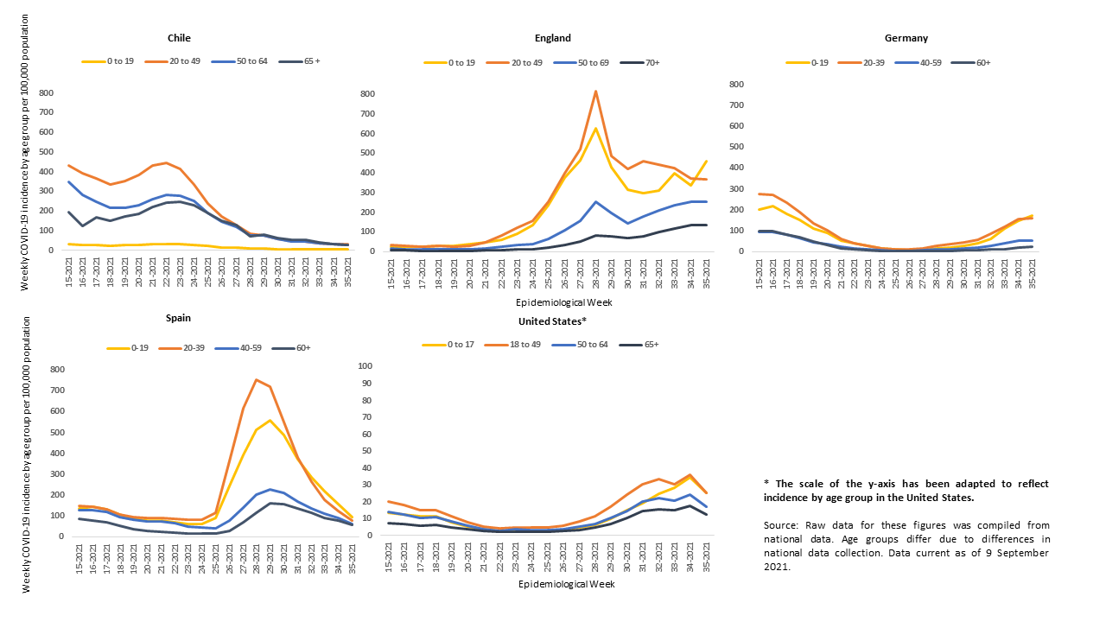
Weekly COVID-19 Incidence by Age Group

Slide 3
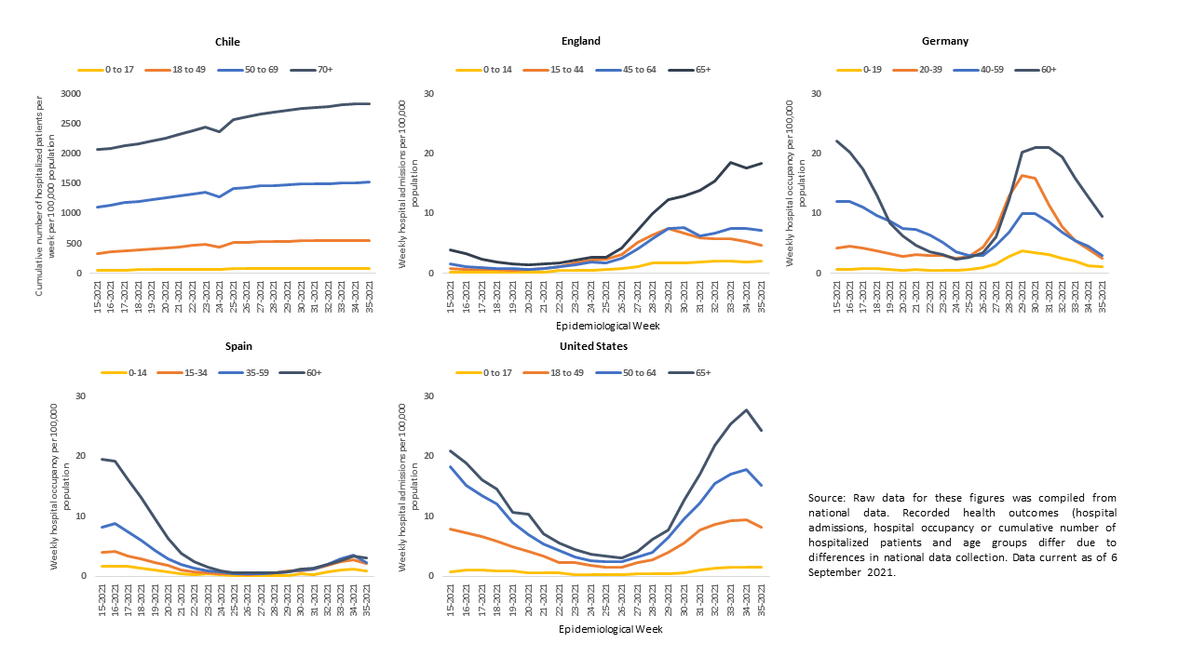
Weekly Hospital Admissions, Occupancy and Cum. Hospitalizations by Age Group

Slide 4
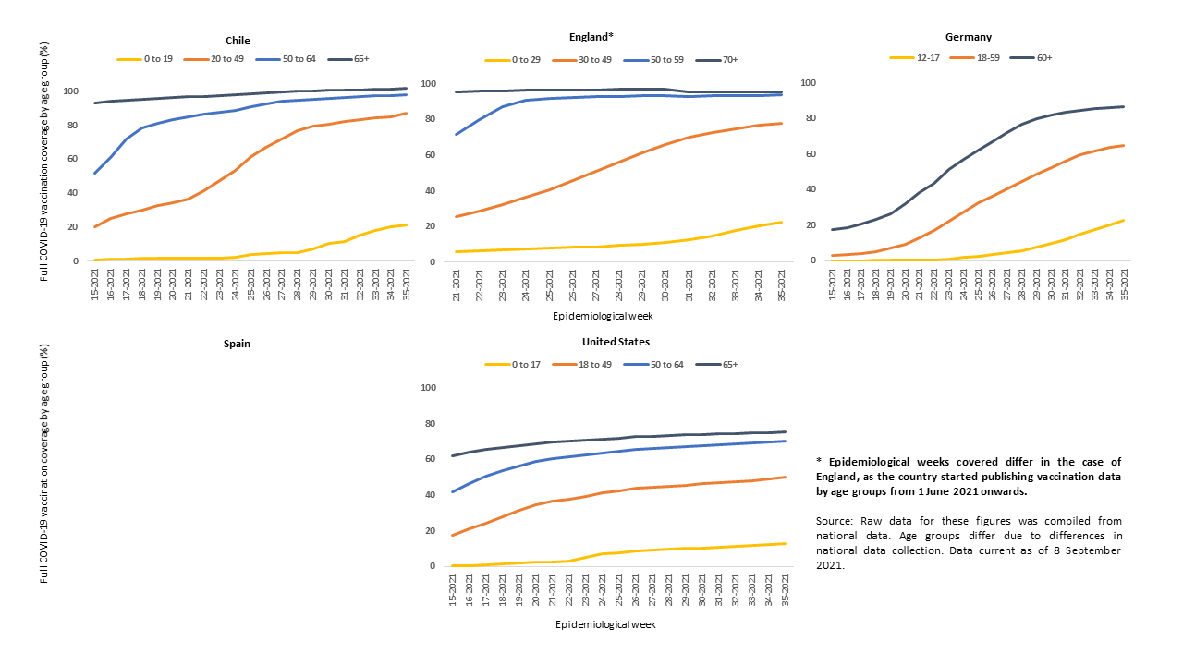
Full Vaccination Coverage by Age Group

Slide 5
Recommendations
Data Collection and Dissemination
  Countries should investigate vaccination status across a range of COVID-19 health outcomes, including infection and hospitalization.
  Countries should also share these data internationally, to inform the development of responses to mobilize unvaccinated members of the population.

