Slide 1
Systematic review of empirical studies comparing the effectiveness of non-pharmaceutical interventions (NPIs) against COVID-19
01.12.2021
Alba Mendez Brito, Francisco Pozo Martin

Slide 2
Objective
To identify which non pharmaceutical intereventions (NPIs) have been more or less effective in controlling the COVID-19 pandemic.
Methods
Systematic review of published and unpublished literature (EMBASE/ MEDLINE/ medRxiv) until March 2021
Inclusion criteria:
1) Empirical (i.e. observational or interventional) studies evaluating health outcomes
2) Any study comparing at least two NPIs in any geographical setting
All studies assesed and ranked for quality using a risk of bias tool
Mendez-Brito A, El Bcheraoui C, Pozo-Martin F. Systematic review of empirical studies comparing the effectiveness of
non-pharmaceutical interventions against COVID-19. Journal of Infection. 2021;83(3):281-93.

Slide 3
Results
34 ecological studies assessed and ranked
The comparative effectiveness of 16 NPIs, was assessed:
Early implementation: higher effectiveness in reducing cases and deaths
Comparative effectiveness of NPIs with repect to mortality related outcomes was not clear
School closing, work closing, business and venue closing and public events bans were the most effective interventions for reducing COVID-19 cases
Public information campaigns and mask wearing requirements were also effective interventions – less disruptive for the population
There was no evidence of the effectiveness of public transport closures, testing strategies, contact tracing strategies, isolation and quarantine
Mendez-Brito A, El Bcheraoui C, Pozo-Martin F. Systematic review of empirical studies comparing the effectiveness of
non-pharmaceutical interventions against COVID-19. Journal of Infection. 2021;83(3):281-93.
Notes:
School closing, work closing and public events bans – consistently among the most effective interventions in the studies assessed

Slide 4
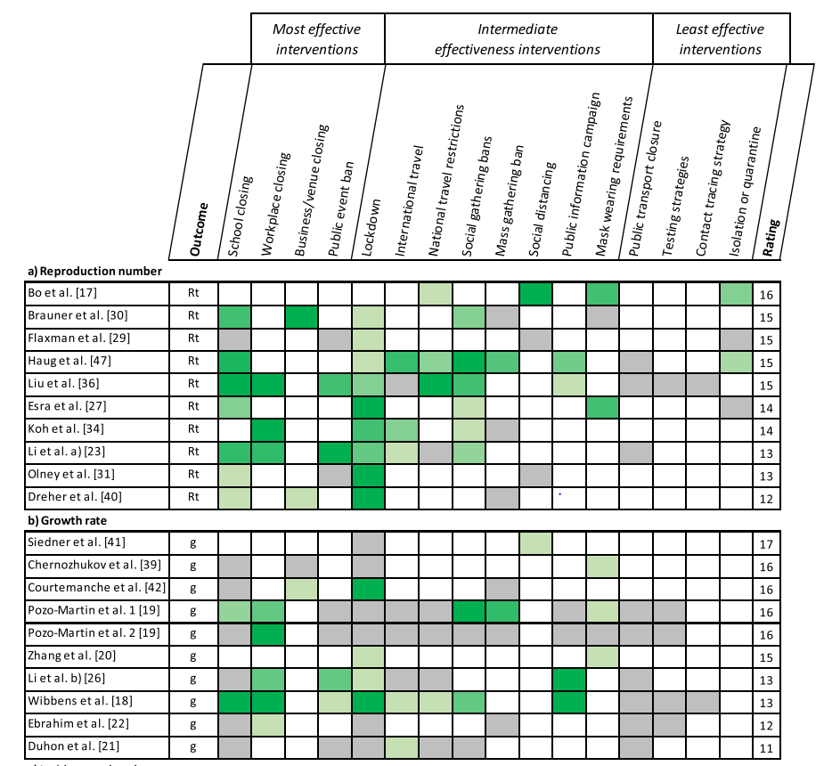
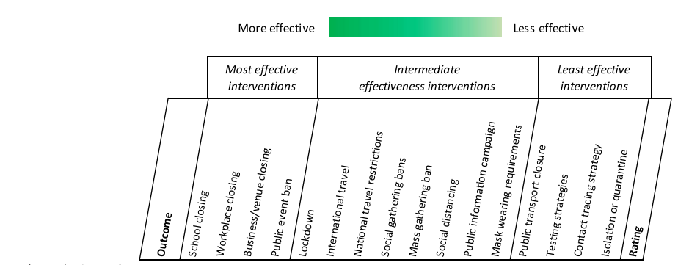
Results – Rt, epidemic growth and incidence-related outcomes
Mendez-Brito A, El Bcheraoui C, Pozo-Martin F. Systematic review of empirical studies comparing the effectiveness of
non-pharmaceutical interventions against COVID-19. Journal of Infection. 2021;83(3):281-93.

Slide 5
Conclusions
School closing, workplace closing, business and venue closing and public event bans were the most effective NPIs in controlling the spread of COVID-19.
An early response and a combination of specific social distancing measures are effective at reducing COVID-19 cases and deaths.
Continuous monitoring of NPIs effectiveness is needed in order to adapt decision making.
Mendez-Brito A, El Bcheraoui C, Pozo-Martin F. Systematic review of empirical studies comparing the effectiveness of
non-pharmaceutical interventions against COVID-19. Journal of Infection. 2021;83(3):281-93.

Slide 6
Limitations
Studies until early March 2021: Mostly susceptible population, impact of vaccination not assessed
Results of ecological studies should be carefully interpreted ≠ unequivocally causality
Testing and contact tracing strategies: improved detection ≠ rise of cases
Mendez-Brito A, El Bcheraoui C, Pozo-Martin F. Systematic review of empirical studies comparing the effectiveness of
non-pharmaceutical interventions against COVID-19. Journal of Infection. 2021;83(3):281-93.

