Slide 1
COVID-19 Containment Measures Analysis, Issue 8
2021
2021
Evidence on use and acceptance of mandatory COVID-19 vaccination policies in selected countries
Inter alia Australia, Canada, Indonesia, Latvia, Malta, Russia, the United States of America, the Vatican. Germany is included for comparison
Report sections
  Epidemiological overview: Weekly incidence and deaths per 100,000 population, full vaccination coverage
  Empirical evidence on COVID-19 vaccine effectiveness
  Overview use of mandatory COVID-19 vaccination policies in countries
  Results peer-reviewed surveys on acceptance mandatory COVID-19 vaccination policies
  Results non-peer-reviewed surveys on acceptance mandatory COVID-19 vaccination policies
Today

Slide 2
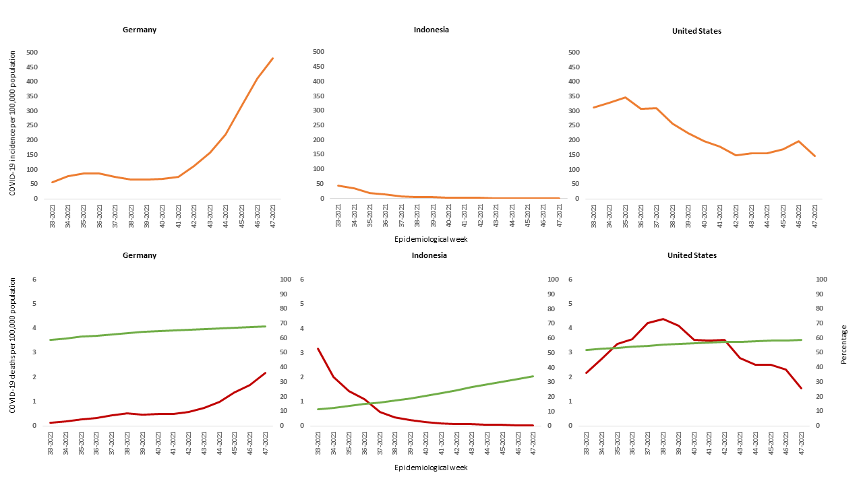
Weekly Incidence, Deaths per 100,000 Population, Full Vaccination Coverage

Slide 3
Selected Results: Overview Use of Mandatory COVID-19 Vaccination Policies
All 5 WHO regions
Mandatory COVID-19 vaccination policy for specific occupational groups
  Exceptions, sanctions for non-compliance
Mandatory COVID-19 vaccination policy for entire adult population is rare

Slide 4
Selected Peer-Reviewed Results: Acceptance Mandatory COVID-19 Vaccination Policies
Several studies reported that mandatory vaccination policies were more likely to be accepted by individuals that are willing to get vaccinated voluntarily against COVID-19
Meaning of „mandatory COVID-19 vaccination“ not defined in detail in many peer-reviewed studies: what did study participants agree and disagree with?

Slide 5
Recommendations
Decision-makers should communicate the benefits of COVID-19 vaccinations to the public, based on what is known about vaccine effectiveness.
If and when decision-makers raise mandatory COVID-19 vaccination policies in public discussions, they should communicate clearly the scope and conditions of any such policy.
The spectrum of policy options should be considered when decision-makers discuss introducing mandatory COVID-19 vaccinations, taking into account the specificities of the population and resistance that may be introduced by such an act.

