Slide 1
SARS-CoV-2 (COVID-19)
European Centre for Disease Prevention and Control
Stockholm, 17 February 2022

Slide 2
Interpretation of the data
14-day notification rates and trends are collected using epidemic intelligence from various sources and are affected by the testing strategy, laboratory capacity and the effectiveness of surveillance systems.
As all of these factors can differ greatly between countries, ECDC does not recommend using notification rates to directly compare countries. Particular caution is needed when interpreting reported rates from areas with small populations where small changes in numbers of reported cases can have a big impact on the notification rate.
In addition, retrospective adjustment of data by reporting authorities is possible. Negative counts of new cases can arise if countries or subnational areas report cumulative totals that are lower than those reported previously, which can affect the presentation of data in maps and time-series plots.

Slide 3
Distribution of COVID-19 cases in accordance with the applied case definitions in the affected countries by country, Africa, as of week 6, 2022.
Places reporting cases | Cumulative cases | Cumulative deaths
Algeria | 261 226 | 6 715
Angola | 98 514 | 1 898
Benin | 26 552 | 163
Botswana | 259 655 | 2 597
Burkina Faso | 20 705 | 375
Burundi | 37 883 | 15
Cameroon | 118 675 | 1 915
Cape Verde | 55 842 | 400
Central African Republic | 14 154 | 111
Chad | 7 216 | 190
Comoros | 8 005 | 160
Congo | 23 860 | 375
Cote dIvoire | 81 213 | 791
Democratic Republic of the Congo | 85 793 | 1 316
Djibouti | 15 534 | 189
Egypt | 454 952 | 23 349
Equatorial Guinea | 15 869 | 182
Eritrea | 9 668 | 103
Eswatini | 68 795 | 1 383
Ethiopia | 467 498 | 7 424
Gabon | 47 446 | 302
Gambia | 11 911 | 365
Ghana | 158 038 | 1 431
Guinea | 36 314 | 434
Guinea Bissau | 7 849 | 161
Kenya | 322 473 | 5 631
Lesotho | 32 372 | 696
Liberia | 7 358 | 290
Libya | 473 114 | 6 135
Places reporting cases | Cumulative cases | Cumulative deaths
Madagascar | 62 844 | 1 335
Malawi | 85 033 | 2 598
Mali | 30 265 | 716
Mauritania | 58 563 | 972
Mauritius | 70 862 | 786
Morocco | 1 155 165 | 15 781
Mozambique | 224 703 | 2 189
Namibia | 158 864 | 3 995
Niger | 8 711 | 303
Nigeria | 254 016 | 3 141
Rwanda | 129 298 | 1 450
Sao Tome and Principe | 5 920 | 71
Senegal | 85 412 | 1 957
Seychelles | 38 395 | 150
Sierra Leone | 7 652 | 125
Somalia | 26 203 | 1 340
South Africa | 3 640 162 | 96 993
South Sudan | 16 896 | 137
Sudan | 59 674 | 3 771
Togo | 36 660 | 271
Tunisia | 967 052 | 27 119
Uganda | 162 763 | 3 577
United Republic of Tanzania | 33 436 | 792
Western Sahara | 766 | 1
Zambia | 309 502 | 3 937
Zimbabwe | 231 381 | 5 374
Total | 11 088 682 | 243 977

Slide 4
Distribution of COVID-19 cases in accordance with the applied case definitions in the affected countries by country, Asia, as of week 6, 2022.
Places reporting cases | Cumulative cases | Cumulative deaths
Afghanistan | 171 076 | 7 501
Bahrain | 463 805 | 1 427
Bangladesh | 1 909 664 | 28 819
Bhutan | 7 429 | 5
Brunei Darussalam | 22 515 | 59
Cambodia | 123 955 | 3 015
China | 124 139 | 4 855
India | 42 665 534 | 509 011
Indonesia | 4 844 279 | 145 321
Iran | 6 806 265 | 133 718
Iraq | 2 275 571 | 24 704
Israel | 3 426 103 | 9 544
Japan | 3 901 544 | 20 351
Jordan | 1 468 360 | 13 508
Kazakhstan | 1 378 771 | 18 771
Kuwait | 601 307 | 2 520
Kyrgyzstan | 200 066 | 2 930
Laos | 139 028 | 594
Lebanon | 1 016 487 | 9 840
Malaysia | 3 040 235 | 38 618
Maldives | 159 061 | 289
Mongolia | 885 554 | 2 074
Places reporting cases | Cumulative cases | Cumulative deaths
Myanmar | 546 771 | 19 310
Nepal | 973 059 | 11 892
Oman | 367 679 | 4 211
Pakistan | 1 486 361 | 29 801
Palestine | 613 846 | 5 283
Philippines | 3 637 280 | 54 930
Qatar | 351 402 | 658
Saudi Arabia | 730 614 | 8 974
Singapore | 469 495 | 897
South Korea | 1 405 246 | 7 102
Sri Lanka | 628 116 | 15 808
Syria | 52 751 | 3 029
Taiwan | 19 567 | 851
Tajikistan | 17 733 | 125
Thailand | 2 608 227 | 22 462
Timor Leste | 21 631 | 124
United Arab Emirates | 869 428 | 2 287
Uzbekistan | 233 761 | 1 604
Vietnam | 2 510 860 | 38 946
Yemen | 11 671 | 2 103
Total | 93 186 246 | 1 207 871

Slide 5
Distribution of COVID-19 cases in accordance with the applied case definitions in the affected countries by country, Europe, as of week 6, 2022.
Places reporting cases | Cumulative cases | Cumulative deaths
Albania | 268 008 | 3 410
Andorra | 37 277 | 149
Armenia | 407 074 | 8 186
Austria | 2 303 724 | 13 806
Azerbaijan | 745 169 | 9 050
Belarus | 838 571 | 6 265
Belgium | 3 414 722 | 29 731
Bosnia and Herzegovina | 364 610 | 15 096
Bulgaria | 1 035 285 | 34 359
Croatia | 1 017 908 | 14 473
Cyprus | 290 153 | 904
Czechia | 3 401 431 | 37 921
Denmark | 2 239 945 | 3 577
Estonia | 408 447 | 2 007
Faroe Islands | 29 065 | 24
Finland | 581 135 | 2 834
France | 21 671 447 | 138 952
Georgia | 1 458 093 | 15 577
Germany | 12 476 502 | 120 210
Gibraltar | 14 464 | 101
Greece | 2 182 550 | 24 819
Guernsey | 12 397 | 31
Holy See | 26 | 0
Hungary | 1 717 153 | 41 493
Iceland | 91 751 | 54
Ireland | 1 252 076 | 6 339
Isle of Man | 22 048 | 77
Italy | 11 772 274 | 151 015
Jersey | 34 557 | 108
Places reporting cases | Cumulative cases | Cumulative deaths
Kosovo | 223 188 | 3 076
Latvia | 518 620 | 5 436
Liechtenstein | 10 578 | 74
Lithuania | 973 491 | 8 515
Luxembourg | 181 614 | 1 006
Malta | 67 317 | 349
Moldova | 484 516 | 10 940
Monaco | 9 021 | 49
Montenegro | 226 692 | 2 638
Netherlands | 5 734 363 | 21 410
North Macedonia | 287 016 | 8 747
Norway | 1 043 790 | 1 513
Poland | 5 421 160 | 108 493
Portugal | 3 093 624 | 20 564
Romania | 2 522 567 | 59 114
Russia | 14 133 509 | 340 248
San Marino | 13 988 | 110
Serbia | 1 841 010 | 14 427
Slovakia | 1 657 981 | 18 105
Slovenia | 851 416 | 6 081
Spain | 10 448 604 | 95 624
Sweden | 2 407 185 | 16 202
Switzerland | 2 575 930 | 12 503
Turkey | 12 833 643 | 90 266
Ukraine | 4 542 693 | 102 950
United Kingdom | 18 348 029 | 159 605
Total | 160 539 407 | 1 788 613

Slide 6
Distribution of COVID-19 cases in accordance with the applied case definitions in the affected countries by country, Oceania, as of week 6, 2022.
Places reporting cases | Cumulative cases | Cumulative deaths
American Samoa | 57 | 0
Australia | 2 527 112 | 4 593
Cook Islands | 1 | 0
Fiji | 63 476 | 819
French Polynesia | 56 658 | 637
Guam | 39 985 | 306
Kiribati | 2 548 | 3
Marshall Islands | 4 | 0
Micronesia (Federated States of) | 0 | 0
New Caledonia | 38 386 | 284
New Zealand | 21 195 | 53
Northern Mariana Islands | 7 530 | 23
Palau | 3 133 | 1
Papua New Guinea | 38 481 | 610
Samoa | 33 | 0
Solomon Islands | 4 489 | 58
Tonga | 65 | 0
Vanuatu | 7 | 0
Wallis and Futuna | 453 | 7
Total | 2 803 613 | 7 394

Slide 7
Distribution of COVID-19 cases in accordance with the applied case definitions in the affected countries by country, America, as of week 6, 2022.
Places reporting cases | Cumulative cases | Cumulative deaths
Anguilla | 2 497 | 9
Antigua and Barbuda | 7 342 | 134
Argentina | 8 747 500 | 124 349
Aruba | 33 513 | 198
Bahamas | 32 931 | 766
Barbados | 51 895 | 299
Belize | 55 518 | 632
Bermuda | 11 246 | 121
Bolivia | 883 734 | 21 301
Bonaire, Saint Eustatius and Saba | 7 450 | 31
Brazil | 27 538 503 | 638 835
British Virgin Islands | 5 997 | 61
Canada | 3 192 309 | 35 470
Cayman Islands | 17 687 | 16
Chile | 2 652 713 | 40 666
Colombia | 6 023 257 | 137 301
Costa Rica | 766 520 | 7 806
Cuba | 1 061 524 | 8 476
Curaçao | 38 394 | 258
Dominica | 10 527 | 53
Dominican Republic | 569 446 | 4 347
Ecuador | 800 320 | 35 038
El Salvador | 147 786 | 4 002
Falkland Islands (Malvinas) | 101 | 0
Greenland | 11 428 | 7
Places reporting cases | Cumulative cases | Cumulative deaths
Grenada | 13 266 | 213
Guatemala | 735 957 | 16 643
Guyana | 61 901 | 1 188
Haiti | 29 907 | 807
Honduras | 403 976 | 10 595
Jamaica | 127 163 | 2 750
Mexico | 5 300 537 | 312 965
Montserrat | 163 | 2
Nicaragua | 17 791 | 218
Panama | 742 854 | 7 950
Paraguay | 624 475 | 17 905
Peru | 3 449 712 | 208 466
Puerto Rico | 468 943 | 4 047
Saint Kitts and Nevis | 5 499 | 40
Saint Lucia | 22 177 | 349
Saint Vincent and the Grenadines | 8 248 | 103
Sint Maarten | 9 496 | 84
Suriname | 77 036 | 1 299
Trinidad and Tobago | 120 895 | 3 531
Turks and Caicos islands | 5 828 | 35
United States of America | 77 739 880 | 919 696
United States Virgin Islands | 15 208 | 106
Uruguay | 777 490 | 6 778
Venezuela | 505 947 | 5 549
Total | 143 934 487 | 2 581 495

Slide 8
Distribution of COVID-19 cases, in accordance with the applied case definitions in the affected countries, by continent, as of week 6, 2022.
Continent | Cases | Deaths | Crude case fatality
Africa | 11 088 682 | 243 977 | 2.2%
America | 143 934 487 | 2 581 495 | 1.8%
Asia | 93 186 246 | 1 207 871 | 1.3%
Europe | 160 539 407 | 1 788 613 | 1.1%
Oceania | 2 803 613 | 7 394 | 0.3%
Total | 411 552 435 | 5 829 350 | 1.4%

Slide 9
Distribution of COVID-19 cases in accordance with the applied case definitions worldwide, as of week 6, 2022.

Slide 10
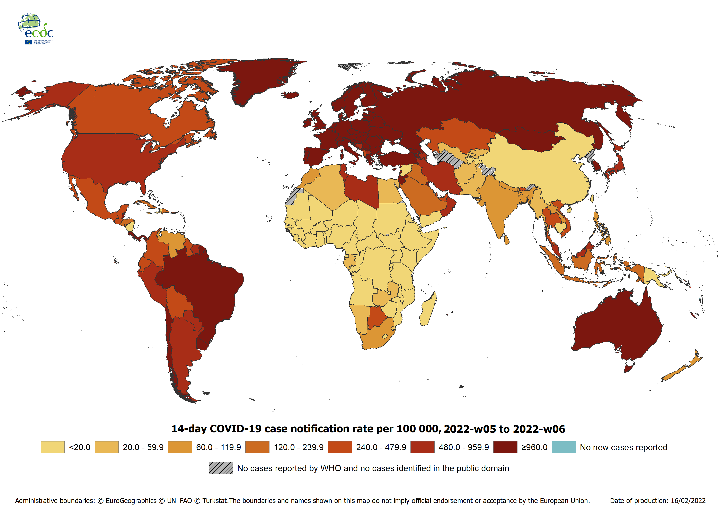
Geographic distribution of 14-day cumulative number of reported COVID-19 cases per 100 000 population, worldwide, as of week 6, 2022.

Slide 11
Distribution of COVID-19 deaths worldwide, as of week 6, 2022.

Slide 12
Distribution of laboratory-confirmed cases of COVID-19 in EU/EEA, as of week 6, 2022.

Slide 13
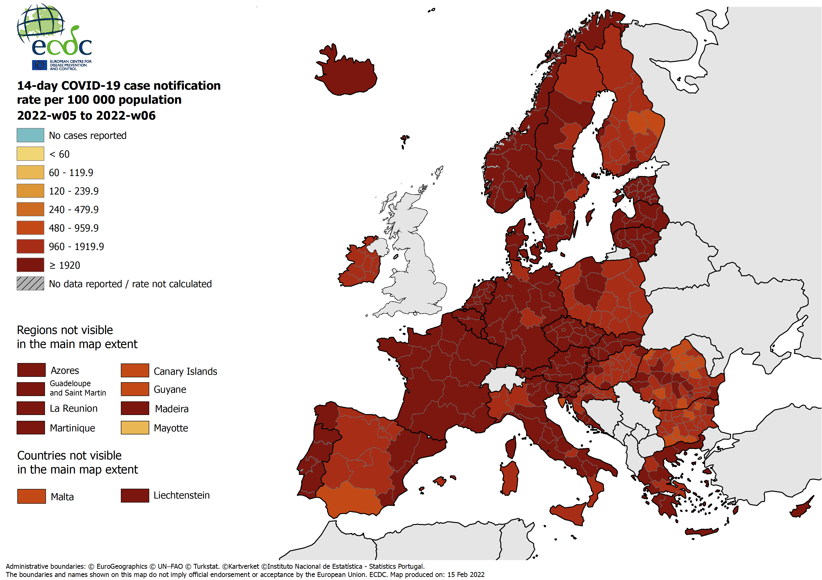
14-day COVID-19 case notification rate per 100 000 for weeks 5 and 6

Slide 14
Distribution of laboratory-confirmed cases of COVID-19 by country in the EU/EEA week 6, 2022.
Country | Cases | Deaths | Cases reported for week 6 | Cases reported for week 5 | Difference between two periods (%)
Austria | 2 303 724 | 13 806 | 214,536 | 229,686 | -6.6 %
Belgium | 3 414 722 | 29 731 | 72,835 | 185,328 | -60.7 %
Bulgaria | 1 035 285 | 34 359 | 42,030 | 54,043 | -22.2 %
Croatia | 1 017 908 | 14 473 | 34,135 | 48,058 | -29.0 %
Cyprus | 290 153 | 904 | 16,543 | 19,574 | -15.5 %
Czechia | 3 401 431 | 37 921 | 159,255 | 229,563 | -30.6 %
Denmark | 2 239 945 | 3 577 | 324,357 | 289,557 | +12.0 %
Estonia | 408 447 | 2 007 | 37,947 | 48,031 | -21.0 %
Finland | 581 135 | 2 834 | 38,637 | 41,099 | -6.0 %
France | 21 671 447 | 138 952 | 997,933 | 1,768,667 | -43.6 %
Germany | 12 476 502 | 120 210 | 1,266,819 | 1,270,424 | -0.3 %
Greece | 2 182 550 | 24 819 | 124,827 | 124,631 | +0.2 %
Hungary | 1 717 153 | 41 493 | 66,512 | 97,160 | -31.5 %
Iceland | 91 751 | 54 | 13,792 | 10,475 | +31.7 %
Ireland | 1 252 076 | 6 339 | 34,970 | 37,971 | -7.9 %
Italy | 11 772 274 | 151 015 | 266,930 | 611,685 | -56.4 %
Latvia | 518 620 | 5 436 | 68,517 | 61,116 | +12.1 %
Liechtenstein | 10 578 | 74 | 813 | 835 | -2.6 %
Lithuania | 973 491 | 8 515 | 74,714 | 154,742 | -51.7 %
Luxembourg | 181 614 | 1 006 | 5,924 | 11,293 | -47.5 %
Malta | 67 317 | 349 | 756 | 1,296 | -41.7 %
Netherlands | 5 734 363 | 21 410 | 857,094 | 567,225 | +51.1 %
Norway | 1 043 790 | 1 513 | 136,946 | 128,628 | +6.5 %
Poland | 5 421 160 | 108 493 | 227,481 | 335,786 | -32.3 %
Portugal | 3 093 624 | 20 564 | 160,786 | 293,100 | -45.1 %
Romania | 2 522 567 | 59 114 | 145,098 | 192,602 | -24.7 %
Slovakia | 1 657 981 | 18 105 | 133,961 | 110,240 | +21.5 %
Slovenia | 851 416 | 6 081 | 51,183 | 89,204 | -42.6 %
Spain | 10 448 604 | 95 624 | 214,069 | 372,520 | -42.5 %
Sweden | 2 407 185 | 16 202 | 62,403 | 185,768 | -66.4 %
Total | 100 788 813 | 984 980 | 5,851,803 | 7,570,307 | -22.7 %

Slide 15
Distribution of laboratory-confirmed cases of COVID-19 by country in the EU/EEA week 6, 2022.
Country | Cases | Deaths | Cases reported for week 6 | Cases reported for week 5 | Difference between two periods (%)
Austria | 2 303 724 | 13 806 | 214,536 | 229,686 | -6.6 %
Belgium | 3 414 722 | 29 731 | 72,835 | 185,328 | -60.7 %
Bulgaria | 1 035 285 | 34 359 | 42,030 | 54,043 | -22.2 %
Croatia | 1 017 908 | 14 473 | 34,135 | 48,058 | -29.0 %
Cyprus | 290 153 | 904 | 16,543 | 19,574 | -15.5 %
Czechia | 3 401 431 | 37 921 | 159,255 | 229,563 | -30.6 %
Denmark | 2 239 945 | 3 577 | 324,357 | 289,557 | +12.0 %
Estonia | 408 447 | 2 007 | 37,947 | 48,031 | -21.0 %
Finland | 581 135 | 2 834 | 38,637 | 41,099 | -6.0 %
France | 21 671 447 | 138 952 | 997,933 | 1,768,667 | -43.6 %
Germany | 12 476 502 | 120 210 | 1,266,819 | 1,270,424 | -0.3 %
Greece | 2 182 550 | 24 819 | 124,827 | 124,631 | +0.2 %
Hungary | 1 717 153 | 41 493 | 66,512 | 97,160 | -31.5 %
Iceland | 91 751 | 54 | 13,792 | 10,475 | +31.7 %
Ireland | 1 252 076 | 6 339 | 34,970 | 37,971 | -7.9 %
Italy | 11 772 274 | 151 015 | 266,930 | 611,685 | -56.4 %
Latvia | 518 620 | 5 436 | 68,517 | 61,116 | +12.1 %
Liechtenstein | 10 578 | 74 | 813 | 835 | -2.6 %
Lithuania | 973 491 | 8 515 | 74,714 | 154,742 | -51.7 %
Luxembourg | 181 614 | 1 006 | 5,924 | 11,293 | -47.5 %
Malta | 67 317 | 349 | 756 | 1,296 | -41.7 %
Netherlands | 5 734 363 | 21 410 | 857,094 | 567,225 | +51.1 %
Norway | 1 043 790 | 1 513 | 136,946 | 128,628 | +6.5 %
Poland | 5 421 160 | 108 493 | 227,481 | 335,786 | -32.3 %
Portugal | 3 093 624 | 20 564 | 160,786 | 293,100 | -45.1 %
Romania | 2 522 567 | 59 114 | 145,098 | 192,602 | -24.7 %
Slovakia | 1 657 981 | 18 105 | 133,961 | 110,240 | +21.5 %
Slovenia | 851 416 | 6 081 | 51,183 | 89,204 | -42.6 %
Spain | 10 448 604 | 95 624 | 214,069 | 372,520 | -42.5 %
Sweden | 2 407 185 | 16 202 | 62,403 | 185,768 | -66.4 %
Total | 100 788 813 | 984 980 | 5,851,803 | 7,570,307 | -22.7 %

Slide 16
Distribution of laboratory-confirmed cases of COVID-19 in EU/EEA, as of week 6, 2022.

Slide 17
Distribution of laboratory-confirmed COVID-19 deaths in EU/EEA, as of week 6, 2022.

Slide 18
Disclaimers
National updates are published at different times and in different time zones.This, and the time ECDC needs to process these data, may lead to discrepancies between the national numbers and the numbers published by ECDC.Users are advised to use all data with caution and awareness of their limitations.Data are subject to retrospective corrections; corrected datasets are released as soon as processing of updated national data has been completed.
Belgium:
• [Daily cases and deaths] 27 August – 02 September 2020 data should be read as 26 August – 01 September 2020 due to a one-day reporting delay
• [Daily cases and deaths] 21 June – 27 June 2020 (week 25), Belgium authoritiesslightly modified the reporting in order to report the COVID-19 cases by date of sampling or diagnosis. COVID-19 deaths are reported by date of death. The earliest available date is used and might be changed as new information becomes available.
• [Long-term care facility data] Data only refers to nursing homes, and not to other types of long-term care facilities.

Slide 19
Disclaimers
Denmark:
• [Long-term care facility data]: The sources for LTCF data are the ”Plejehjemsoversigten” (a database of care homes), the Danish Microbiology Database (MiBa) and the Danish Civil Registration system.
France:
• [Testing, national and subnational cases] Starting in week 49 of 2020, the following changes have occurred in COVID-19 surveillance in France: a) the case definition has been updated to include antigen tests as a laboratory method to confirm a case; b) test positivity is calculated as the number of patients testing positive for SARS-CoV-2 (by RT-PCR or AT) divided by the number of patients testing positive for SARS-CoV-2 and the number of individuals testing negative; c) the number of individuals tested during a certain period corresponds to the number of people who had at least one test during this period and who have never tested positive in the previous 60 days; d) the number of individuals tested positive corresponds to a person who tested positive either for the first time or after more than 60 days after a previous positive test (in this event the person will be counted as a new case). As a result of these changes, surveillance artefacts are present in the values for week 49 compared to week 48 for test positivity (decrease, due to an increase in the denominator of number of people tested) and the testing rate (increase, approximately doubled). An increase in the case notification rate is also expected to occur due to an increased number of detections by antigen tests.
• [Testing, subnational cases] Starting in week 44 of 2020, data for some indicators displayed in ECDC’s surveillance outputs (testing rate, test positivity and subnational case notification rates) are provided for a week that runs from Saturday to Friday (i.e. two days earlier than calendar week). Data for all other indicators are for the calendar week.

Slide 20
Disclaimers
• [Daily cases and deaths] 29 May 2020, the increase in cases in the dashboard does not reflect increased incidence of COVID-19 cases, but an improved comprehensiveness of the surveillance system.
• [Daily cases and deaths] 13 May 2020 there was a significant change in the French surveillance of lab confirmed COVID-19 cases and virtually all laboratories in France are now included in the system. Cases from this new system were reported on 29 May.
• [Daily cases and deaths] 7 May 2020, France reported an increase over 3 200 cases. This increase is due to the addition of new laboratories who transmitted retrospective positive tests (since 16 March 2020).
Germany:
• [Long-term care facility data] The reporting week starts on Tuesdays and ends on Mondays. The number of cases and deaths (the numerators) and the number of LTCF residents (the denominator) only includes residents older than 65 years.

Slide 21
Disclaimers
Italy:
• [Long-term care facility data]: The data reported represent 7 participating regions of 19 regions and 2 autonomous provinces of Italy until Week 2 2021. Thereafter, the data represented 8 of 19 regions and 2 autonomous provinces (1590/4629 LTFs).
Ireland:
• [Daily cases and deaths] 2 October 2020 authorities in Ireland retrospectively corrected the total number of COVID-19 deaths leading to a negative value for the deaths reported on 3 October 2020.
• [Daily cases and deaths] 5 April – 19 April 2020 the daily number of confirmed COVID-19 cases reported in Ireland is inflated due to batch reporting of cases with specimen dates between from 19 March – 01 April 2020 in addition to real-time reporting of cases with contemporaneous specimen dates.

Slide 22
Disclaimers
• [Long-term care facility data] The rates that use ‘number of beds’ as a denominator are an overestimate, because currently the denominator does not include all facility types.
Luxembourg:
• [Daily cases and deaths] 24 August 2020, authorities in Luxembourg report COVID-19 cases and deaths from their resident population only. Therefore, the difference with the figure from 27 August translates into a negative value for the cases and deaths reported on 28 August 2020.
Netherlands:
• [Testing] Since week 38 of 2020, the number of tests reported are corrected for underreporting from virological laboratories. The estimated number of tests is obtained by multiplying the weekly total number of tests reported from virological laboratories by the weekly ratio of COVID-19 notifications by municipal health services to positive tests reported from virological laboratories. Since week 12 of 2021, the number of entry tests for events and activities, as reported by ‘Stichting Open Nederland’, are added to this data. From week 29 up to and including week 39 of 2021, the number of tests for commercial testing of outbound travellers, sourced from the various commercial testing organizations as reported by ‘the Ministry of Infrastructure and Water Management’, were added to these data.

Slide 23
Disclaimers
• [Daily cases and deaths] Due to the high volume of positive test results, the Municipal Public Health Services (GGDs) have experienced delays in reporting these figures to the RIVM National Institute for Public Health since 18 January 2022. As a result, the actual number of reported positive tests was during the period between 18 January 2022 – 08 February 2022 was higher than the numbers reported daily by RIVM. To include the back-log of cases, the RIVM has reported a particularly high number of positive tests on 08/02/2022, which includes positive cases tested.
Norway:
• [Long-term care facility data]: The data presented is from the national Emergency preparedness register for COVID-19 (Beredt C19) established at the Norwegian Institute of Public Health. The results are from merged registers and not collected from local level LTCFs.
Slovakia:
• [Note] As of 18 May 2021, the COVID-19 data reported for Slovakia includes both positive PCR and antigen tests resulting in an increase in cases.

Slide 24
Disclaimers
Spain:
• [Daily cases and deaths] 27 August – 02 September 2020 data should be read as 26 August – 01 September 2020 due to a one-day reporting delay.
• [Long-term care facility data]. National reports present data on confirmed cases only. According to the national definition, a facility with a single case is considered to have an outbreak.
Sweden:
• [Testing] Since week 40 of 2020, the number of tests reported has been the number of tested individuals per week. From weeks 27–39 this related to the number of analysed tests per week. Where testing data are not available in advance of the reporting deadline the number of tests for the most recent week are estimated using the previous week’s data.

Slide 25
Disclaimers
• [Daily cases and deaths] 31 August 2020 Swedish authorities are now performing daily data consolidation leading to data retro-corrections. From week 38, the Swedish Public Health Agency will update COVID-19 daily data four times per week on Tuesday–Friday. This can result in a decrease of cumulative figures (cases or deaths) and related outputs.
• [Daily cases and deaths] 27 August – 02 September 2020 data should be read as 26 August – 01 September 2020 due to a one-day reporting delay.
United Kingdom:
• [Daily cases and deaths] 3 October 2020, due to a technical issue, COVID-19 cases from 24 September to 1 October will be reported by British authorities in the coming days.
• [Daily cases and deaths] 13 August 2020, the United Kingdom did not report cumulative cases and deaths due to technical difficulties. Data are updated as soon as available.

