Slide 1
Ergänzung:
Inzidenzverlauf ohne Flugverkehr-Reduktion
Montag, 21.02.2022
P4 (Computational Epidemiology Group ) + ZIG(Zentrum für Internationalen Gesundheitsschutz)
Dirk Brockmann, Pascal Klamser, Benjamin F. Maier, Adrian Zachariae
Kontakt:
Pascal Klamser (klamser@physik.hu-berlin.de)
Adrian Zachariae (scazachariae@gmail.com)

Slide 2
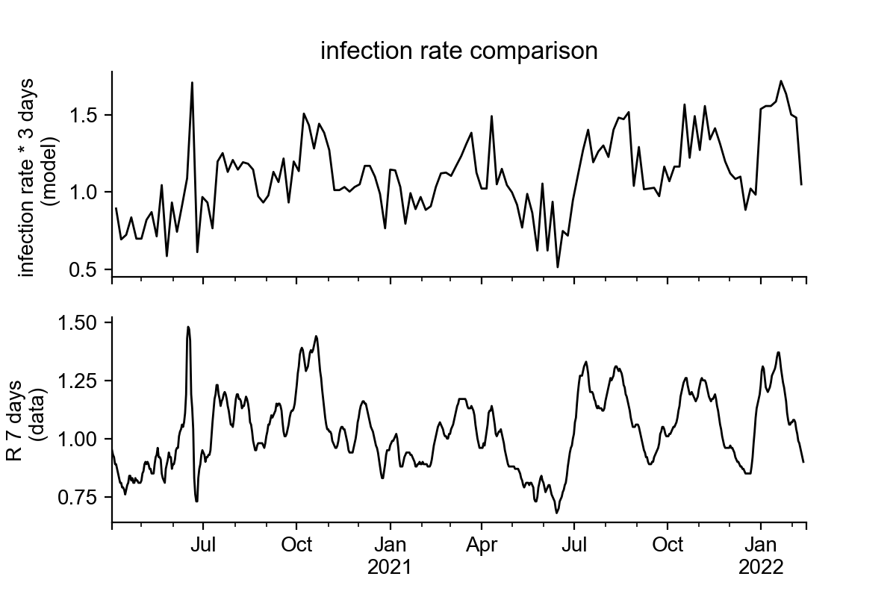
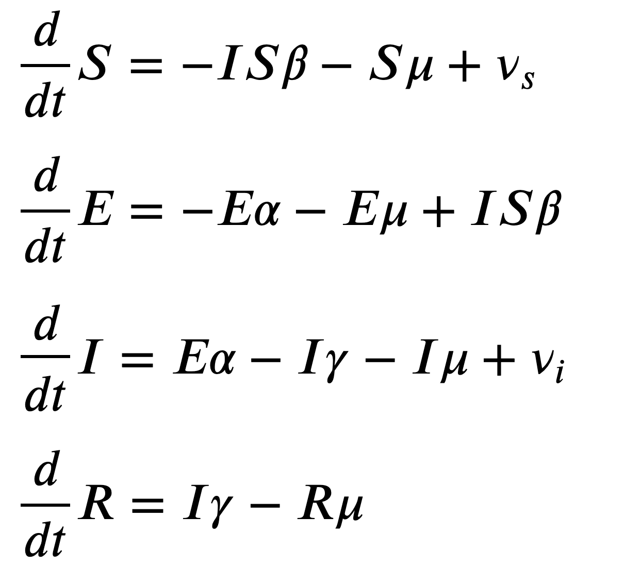
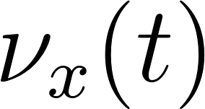
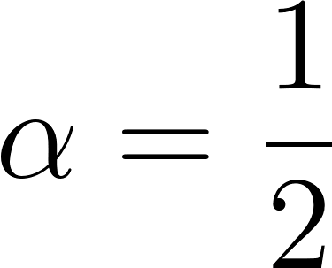
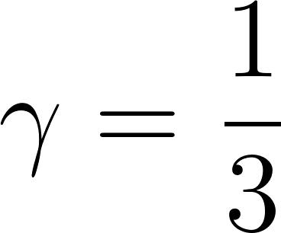
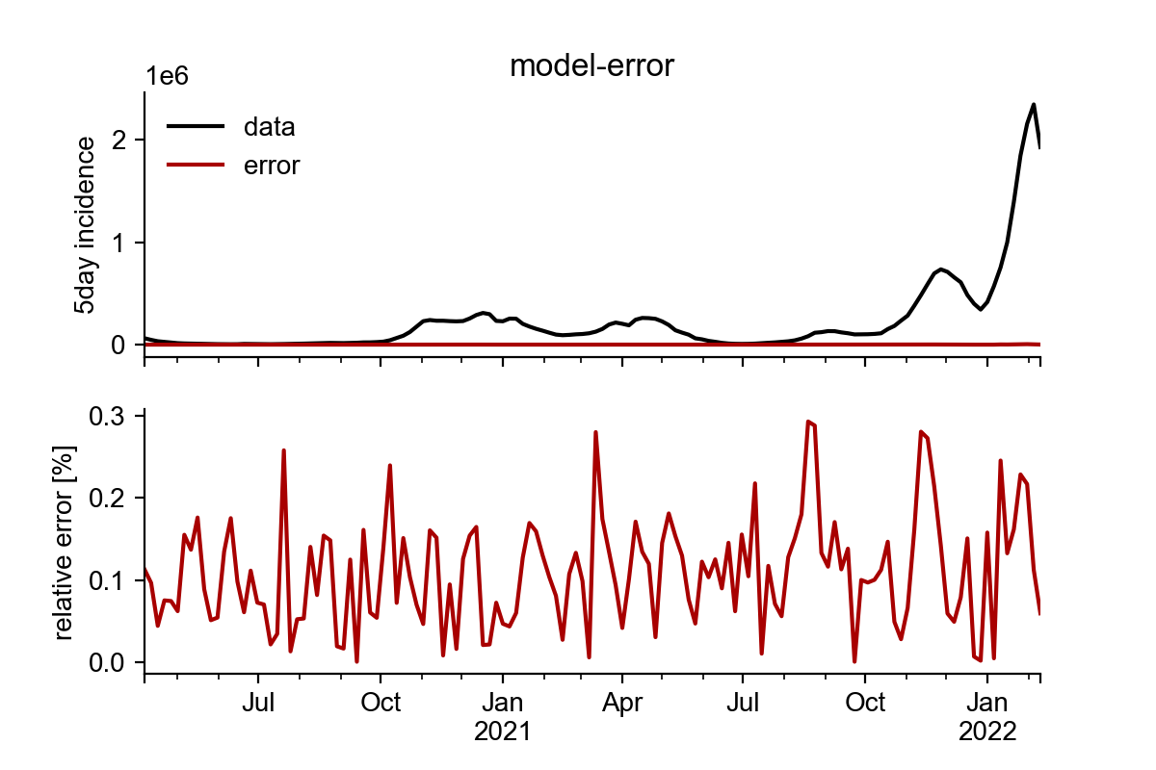
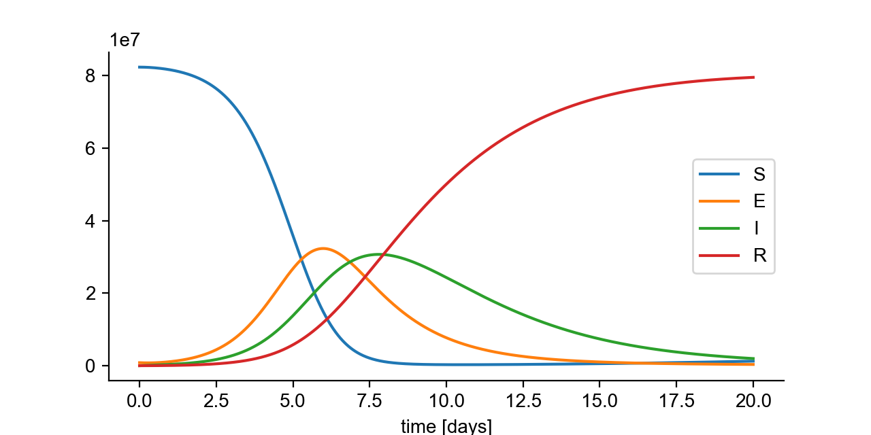
Model-outline + fit
infection-rate: estimated by incidence fit
outflux-rate:
influx: time depending
influx (5-day steps)
other parameter: set default values for
transition-, recovery- rate
sequential fitting of 5-day intervals

Slide 3
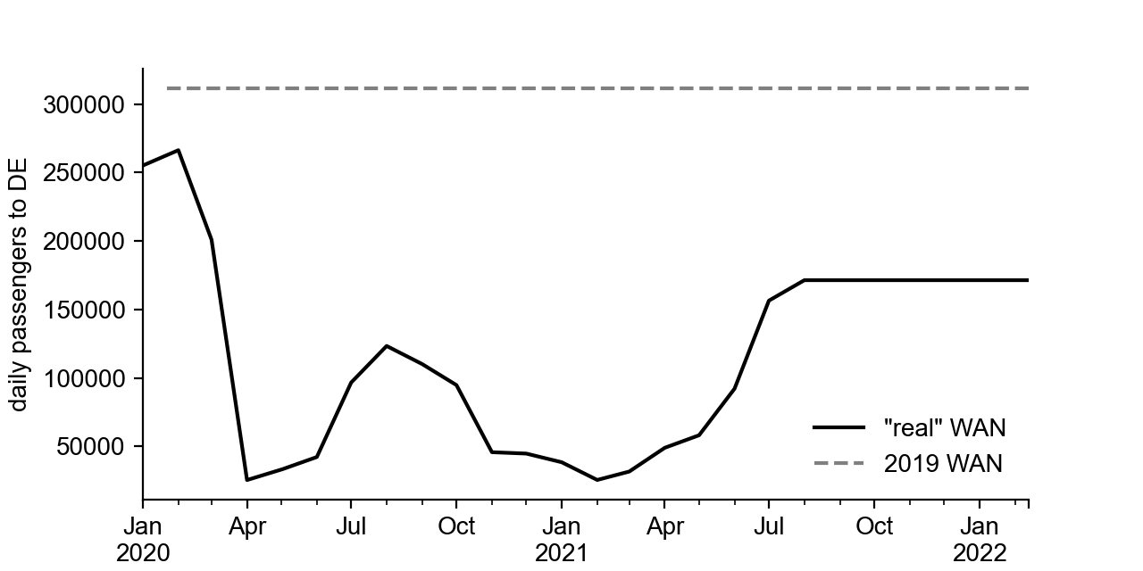
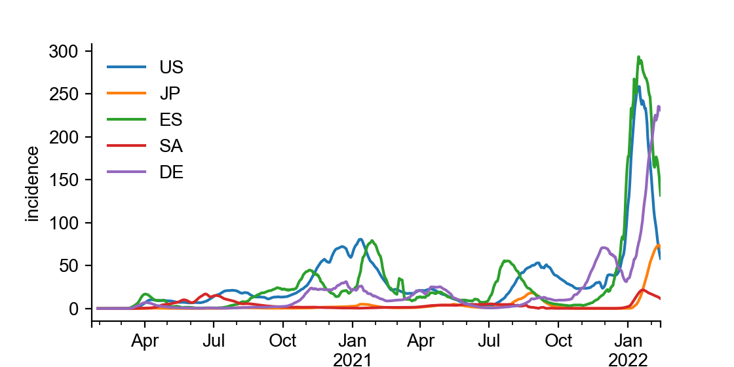
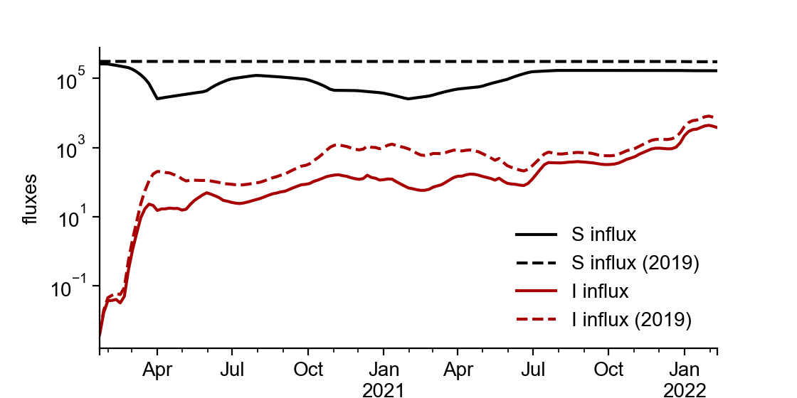
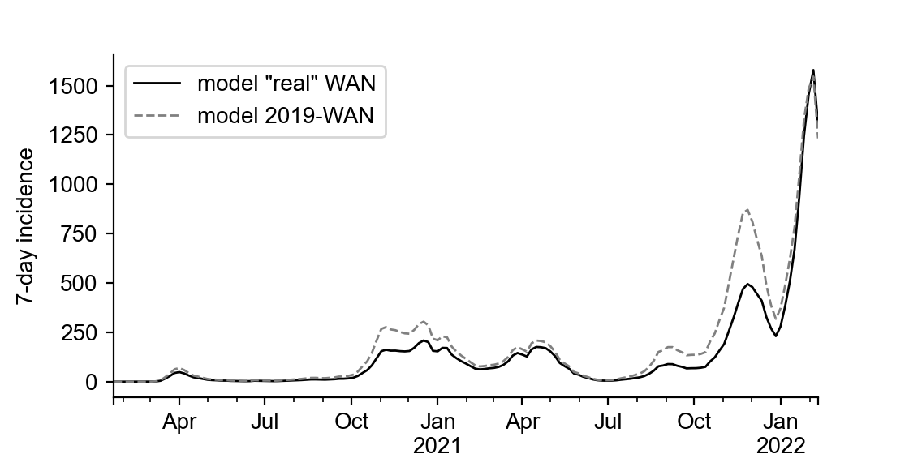
Model and Data Combination
WAN = World Aviation Network
combining:
WAN +
country incidence +
import risk
changing the influx
to estimate
WAN-reduction
effects
infection-rate fitting
(using “real” WAN fluxes)

Slide 4
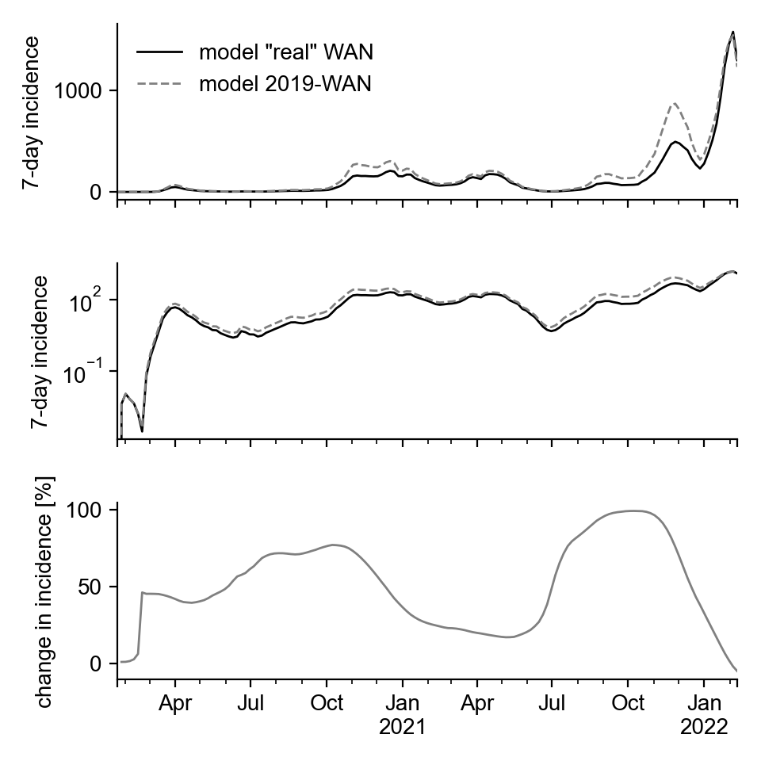
If the WAN had been like 2019

Slide 5
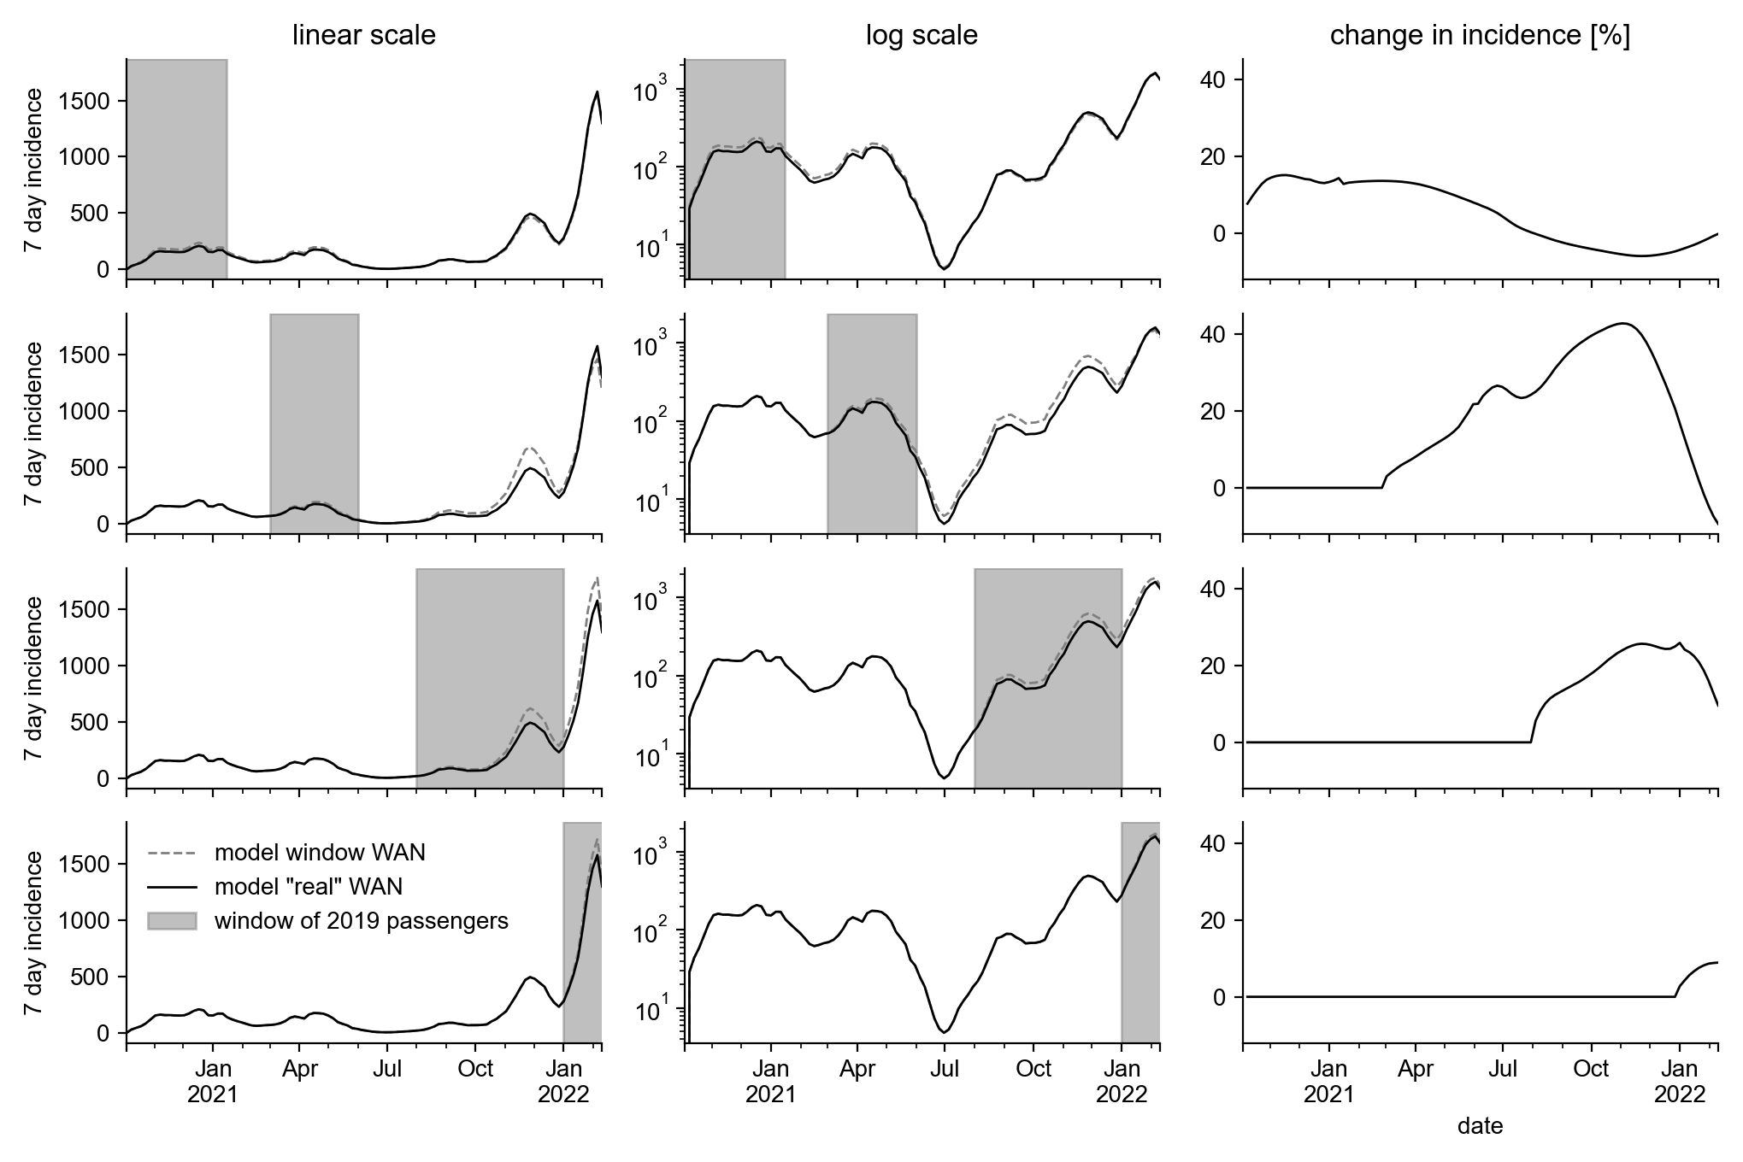
If the WAN had been like 2019
in specific windows

