Slide 1
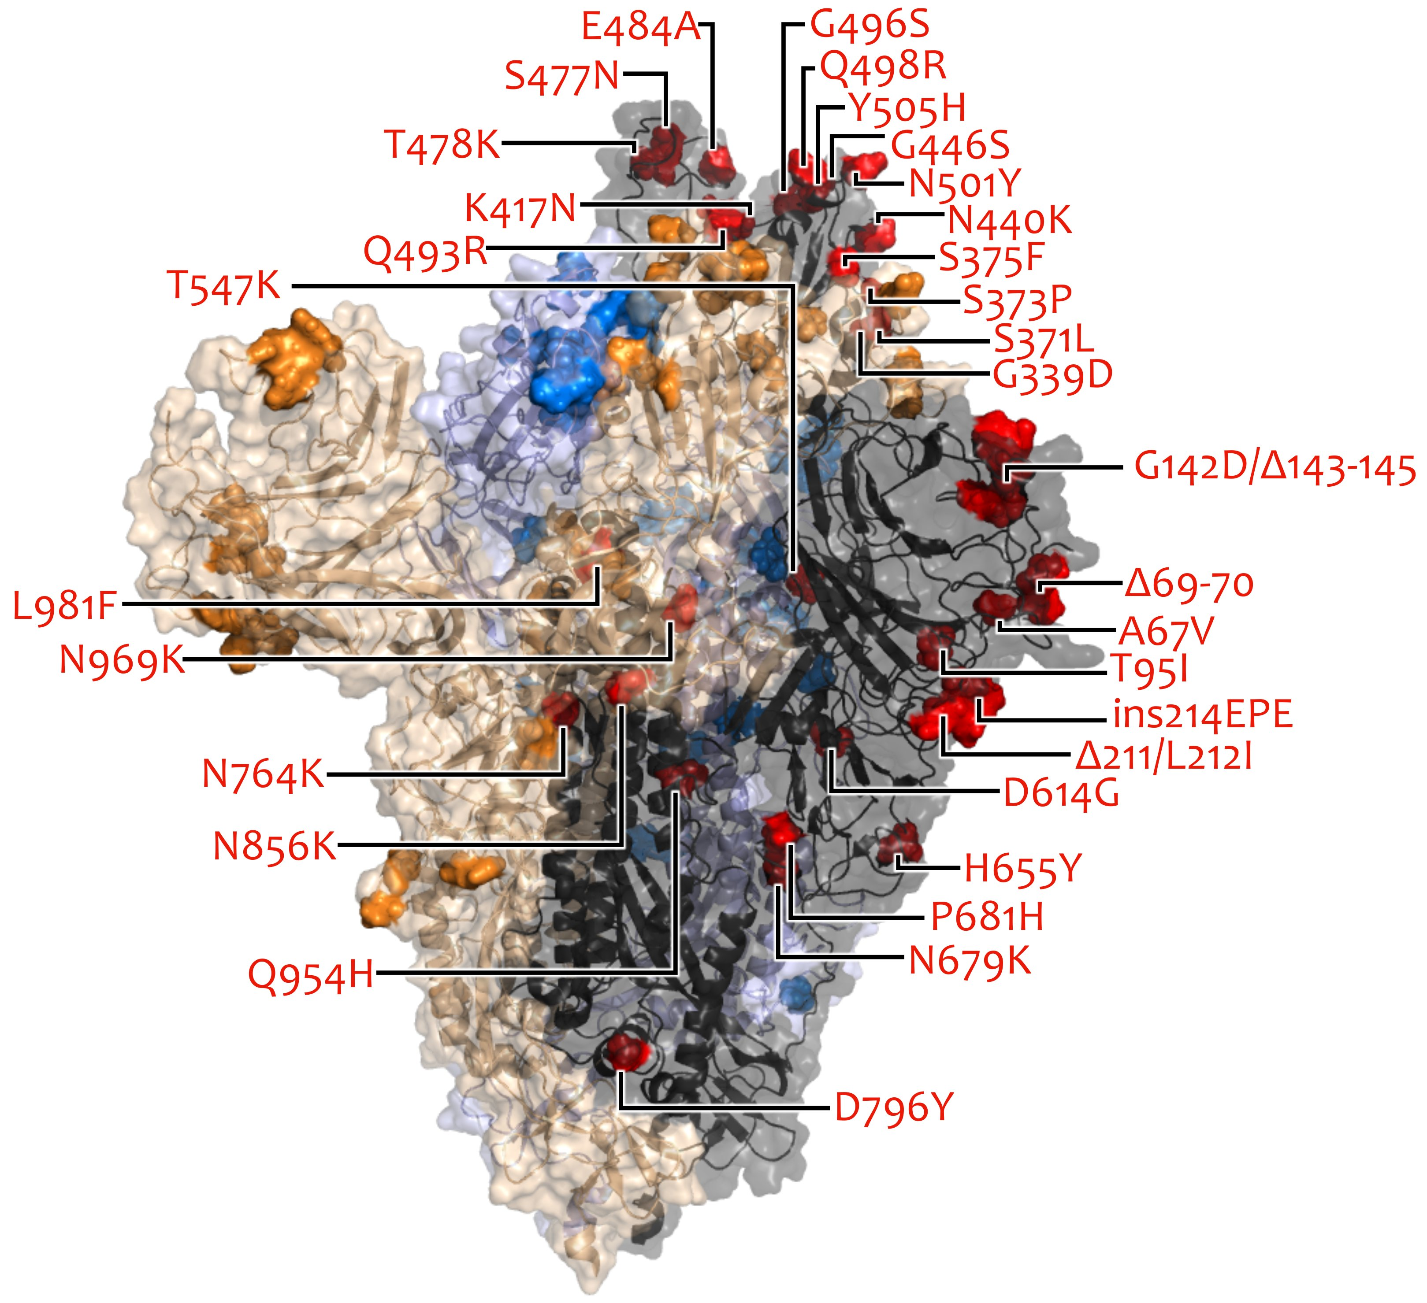
VOC/VOI in Deutschland aktuelle Situation
FG36, FG32, MF1, MF2, MF4, AG Evo, FG17
Berlin, 16.03.2022

Slide 2
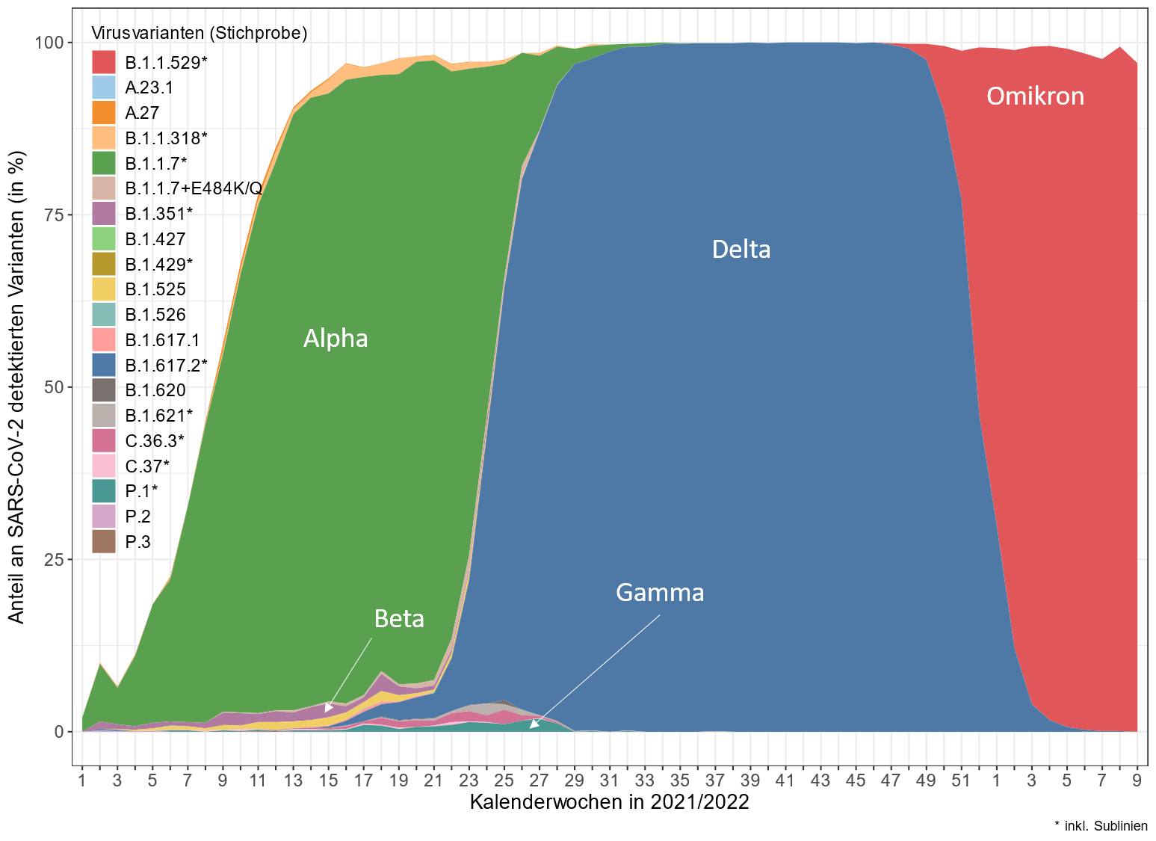
Übersicht VOC/VOI in Stichprobe - Genomsequenzierung

Slide 3
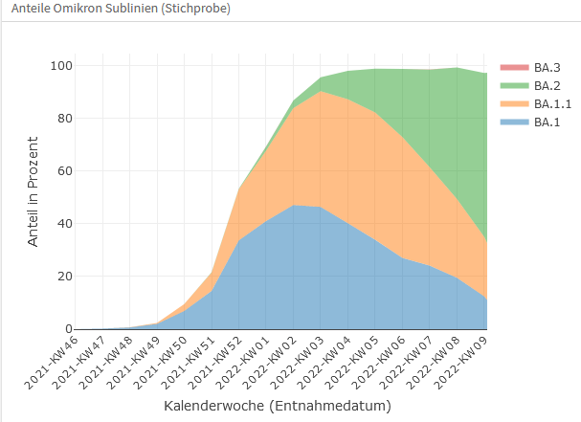
Omikron-Sublinien in Stichprobe
KW 2021 /2022 | Anteile der Sublinen von Omikron in %
 | BA.1 | BA.1.1 | BA.2 | BA.3
01 | 41 | 26,7 | 1,5 | 0
02 | 47,1 | 36,8 | 2,8 | 0
03 | 46,4 | 43,9 | 5,1 | 0
04 | 40,2 | 47 | 10,6 | 0
05 | 33,9 | 48,3 | 16,1 | 0
06 | 27 | 45,9 | 25,1 | 0
07 | 24,1 | 37,3 | 36 | 0
08 | 19,5 | 29,8 | 50 | 0
09 | 11,9 | 22,9 | 62,3 | 0

Slide 4
IfSG-Daten
Zahl der Übermittlungen
stabil
Großer Unterschiede in
Intensität (Anzahl) der
var.-spec. Testungen

Slide 5
Confirmed AY.4/BA.1 Recombination
Parental Delta (AY.4)
2 breakpoints (BP) ->
AY.4: beginning till spike start
BA.1: spike start till ORF3a start
AY.4: ORF3a start till end
Parental Omicron (BA.1)
AY4/BA.1 Recombinant
BP1
BP2
Patient Details (FG32):
64-old woman from Rheinland-Pfalz, LK Neuwied, South-West Germany
3x vaccinated using Pfizer-BioNTech COVID-19 Vaccine (Booster in 12/2021)
hospitalized in Linz for 4 days due to massive complaints in the chest area, with a suspected heart attack
severe cough and, according to her, "badly ill" for 2 weeks and still quickly tired, powerless and sense of smell not yet fully recovered
husband was sick to but less badly ill
source of infection unknown
no travel history

Slide 6
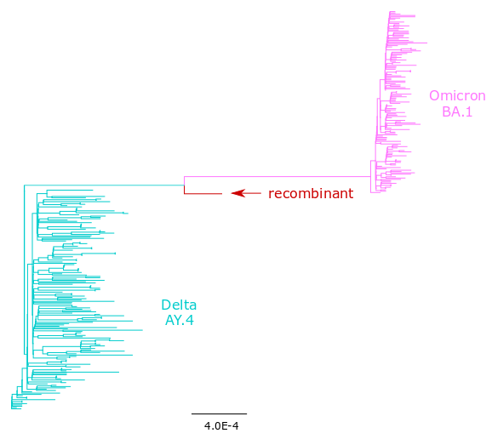
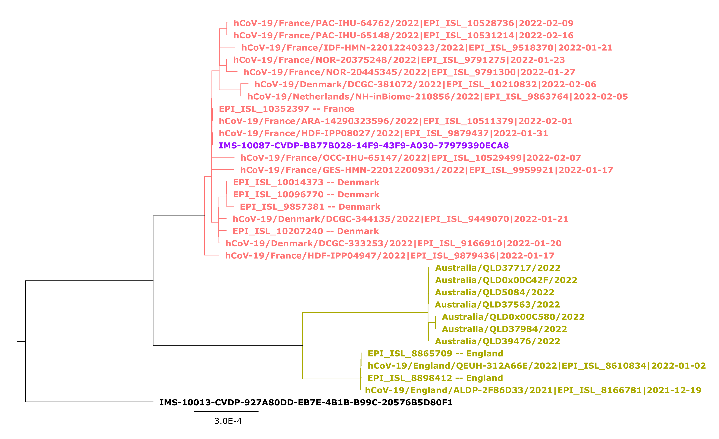
Context of the AY.4/BA.1 isolate from Germany
National
International

Slide 7
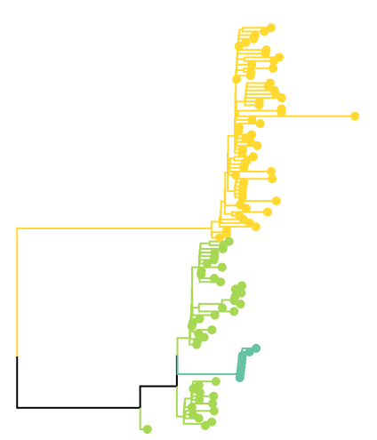
UNCONFIRMED BA.1/BA.2 recombinants
Reported breakpoint at NSP3 gene (within ORF1a)
5 from Köln lab
9 genomes in DESH
3 from Leverkusen lab
BA.1
1 from IMSSC2 LabNetwork
BA.2
recombinants
BA.2
Investigations going on ...

