Slide 1
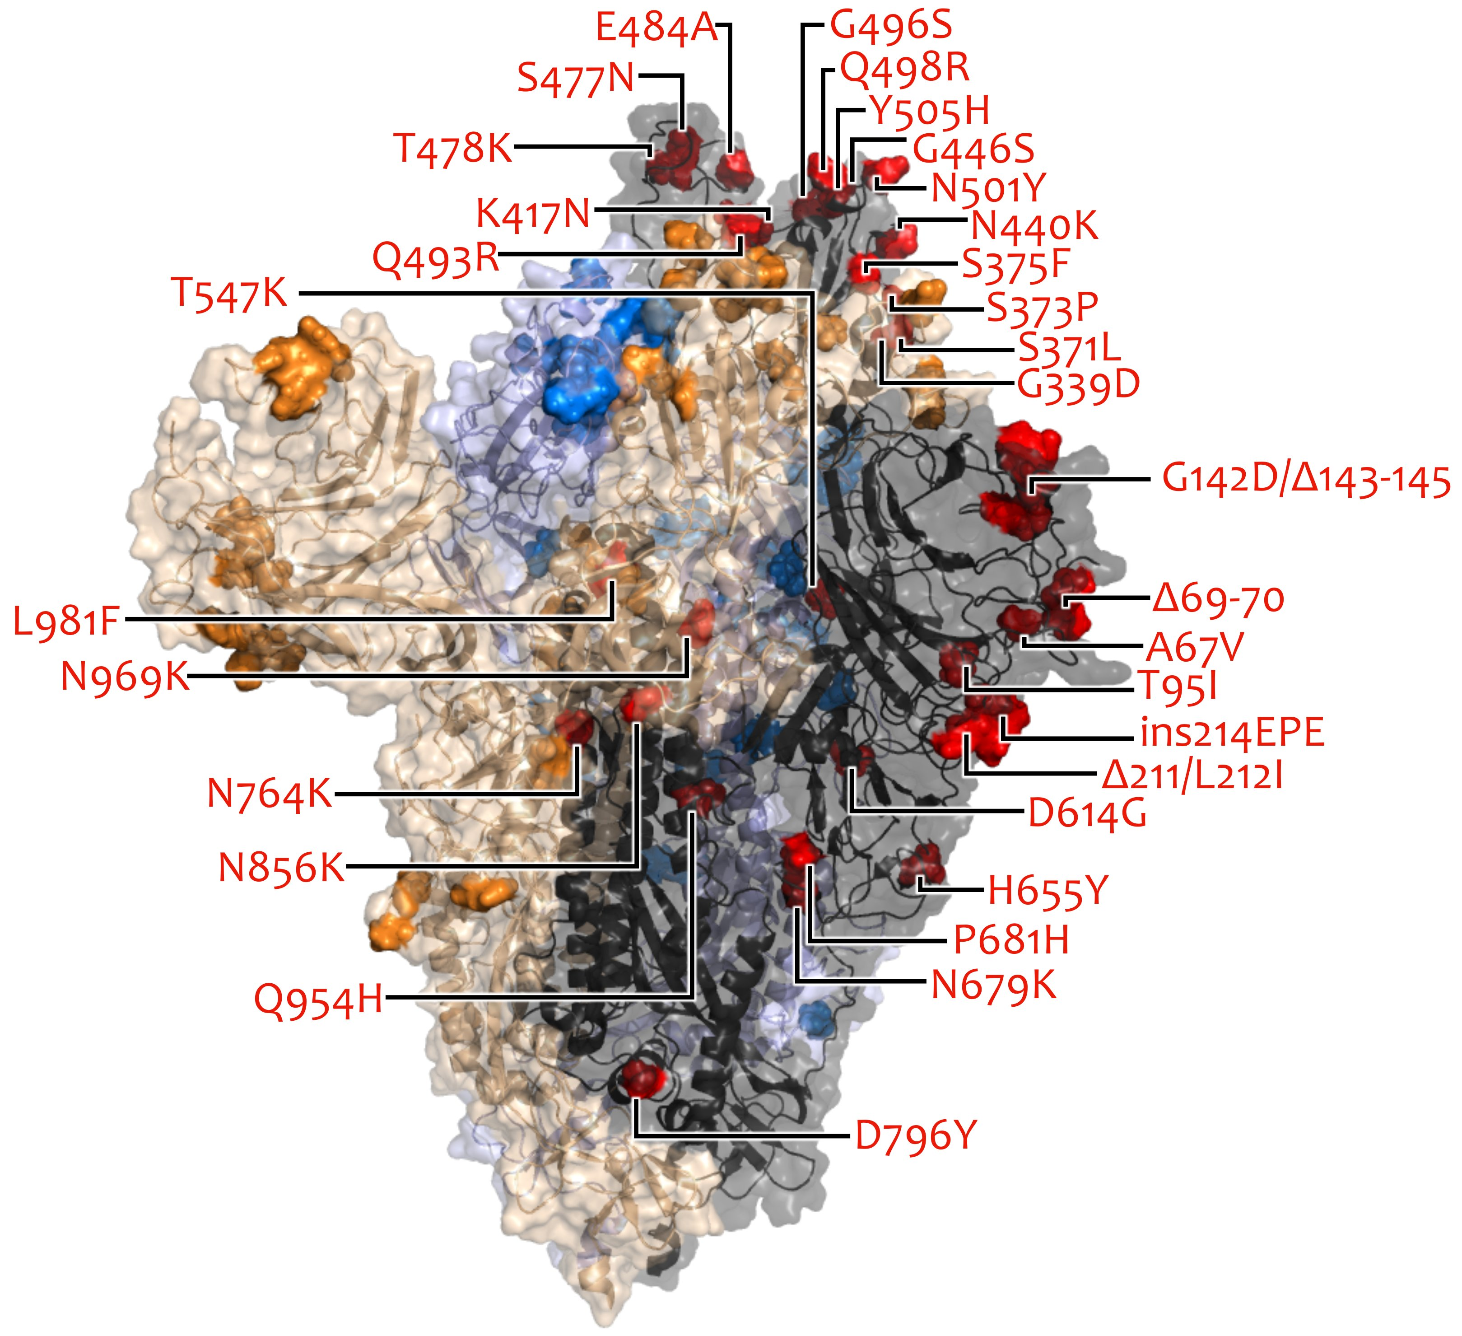
VOC/VOI in Deutschland aktuelle Situation
FG36, FG32, MF1, MF2, MF4, AG Evo, FG17
Berlin, 06.04.2022

Slide 2
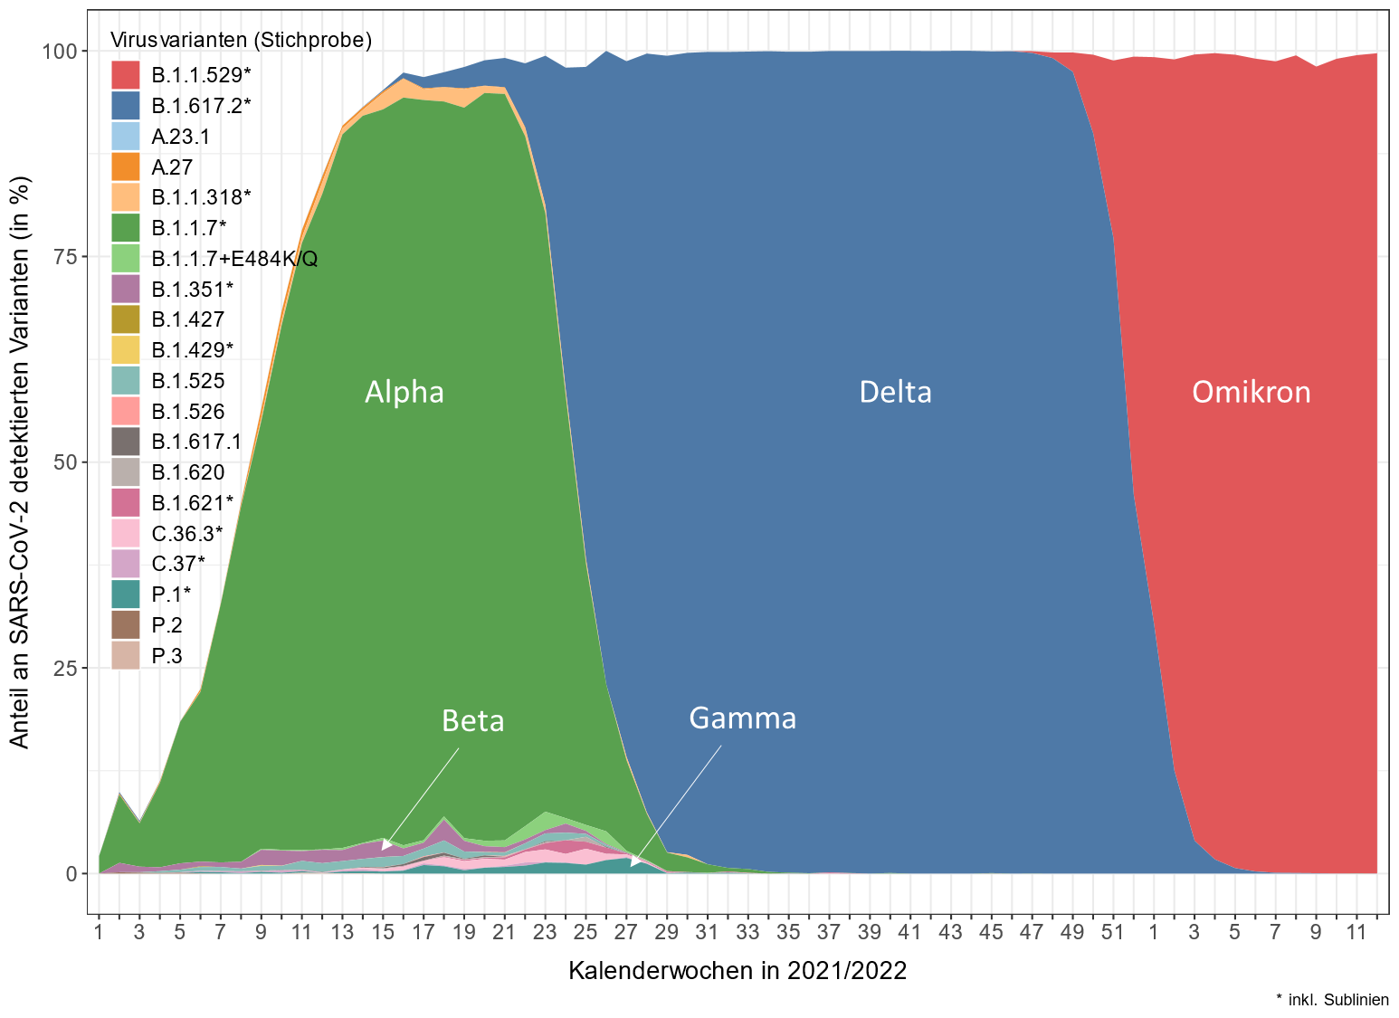
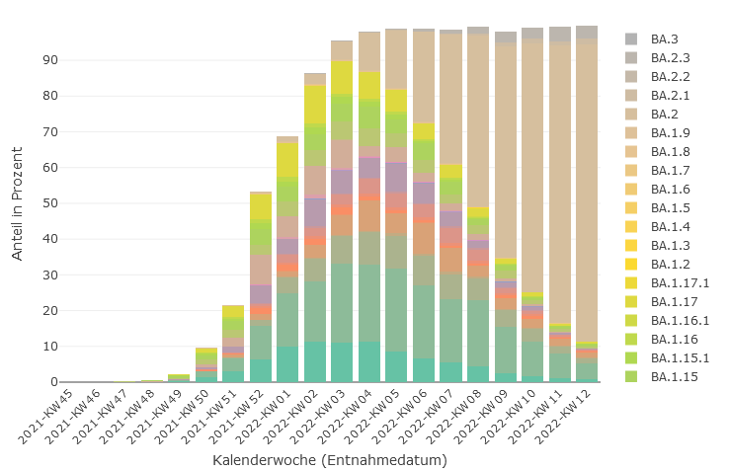
Übersicht VOC/VOI in Stichprobe - Genomsequenzierung

Slide 3
IfSG-Daten
Bundesland | Alpha (B.1.1.7) |  | Beta (B.1.351) |  | Gamma (P.1) |  | Delta (B.1.617.2) |  | Omikron (B.1.1.529)
 | Anteil | Anzahl | Anteil | Anzahl | Anteil | Anzahl | Anteil | Anzahl |  | Anteil | Anzahl
Baden- Württemberg | 0,3% | 2 | 0% | 0 | 0,3% | 2 | 0,3% | 2 | 98,6% |  | 712
Bayern | 0% | 3 | 0% | 1 | 0% | 0 | 0,1% | 10 | 99,9% |  | 17.055
Berlin | 0,9% | 1 | 0% | 0 | 0% | 0 | 0,9% | 1 | 96,4% |  | 106
Brandenburg | 0% | 0 | 0% | 0 | 0% | 0 | 1,9% | 2 | 97,1% |  | 101
Bremen | 0% | 0 | 0% | 0 | 0% | 0 | 0% | 0 | 100% |  | 36
Hamburg | 1,8% | 1 | 0% | 0 | 1,8% | 1 | 1,8% | 1 | 92,9% |  | 52
Hessen | 0% | 0 | 0% | 0 | 0% | 0 | 0% | 0 | 100% |  | 328
Mecklenburg- Vorpommern | 0% | 1 | 0% | 0 | 0% | 0 | 0% | 0 | 100% |  | 3.111
Niedersachsen | 14,6% | 7 | 0% | 0 | 0% | 0 | 6,3% | 3 | 79,2% |  | 38
Nordrhein-Westfalen | 0,1% | 8 | 0% | 0 | 0% | 0 | 0,1% | 14 | 99,8% |  | 10.253
Rheinland-Pfalz | 2,1% | 2 | 0% | 0 | 0% | 0 | 0% | 0 | 96,9% |  | 93
Saarland | 0% | 0 | 0% | 0 | 0% | 0 | 0% | 0 | 100% |  | 10
Sachsen | 0% | 1 | 0% | 0 | 0% | 0 | 0,1% | 12 | 99,9% |  | 9.513
Sachsen-Anhalt | 0% | 0 | 0% | 0 | 0% | 0 | 0% | 0 | 100% |  | 102
Schleswig- Holstein | 0% | 0 | 0% | 0 | 0% | 0 | 0% | 0 | 89,2% |  | 99
Thüringen | 0% | 0 | 0% | 0 | 0% | 0 | 1,4% | 2 | 98,6% |  | 137
Gesamt | 0,1% | 26 | 0% | 1 | 0% | 3 | 0,1% | 47 | 99,7% |  | 41.746

