Slide 1
Top 10 Länder nach Anzahl neuer COVID-19-Fälle
503.131.834 Fälle (-30% im Vergleich zu Vorwoche)
6.200.571 Todesfälle (CFR: 1,2%)
Land | Fälle kumulativ | Neue Fälle (7T) | Verände-rung % (7T) | Trend | 7T-Inz. Fälle/ 100.000 Ew | CFR % | Auffrisch-impfung %* | Vollständige Impfung %* | Mind. eine Impfung %*
Südkorea | 16.471.940 | 836.715 | -39 | ▼ | 1632 | 0,13 | 64 | 87 | 88
Frankreich | 27.001.702 | 800.664 | -15 | ▼ | 1231 | 0,52 | 57 | 81 | 83
Deutschland | 23.459.628 | 618.852 | -38 | ▼ | 744 | 0,57 | 59 | 76 | 77
Italien | 15.730.676 | 409.923 | -8 | ▼ | 687 | 1,03 | 66 | 80 | 85
Japan | 7.402.533 | 329.834 | -2 | ▼ | 261 | 0,39 | 49 | 80 | 81
Australien | 5.225.150 | 306.439 | -21 | ▼ | 1202 | 0,13 | 52 | 84 | 87
USA | 79.896.146 | 241.491 | 18 | ▲ | 73 | 1,23 | 30 | 66 | 78
Vietnam | 10.475.819 | 225.659 | -41 | ▼ | 232 | 0,41 | 47 | 80 | 82
Thailand | 4.063.844 | 137.990 | -18 | ▼ | 198 | 0,67 | 36 | 72 | 80
Brasilien | 30.252.618 | 100.216 | -34 | ▼ | 47 | 2,19 | 40 | 77 | 86
Quelle: WHO, 19.04.2022; *Our World In Data - Vacc, abgerufen: 19.04.2022
Notes:
Officials closely track rising COVID levels in Northeastern states
Rising COVID-19 activity in a few Northeastern states appears to be driving a slight increase in national cases, according to the latest data from the Centers for Disease Control and Prevention (CDC). … Four of the five states with the highest 7-day case rises are in the Northeast, ABC News reported yesterday, citing CDC data. Rhode Island has the highest 7-day case rate, with increases also occurring in Vermont, New York, New Jersey, Maine, and Connecticut. https://www.cidrap.umn.edu/news-perspective/2022/04/officials-closely-track-rising-covid-levels-northeastern-states
https://abcnews.go.com/Health/covid-19-cases-rising-northeast-partly-fueled-ba2/story?id=84011868
The C.D.C. extended the mask mandate on planes and public transit. https://www.nytimes.com/live/2022/04/13/world/covid-19-mandates-cases-vaccine?name=styln-coronavirus&region=hub&block=storyline_live_updates_block_recirc&action=click&pgtype=LegacyCollection#two-new-omicron-subvariants-are-spreading-quickly-in-new-york-state
A federal judge in Florida today struck down the Centers for Disease Control and Prevention (CDC) mask mandate for airline flight and other travel, just days after the agency extended it by 2 weeks to assess activity related to the BA.2 SARS-CoV-2 subvariant.
https://www.cidrap.umn.edu/news-perspective/2022/04/judge-nixes-travel-mask-mandate-covid-19-cases-inch
New York State Department of Health Announces Emergence of Recently Identified, Highly Contagious Omicron Subvariants in New York and Urges Continued Vigilance Against COVID-19
The New York State Department of Health today announced the emergence of two Omicron subvariants in New York State, BA.2.12 and BA.2.12.1. Both variants are sub-lineages of BA.2, which now accounts for 80.6% of COVID-19 infections in New York. The subvariants have been estimated to have a 23% – 27% growth advantage above the original BA.2 variant. Over the past few weeks, the Department has been investigating higher than average infection rates in Central New York. Based on newly available data in the public database, GISAID, as well as additional data submitted directly to the Wadsworth Center from sequencing laboratories in New York, State health officials have determined that these highly contagious new variants are likely contributing to the rising cases. For the month of March, BA.2.12 and BA.2.12.1 rose to collectively comprise more than 70% prevalence in Central New York and more than 20% prevalence in the neighboring Finger Lakes region. Data for April indicate that levels in Central New York are now above 90%. The Department's findings are the first reported instances of significant community spread due to the new subvariants in the United States. At this time, there is no evidence of increased disease severity by these subvariants, though the Department is closely monitoring for any changes.
https://www.health.ny.gov/press/releases/2022/2022-04-13_covid-19.htm

Slide 2
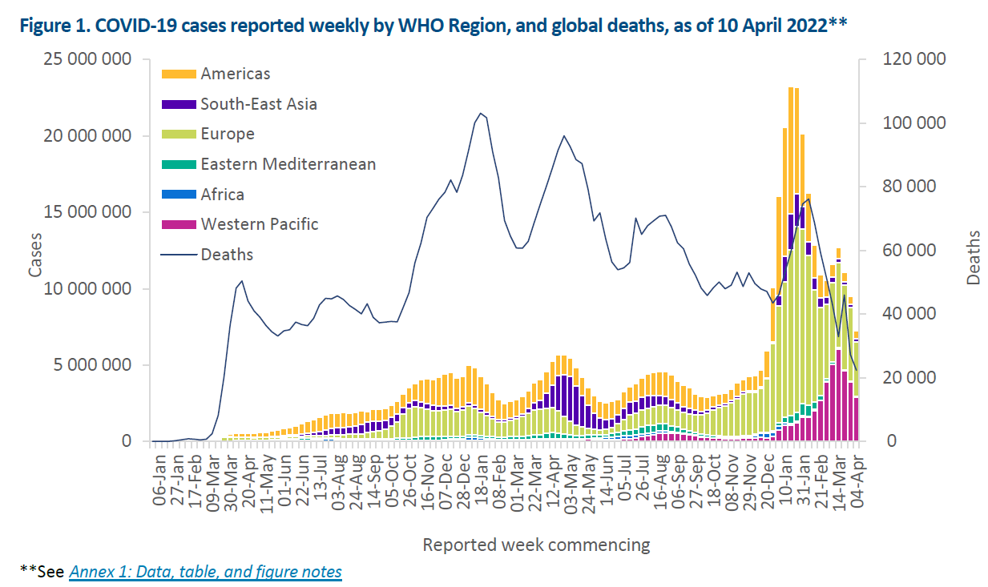
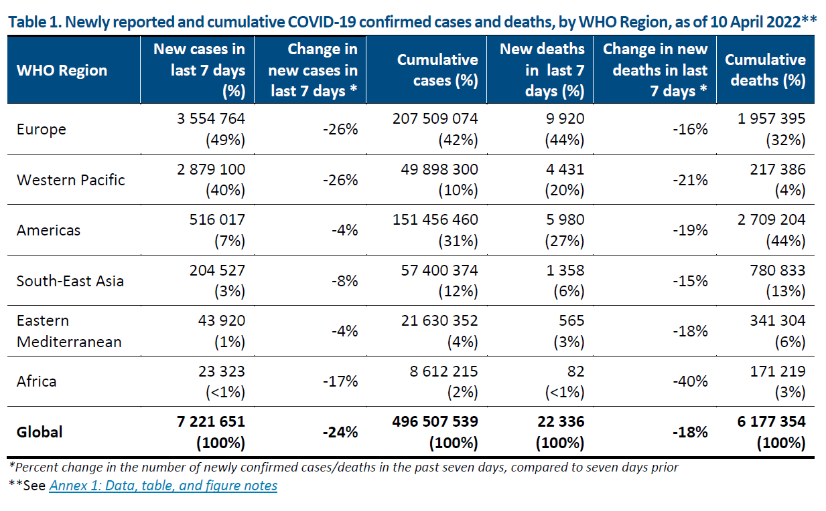
WHO epidemiological update, 12.04.2021
CAVE vielerorts geänderte Teststrategien insbesondere in Europa z.B. Spanien, Dänemark, England testen nur Risikogruppen, Personen die Behandlung im KH benötigen und Personen die mit RG arbeiten; Österreich hat den Anzahl PCR pro Einwohner reduziert
Quelle: WHO SitRep 12.04.2022, Datenstand 10.04.2022
Notes:
The highest numbers of new weekly deaths were reported from
the United States of America (3 682 new deaths; -9%),
Republic of Korea (2 186 new deaths; -6%),
the Russian Federation (2 008 new deaths; -15%),
Germany (1 686 new deaths; +6%), and
Brazil (1 120 new deaths; -22%).
Early estimates suggest that XE has a community growth rate advantage of 1.1 (which represents a 10% transmission advantage) as compared to BA.2; however, this finding requires further confirmation.

Slide 3
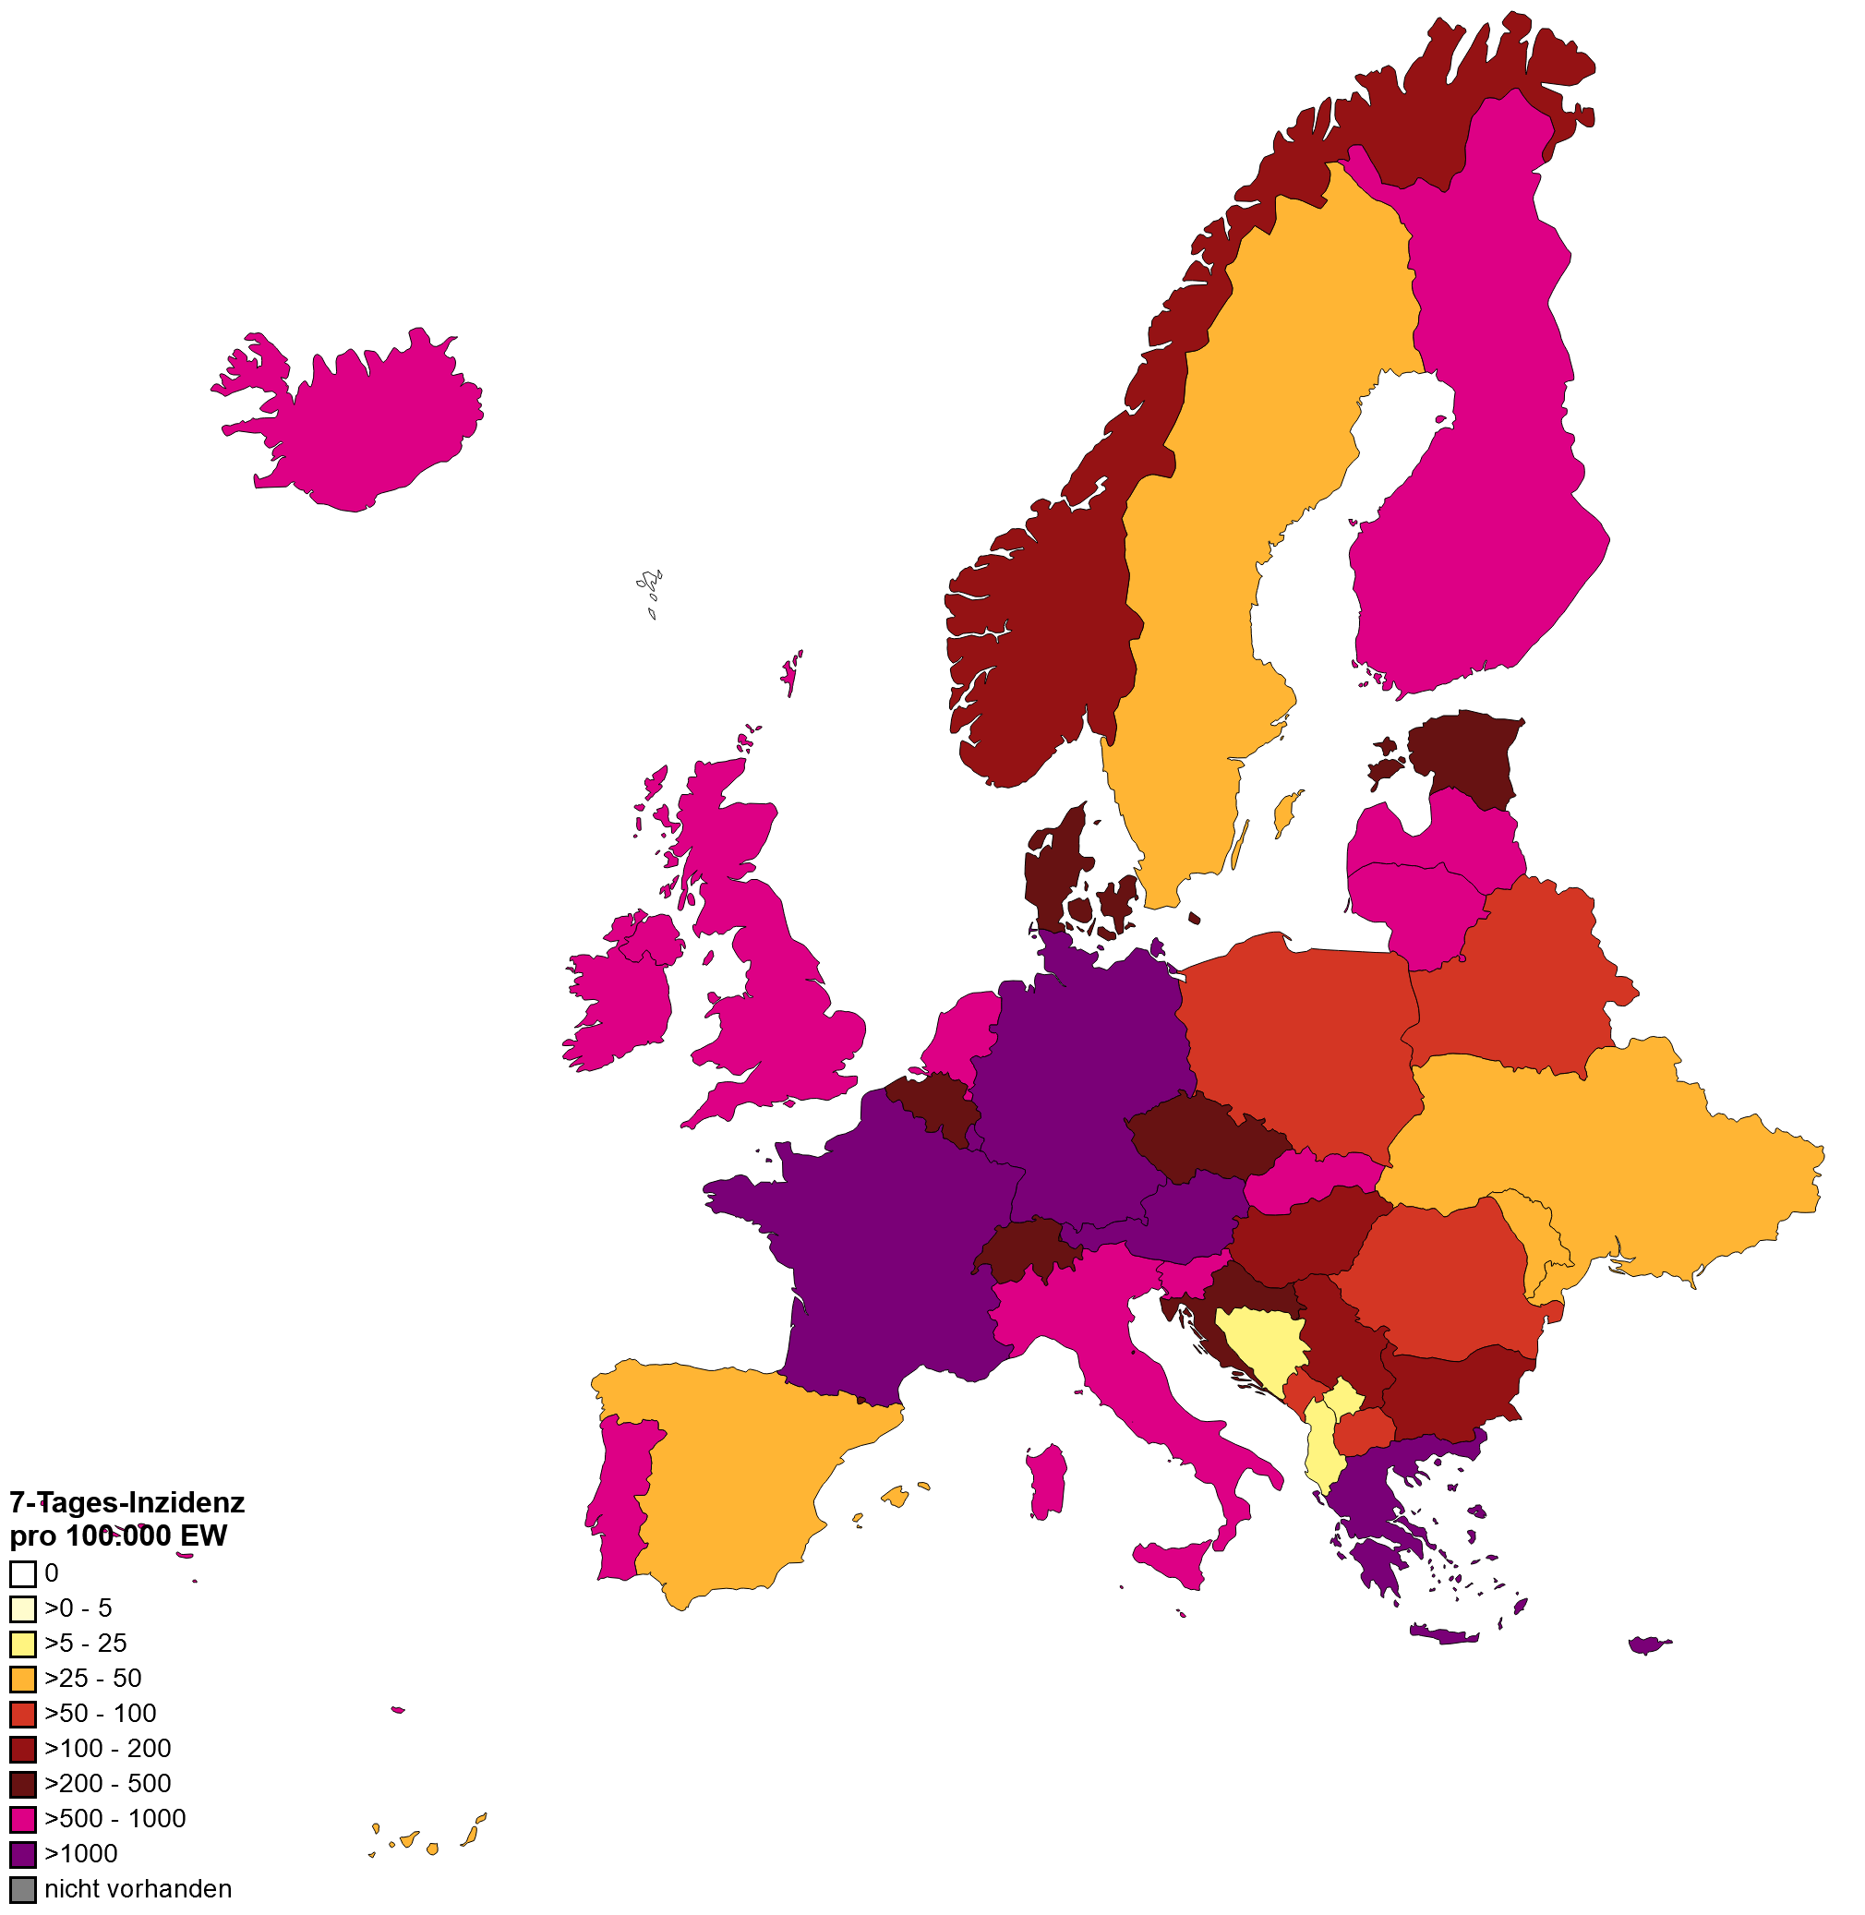
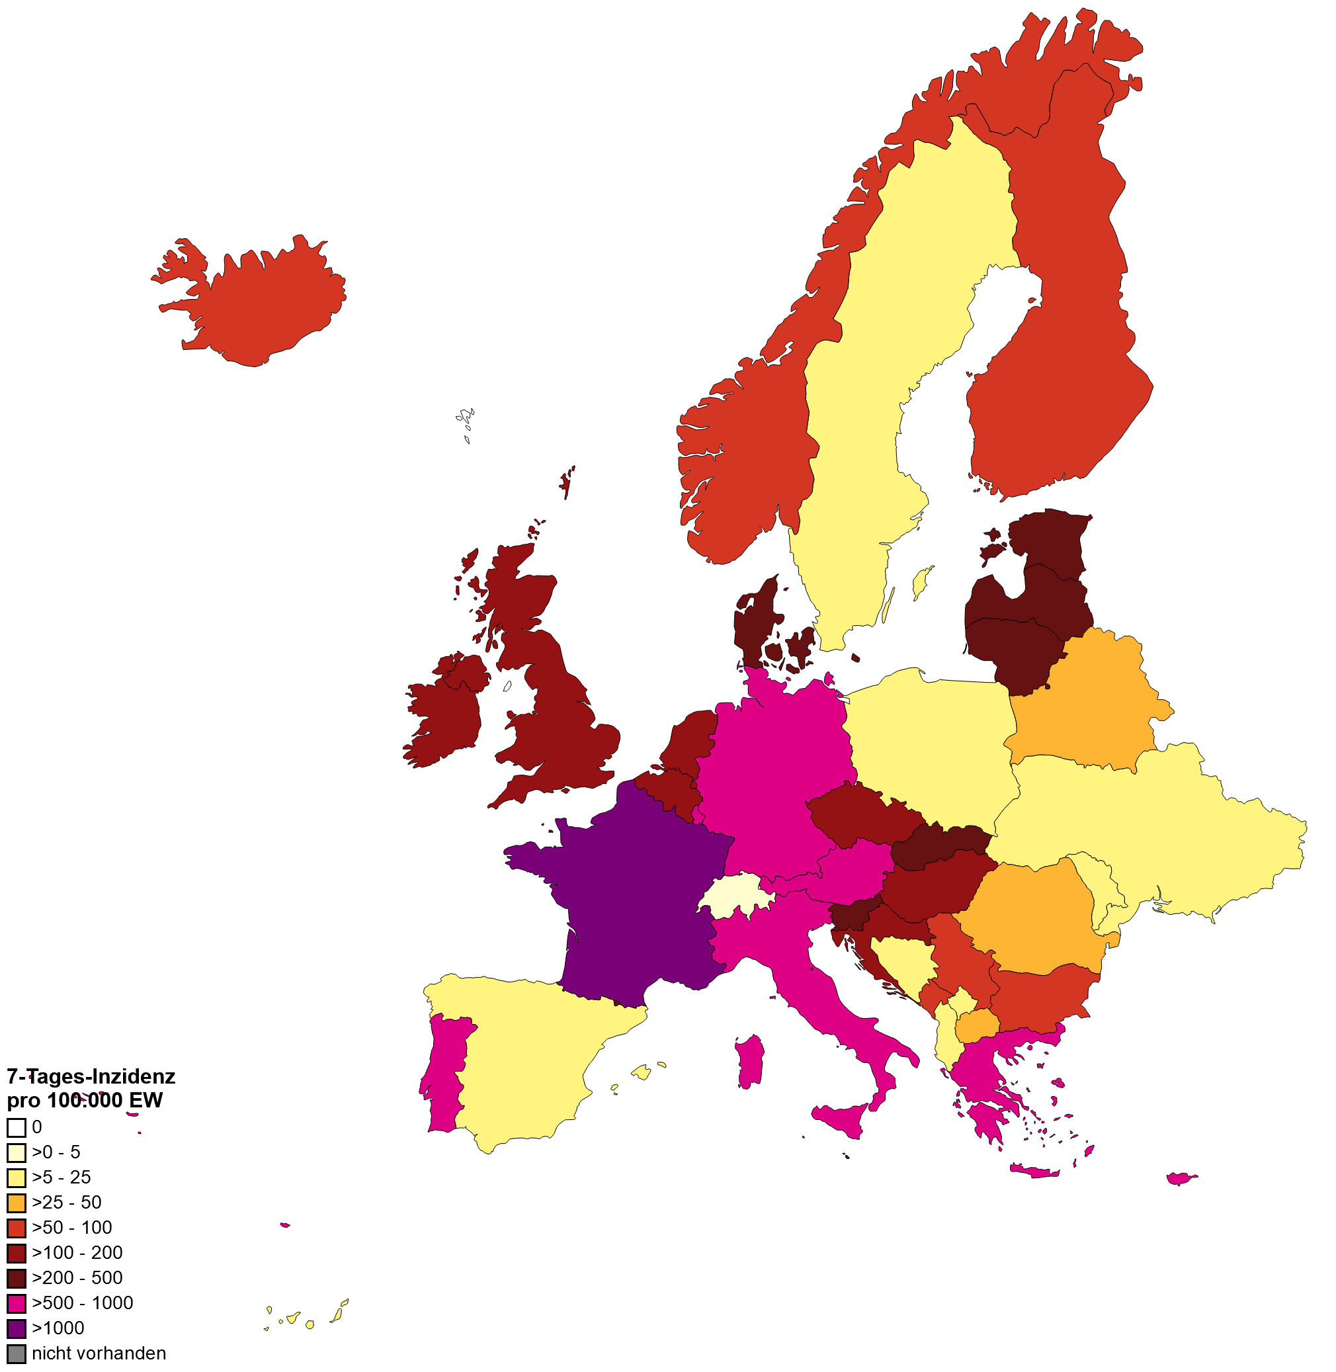
7-Tages-Inzidenz pro 100.000 Einwohner in Europa
WHO, 05.04.2022
WHO, 19.04.2022

Slide 4
Backup
Notes:
China - deaths
Today China reported 29,317 new COVID-19 cases, which include 26,318 asymptomatic cases. Shanghai has 85.7% of the symptomatic cases and 95.5% of the asymptomatic cases, according to officials. The latest numbers, which come as Shanghai's 26 million residents continue a 2-week-long lockdown, raise suspicion among COVID-19 experts.
"There's simply no way what they are reporting is what is happening," said Michael Osterholm, PhD, MPH, who directs the University of Minnesota's Center for Infectious Disease Research and Policy (CIDRAP), publisher of CIDRAP News. The proportion of asymptomatic cases defies biological logic, he said, and to report that Shanghai's death toll is so low is a misrepresentation when Hong Kong currently has the highest per capita death rate in the world.
During a January to March surge in Omicron cases, Hong Kong recorded 5,906 COVID-19 deaths. That contrasts starkly with Shanghai, where health officials maintain that no residents have died during the Omicron surge and only 1 case out of 250,000 recorded since Mar 1 required medical treatment.
"Why would no one be dying in mainland China?" Osterholm asked. "Unfortunately, this adds to the lack of trust in China's ability to report public health." …..
https://www.cidrap.umn.edu/news-perspective/2022/04/china-clings-zero-covid-policy-pfizer-touts-booster-kids (14.04.22)
Hong Kong (CNN)Shanghai reported three Covid-19 deaths Monday, the first officially announced fatalities from a raging Omicron outbreak that has infected hundreds of thousands of people despite a government-enforced city-wide lockdown.
Three elderly people aged between 89 and 91 died from Covid on Sunday, after their condition deteriorated in hospital, the Shanghai Municipal Health Commission said in a statement Monday.
All three were unvaccinated and had underlying health conditions such as coronary heart disease, diabetes and high blood pressure, according to officials.
On Tuesday, Shanghai's health commission reported another seven Covid deaths, aged between 60 and 101 and all had underlying ailments.
"The immediate cause of death is (their) underlying diseases," the commission said in a statement.
The city reported 3,084 symptomatic cases and 17,332 asymptomatic infections Tuesday, according to the statement. The death toll appears strikingly low against the vast number of cases -- since March 1, more than 390,000 people in Shanghai have been infected, and by the official count, no one had died of Covid until Sunday.
18.04.22: https://edition.cnn.com/2022/04/18/china/shanghai-reports-covid-deaths-mic-intl-hnk/index.html
… Experts questioned the accuracy of China's reporting of COVID-19 deaths.
The official death toll, which is remarkably lower than those in other major cities, has fueled skepticism of the official data coming out of China.
Some experts suspect that China is attributing underlying health conditions to COVID deaths. Yanzhong Huang, a Senior Fellow for Global Health at the Council on Foreign Relations pointed to a Shanghai study that estimates there were more than 2,000 excess diabetes deaths in Shanghai associated with the lockdown. https://abcnews.go.com/International/china-reports-deaths-shanghai-covid-outbreak-fueling-skepticism/story?id=84142928

Slide 5
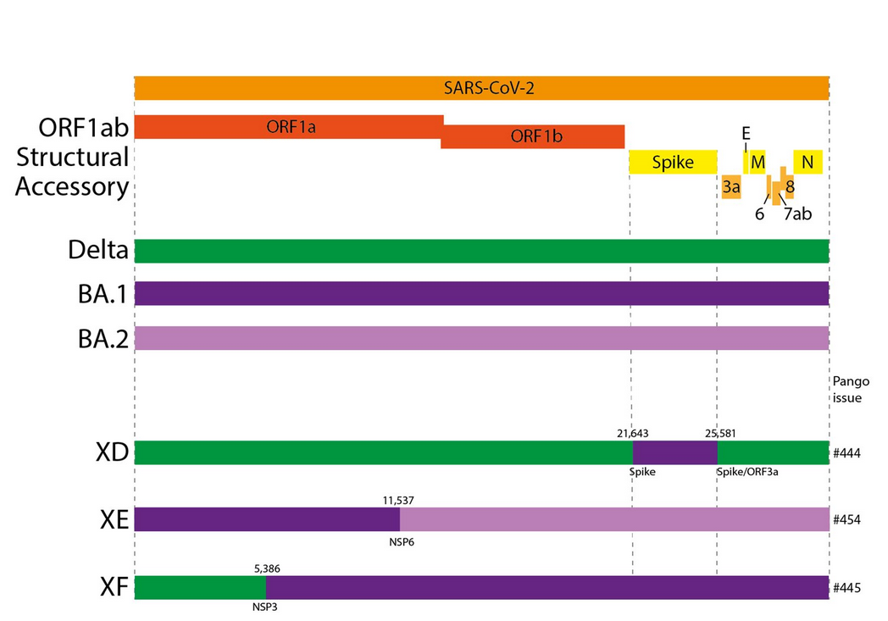
WHO Update: SARS-CoV-2-Varianten Rekombination
Vorkommen in Europa: bisher berichtet aus Dänemark, Frankreich, Finnland, Deutschland, Norwegen, Vereinigtes Königreich
UK: Zunahme und bereits „community transmission“ der XE-Fälle (763 Fälle in UK, 22.03.22)
Geschätzt leicht erhöhte Wachstumsrate von XE um ca. 10% im Vergleich zu BA.2
Bislang keine erhöhte Pathogenität oder Virulenz von XE beobachtet.
XE gehört weiterhin zu Omikron
ECDC stuft XD und XF und WHO stuft XD als „Variants under Monitoring“ ein.
Quelle: UK HSA Technical Briefing 25.03.2022, WHO SitRep 29.03.2022
Notes:
WHO SitRep: XE belongs to the Omicron variant until significant differences in transmission and disease characteristics, including severity, may be reported.
https://www.ecdc.europa.eu/en/covid-19/variants-concern
https://www.who.int/en/activities/tracking-SARS-CoV-2-variants/

