Slide 1
Top 10 Länder nach Anzahl neuer COVID-19-Fälle
508.041.253 Fälle (-17% im Vergleich zu Vorwoche)
6.224.220 Todesfälle (CFR: 1,2%)
Land | Fälle kumulativ | Neue Fälle (7T) | Verände-rung % (7T) | Trend | 7T-Inz. Fälle/ 100.000 Ew | CFR % | Auffrisch-impfung %* | Vollständige Impfung %* | Mind. eine Impfung %*
Deutschland | 24.337.394 | 756.693 | 13 | ▲ | 910 | 0,55 | 59 | 76 | 77
Südkorea | 17.009.865 | 537.964 | -36 | ▼ | 1049 | 0,13 | 65 | 87 | 87
Frankreich | 27.511.076 | 509.374 | -36 | ▼ | 783 | 0,52 | 57 | 81 | 83
Italien | 16.161.339 | 430.663 | 5 | ▲ | 722 | 1,01 | 66 | 80 | 85
USA | 80.205.437 | 293.360 | 19 | ▲ | 89 | 1,23 | 30 | 66 | 78
Japan | 7.688.507 | 285.974 | -13 | ▼ | 226 | 0,38 | 52 | 84 | 87
Australien | 5.512.954 | 274.072 | -14 | ▼ | 1075 | 0,13 | 51 | 80 | 82
Thailand | 4.194.684 | 130.840 | -5 | ▼ | 187 | 0,67 | 36 | 73 | 80
Vereinigtes Königreich | 21.978.202 | 126.232 | -34 | ▼ | 186 | 0,79 | 47 | 80 | 82
Brasilien | 30.349.463 | 96.845 | -3 | ▼ | 46 | 2,18 | 58 | 73 | 78
Quelle: WHO, 26.04.2022; *Our World In Data - Vacc, abgerufen: 26.04.2022

Slide 2
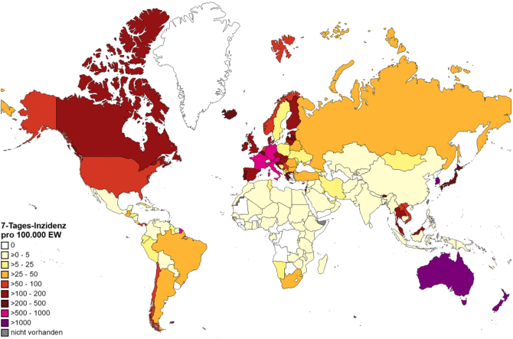
WHO epidemiological update, 27.04.2021
CAVE: vielerorts geänderte Teststrategien insbesondere in Europa z.B. Spanien, Dänemark, England testen nur Risikogruppen, Personen die Behandlung im KH benötigen und Personen die mit RG arbeiten; Österreich hat den Anzahl PCR pro Einwohner reduziert
Quelle: WHO Dashboard Zugriff 26.04.2022, Datenstand 17.04.2022; Karte WHO, 26.04.2022

Slide 3
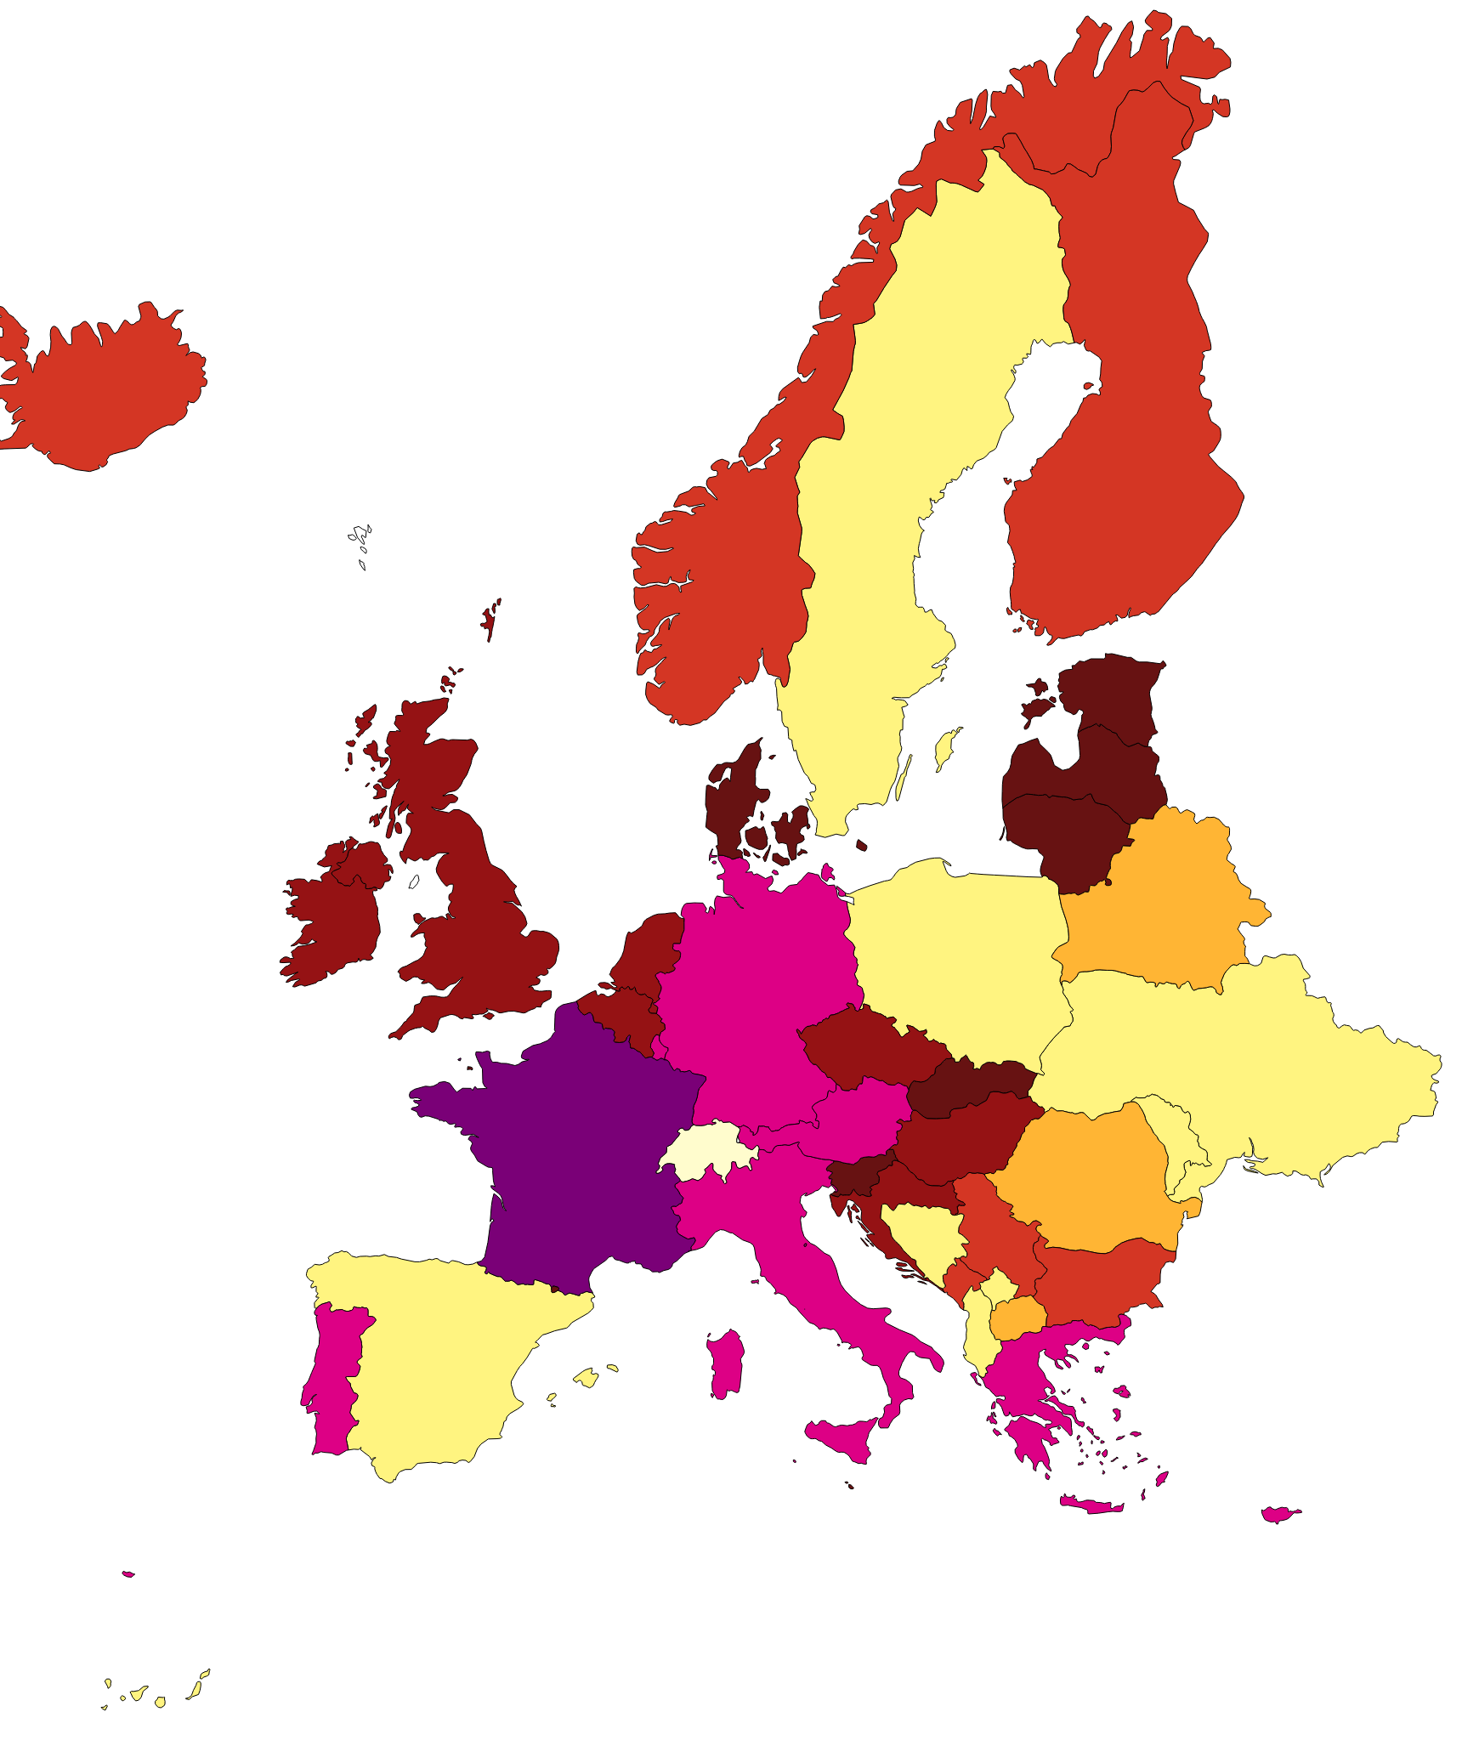
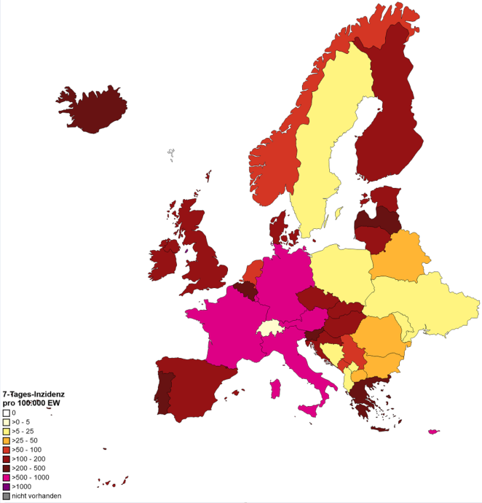
7-Tages-Inzidenz pro 100.000 Einwohner in Europa
WHO, 19.04.2022
WHO, 26.04.2022

Slide 4
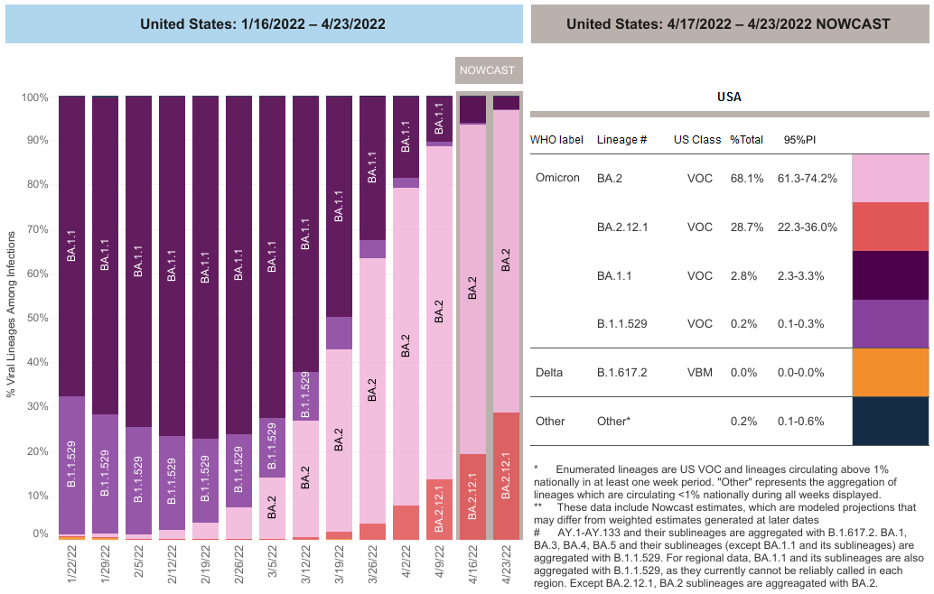
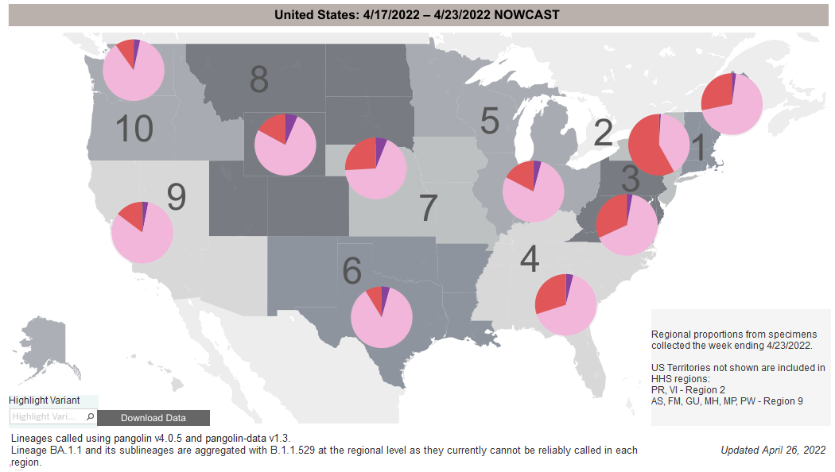
USA: SARS-CoV-2-Varianten BA.2.12.1
VOC: BA.2.12.1 nahmen im März in Central NY zu, 29% Prävalenz in USA, 58% in Region 2
Wachstumsvorteil gegenüber über BA.2: 27%
Quelle: US CDC 26.04.2022, PM NY State Department of Health 14.03.2022

Slide 5
Backup
Notes:
China - deaths
Today China reported 29,317 new COVID-19 cases, which include 26,318 asymptomatic cases. Shanghai has 85.7% of the symptomatic cases and 95.5% of the asymptomatic cases, according to officials. The latest numbers, which come as Shanghai's 26 million residents continue a 2-week-long lockdown, raise suspicion among COVID-19 experts.
"There's simply no way what they are reporting is what is happening," said Michael Osterholm, PhD, MPH, who directs the University of Minnesota's Center for Infectious Disease Research and Policy (CIDRAP), publisher of CIDRAP News. The proportion of asymptomatic cases defies biological logic, he said, and to report that Shanghai's death toll is so low is a misrepresentation when Hong Kong currently has the highest per capita death rate in the world.
During a January to March surge in Omicron cases, Hong Kong recorded 5,906 COVID-19 deaths. That contrasts starkly with Shanghai, where health officials maintain that no residents have died during the Omicron surge and only 1 case out of 250,000 recorded since Mar 1 required medical treatment.
"Why would no one be dying in mainland China?" Osterholm asked. "Unfortunately, this adds to the lack of trust in China's ability to report public health." …..
https://www.cidrap.umn.edu/news-perspective/2022/04/china-clings-zero-covid-policy-pfizer-touts-booster-kids (14.04.22)
Hong Kong (CNN)Shanghai reported three Covid-19 deaths Monday, the first officially announced fatalities from a raging Omicron outbreak that has infected hundreds of thousands of people despite a government-enforced city-wide lockdown.
Three elderly people aged between 89 and 91 died from Covid on Sunday, after their condition deteriorated in hospital, the Shanghai Municipal Health Commission said in a statement Monday.
All three were unvaccinated and had underlying health conditions such as coronary heart disease, diabetes and high blood pressure, according to officials.
On Tuesday, Shanghai's health commission reported another seven Covid deaths, aged between 60 and 101 and all had underlying ailments.
"The immediate cause of death is (their) underlying diseases," the commission said in a statement.
The city reported 3,084 symptomatic cases and 17,332 asymptomatic infections Tuesday, according to the statement. The death toll appears strikingly low against the vast number of cases -- since March 1, more than 390,000 people in Shanghai have been infected, and by the official count, no one had died of Covid until Sunday.
18.04.22: https://edition.cnn.com/2022/04/18/china/shanghai-reports-covid-deaths-mic-intl-hnk/index.html
… Experts questioned the accuracy of China's reporting of COVID-19 deaths.
The official death toll, which is remarkably lower than those in other major cities, has fueled skepticism of the official data coming out of China.
Some experts suspect that China is attributing underlying health conditions to COVID deaths. Yanzhong Huang, a Senior Fellow for Global Health at the Council on Foreign Relations pointed to a Shanghai study that estimates there were more than 2,000 excess diabetes deaths in Shanghai associated with the lockdown. https://abcnews.go.com/International/china-reports-deaths-shanghai-covid-outbreak-fueling-skepticism/story?id=84142928

Slide 6
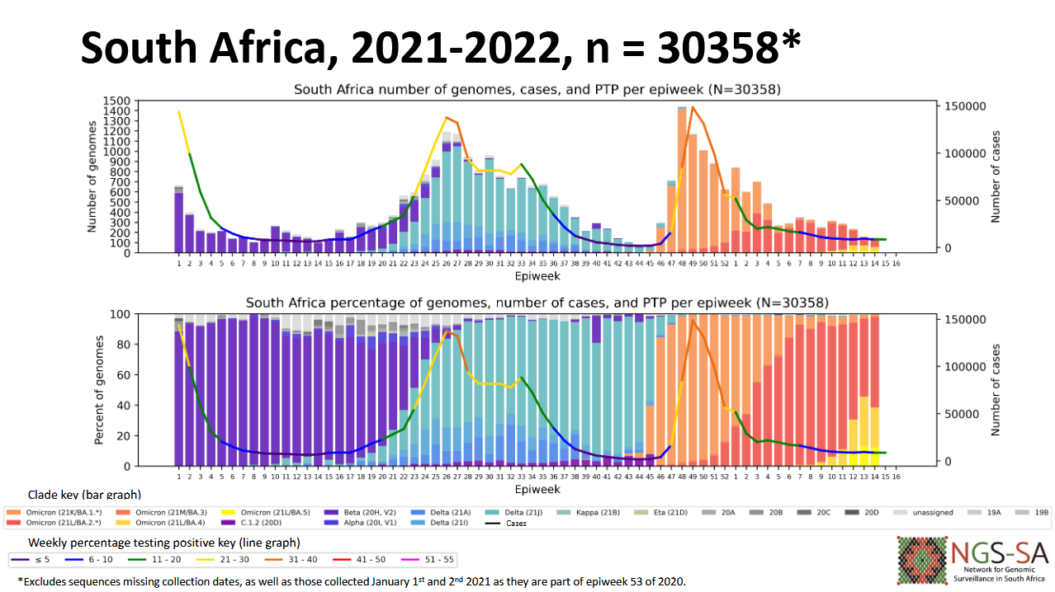
Südafrika: SARS-CoV-2-Varianten BA.4 und BA.5
BA.4 und BA.5 mit Zunahme seit März 2022
BA.4 in Gauteng bereits dominant.
BA.5 in KwaZulu-Natal bereits dominant.
Steigerung der Infektionszahlen & Positivitätsrate in Provinzen Gauteng, Kwazulu-Natal, Western Cape
Quelle: NICD Surveillance Report 22.04.2022
Notes:
https://www.nicd.ac.za/diseases-a-z-index/disease-index-covid-19/sars-cov-2-genomic-surveillance-update/

