Slide 1
Top 10 Länder nach Anzahl neuer COVID-19-Fälle
519.729.804 Fälle insgesamt (-0,6% im Vergleich zu Vorwoche)
6.268.281 Todesfälle (CFR: 1,2%)
Land | Fälle kumulativ | Neue Fälle (7T) | Verände-rung % (7T) | Trend | 7T-Inz. Fälle/ 100.000 Ew | CFR % | Test Positiv Rate | Auffrisch-impfung %* | Vollständige Impfung %* | Mind. eine Impfung %*
USA | 81.682.634 | 604.347 | 33 | ▲ | 183 | 1,21 | 9,3 | 31 | 67 | 78
China | 18.12.984 | 435.347 | 74 | ▲ | 30 | 0,86 | 0,2 | - | - | -
Deutschland | 25.818.405 | 364.519 | -22 | ▼ | 438 | 0,53 | 42 | 65 | 78 | 78
Australien | 6.631.359 | 350.866 | -26 | ▼ | 1376 | 0,12 | 21 | 53 | 85 | 87
Japan | 8.399.390 | 266.193 | 28 | ▲ | 210 | 0,36 | 28 | 57 | 81 | 82
Italien | 17.071.649 | 255.230 | -13 | ▼ | 428 | 0,97 | 15 | 67 | 80 | 85
Südkorea | 17.830.429 | 215.560 | -20 | ▼ | 420 | 0,13 | 25 | 72 | 87 | 88
Frankreich | 28.328.687 | 204.491 | -21 | ▼ | 314 | 0,51 | 20 | 58 | 81 | 83
Portugal | 4.114.316 | 144.066 | 58 | ▲ | 1399 | 0,55 | 38 | 63 | 86 | 94
Brasilien | 30.688.390 | 123.854 | 13 | ▲ | 58 | 2,17 | - | 43 | 78 | 86
Quelle: WHO, 17.05.2022; *Our World In Data - Vacc, abgerufen: 17.05.2022

Slide 2
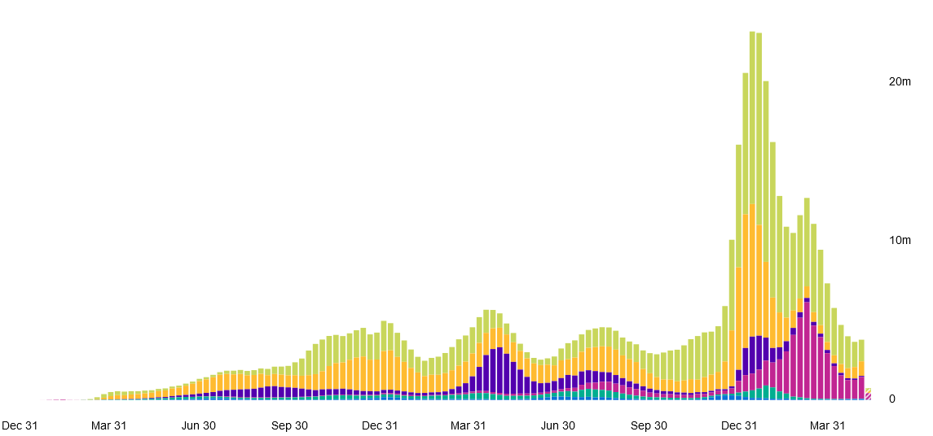
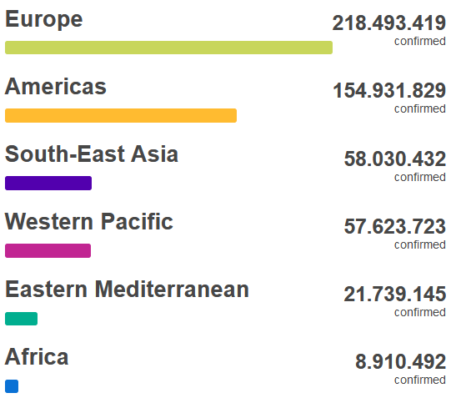
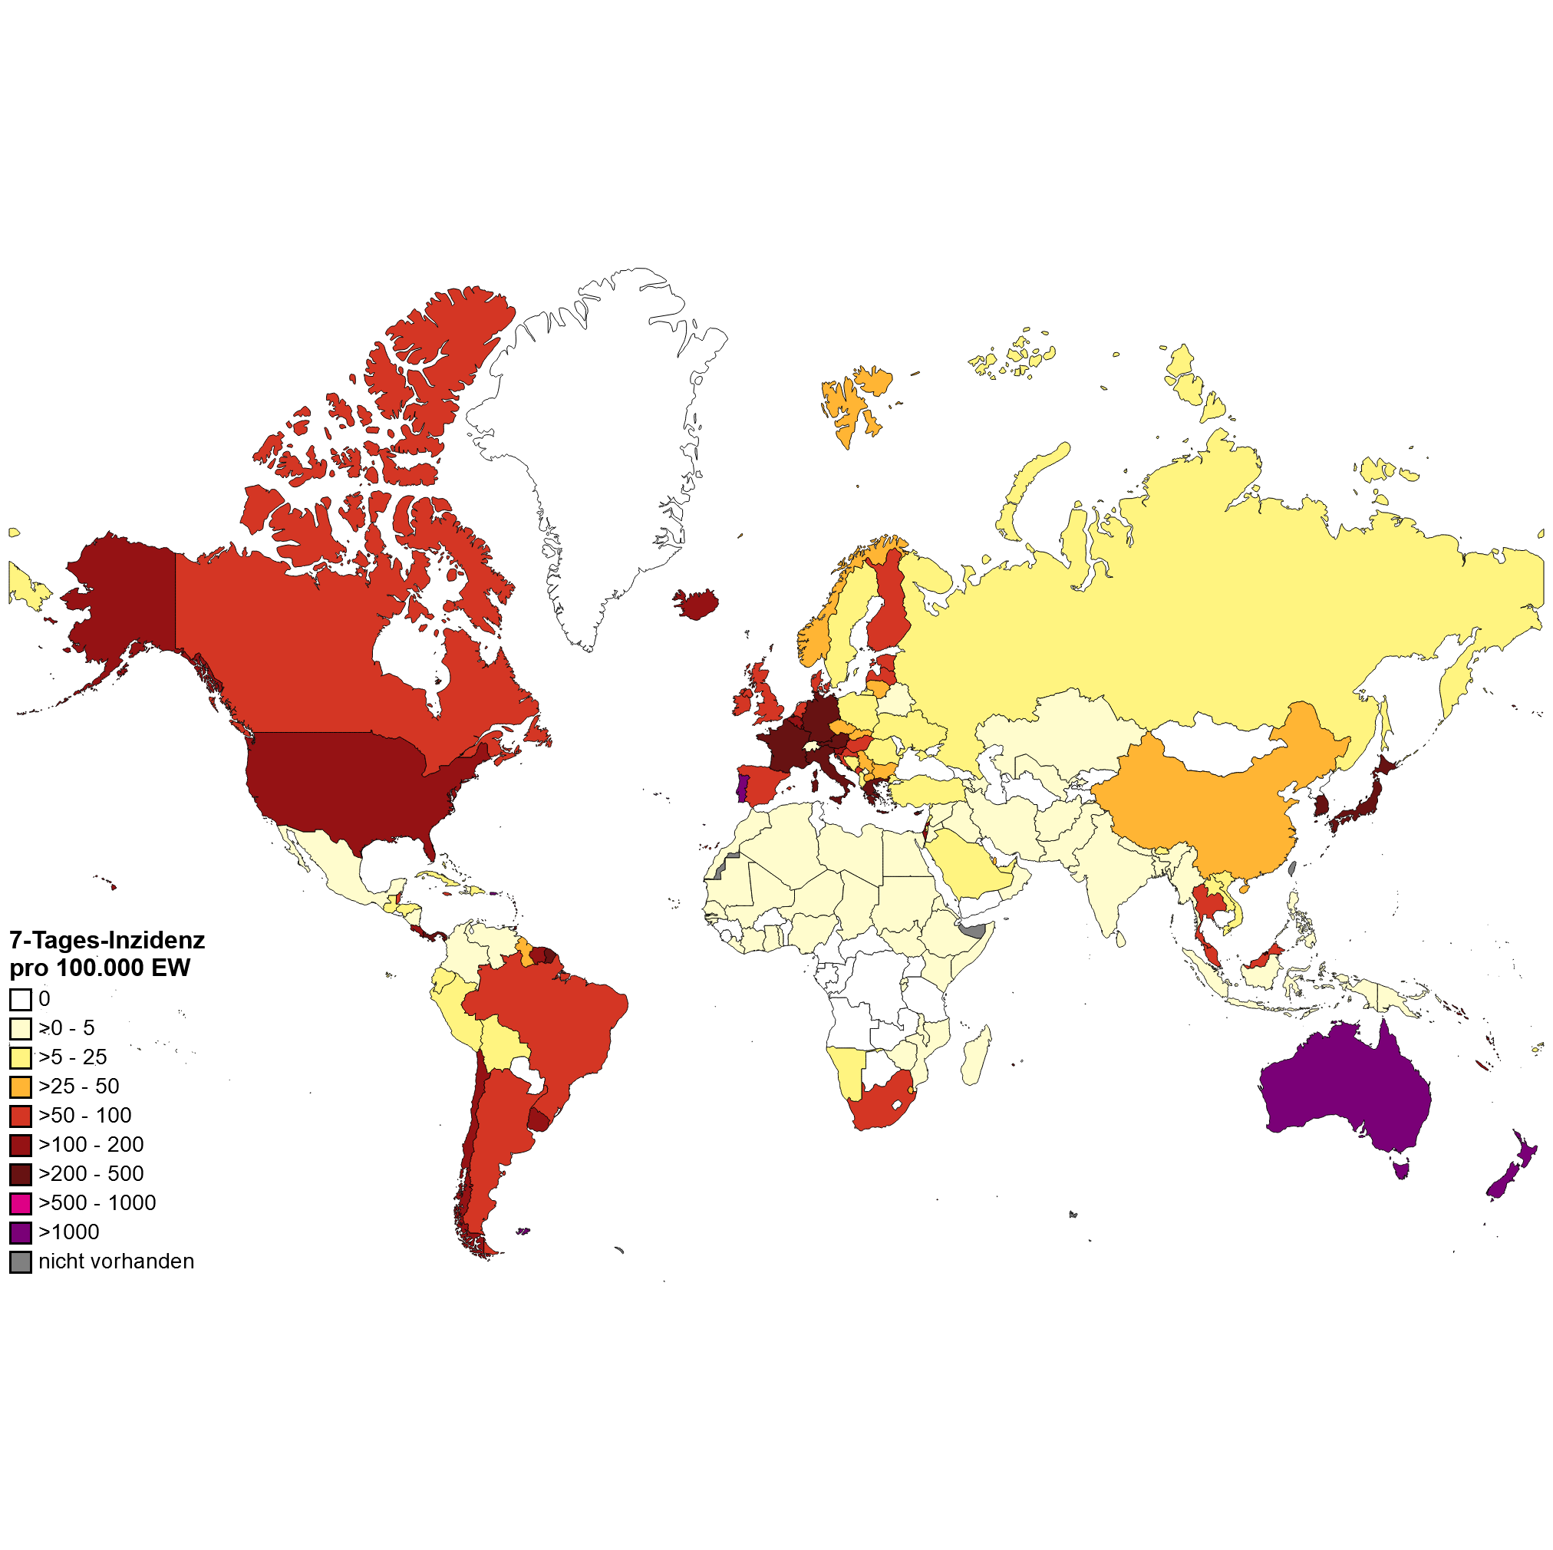
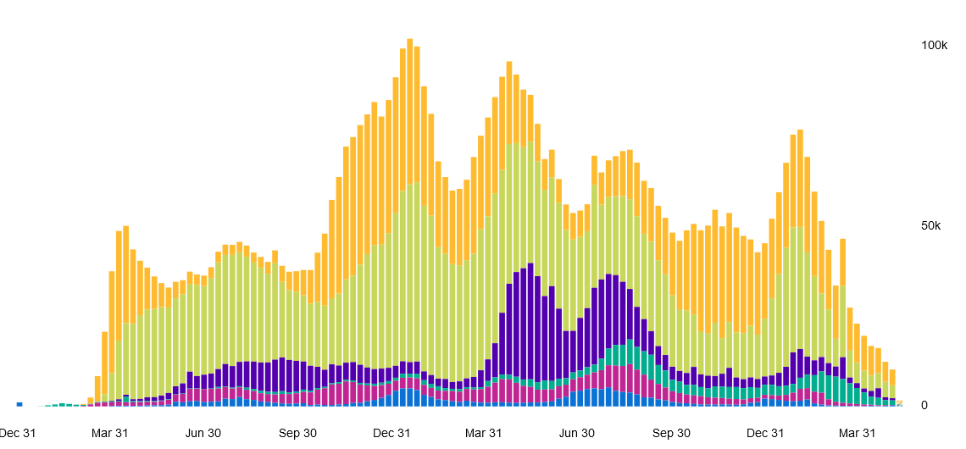
WHO epidemiological update, datenstand 17.05.2022
Anzahl Fälle pro KW und WHO Region, Dez 2019 – 16. Mai 2022
7-T Inzidenz pro 100.000 Einwohner Weltweit
Anzahl Todesfälle pro KW und WHO Region, Dez 2019 – 16. Mai 2022
Quelle: WHO Dashboard Zugriff 18.05.2022, Datenstand 17.05.2022; Karte WHO, 17.05.2022
Notes:
CAVE: vielerorts geänderte Teststrategien insbesondere in Europa z.B. Spanien, Dänemark, England testen nur Risikogruppen, Personen die Behandlung im KH benötigen und Personen die mit RG arbeiten; Österreich hat den Anzahl PCR pro Einwohner reduziert

Slide 3
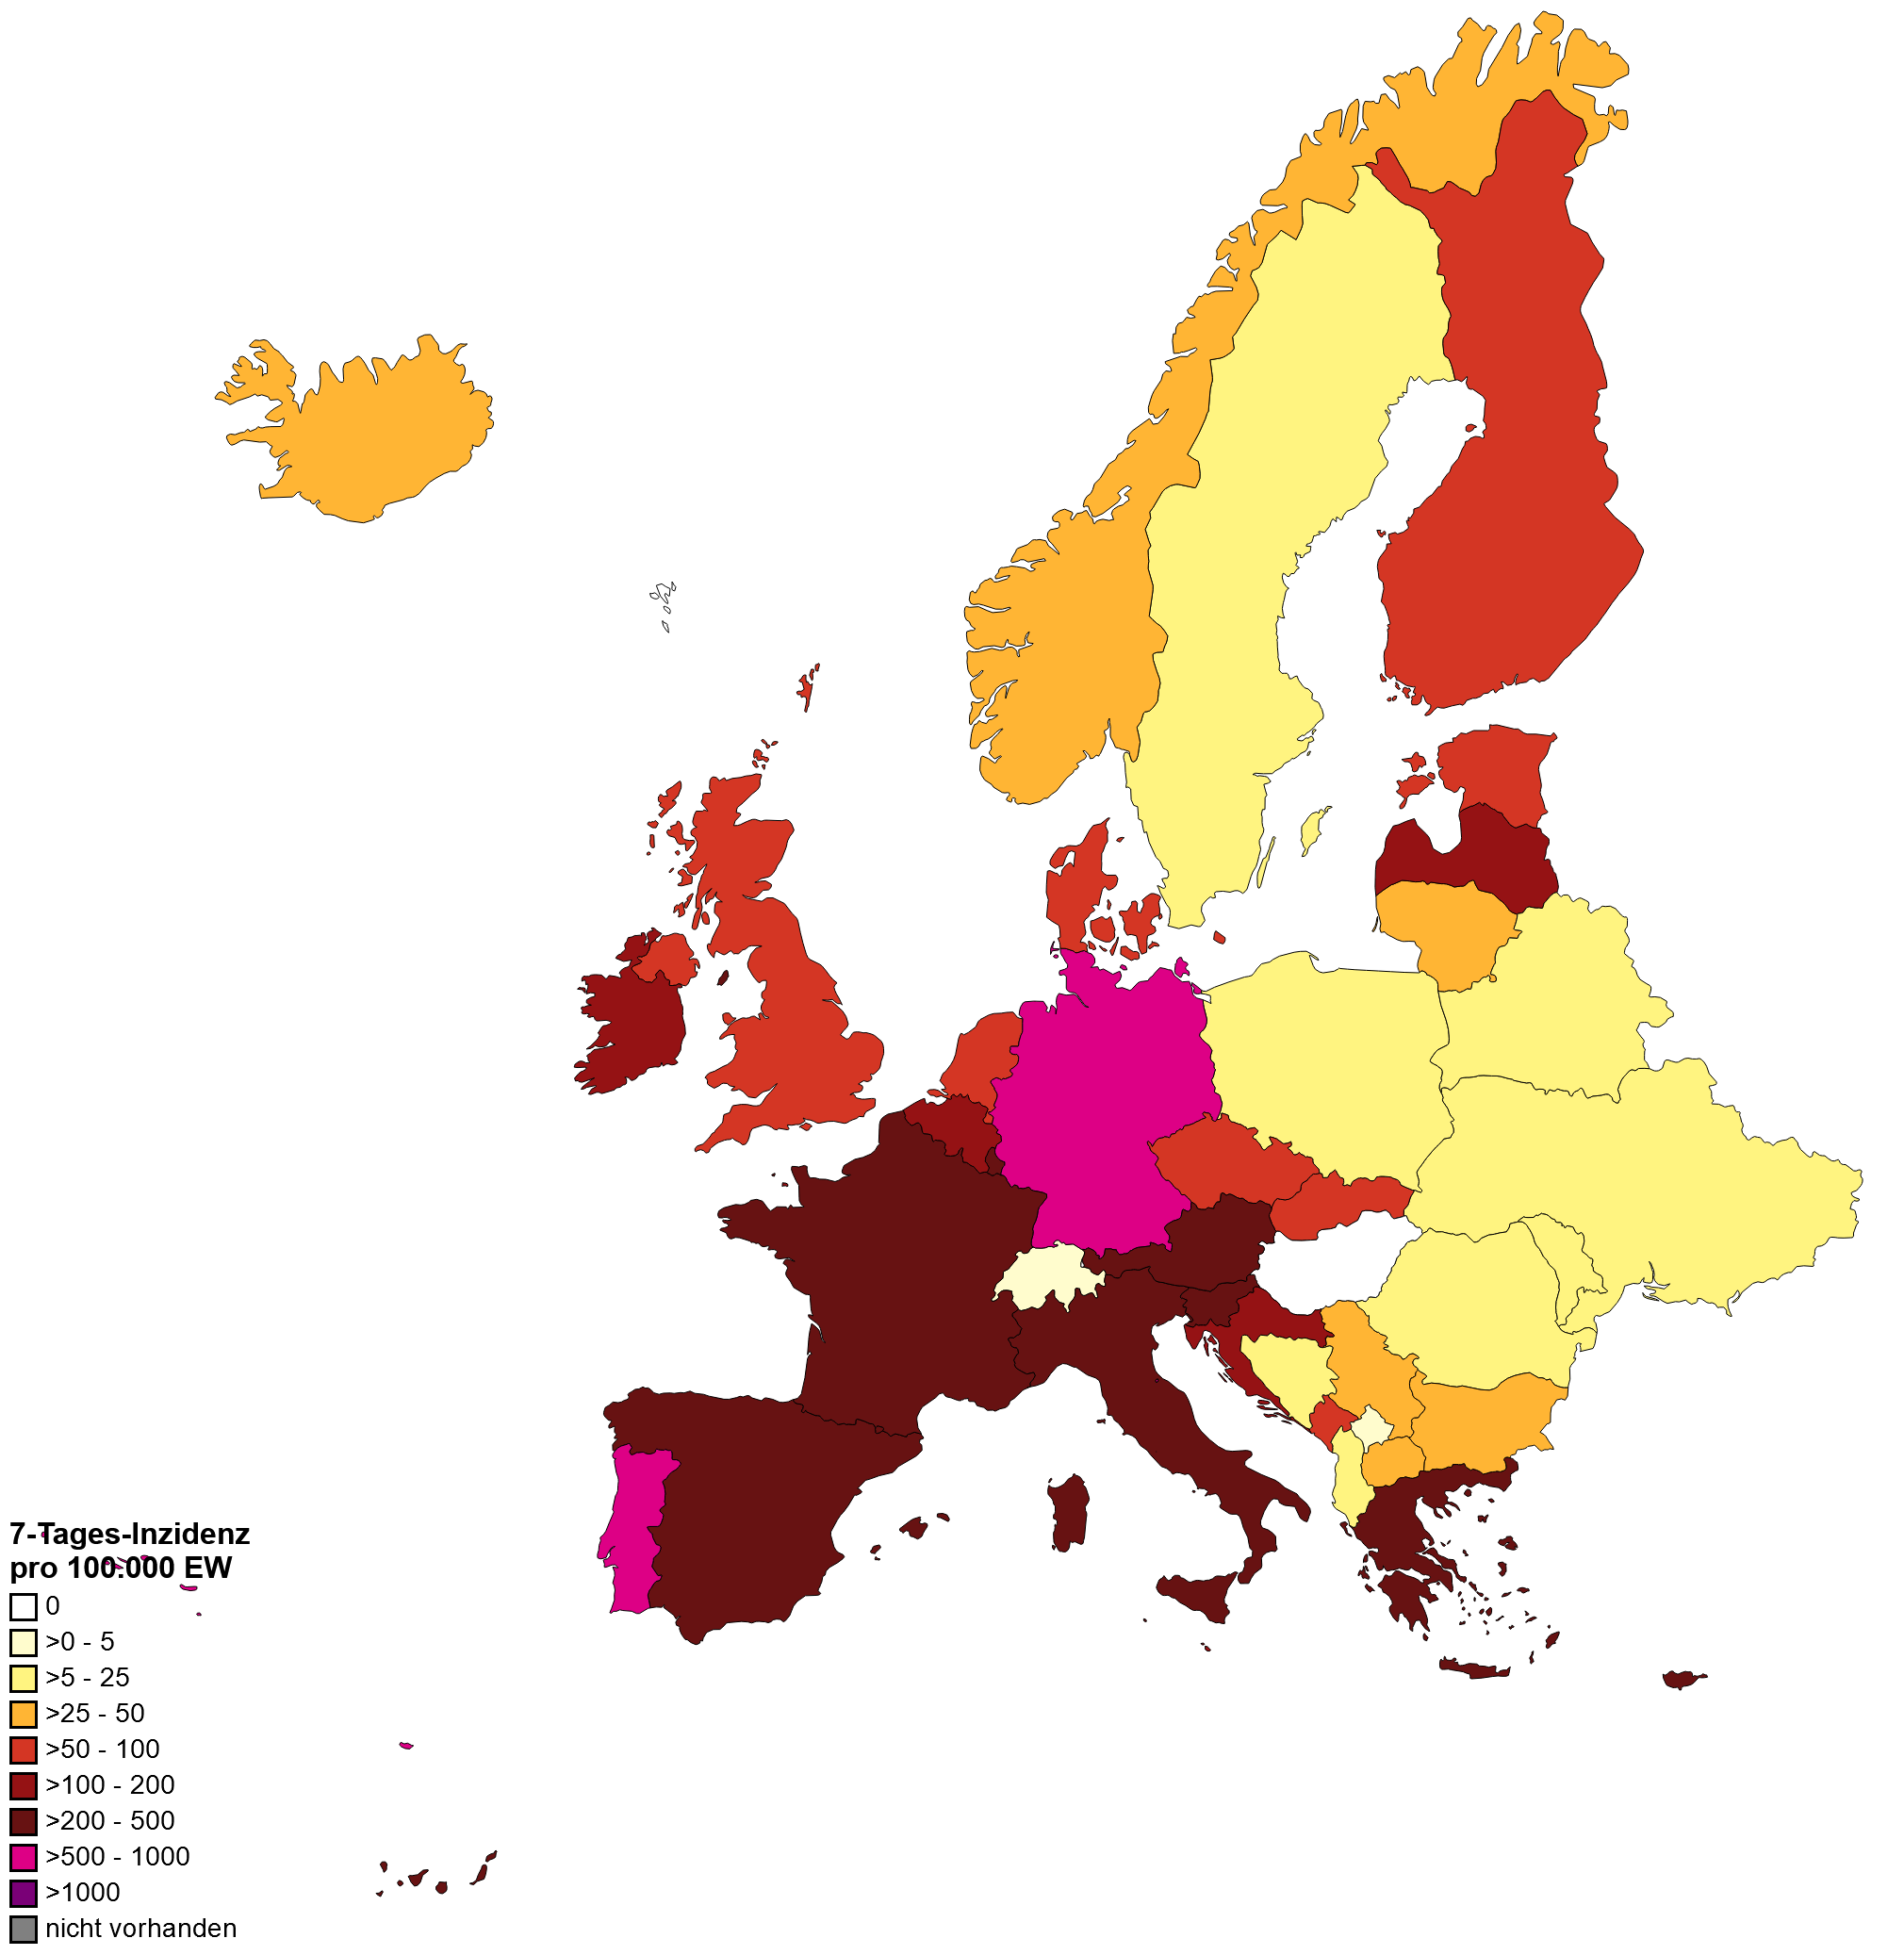
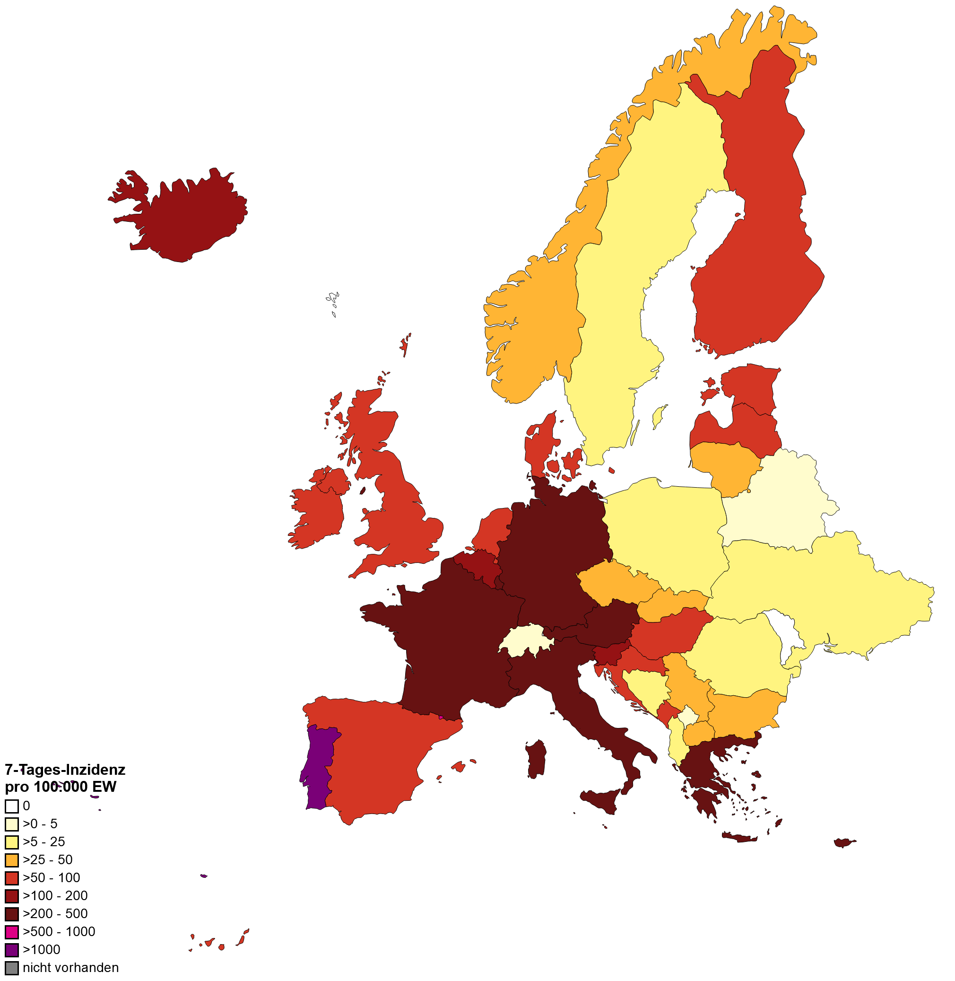
7-Tages-Inzidenz pro 100.000 Einwohner in Europa
WHO, 10.05.2022
WHO, 17.05.2022

Slide 4
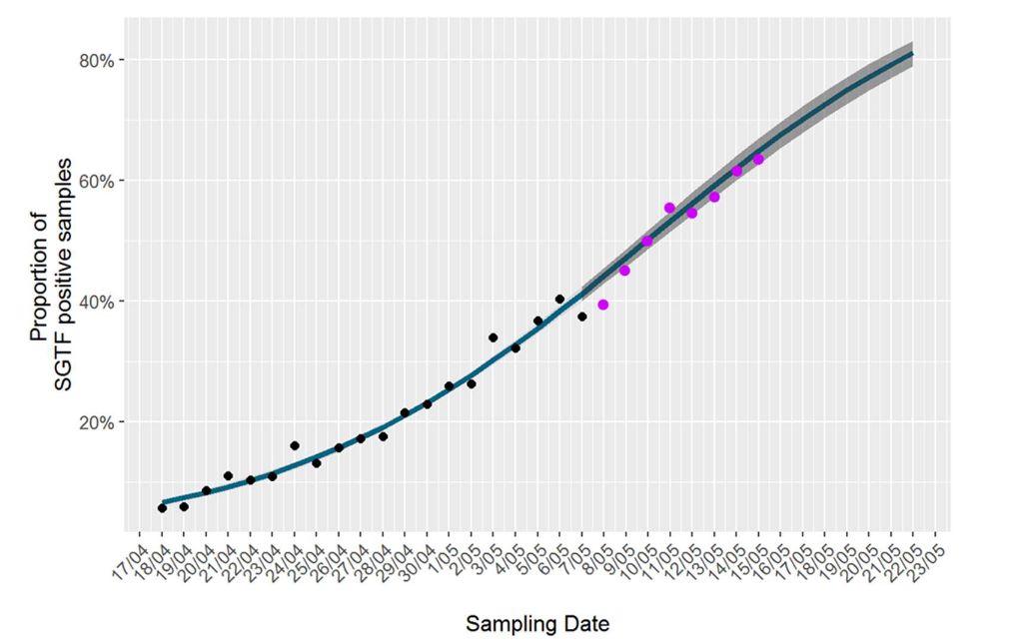
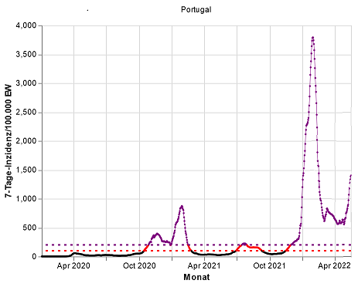
Länderfokus: Portugal
Fallzahlsteigerung seit Anfang Mai 2022
Test Positive rate gestiegen (Stand 17.05.2022: 38%)
R 7-Tage: 1,34
Bisher kein Steigerung der Covid-19 Krankenhausbelegung, IST oder todesfälle zu beobachten
BA.5, Bericht 17.05.2022
-geschätzt 64% bei 15.Mai 2022
-geschätz 80% bei 22. Mai 2022
Figur: Evolution of the proportion of positive samples with S gene target failure (SGTF) in Portugal during the period from April 18th to May 7th (black dots), 2022, together with a 15-day forecast of the growth trend (Subsequent SGTF data (from 8 to 15 May 2022) is depicted by purple dots)
Quelle: WHO, Datenstand 17.05.2022; OWID, Zugriff 17.05.2022; NIPH Portugal, SARS-CoV-2 genetic diversity Bericht, 10. Mai 2022
Notes:
Quelle BA.5 Modellierung: https://insaflu.insa.pt/covid19/relatorios/PORTUGAL_INSA_SARS_CoV_2_GENETIC_DIVERSITY_situation_report_2022-05-17.pdf
BA.1 has been firstly identified in Portugal by mid November, 2021, and was dominant between ISO weeks 51, 2021 (20th-26th November) and 7, 2022 (14th-20th February), having reached its maximum circulation in week 2 (95,6%, 10th- 16th January, 2022) (Figures 2 and 3). The current circulation of BA.1 in Portugal is estimated to be residual, and, so far, no cases have been detected on week 17 (analysis ongoing).
BA.2 has been firstly detected in random nationwide sequencing surveys in ISO week 52 (27th December 2021 – 2nd January 2022) (Figure 2), becoming dominant on week 8 (21st–27th February 2022). According to the proportion of non-SGTF positive samples (indicative of probable Omicron BA.2 case), BA.2 relative frequency shows a decreasing trend and is estimated to be 62.9% on 8 May 2022 (Figures 2, 3 and 4).insaflu.insa.pt/covid19/relatorios/PORTUGAL_INSA_SARS_CoV_2_GENETIC_DIVERSITY_situation_report_2022-05-10.pdf
In Portugal, after its detection in week 13, lineage BA.5 has been increasing in relative frequency, having duplicated its relative frequency between ISO weeks 15 (4.0%, 11-17 April) and 16 (9.0%, 18-24 April) (analysis and sampling concluded) (Figure 2). The nationwide sequencing survey of week 17 (ongoing), together with the proportion of samples with SGTF profile, indicate that this trend of duplication of the relative frequency by week has continued, and it is estimated that BA.5 represented ~37% of the positive cases by 8 May 2022.

Slide 5
Backup

Slide 6
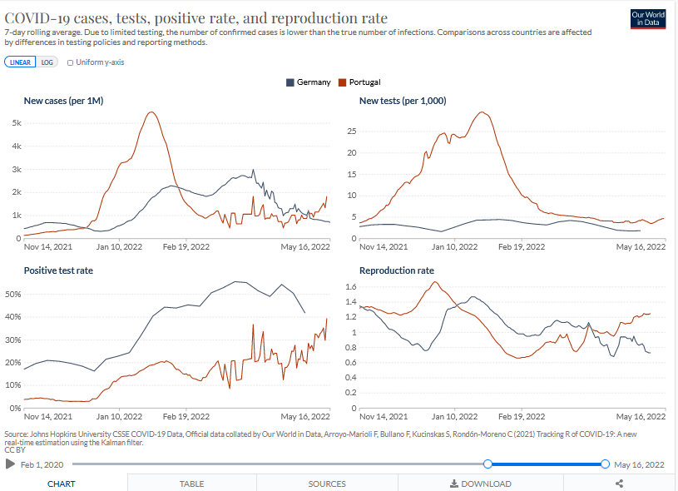
Länderfokus: Portugal vs Deutschland
Quelle: Covariants.org, zugriff 17.05.2022 ; ECDC Zugriff 17.05.2022
Notes:
https://covariants.org/per-country?country=United+Kingdom&country=Germany&country=Denmark&country=France&country=Sweden&country=Switzerland&country=Netherlands&country=Spain&country=Belgium&country=Italy&country=Poland&country=Turkey&country=Ireland&country=Slovenia&country=Norway&country=Czech+Republic&country=Lithuania&country=Slovakia&country=Portugal&country=Croatia&country=Luxembourg&country=Finland&country=Austria&country=Bulgaria&country=Greece&country=Romania&country=Latvia&country=Estonia&country=Russia&country=Iceland&country=Bosnia+and+Herzegovina&country=Kosovo&country=Liechtenstein&country=Malta&country=Ukraine&country=Montenegro&country=North+Macedonia&country=Moldova&country=Cyprus&country=Serbia&country=Hungary&country=Belarus&country=Andorra&country=Monaco
https://covid19-country-overviews.ecdc.europa.eu/countries/Portugal.html

Slide 7
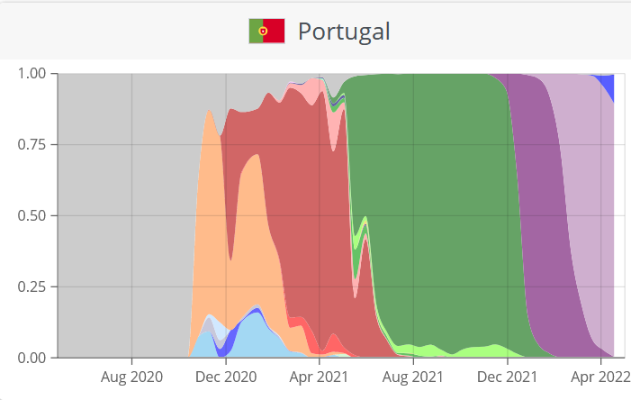
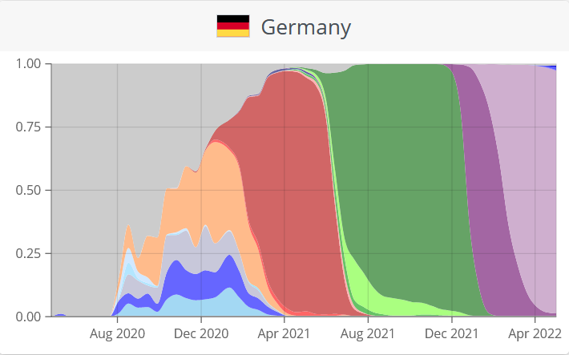
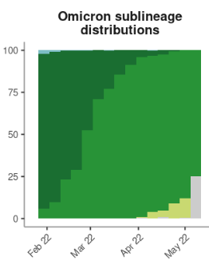
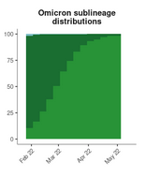
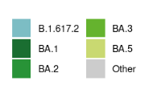
Länderfokus: Portugal vs Deutschland
Anteile VOC in GIDAID.; Dunkel Lila = BA.1 Hell lila =BA.2
Quelle: Covariants.org, zugriff 17.05.2022 ; ECDC Zugriff 17.05.2022
Notes:
https://covariants.org/per-country?country=United+Kingdom&country=Germany&country=Denmark&country=France&country=Sweden&country=Switzerland&country=Netherlands&country=Spain&country=Belgium&country=Italy&country=Poland&country=Turkey&country=Ireland&country=Slovenia&country=Norway&country=Czech+Republic&country=Lithuania&country=Slovakia&country=Portugal&country=Croatia&country=Luxembourg&country=Finland&country=Austria&country=Bulgaria&country=Greece&country=Romania&country=Latvia&country=Estonia&country=Russia&country=Iceland&country=Bosnia+and+Herzegovina&country=Kosovo&country=Liechtenstein&country=Malta&country=Ukraine&country=Montenegro&country=North+Macedonia&country=Moldova&country=Cyprus&country=Serbia&country=Hungary&country=Belarus&country=Andorra&country=Monaco
https://covid19-country-overviews.ecdc.europa.eu/countries/Portugal.html

Slide 8
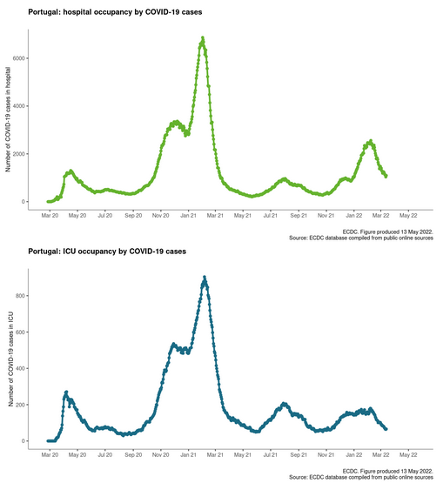
Länderfokus: Portugal – Krankenhausbelegung/ICU
Quelle: OWID, Zugriff 17.05.2022; NIPH Portugal, SARS-CoV-2 genetic diversity Bericht, 10. Mai 2022
Notes:
Quelle BA.5 Modellierung: https://insaflu.insa.pt/covid19/relatorios/PORTUGAL_INSA_SARS_CoV_2_GENETIC_DIVERSITY_situation_report_2022-05-10.pdf

Slide 9
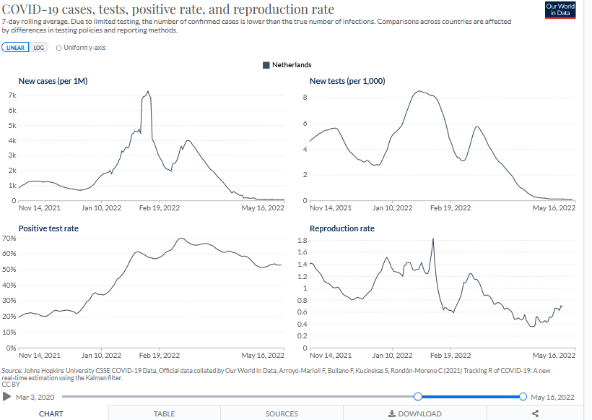
Länderfokus: Niederlande
BA.4 Steigerung in Genomic Surveillance
Quelle: OWID, Zugriff 17.05.2022; NIPH Portugal, SARS-CoV-2 genetic diversity Bericht, 10. Mai 2022
Notes:
Quelle BA.5 Modellierung: https://insaflu.insa.pt/covid19/relatorios/PORTUGAL_INSA_SARS_CoV_2_GENETIC_DIVERSITY_situation_report_2022-05-10.pdf

