Slide 1
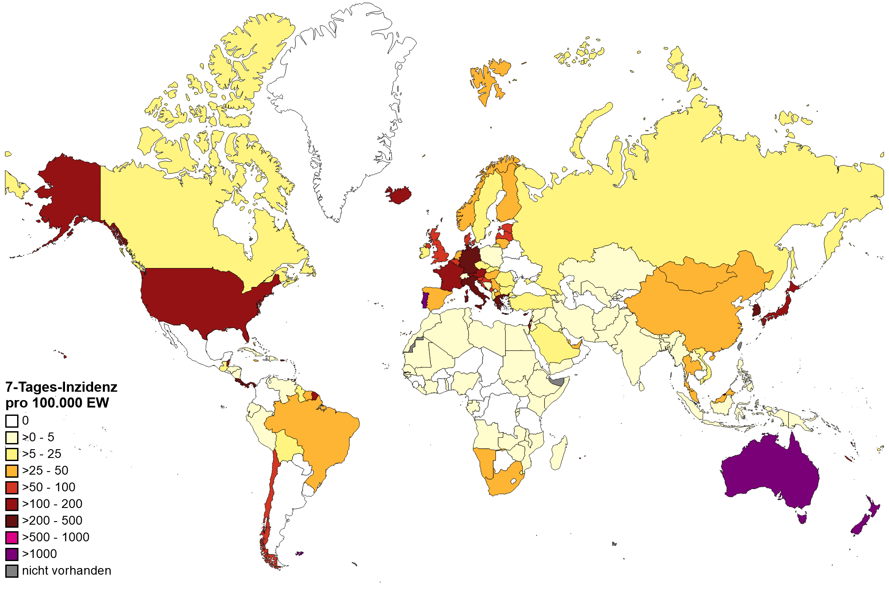
WHO epidemiological update, Datenstand 31.05.2022
Anzahl Fälle pro KW und WHO Region, Dez 2019 – 31. Mai 2022
7-T Inzidenz pro 100.000 Einwohner Weltweit
Continent | cases_7d | change_cases_7d | proportion_of_cases_7d | deaths_7d | change_deaths_7d | proportions_of_deaths_7d
Africa | 29.758 | -40,82 | 1,1 | 245 | -15,22 | 3,28
America | 564.250 | -44,65 | 20,95 | 2.331 | -32,71 | 31,18
Asia | 1.002.839 | -10,07 | 37,23 | 1.692 | 6,89 | 22,63
Europe | 783.305 | -29,4 | 29,08 | 2.745 | -24,61 | 36,71
Oceania | 313.448 | -21,46 | 11,64 | 464 | 14,29 | 6,21
Global | 2.693.600 | -27,07 |  | 7.477 | -20,31
Quelle: WHO Dashboard Zugriff 01.06.2022, Datenstand 31.05.2022; Karte WHO, 31.05.2022
Notes:
CAVE: vielerorts geänderte Teststrategien insbesondere in Europa z.B. Spanien, Dänemark, England testen nur Risikogruppen, Personen die Behandlung im KH benötigen und Personen die mit RG arbeiten; Österreich hat den Anzahl PCR pro Einwohner reduziert

Slide 2
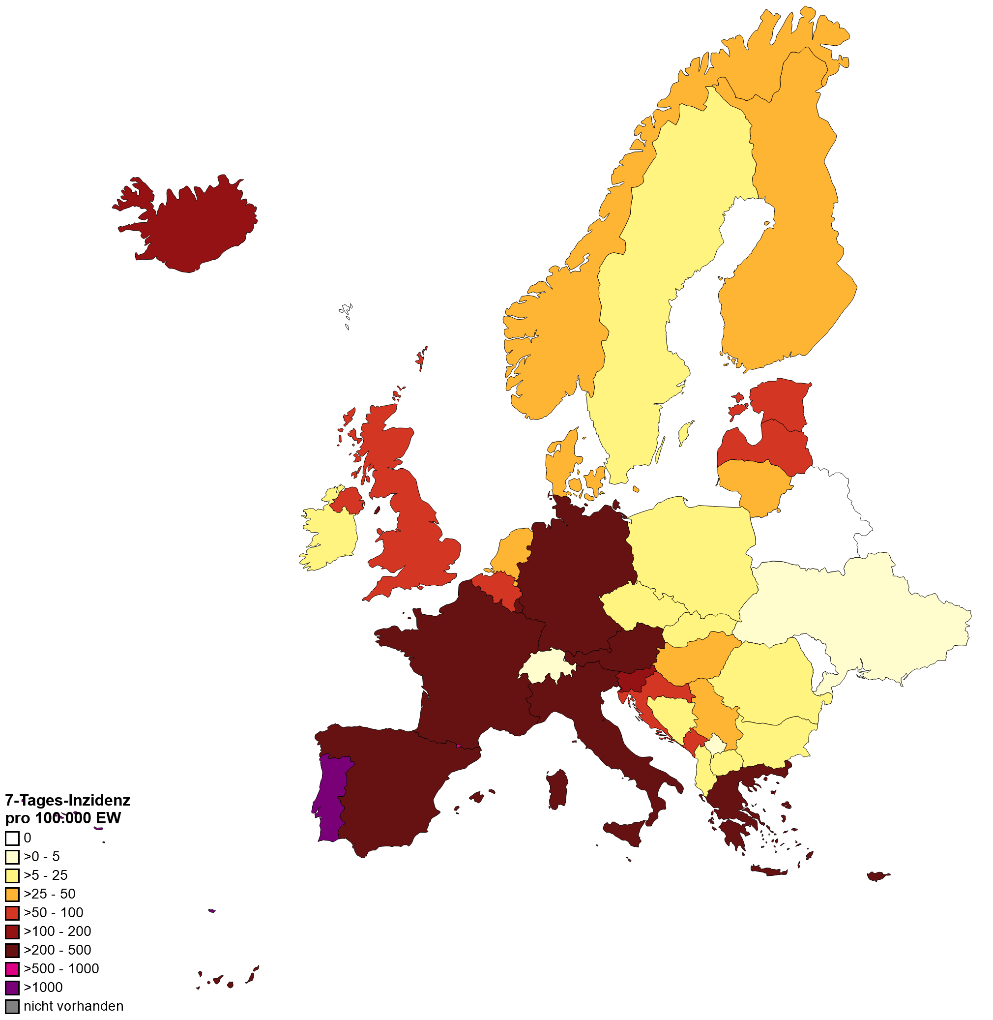
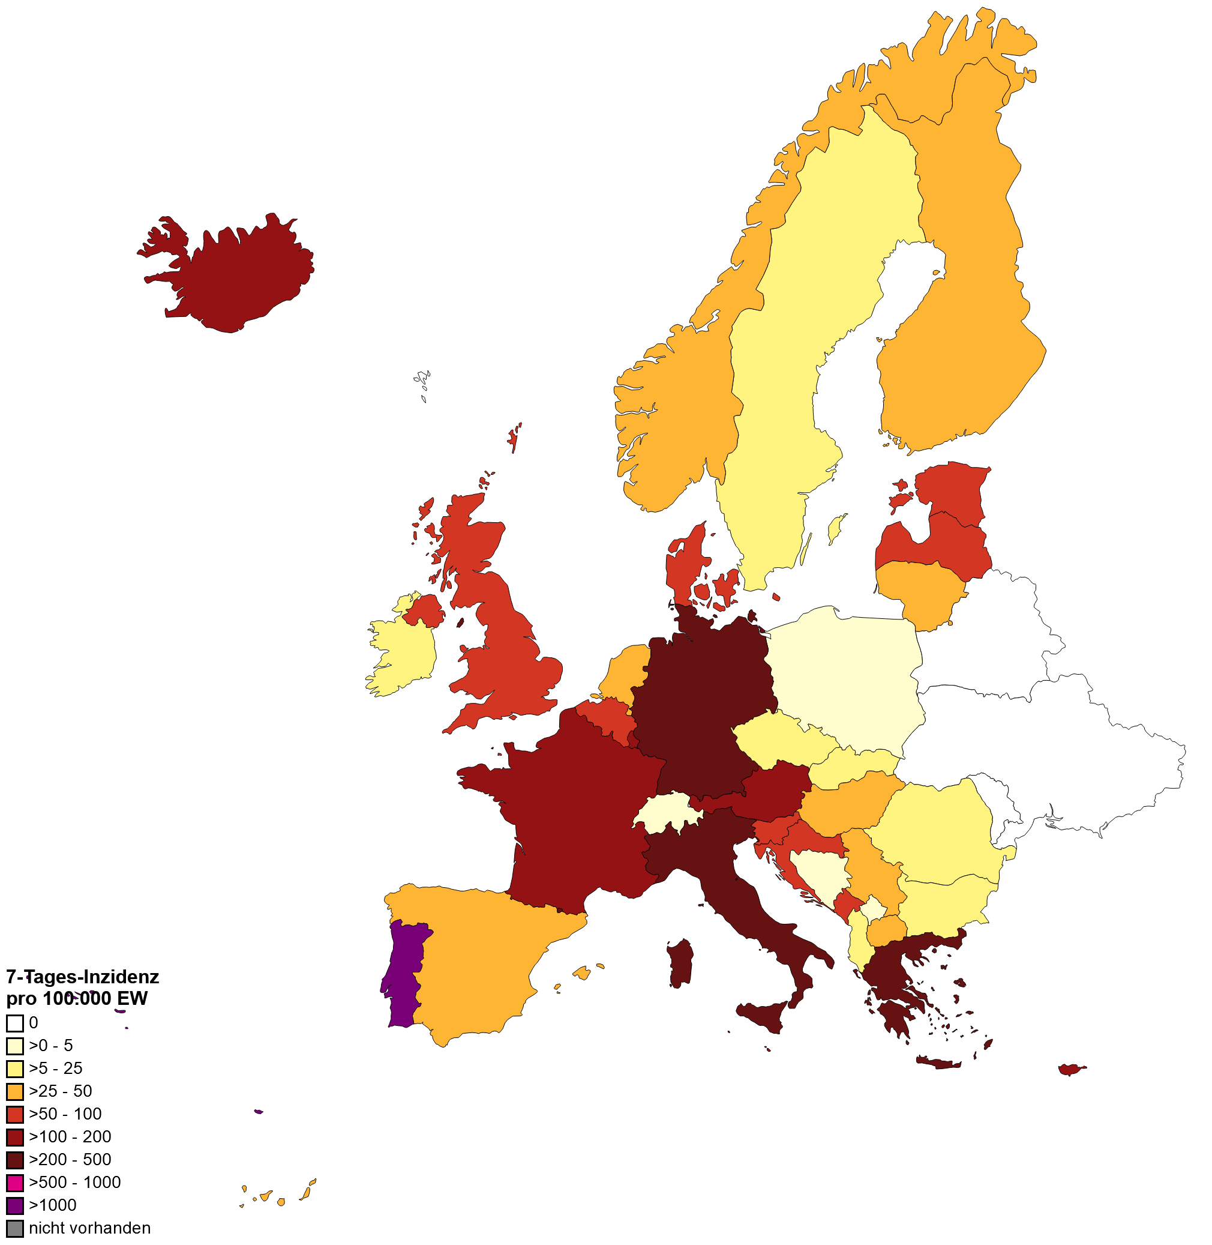
7-Tages-Inzidenz pro 100.000 Einwohner in Europa
WHO, 24.05.2022
WHO, 31.05.2022

Slide 3
Länderfokus: China, Shanghai
Behörden beenden harten Lockdown
Quelle: https://coronalevel.com/China/Shanghai/
Notes:
https://www.sanidad.gob.es/profesionales/saludPublica/ccayes/alertasActual/nCov/documentos/COVID19_Actualizacion_variantes_20220523.pdf

Slide 4
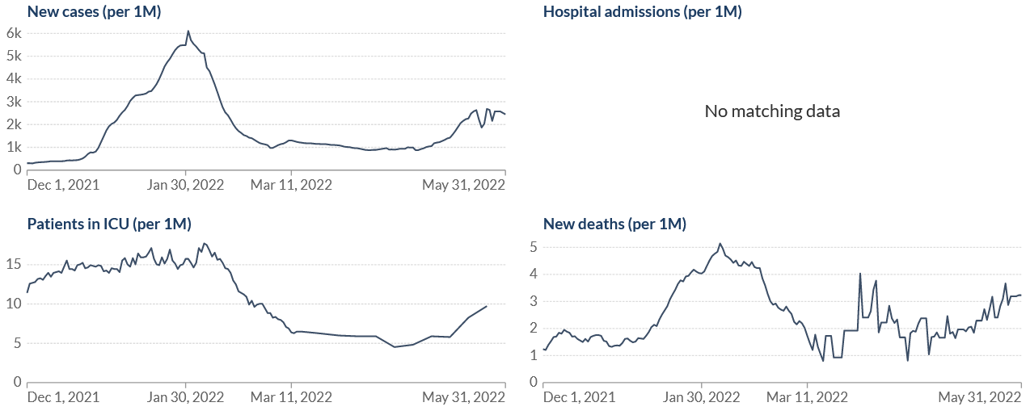
Länderfokus: Portugal - BA.5
Fallzahlsteigerung seit Anfang Mai 2022 (KW17/18)
R 7-Tage: 0,99 leicht gefallen
Leichte Steigerung der Todesfälle: 0,45
BA.5, Bericht 24.05.2022
Erstauftreten KW13
Dominanz KW19
Bislang kein Hinweis auf erhöhte Krankheitsschwere
Quelle: WHO, Datenstand 31.05.2022; OWID, Zugriff 24.05.2022
Notes:
https://insaflu.insa.pt/covid19/relatorios/PORTUGAL_INSA_SARS_CoV_2_GENETIC_DIVERSITY_situation_report_2022-05-24.pdf
Quelle BA.5 Modellierung: https://insaflu.insa.pt/covid19/relatorios/PORTUGAL_INSA_SARS_CoV_2_GENETIC_DIVERSITY_situation_report_2022-05-17.pdf
BA.1 has been firstly identified in Portugal by mid November, 2021, and was dominant between ISO weeks 51, 2021 (20th-26th November) and 7, 2022 (14th-20th February), having reached its maximum circulation in week 2 (95,6%, 10th- 16th January, 2022) (Figures 2 and 3). The current circulation of BA.1 in Portugal is estimated to be residual, and, so far, no cases have been detected on week 17 (analysis ongoing).
BA.2 has been firstly detected in random nationwide sequencing surveys in ISO week 52 (27th December 2021 – 2nd January 2022) (Figure 2), becoming dominant on week 8 (21st–27th February 2022). According to the proportion of non-SGTF positive samples (indicative of probable Omicron BA.2 case), BA.2 relative frequency shows a decreasing trend and is estimated to be 62.9% on 8 May 2022 (Figures 2, 3 and 4).insaflu.insa.pt/covid19/relatorios/PORTUGAL_INSA_SARS_CoV_2_GENETIC_DIVERSITY_situation_report_2022-05-10.pdf
In Portugal, after its detection in week 13, lineage BA.5 has been increasing in relative frequency, having duplicated its relative frequency between ISO weeks 15 (4.0%, 11-17 April) and 16 (9.0%, 18-24 April) (analysis and sampling concluded) (Figure 2). The nationwide sequencing survey of week 17 (ongoing), together with the proportion of samples with SGTF profile, indicate that this trend of duplication of the relative frequency by week has continued, and it is estimated that BA.5 represented ~37% of the positive cases by 8 May 2022.

