Slide 1
Are vaccinations against COVID-19, administered before SARS-CoV-2 infection, effective against
Long COVID?
RKI Krisenstab – 6.07.2022

Slide 2
Hintergrund und Fragestellung
Review question
Are vaccinations against COVID-19, administered before SARS-CoV-2 infection, effective against Long COVID?
What is already known?
February 2022
Narrative Summary of the UK Health Security Agency (Search up to January 12, 2022; 8 studies)
There is evidence that vaccinated people who are subsequently infected with COVID-19 are less likely to report symptoms of long COVID than unvaccinated people…However, there is a risk of bias across all studies due to differences in people who were vaccinated and unvaccinated, the measurement of outcomes, and in the selection of participants.
April 2022
Evidence Brief of the Public Health Agency of Canada (Search up to January 13, 2022; 7 studies )
Preliminary research findings suggest COVID-19 vaccination may decrease the risk of developing PCC (…) There is low confidence in these findings as the evidence was limited by the number of studies, lack of peer review and risk of bias in the retrospective studies. Peer-reviewed longer-term prospective studies are needed.
June 2022
Preprint of an Systematic Review by Byambasuren et al. from Australia (Search up to February 22, 2022; 6 studies)
Data from six observational studies suggest COVID-19 vaccination may protect against long COVID… However, the impact of vaccines on preventing or treating long COVID could not have been conclusively established in this review.

Slide 3
Hintergrund RKI Aktivitäten und Zeitplan

Slide 4
Systematisches Review - Methodik (PICOS)
Population
Individuals of all ages who were eligible to receive COVID-19 vaccination and with a confirmed diagnosis of SARS-CoV-2 infection (PCR or by a rapid antigen test).
Intervention
Full vaccination course (including heterologous scheme, including booster) finished before a defined time interval (14/7 days) before the SARS-CoV-2-infection. Vaccines have to be approved by the EMA or licensed abroad and identical in formulation.
Comparator(s)/control
a) Primary vaccination vs. placebo, no vaccination, or vaccine not directed against COVID-19 (active comparator);
b) Booster vaccination vs. placebo or vaccine not directed against COVID-19 (active comparator);
c) Booster vaccination vs. primary vaccination
Outcome
1) Post-COVID diagnosis by health professionals (preferably as defined by the WHO post COVID-19 condition)
2) Post /Long COVID defined by study authors
3) Prevalence and severity of Long COVID symptoms/outcomes that last for more than 4 weeks after the infection:
Fatigue (including “weakness”); Concentration and/or Memory Impairment (including “Brain Fog”); Dyspnea; Sleep Disorder; Myalgia and/or Arthralgia; Anxiety and/or Depression; Loss of taste and/or smell; (Functional limitation and days of absenteeism from work)
Study design
Any study design with a comparison group to assess effects of vaccination including randomized controlled trials (RCT)
Christina Poethko-Mueller, Christa Scheidt-Nave, Giselle Sarganas Margolis, Giselle, Julia Nuebel, Agata Mikolajewska, Katharina Heldt, Denise Ducks, Vanessa Piechotta, Wiebe Kuelper-Schiek, Antonia Pilic, Thomas Harder. Effectiveness of vaccination against Long COVID: A systematic evidence synthesis. PROSPERO 2022 CRD42022328481 Available from: https://www.crd.york.ac.uk/prospero/display_record.php?ID=CRD42022328481
Notes:
preferably as defined by the WHO post COVID-19 condition) : history of confirmed or probable COVID-19 prior to the last 3 months and symptoms that last at
least 2 months that can't be explained by an alternative diagnosis

Slide 5
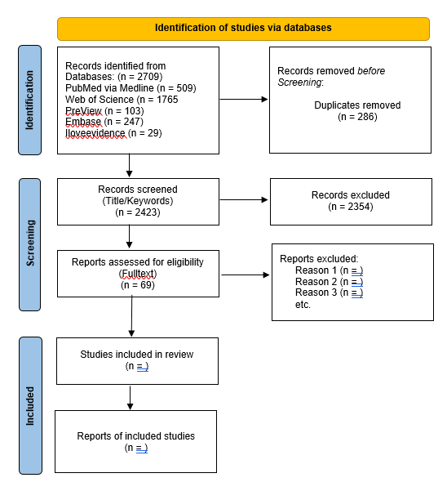
Systematisches Review –
Methodik
(Search strategy; Flowchart)
External Check of search strategy by:
Dr. Siw Waffenschmidt (Ressortleitung Informationsmanagement des IQWiG - Institut für Qualität und Wirtschaftlichkeit im Gesundheitswesen)
Dr. Corinna Dressler (Leiterin Informationskompetenzvermittlung - Systematic Reviews Bibliothek Charité)
PubMed search strategy for Protocol: https://www.crd.york.ac.uk/PROSPEROFILES/328481_STRATEGY_20220426.pdf
Juli

