Slide 1
Prevalence and determinants of Post-COVID-19 condition in Germany Results of the second wave of the study “Corona Monitoring Bundesweit” (RKI-SOEP-2-study) Christina Poethko-Müller, Ana Ordonez Cruickshank, Giselle Sarganas, Julia Nübel, Antje Gößwald, Lorenz Schmid, Angelika Schaffrath Rosario, Hannelore Neuhauser, Christa Scheidt-Nave and the RKI-SOEP-2-study group
Krisenstab - CoMoBu II: Prevalence and determinants of Post-COVID-19 condition

Slide 2
Post COVID-19 condition - WHO Definition
History of Probable or Confirmed SARS CoV-2 infection
Symptoms may be new onset or persist from the initial illness
It can be diagnosed usually 3 months from the onset of COVID-19 and lasts for at least 2 months
NICE*-Guideline and S1-Leitlinie Post COVID/Long-COVID: “Long COVID” ≥4 weeks after infection ”Post COVID” ≥ 12 weeks after infection
Cannot be explained by an alternative diagnosis
Common symptoms include fatigue, shortness of breath, cognitive dysfunction but also others
Generally, has an impact on everyday functioning
* British National Institute for Health and Care Excellence
Krisenstab - CoMoBu II: Prevalence and determinants of Post-COVID-19 condition
Notes:
Post COVID ist ein Syndrom das nicht einfach und nicht völlig eindeutig und abschließend abgegrenzt definiert werden kann.
Die WHO hat vorläufige Kriterien für eine Fall-Definition festgelegt. Neuere Leitlinien wie die Britische NICE-Guideline und die deutsche S1-Leitlinie grenzen die Begrifflichkeit hinsichtlich LC/PC näher ein.
Von LC spricht man, wenn Gesundheitseinschränkungen 4 Wochen nach der akuten Erkrankung noch fortbestehen, vom Post COVID Zustand wird den Übereinkünften nach ausgegangen, wenn ein Zeitraum von 12 Wochen nach der SARS-CoV-2-Infektion vergangen ist.
Die WHO-Kriterien für eine Definition enthalten Begriffe wie „u.a.“; „meistens“, und „normalerweise“, die zeigen, dass bei der Falldefinition Ermessensspielräume bestehen.
Das spiegelt sich auch in der Vielzahl unterschiedlicher Long oder Post COVID Definitionen wieder, die in Studien Verwendung finden. Die Studiendefinitionen sind jeweils auch abhängig von den zur Verfügung stehenden Daten.
Unsere Studie war geplant im Rahmen der Corona Monitoring Bundesweit Studie Welle 2.
NEXT

Slide 3
Corona Monitoring Bundesweit Second Wave (CoMoBuII)
Sozio-oekonomischen Panel (SOEP) German Institute for Economic Research, „Leben in Deutschland“
Random sample of the resident population in Germany, 14 years and older
Self-collected dry blood sample for antibody determination (IgG-S and N antibodies, Euroimmun)
Questionnaire on vaccination and infection status Response 54%
November 2021 to February 2022
≈80% of the survey in 2021
Krisenstab - CoMoBu II: Prevalence and determinants of Post-COVID-19 condition
Notes:
• Einladung von 20.774 Personen aus 11.785 Haushalten in sieben Sprachen
• Freiwillige Teilnahme von 11.162 Personen aus 6.760 Haushalten
• Teilnahmequote (Responsequote): 54 Prozent
• Gewichtung: Die Prozentwerte wurden gewichtet berechnet. Durch das Gewichtungsverfahren wurde die Stichprobe für potenzielle Verzerrung durch Nicht-Teilnahme-Effekte so gut wie möglich korrigiert und an die Bevölkerungsstruktur Deutschlands gemäß amtlicher Statistik angepasst.

Slide 4
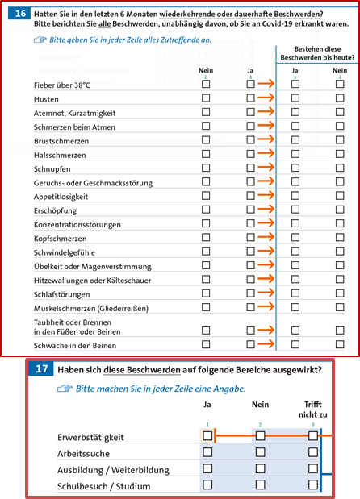
CoMoBuII: Long/Post COVID
List of 19 permanent or recurrent symptoms in the last 6 months
Are they persistent?
Do they have an impact on everyday functioning? (restricted to participants <66 yol)
Krisenstab - CoMoBu II: Prevalence and determinants of Post-COVID-19 condition
Notes:
Hinweis Fragetext (nicht einfach Symptome der letzten Woche sondern wiederkehrend oder dauerhaft i d letzten 6 Mo)
Everyday functioning refers to work and educational activities
Not suitable for participants older than 65 years

Slide 5
Case & Outcome definition Long/Post COVID
Definition of cases and controls
Known Infection: Participants with a reported positive PCR-test >4 weeks ago (excluded: Hospitalization due to SARS-CoV-2 infection)
Unknown Infection: Participants with positive antibody test against the SARS-CoV-2 nucleocapsid protein (positive anti-S-antibody test if unvaccinated)
No Infection: Participants with no report of positive PCR and negative antibody test(s) against SARS-CoV-2 (taking into account vaccination status)
Study definition of Long COVID
Having 2 or more persistent symptoms ≥ 4 weeks after infection
Krisenstab - CoMoBu II: Prevalence and determinants of Post-COVID-19 condition

Slide 6
Prevalence* of Long COVID-like symptoms by infection status in participants 14-65 years old
Significant differences between participants with „Known Infection“ and „No Infection“
*Weighted estimates: Correction for potential bias due to non-participation effects and adjusted to the population structure of Germany according to official statistics
* p<0.05
Study definition
Krisenstab - CoMoBu II: Prevalence and determinants of Post-COVID-19 condition
Notes:
Gewichtete Prävalenzen für die drei Gruppen (bekannte I dunkelbl; unbemerkte (Indikator für mild/asymptomatisch) mittelblau,Kontrollgruppe ohne Inf hellblau.
Vier Balkengruppen von links nach rechs zunehmend engere Definition
Unabhängig von der Defi (weit gefasst mind 2 Symptome… bis mind 2 Symptome, dieaktuell noch anhielten und zu funktionellen Einschränkungen führen) known versus keine Infektion stat sig wenn auch mit abnehmenden Prävalenzhöhen
Aber ein zweites Muster: Sind Funktionelle Limitationen in der Def NICHT berücksichtigt, dann unterscheiden sich diejenigen mit unbemerkter Inf nicht von denjenigen ohne Infektion. Berücksichtigt die Def funktionelle Limitationen, zeigt sich dass auch ein signifikanter Anteil von Menschen, die die Infektion undiagnostiziert durchgemacht haben, von LC betroffen zu sein scheint.
The occurrence of several symptoms at the same time is typical for Long COVID
Although prevalence of continuous or recurring symptoms is generally high, difference between „known infection“ and „non-infected“ is statistically significant.
the indicator that is close to the WHO-definition of Post Covid Condition ist statistically different between those with diagnosed infection an non-infected.
Little difference between known and unknown infection if functional limitation is in the indicator
(without functional limitation might be less often recognised after unknown infection, however the proportion of asymptomatic infection that lead to severe Long Covid (with limitation) might be not that different between unrecognised and diagnosed infection

Slide 7
Determinants for Long COVID in adults with known or unknown SARS-CoV-2 infection
Krisenstab - CoMoBu II: Prevalence and determinants of Post-COVID-19 condition

Slide 8
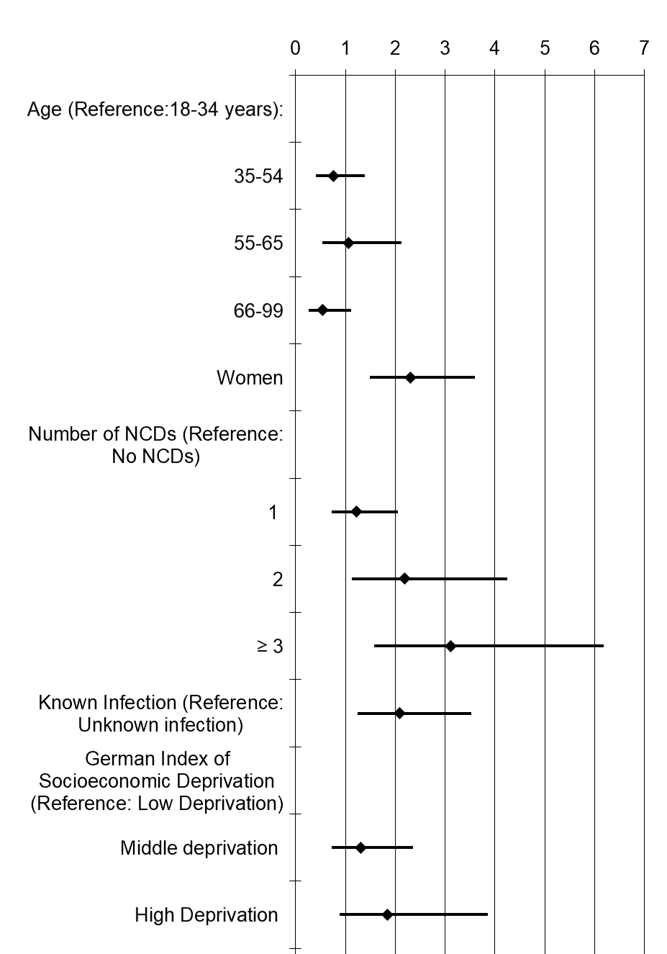
Multivariable Logistic Regression Association of socio-demografic and health related factors with Long COVID in SARS-CoV-2 infected (known and unknown) adults
*
*NCDs=non-communicable diseases
Krisenstab - CoMoBu II: Prevalence and determinants of Post-COVID-19 condition
Notes:
Vorbestehende Nichtübertragbare Erkrankungen/Komorbidität:
Diabetes
Asthma
Heart disease
Cancer
Stroke
Migraine
High blood pressure
Depression
Dementia
Joint disease

Slide 9
Self-Rated Health and Long COVID
Krisenstab - CoMoBu II: Prevalence and determinants of Post-COVID-19 condition

Slide 10
Current Self-Rated Health (SRH) compared to pre-pandemic health in infected adults
Worsening of SRH compared to pre-pandemic health | OR | 95%-CI | p
Long COVID (Ref.: Infected without Long COVID) | 6.2 | 3.6 - 10.5 | <0.001
Long COVID, adjusted for age, sex, comorbidities and GISD | 6.5 | 3.8 - 11.1 | <0.001
Krisenstab - CoMoBu II: Prevalence and determinants of Post-COVID-19 condition

Slide 11
Discussion and conclusions
Female sex, younger age and having comorbidities are determinants for Long COVID (Sylvester et al. 2022, Wulf Hanson et al. 2022; Subramanian, et al. 2022).
Our study supports findings (Huang et al. 2021; Malkova et al. 2021) showing a risk of Long COVID (with functional limitation) even after mild and asymptomatic SARS-CoV-2 infection.
Self-Rated Health is negatively affected by Long COVID (Peters et al. 2022)
Population health monitoring on Long COVID/Post-COVID-19 condition is needed
Krisenstab - CoMoBu II: Prevalence and determinants of Post-COVID-19 condition
Notes:
Our study supports findings (Huang Y et al. 2021; Malkova A et al. 2021) showing that there is a risk of Long COVID (with functional limitation) => Slide 8 even after milder and unrecognized SARS-CoV-2 infection.
Literatur:
Strahm C, Seneghini M, Güsewell S, Egger T, Leal-Neto O, Brucher A, Lemmenmeier E, Meier Kleeb D, Möller JC, Rieder P, Ruetti M, Rutz R, Schmid HR, Stocker R, Vuichard-Gysin D, Wiggli B, Besold U, Kuster SP, McGeer A, Risch L, Friedl A, Schlegel M, Schmid D, Vernazza P, Kahlert CR, Kohler P. Symptoms Compatible With Long Coronavirus Disease (COVID) in Healthcare Workers With and Without Severe Acute Respiratory Syndrome Coronavirus 2 (SARS-CoV-2) Infection-Results of a Prospective Multicenter Cohort. Clin Infect Dis. 2022 Aug 24;75(1):e1011-e1019. doi: 10.1093/cid/ciac054. PMID: 35090015; PMCID: PMC9383387.
Malkova A, Kudryavtsev I, Starshinova A, Kudlay D, Zinchenko Y, Glushkova A, Yablonskiy P, Shoenfeld Y. Post COVID-19 Syndrome in Patients with Asymptomatic/Mild Form. Pathogens. 2021 Oct 30;10(11):1408. doi: 10.3390/pathogens10111408. PMID: 34832564; PMCID: PMC8620929.
Yong Huang1, Melissa D. Pinto2, Jessica L. Borelli3, Milad Asgari Mehrabadi1, Heather Abrihim2, Nikil Dutt1, Natalie Lambert4, Erika L. Nurmi5, Rana Chakraborty6, Amir M. Rahmani1,2 &. Charles A. Downs: COVID Symptoms, Symptom Clusters, and Predictors for Becoming a Long-Hauler: Looking for Clarity in the Haze of the Pandemic https://www.medrxiv.org/content/10.1101/2021.03.03.21252086v1.full.pdf
Jacobson, KB, Rao, M, Bonilla, H, Subramanian, A, Hack, I, Madrigal, M, et al. Patients with Uncomplicated Coronavirus Disease 2019 (COVID-19) Have Long-Term Persistent Symptoms and Functional Impairment Similar to Patients with Severe COVID-19: A Cautionary Tale during a Global Pandemic. Clin Infect Dis (2021) 73:e826–e829. doi:10.1093/cid/ciab103
Other determinants (literture): high BMI; low SES; severity of illness

Slide 12
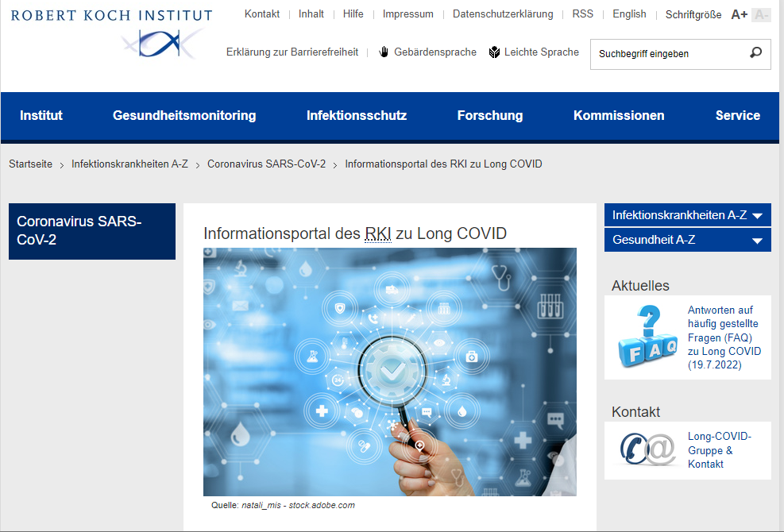
Thank you very much for your attention
https://www.rki.de/long-covid
Krisenstab - CoMoBu II: Prevalence and determinants of Post-COVID-19 condition

Slide 13
Vielen Dank für Ihre Aufmerksamkeit
Krisenstab - CoMoBu II: Prevalence and determinants of Post-COVID-19 condition

Slide 14
Flowchart Definition of SARS-CoV-2 infection status
Total participants 11,162; 100%
Evaluabe questionnaire 10,985; 98.7% [98.3-99.0%]
Not evaluable questionnaire 177; 1.3% [1.0-1.7]
*Infection status
*definition for Long/Post Covid
Evaluable PCR status 10,975; 98.6% [98.2-98.9]
Missing PCR status 10; 0.05% [0.02-0.1]
Never had a confirmed infection by PCR 9,967; 91.7% [90.8-92.5]
Don´t know (DK) 86; 0.9% [0.7-1.2]
Had an infection confirmed by PCR 922; 7.3% [6.5-8.1]
Available anti-N Ab test 9,324; 92.0% [91.1-92.8]
Missing anti-N Ab test 729; 8.0% [7.2-8.9]
Available data on hospitalization because of SARS-CoV-2 infection 909; 7.1% [6.3-7.9]
Missing data on hospitalization because of SARS-CoV-2 infection 13; 0.14% [0.06-0.29]
DK and +ant-N Ab test 5; 0.04% [0.01-0.12]
-PCR and +anti-N Ab test 227; 2.5% [2.1-3.1]
DK and –anti-N Ab test 70; 0.8% [0.6-1.1]
-PCR and –anti-N Ab test 9,022; 88.6% [87.6-89.6]
Available PCR-FB zeit response 866; 6.9% [6.1-7.7]
Missing PCR-FB zeit response 56; 0.5% [0.3-0.7]
Available vaccine data 9,813 99.9% [99.7-99.9]
Missing vaccine data 8 0.1% [0.06-0.3]
>4 weeks from infection 685; 5.5% [4.8-6.2]
>12 weeks from infection 513; 4.4% [3.8-5.1]
Vaccinated 9292 94.1% [93.3-94.9]
Not vaccinated 521 5.8% [5.0-6.6]
Available S Ab test 494 94.7% [91.0-97.0]
Missing S Ab test 27 6.2% [3.6-10.6]
+ S Ab 21 3.5% [1.8-6.6]
-S Ab 473 90.3% [85.6-93.6]
10,904: Total included population
1.8% [1.5- 2.3] 222 observations excluded
Unknown infection 253 2.5% [2.1-3.0]
No infection 9,765 88.4% [87.4-89.4]
Notes:
svy, subpop (if frabo_gesamt==1 & PCR!=. & PCR!=1): tab LBcov2iggB_N_korr , percent obs ci missing

Slide 15
Prevalence of Long-/Post COVID-like symptoms by time since SARS-CoV-2 infection in ≥14 year olds
No significant differences between prevalences during the Long COVID period (4-12 weeks) and the Post COVID period (>12 weeks)
Krisenstab - CoMoBu II: Prevalence and determinants of Post-COVID-19 condition
Notes:
Because of the limited case numbers we include cases during the long Covid period in our analyses.

Slide 16
Prevalence of Long COVID-like symptoms by infection status and age
Differences between „known“ and „no infection“ are significant, (no difference in >65 year olds)
Krisenstab - CoMoBu II: Prevalence and determinants of Post-COVID-19 condition
Notes:
Differences between known and no infection are very significant specially in younger agegroups

Slide 17
Prevalence of Long COVID-like symptoms by infection status and sex
Significant difference between participants with „known infection“ and „no infection“ in men and women
Women are more frequently affected by Long COVID
Krisenstab - CoMoBu II: Prevalence and determinants of Post-COVID-19 condition
Notes:
Among the cohort of patients infected with SARS-CoV-2, risk factors for long COVID included female sex, belonging to an ethnic minority, socioeconomic deprivation, smoking, obesity and a wide range of comorbidities. The risk of developing long COVID was also found to be increased along a gradient of decreasing age. Subramanian A, Nirantharakumar K, Hughes S, Myles P, Williams T, Gokhale KM, Taverner T, Chandan JS, Brown K, Simms-Williams N, Shah AD, Singh M, Kidy F, Okoth K, Hotham R, Bashir N, Cockburn N, Lee SI, Turner GM, Gkoutos GV, Aiyegbusi OL, McMullan C, Denniston AK, Sapey E, Lord JM, Wraith DC, Leggett E, Iles C, Marshall T, Price MJ, Marwaha S, Davies EH, Jackson LJ, Matthews KL, Camaradou J, Calvert M, Haroon S. Symptoms and risk factors for long COVID in non-hospitalized adults. Nat Med. 2022 Jul 25. doi: 10.1038/s41591-022-01909-w. Epub ahead of print. PMID: 35879616.

Slide 18
Percentage of participants (not hospitalized and in the Long COVID period (PCR >4 weeks after infection)) with the symptom for each group
Symptom (% [95%CI]) | Known infection | Unknown infection | No infection
Atemnot | 28.65 [23.36,34.58] | 12.18 [7.306,19.63] | 14.72 [13.71,15.8]
Anhaltend Atemnot | 19.74 [15.31,25.06] | 5.244 [2.716,9.884] | 9.549 [8.757,10.4]
Geruchs- oder Geschmacksstörung | 29.68 [24.55,35.38] | 19.33 [12.11,29.41] | 4.28 [3.697,4.951]
Anhaltend Geruchs- oder Geschmacksstörung | 12.1 [8.833,16.37] | 3.736 [1.556,8.698] | 1.693 [1.386,2.067]
Erschöpfung | 59.46 [53.36,65.28] | 41.95 [33.29,51.13] | 37.12 [35.68,38.59]
Anhaltend Erschöpfung | 31.09 [25.8,36.93] | 15.7 [10.46,22.89] | 17.25 [16.16,18.39]
Konzentrationsstörungen | 39.32 [33.37,45.59] | 21.96 [15.26,30.54] | 21.9 [20.65,23.19]
Anhaltend Konzentrationsstörungen | 24.88 [19.75,30.84] | 10 [5.928,16.38] | 12.98 [11.99,14.05]
Schlafstörungen | 41.33 [35.36,47.56] | 32.21 [24.44,41.1] | 35.16 [33.74,36.62]
Anhaltend Schlafstörungen | 29.68 [24.37,35.62] | 19.36 [13.5,26.98] | 24.26 [23.04,25.52]
Muskelschmerzen | 31.26 [26.33,36.66] | 27.6 [20.16,36.54] | 25.13 [23.84,26.46]
Anhaltend Muskelschmerzen | 15.42 [11.57,20.25] | 13.57 [8.712,20.52] | 13.26 [12.32,14.25]

Slide 19
Percentage of participants (not hospitalized and in the Long COVID period (PCR >4 weeks after infection)) with the symptom for each group
Symptom (% [95%CI]) | Known infection | Unknown infection | No Infection
Fieber | 10.47 [7.52,14.39] | 12.14 [6.575,21.34] | 5.134 [4.497,5.856]
Anhaltend Fieber | .2267 [.0318,1.596] | 0 [.0602,.3305] | .1412 [.0318,1.596]
Husten | 41.09 [35.24,47.2] | 34.8 [26.46,44.2] | 31.15 [29.72,32.63]
Anhaltend Husten | 12.66 [9.41,16.83] | 11.71 [6.452,20.33] | 9.486 [8.619,10.43]
Atemschmerzen | 8.299 [5.413,12.52] | 7.563 [3.596,15.21] | 3.603 [3.091,4.197]
Anhaltend Atemschmerzen | 2.52 [.9741,6.362] | 1.315 [.3235,5.19] | 1.157 [.8864,1.509]
Brustschmerzen | 15.95 [12.05,20.81] | 10.36 [5.773,17.91] | 8.344 [7.554,9.208]
Anhaltend Brustschmerzen | 7.525 [4.803,11.6] | 3.174 [1.266,7.731] | 3.358 [2.869,3.928]
Halsschmerzen | 39.1 [33.42,45.08] | 33.35 [25.34,42.45] | 28.28 [26.91,29.68]
Anhaltend Halsschmerzen | 8.102 [5.189,12.44] | 6.66 [3.107,13.7] | 3.231 [2.74,3.808]
Schnupfen | 54 [48.28,59.63] | 48.78 [39.89,57.75] | 42.27 [40.77,43.79]
Anhaltend Schnupfen | 12.68 [9.336,17.01] | 7.787 [4.331,13.61] | 8.887 [8.066,9.783]

Slide 20
Percentage of participants (not hospitalized and in the Long COVID period (PCR >4 weeks)) with the symptom
Symptom (% [95%CI]) | Know infection | Unknown infection | No infection
Appetitlosigkeit | 17.69 [13.28,23.18] | 11.21 [6.436,18.81] | 7.446 [6.639,8.342]
Anhaltend Appetitlosigkeit | 4.373 [2.316,8.105] | 2.751 [1.015,7.238] | 2.616 [2.167,3.154]
Kopfschmerzen | 50.82 [45.12,56.5] | 45.53 [36.4,54.96] | 41.44 [39.95,42.95]
Anhaltend Kopfschmerzen | 18.79 [14.75,23.62] | 12.18 [7.118,20.07] | 11.9 [10.95,12.92]
Schwindel | 28.61 [23.5,34.32] | 25.54 [18.12,34.71] | 19.63 [18.45,20.86]
Anhaltend Schwindel | 12.36 [9.245,16.34] | 11.23 [6.803,17.99] | 8.325 [7.566,9.151]
Übelkeit o. Magenverstimmung | 23.43 [18.92,28.64] | 19.07 [12.31,28.35] | 18.64 [17.48,19.87]
Anhaltend Übelkeit o. Magenverstimmung | 8.772 [5.745,13.17] | 3.292 [1.303,8.071] | 5.3 [4.685,5.99]
Hitzewallung o. Kälteschauer | 25.64 [21.01,30.89] | 23.64 [16.04,33.42] | 17.83 [16.75,18.97]
Anhaltend Hitzewallung o. Kälteschauer | 10.34 [7.788,13.6] | 6.525 [3.565,11.65] | 8.224 [7.507,9.004]
Taubheit o. Brennen in Fuss o. Bein | 14.31 [10.77,18.77] | 13.33 [8.345,20.63] | 12.13 [11.22,13.11]
Anhaltend Taubheit o. Brennen in Fuss o. Bein | 10.16 [7.262,14.03] | 6.332 [3.235,12.02] | 8.556 [7.782,9.4]
Schwäche in Beinen | 18.15 [14.18,22.92] | 18.28 [12.02,26.82] | 12.94 [12,13.95]
Anhaltend Schwäche in Beinen | 11.55 [8.429,15.62] | 12.64 [7.422,20.7] | 8.886 [8.118,9.719]

Slide 21
NCDs
Excluded NCDs
Included NCDs
Schlafstörung
Schilddrüsenerkrankung
Diabetes
Asthma
Herzkrankheit
Krebserkrankung
Schlaganfall
Migräne
Bluthochdruck
Depressive Erkrankung
Demenzerkrankung
Gelenkerkrankungen (Arthrose, Rheuma)
Chronische Rückenbeschwerden
Ausgebranntsein (Burnout)
Sonstige Krankheit

Slide 22
Attributable fraction among the exposed
= Proportion of cases among the exposed that is due (attributable) to the exposure
OR-1/OR
>= 2 persistent symptoms: AF=58.7%
If we consider Known+Unknow = Infected participants, as 1 only group, then AF=47.1%
>= 2 persistent symptoms + functional limitation : AF=43.3%
If we consider Known+Unknow= Infected participants, as 1 only group, then AF=44.1%
Krisenstab - CoMoBu II: Prevalence and determinants of Post-COVID-19 condition

