Slide 1
Übersichtsarbeit zu
Langzeitfolgen bei grundimmunisierten Personen
(Long COVID)
RKI Krisenstab – 23.11.2022

Slide 2
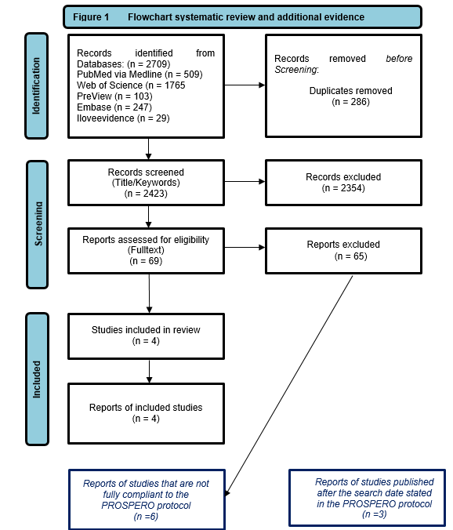
Flowchart zur Übersichtsarbeit (ID4726)
„Langzeitfolgen bei grundimmunisierten Personen (Long COVID)“
Teil I: Erste Ergebnisse des systematischen Reviews
Teil II: Ergebnisse von Studien, die nicht vollständig die Einschlusskriterien des Reviews erfüllen
Teil III: Ergebnisse von Studien, die nach dem Suchlauf des Reviews (17.6.2022) publiziert wurden

Slide 3
Teil I: Systematisches Review - Methodik (PICOS)
Population
Individuals of all ages who were eligible to receive COVID-19 vaccination and with a confirmed diagnosis of SARS-CoV-2 infection.
Intervention
Full vaccination course (including heterologous scheme, including booster) finished before a defined time interval (14/7 days) before the SARS-CoV-2-infection. Vaccines have to be approved by the EMA or licensed abroad and identical in formulation.
Comparator(s)/control
a) Primary vaccination vs. placebo, no vaccination, or vaccine not directed against COVID-19 (active comparator);
b) Booster vaccination vs. placebo or vaccine not directed against COVID-19 (active comparator);
c) Booster vaccination vs. primary vaccination
Outcome
1) Post-COVID diagnosis by health professionals (preferably as defined by the WHO post COVID-19 condition)
2) Post /Long COVID defined by study authors
3) Prevalence and severity of Long COVID symptoms/outcomes that last for more than 4 weeks after the infection:
Fatigue (including “weakness”); Concentration and/or Memory Impairment (including “Brain Fog”); Dyspnea; Sleep Disorder; Myalgia and/or Arthralgia; Anxiety and/or Depression; Loss of taste and/or smell; (Functional limitation and days of absenteeism from work)
Study design
Any study design with a comparison group to assess effects of vaccination including randomized controlled trials (RCT)
Christina Poethko-Mueller, Christa Scheidt-Nave, Giselle Sarganas Margolis, Giselle, Julia Nuebel, Agata Mikolajewska, Katharina Heldt, Denise Ducks, Vanessa Piechotta, Wiebe Kuelper-Schiek, Antonia Pilic, Thomas Harder. Effectiveness of vaccination against Long COVID: A systematic evidence synthesis. PROSPERO 2022 CRD42022328481 Available from: https://www.crd.york.ac.uk/prospero/display_record.php?ID=CRD42022328481

Slide 4
Teil I: Systematisches Review - Ergebnisse

Slide 5
Teil II: Ergebnisse von Studien, die nicht vollständig die Einschlusskriterien des Reviews erfüllen
Kuodi et al. cross-sectional study nested in a prospective cohort (Israel)
  Only bridging information on vaccination status
  Study results: Two doses BnT162b2 mRNA resulted in statistically significant risk ratios for:
  fatigue: 0.36 [ 95% CI 0.19-0.71]; headache: 0.46 [0.26-0.83]; persistent muscle pain: 0.32 [0.11-0.88]; shortness of breath: 0.23 [0.07-0.84]; dizziness: 0.26 [0.09 to 1.79] and some others.
Taquet et al. international TriNetX Research Network platform (mainly US)
  Wrong definition of Long COVID, symptoms of acute COVID-19 disease included
  Study results: Fully vaccinated cases were less likely to be diagnosed with
  fatigue: HR = 0.86 [95% CI 0.77-0.96]; anosmia: 0.68 [0.55-0.84]; hair loss: 0.66 [0.54-0.81]; interstitial lung disease: 0.74 [0.62-0.88]; myalgia: 0.70 [0.59-0.84] and other pain: 0.90 [0.81-0.99].
Simon et al. analysis of a federated research study (electronic health records) (US)
  Wrong definition of vaccination (just one dose)
  Study results: Patients who received at least one dose of any of the three COVID vaccines were less likely to report at least one symptom of Long COVID: OR = 0.22 (95% CI: 0.20-0.25), and less likely to have more than one symptom of Long COVID: 0.11 [0.09-0.14].
Herman et al. (Indonesia) and Senjam et al. (India)
  Wrong intervention: Inactivated vaccine from India/ ‘protective effect’
Arjun et al.
  Wrong intervention: Inactivated vaccine from India/ no ‘protective effect’ aOR 2.32 [1.17-4.58].

Slide 6
Teil III: Ergebnisse von Studien, die nach dem Suchlauf des Reviews publiziert wurden
Zisis et al. international TriNetX Research Network platform (mainly US)
  Time period between vaccination and infection was only one week and missing specification of “complete vaccination”
  Study results: Relative risks (RR) for death: 0.21 (95% CI 0.16-0.27); respiratory symptoms: 0.54 [0.50-0.57], headache: 0.39 [0.34-0.45], fatigue: 0.48 [0.43-0.52], body ache: 0.34 [0.28-0.42] and diarrhea or constipation: 0.44 [0.40-0.49].
Azzolini et al. observational cohort study in health care workers (Italy)
  Correct definition of intervention and outcome
  Study results: Fully vaccinated persons had a lower chance of at least one SARS-CoV-2–related symptom: OR 0.25 (95% CI 0.07-0.87).
Tannous et al. US-record-based cohort study and TriNetX Research Network platform (mainly US)
  Correct definition of intervention and outcome
  Study results: Fully vaccinated persons had a lower likelihood for developing Post-Acute Sequelae of SARS-CoV-2 infection (PASC): aOR 0.58 (95% CI 0.52-0.66).

Slide 7
Zusammenfassung
Nur vier Studien erfüllten die vordefinierten methodischen Anforderungen des systematischen Reviews zum Zeitpunkt des Suchlaufs (Juni 2022).
Große Heterogenität der Studien (Studiendesign, Definition Long COVID, Covariablen, Dauer).
Trotz der Unterschiede im Studiendesign zeigen alle Studien ein signifikant verringertes Risiko für Symptome in der postakuten Phase (≥4 Wochen nach der Erstinfektion).
  Dies stützt die Hypothese, dass eine vollständige Impfung vor der SARS-CoV-2 Infektion das Auftreten von Long COVID-Symptomen positiv beeinflussen kann.
Drei weitere, kürzlich publizierte Studien stützen diese Ergebnisse.
Die Ergebnisse zum Outcome „Mindestens ein Symptom" und für Müdigkeit/Erschöpfung, Myalgie/Muskelschmerzen und Atembeschwerden sind relativ konsistent.
Für viele andere Symptome zeigen die Ergebnisse eine hohe Variabilität.
Es gibt (zunehmend) Belege aus Beobachtungsstudien, die auf einen protektiven Effekt der COVID-19-Impfung auf Long COVID hinweisen.
Eine evidenzbasierte, abschließende Bewertung kann jedoch aufgrund der noch begrenzten Datenlage und der uneinheitlichen Studienmethodik und –qualität nicht getroffen werden.

Slide 8
Vielen Dank für Ihre Aufmerksamkeit
RKI Krisenstab – 23.11.2022

Slide 9
Hintergrund RKI Aktivitäten und Zeitplan
Stand 06.07.2022
Stand 23.11.2022

Slide 10
Hintergrund und Fragestellung
Are vaccinations against COVID-19, administered before SARS-CoV-2 infection, effective against Long COVID?
What was already known (until 6.7.2022 – 1. Präsentation auf Sitzung des Krisenstabs)?
February 2022
Narrative Summary of the UK Health Security Agency (Search up to January 12, 2022; 8 studies)
There is evidence that vaccinated people who are subsequently infected with COVID-19 are less likely to report symptoms of long COVID than unvaccinated people…However, there is a risk of bias across all studies due to differences in people who were vaccinated and unvaccinated, the measurement of outcomes, and in the selection of participants.
April 2022
Evidence Brief of the Public Health Agency of Canada (Search up to January 13, 2022; 7 studies )
Preliminary research findings suggest COVID-19 vaccination may decrease the risk of developing PCC (…) There is low confidence in these findings as the evidence was limited by the number of studies, lack of peer review and risk of bias in the retrospective studies. Peer-reviewed longer-term prospective studies are needed.
June 2022
Preprint of an Systematic Review by Byambasuren et al. from Australia (Search up to February 22, 2022; 6 studies)
Data from six observational studies suggest COVID-19 vaccination may protect against long COVID… However, the impact of vaccines on preventing or treating long COVID could not have been conclusively established in this review.
Published since 6.7.2022
July 2022
Bauernfeind et al. from Germany in Innere Medizin (Search up to June 2022 (?) ; 9 studies – “weiche” Einschlusskriterien )
Die Bewertung der vorhandenen Studien ist durch uneinheitliche Definitionen erschwert. Es gibt jedoch Hinweise, dass die (vollständige) COVID-19-Impfung nicht nur die symptomatische Infektion verhindern kann, sondern auch das Risiko für Long-COVID bei Durchbruchinfektionen zu reduzieren vermag.
November 2022
Systematic Review by Notarte et al. in from US in eClinicalMedicine (Search up to June 20,2022; 6 studies)
Overall, vaccination was associated with reduced risks or odds of long-COVID, with preliminary evidence suggesting that two doses are more effective than one dose

