Slide 1
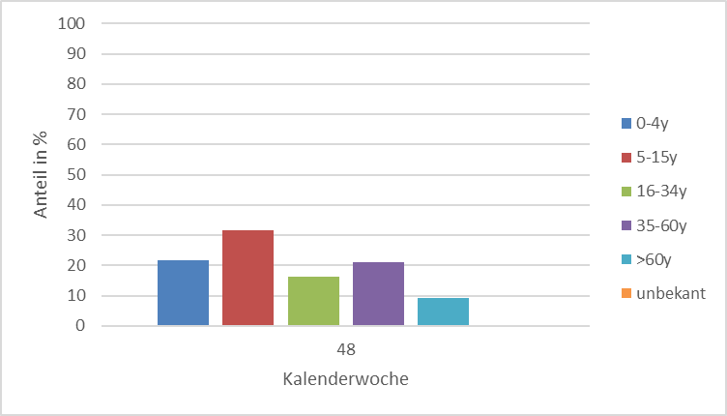
KW48 - 2022
326 Einsendungen
74 Arztpraxen / 15 Bundesländer
81% Positivenrate (264/326)
1

Slide 2
NL63
OC43
HKU1
SARS-CoV-2
A(H3N2)
A(H1N1)pdm09
B/Victoria

Slide 3
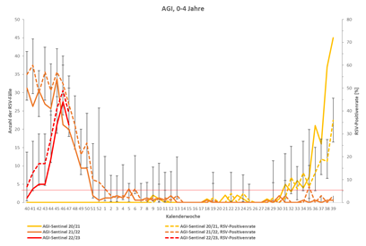
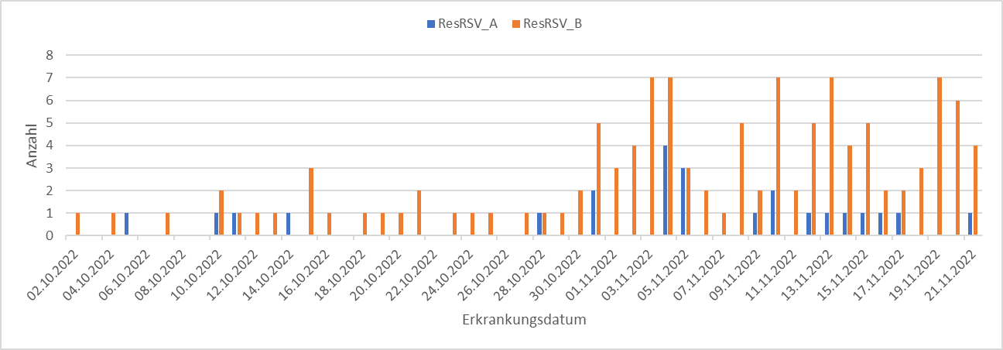
HRV
PIV
HMPV
RSV
 | RSV A | RSV B
2018/2019 |  | 60%
2019/2020 | 90%
2020/2021/2022 | 72%
2022/2023 |  | 83%
RSV

