Slide 1
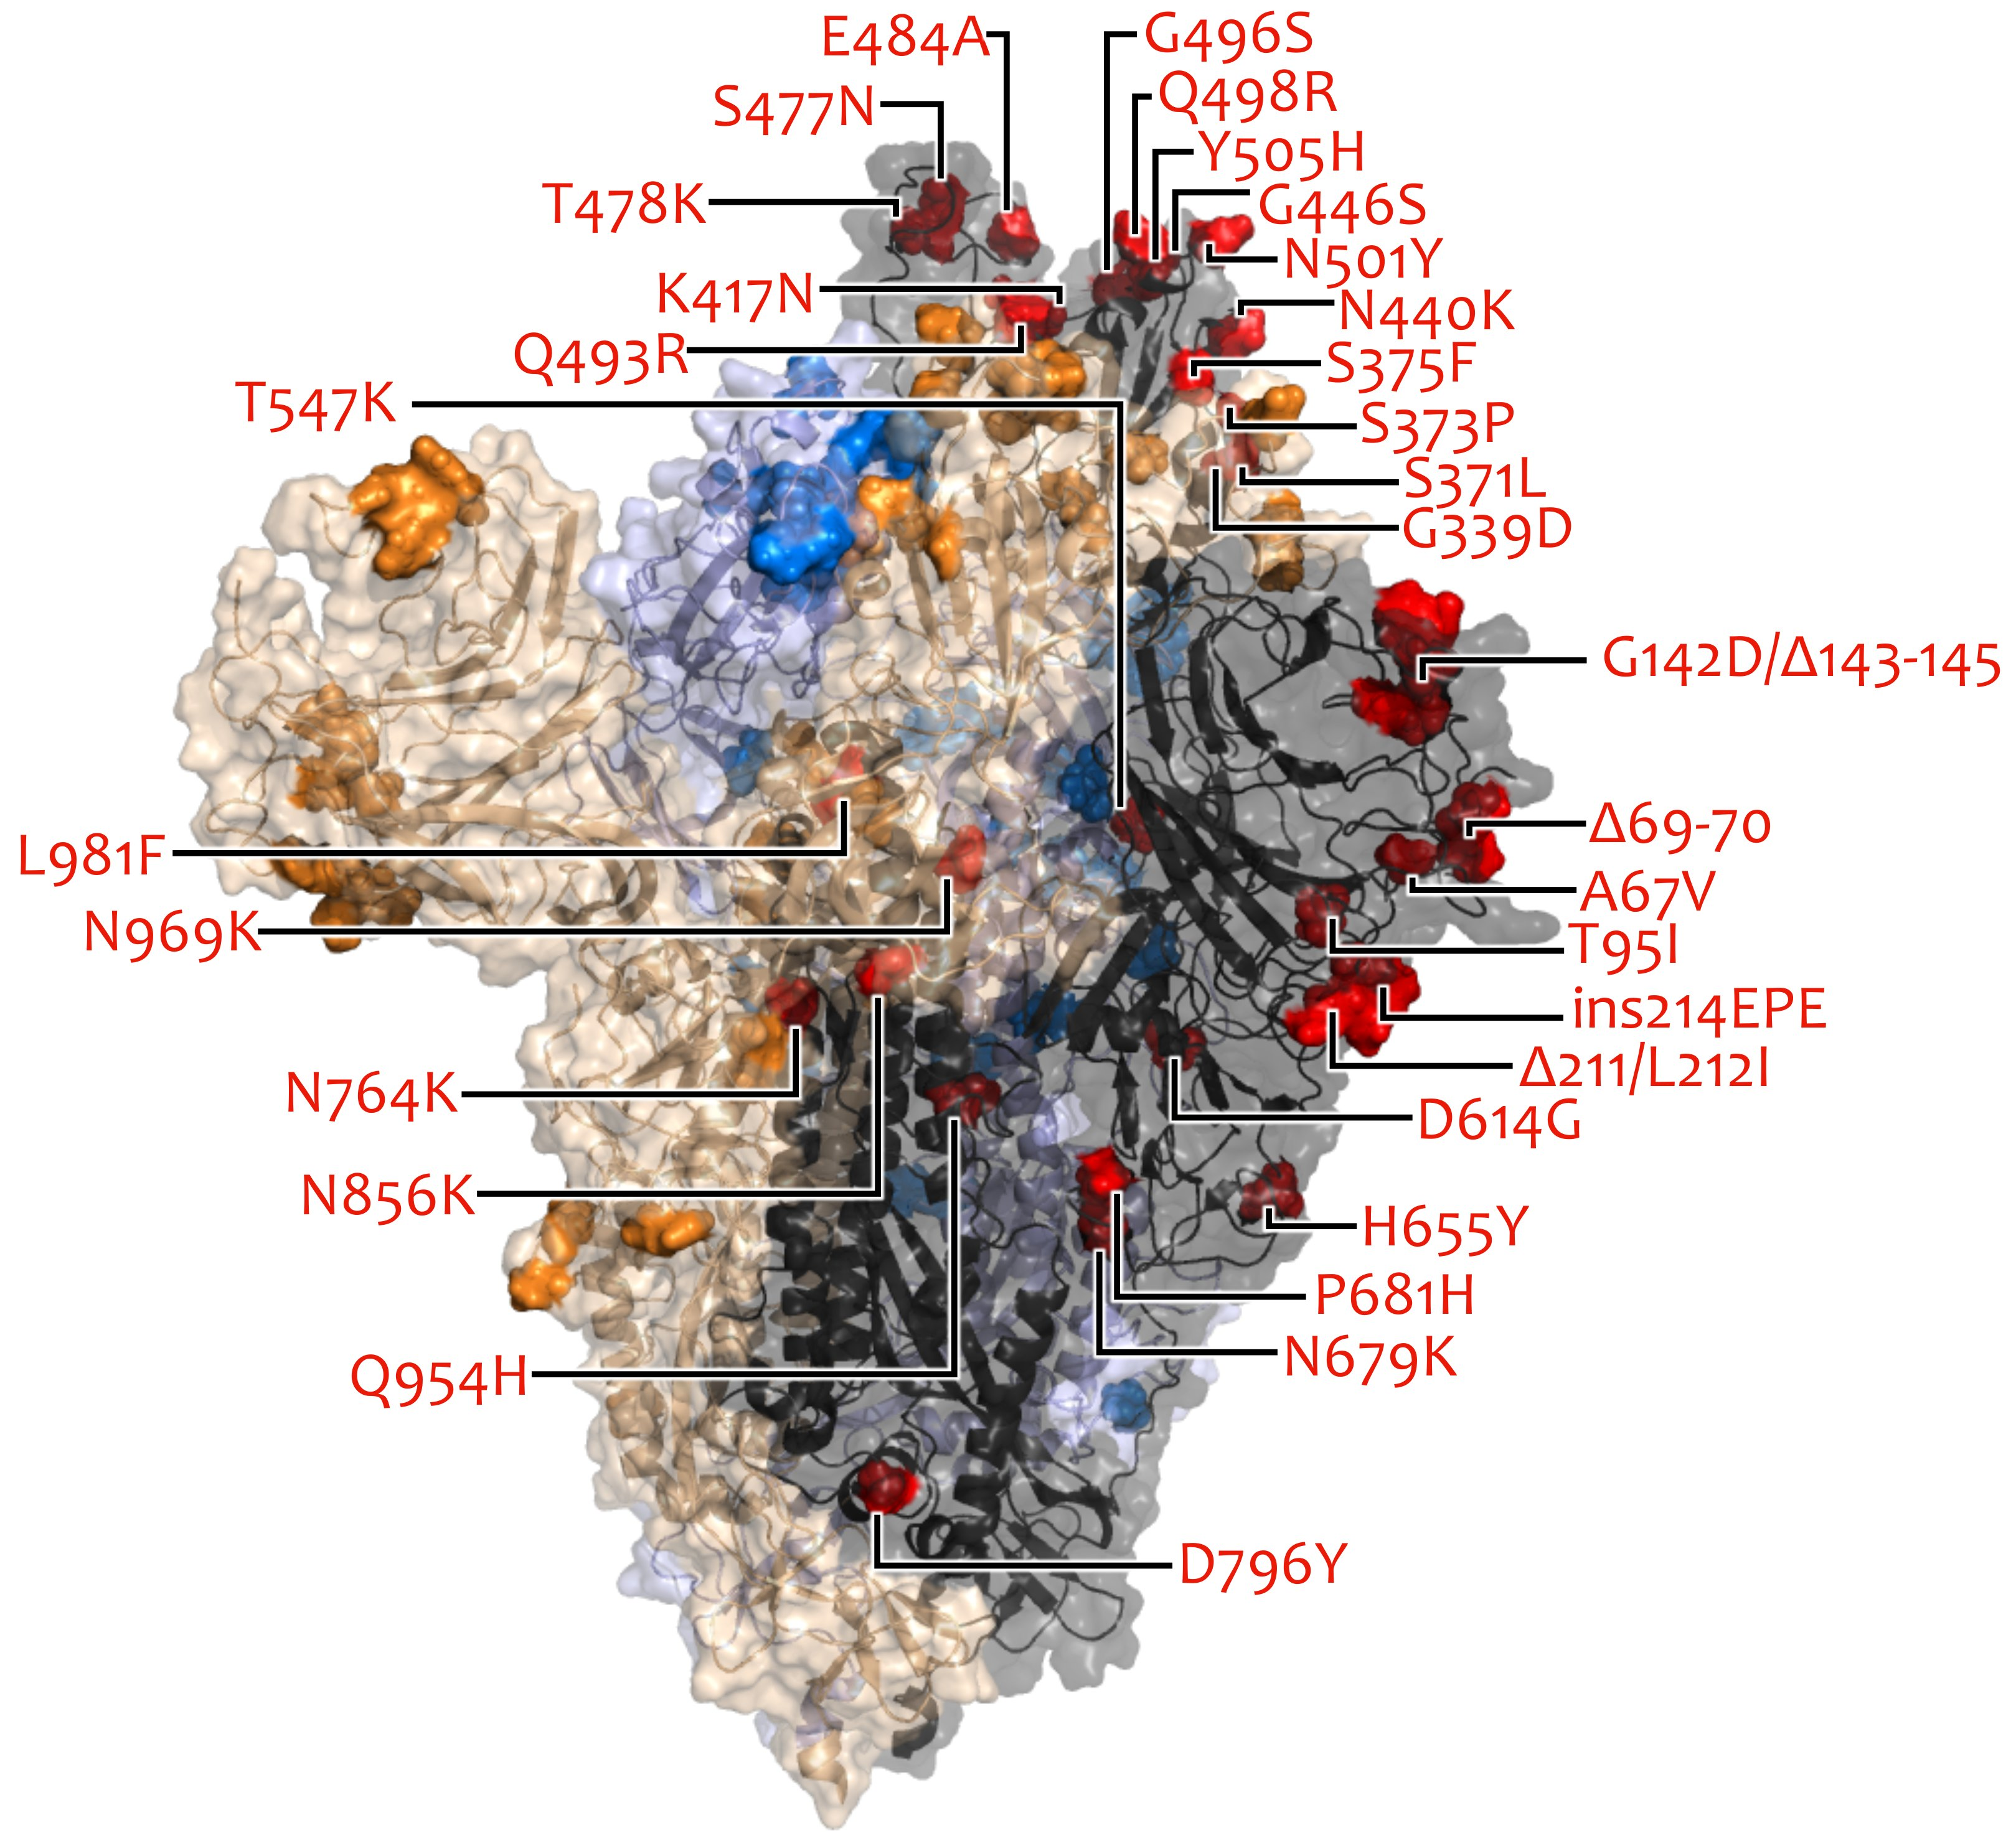
VOC/VOI in Deutschland aktuelle Situation
FG36, FG32, MF1, MF2, MF4, AG Evo, FG17 Berlin, 18.01.2023

Slide 2
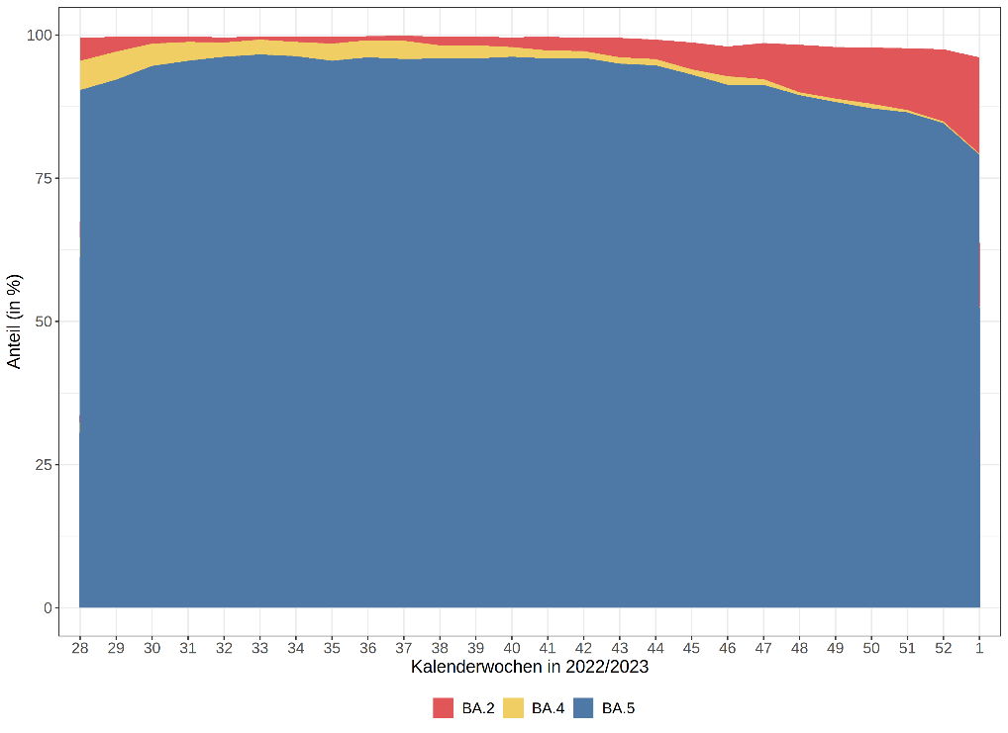
VOC Omikron Anteile
KW /Jahr | Omikron
 | BA.1 | BA.2 | BA.3 | BA.4 | BA.5
44/2022 | 0 % | 3,4 % | 0 % | 1,1 % | 94,7 %
45/2022 | 0 % | 4,7 % | 0 % | 0,9 % | 93,1 %
46/2022 | 0 % | 5,2 % | 0 % | 1,5 % | 91,3 %
47/2022 | 0 % | 6,3 % | 0 % | 1,0 % | 91,3 %
48/2022 | 0% | 8,3 % | 0 % | 0,5 % | 89,5 %
49/2022 | 0 % | 9,0 % | 0 % | 0,6 % | 88,3 %
50/2022 | 0 % | 9,8 % | 0 % | 0,8 % | 87,2 %
51/2022 | 0 % | 10,8 % | 0 % | 0,4 % | 86,5 %
52/2022 | 0 % | 12,6 % | 0 % | 0,3 % | 84,6 %
1/2023 | 0 % | 16,8 % | 0 % | 0,2 % | 79,1 %
KW /Jahr | Stichprobe Anzahl | Anteil an übermittelten Fällen
49/2022 | 5783 | 2,9%
50/2022 | 5985 | 2,7%
51/2022 | 4472 | 1,9%
52/2022 | 2289 | 1,5%
1/2023 | 1079 | 0,8%

Slide 3
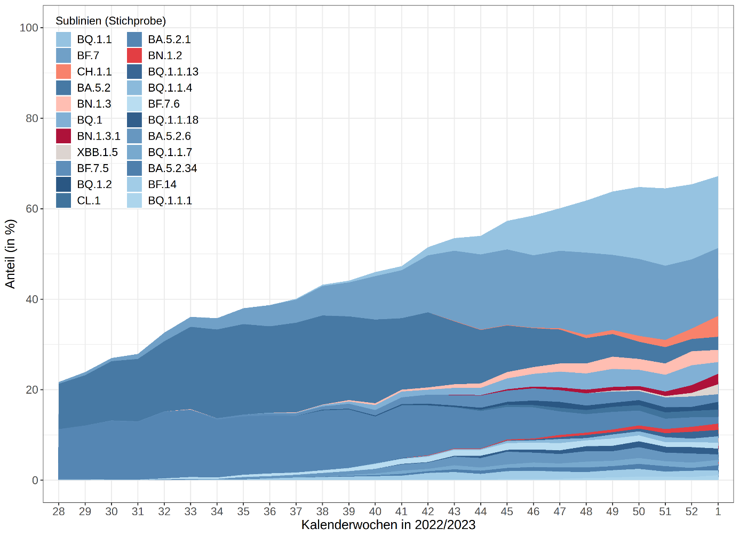
Omikron (Sub-)Linien Anteile
KW1/2023 (Stichprobe)
Omikron 100%
BF.7* 21,3%
BQ.1.1 25,9% (S:K444T, S:N460K)
BA.2.75* 16,1%
XBB.1* 2,9%
XBB.1.5 2,2% (S:S486P)
BQ.1 2,6%
BA.2.75 Sublinien (S:K356T, S:R346T)
CH.1.1 4,6% (S:K444T, S:F486S,S:L452R)
BN.1.3 2,7% (S:F490S)
BN.1.3.1 2,3% (S:F490S)
* inkl. Sublinien
Hinweis: Anteil der Sequenzen der Stichprobe an übermittelten Fällen beträgt für KW 1/2023 nur 0,8% (für KW52/2022 1,5%).
WHO: XBB* → Omicron subvariants under monitoring (13/01/2023)
ECDC: XBB*/XBB.1.5 → Variants of Interest (VOI) (12/01/2023)

Slide 4
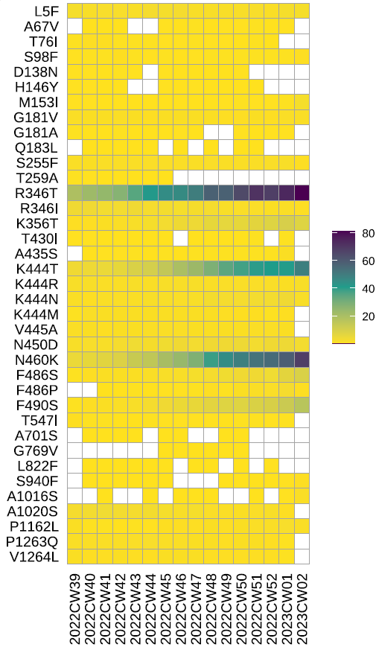
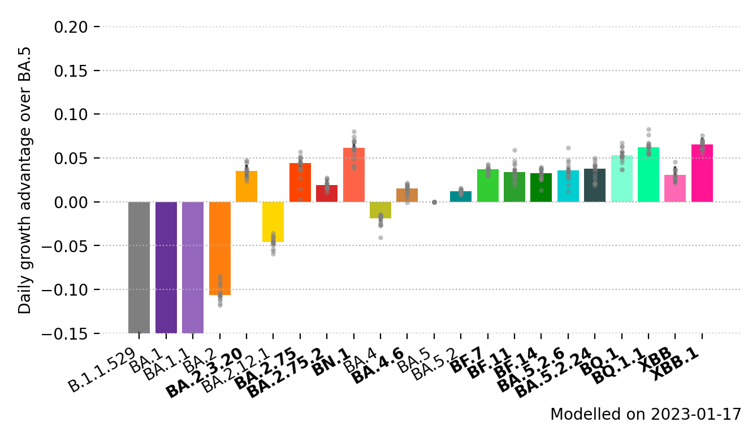
MOCs
S:R346T, S:K444T, S:N460K (BQ.1.1) → antibody escape /enhanced neutralization resistance
S:F486P (XBB.1.5)→ immune escape, enhanced ACE2 receptor binding
S:F490S (BN.1.3*)
Wachstumsvorteil
XBB.*
XBB.1.5
BN.1.3*
Notes:
covSPECTRUM: The XBB.1.5 variant above) currently exhibits a daily growth advantage of 12% (95%CI 11-13%) in the US compared to other circulating variants
If the difference in observed growth rate would be completely explained by an increase in inherent transmissibility, it would correspond to an increase of between 27% and 62% in the basic reproduction number (R0) compared to other XBB variants circulating in the US, using an assumed generation time range between two published estimates of 3.3 and 6.8 days [14,15].
Zusatz: According to a preliminary study, XBB and XBB.1.5 have very similar antigenic properties, while XBB.1.5 exhibits significantly stronger binding to the human ACE2 receptor, similar to that of BA.2.75 [13]. It is therefore plausible that the difference in growth rate between XBB and XBB.1.5 is mainly explained by a difference in transmissibility (Quelle: https://www.ecdc.europa.eu/sites/default/files/documents/TAB-Implications%20for%20the%20EU-EEA%20of%20the%20spread%20of%20the%20SARS-CoV-2%20Omicron%20XBB.1.5%20sub-lineage.pdf)

Slide 5
XBB.1.5 – Einschätzungen WHO/ECDC
ECDC
…most likely explanation for the growth advantage is the already high level of immune escape demonstrated by XBB, combined with the effect of the spike change S:F486P which could provide either a transmissibility advantage, additional immune escape, or both. 9. Jan 2023
… Mathematical modelling by ECDC indicates that XBB1.5 could become dominant in the EU/EEA after one to two months… 13 Jan 2023
…overall level of risk associated with the spread of XBB.1.5 sub-lineage in the EU/EEA is assessed, with a high degree of uncertainty, as low for the general population and moderate-to-high for vulnerable individuals. 13. Jan 2023
WHO (TAG-VE)
XBB.1.5 may contribute to increases in case incidence. To date, the overall confidence in the assessment is low as growth advantage estimates are only from one country, the United States of America. 5 Jan 2023
At present, there is no available information on clinical severity for XBB.1.5. 11. Jan 2023
WHO, Annex 3. XBB.1.5 rapid risk assessment, 11 Jan 2023
Notes:
ECDC assessment on the XBB.1.5 sub-lineage
https://www.ecdc.europa.eu/sites/default/files/documents/communicable-disease-threats-report-week-1-January-2022.pdf
https://www.ecdc.europa.eu/en/news-events/update-sars-cov-2-variants-ecdc-assessment-xbb15-sub-lineage
ECDC_Risk assessment Freitag 13.01.2023
https://www.ecdc.europa.eu/en/news-events/covid-19-implications-spread-omicron-xbb15
https://www.ecdc.europa.eu/en/publications-data/covid-19-threat-assessment-brief-implications-spread-omicron-xbb
https://www.ecdc.europa.eu/sites/default/files/documents/TAB-Implications%20for%20the%20EU-EEA%20of%20the%20spread%20of%20the%20SARS-CoV-2%20Omicron%20XBB.1.5%20sub-lineage.pdf
WHO update
https://www.who.int/docs/default-source/coronaviruse/situation-reports/20230111_weekly_epi_update_125.pdf?sfvrsn=4812c797_4&download=true

